Slide 1
Defense

Slide 2
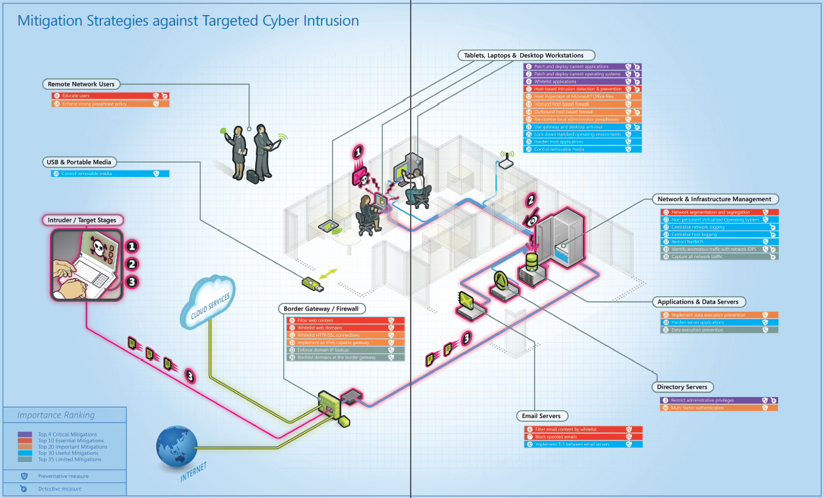
http://www.dsd.gov.au/publications/Implementing_Top_35_on_Microsoft_Platform.pdf

Slide 3
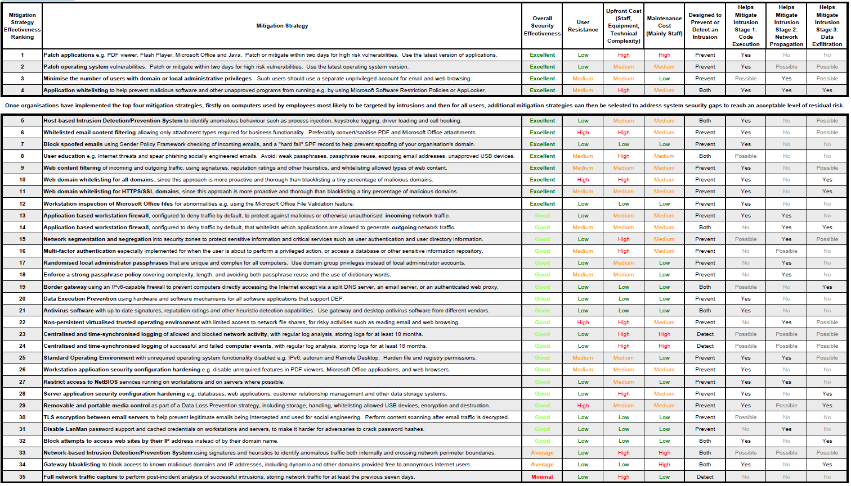
Notes:
http://www.asd.gov.au/publications/Mitigation_Strategies_2014.pdf

Slide 4
GRC
Governance
  Refers to the frameworks, policies, procedures, controls, decision-making hierarchy, etc. which are employed to make decisions and manage the business
Risk Management
  Refers to the identification, prioritization and mitigation of risks that could potentially impact the organization
Compliance
  Refers to meeting and sustaining requirements for government regulations, industry regulations, and internal policies within the allotted timeframe
Notes:
Which do you first? Typical first compliance, then governance, then Risk
Drivers: reducing total cost,
providing greater visibility
improving decision-making
mitigating technical and operational risks

Slide 5
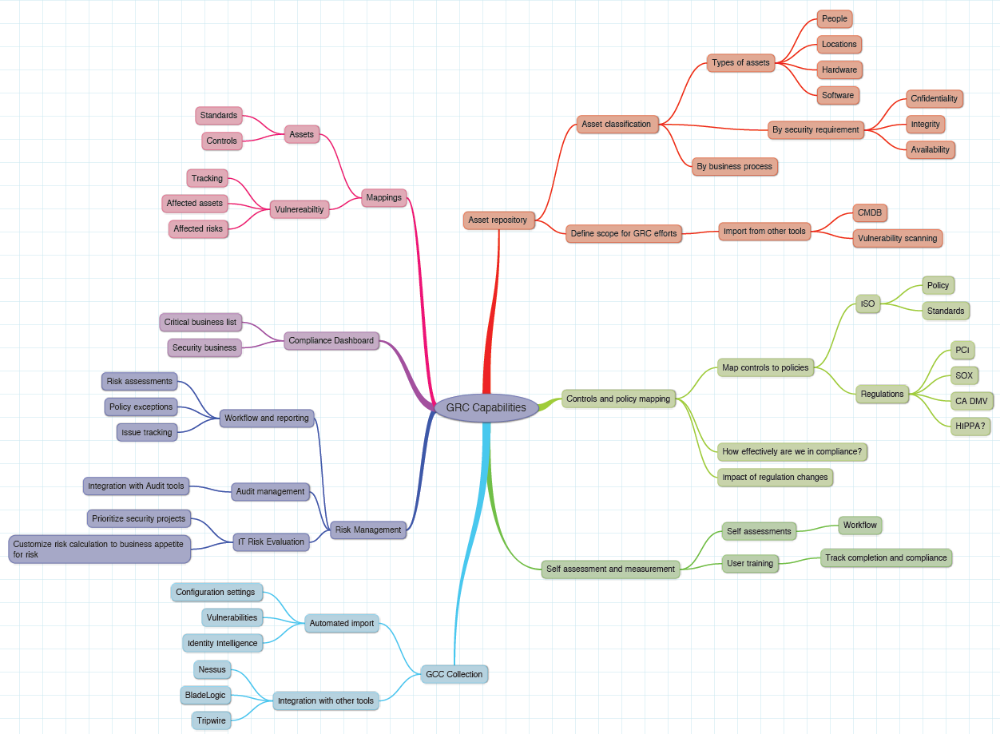

Slide 6
Management Complexity
Lack of board-level oversight
Absence of enterprise wide standards
Orchestrating key activities across business and GRC domains
Inability to identify policy, process and control gaps and redundancies

Slide 7
Alignment of controls and metrics
Enterprise needs a common system of record “language”
  Metrics
  Standards
  Responsibilities
  Data classification

Slide 8
Building out infrastructure
Business silos with different technologies
Contractual and regulatory mandates
Employees with predictive analytic skills are hard to find
Big ticket item that is difficult to show the proper investment return

Slide 9
Align GRC groups
Specialized teams
  Security operations
  IT operations
  Audit
  Incident response
  Legal
Geographically dispersed
Lack of transparency

Slide 10
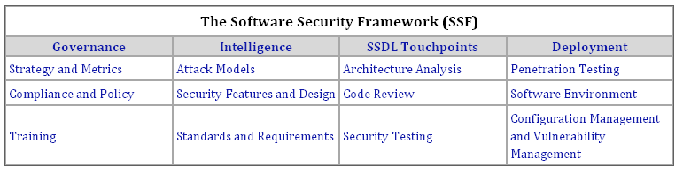
BSIMM
110 activities divided into 12 practices
Largely used by security professionals to compare efforts at competitive firms
The more “mature” an organization the more activities are attempted
Notes:
The Building Security in Maturity Model
http://bsimm.com/
OpenSamm maps BSIMM’s 110 to 72 activities
http://www.opensamm.org/2011/03/bsimm-activities-mapped-to-samm/

Slide 11
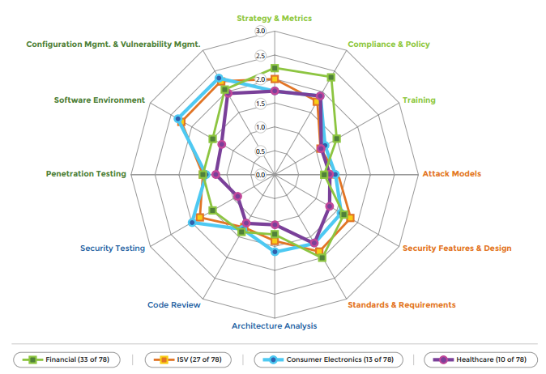
BSIMM Categories
Notes:
Building security in maturity model
http://bsimm.com/

Slide 12
UNH AUP
5.1.2 Use of information technology resources can be broadly categorized as acceptable, allowable, or prohibited.
5.1.3 Acceptable use of information technology resources is legal use consistent with the mission of the University of New Hampshire, i.e., use that furthers the University's mission of learning and teaching, research, and outreach.
5.1.4 Allowable use is legal use for other purposes that do not impinge on acceptable use. The amount of allowable use will vary over time based on the capacity reserve of information technology resources available beyond Acceptable use.
5.1.5 Prohibited use is illegal use and all other use that is neither acceptable nor allowable.
Notes:
Prohibited
impedes, interferes with, impairs, or otherwise causes harm to the activities of others
inconsistent with the University's non-profit status
suggests University endorsement of any political candidate or ballot initiative
harassing or threatening use
damages the integrity of University or other IT resources
Attempts to defeat system security
Unauthorized access or use
Unauthorized access or use
Users must not conceal their identity
Distributing computer hoaxes and viruses
Removal of data or equipment
Violation of Law
Criminal
Copyright
Violation of University contracts
Violation of external data network policies

Slide 13
AUP Goals
5.2.1 To ensure the integrity, reliability, availability, and performance of IT resources.
5.2.2 To ensure that use of IT resources is consistent with the principles and values that govern use of other University facilities and services.
5.2.3 To ensure that IT resources are used for their intended purposes.
5.2.4 To establish processes for addressing policy violations and sanctions for those committing violations.

Slide 14
AUP Scope
5.4.1 This Policy applies to all users of IT resources, including but not limited to University students, faculty, and staff, and to the use of all IT resources. These include systems, networks, and facilities administered by Computing and Information Services (CIS), as well as those administered by individual schools, departments, University laboratories, and other University-based entities. This includes the general public.
5.4.2 Use of University IT resources, even when carried out on a privately owned computer that is not managed or maintained by the University, is governed by this policy.

Slide 15
Security Tools
Scanners
Sniffers
Proxies
Frameworks

Slide 16
Tools
http://sectools.org/
  A little dated but good list of popular tools
https://resources.infosecinstitute.com/category/certifications-training/ceh/ethical-hacking-tools/#gref
  Short list more up todate
https://www.owasp.org/index.php/Phoenix/Tools
  Long list organized by function
  Includes cheat sheets
http://rumkin.com/tools/cipher/
  Crypto tools
http://www.amanhardikar.com/mindmaps/Practice.html
  Practice sites
Browser plugins

Slide 17
Really basic: Nmap and Netcat (nc)
Port scan
  nmap localhost
Netcat (nc)
  Simple chat
    nc –l <host> 1111 (with) nc <host> 1111
  Simple browser
    nc <host> 80 (with) GET /
  Simple FTP
    nc –l 1133 > outfile (with) nc <host> 1133 < infile
  Simple Webserver
    while true; do nc -l 8080 -q 1 < index.html; done

Slide 18
Prebuilt Tool Sets - Live CD / Virtual Box
Kali (pen test focus)
  http://www.kali.org
SIFT (SANS Investigative Forensic Toolkit)
  http://digital-forensics.sans.org/community/downloads
OWASP WTE (web app testing focus)
  http://appseclive.org/

Slide 19
Network Defense
Firewalls
Proxies
Virtual Private Networks (VPN)
Intrusion Prevention Systems (IPS)

Slide 20
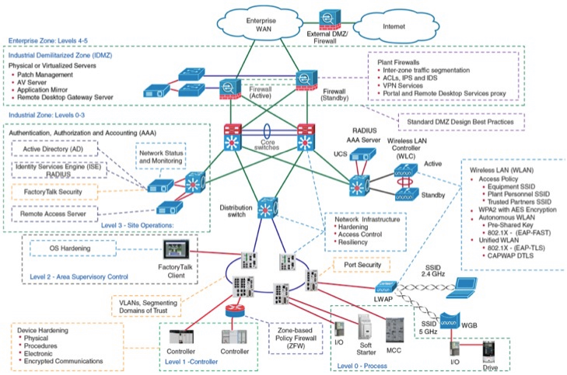
Enterprise Network Defense
Notes:
Complexity driven by rapidly expanding capacity needs vs. expense
Continuity teams tend to focus on backup and recovery plans
Risk teams prefer to think in terms of reducing exposure
Smaller range of device type as we move to SDN

Slide 21
Private Addressing : RFC 1918
Subnet masks the Internet does not route
  10.0.0.0/8
  172.16.0.0/20
  192.168.0.0/16
  Fd00::/8
Carrier allocation 100.64.0.0/10
Special
  169.254.0.0/16 auto-configuration
  127.0.0.1/32 localhost
Notes:
NAT

Slide 22
Firewall Definition
A firewall is a part of a computer system or network that is designed to block unauthorized access while permitting authorized communications. It is a device or set of devices that is configured to permit or deny network transmissions based upon a set of rules and other criteria.
Notes:
Stateful firewalls
maintain context about active sessions, and use that "state information" to speed packet processing. Any existing network connection can be described by several properties, including source and destination IP address, UDP or TCP ports, and the current stage of the connection's lifetime
Stateless firewalls
require less memory, and can be faster for simple filters that require less time to filter than to look up a session. They may also be necessary for filtering stateless network protocols that have no concept of a session.

Slide 23
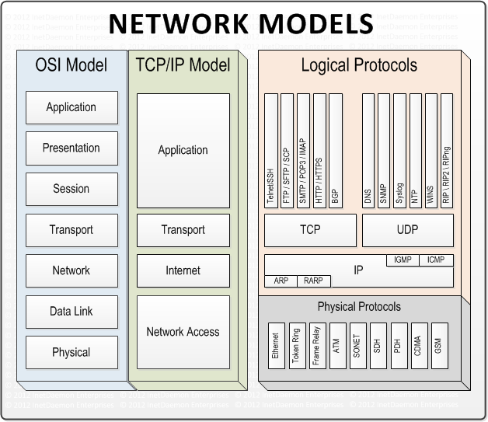
HISTORIC FIREWALL

Slide 24
Historic Firewall Summary
Single function computer with two or more network connections
Default: deny all
Allow specific exceptions
Firewall decisions based on header information not data
Firewalls rules may or may not be stateful
Transport/Network layer firewalls can not make Application layer decisions

Slide 25
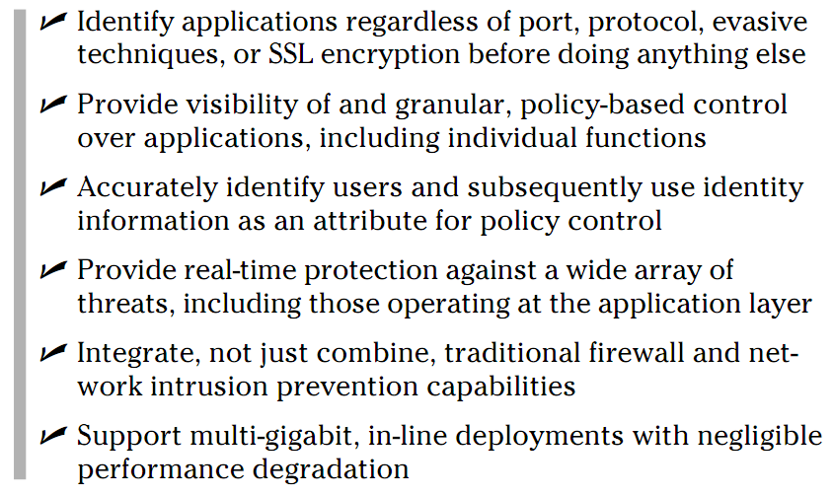
Next Generation Firewall
From page 36: Firewalls for Dummies
Notes:
Easy to say; very, very, very hard to do.

Slide 26
Current needs are data and identity centric (not port/protocal)
HIPAA, SARBOX, PCI DSS
  Compliance measured by control of data not protocols, addresses or ports used.
Encrypted tunnels (VPN, SSL) hide data entering and leaving an organization
Is visible employee communication (email, Facebook, blog) to friend or foe?
Is data executable? Malicious?

Slide 27
Application Firewall
Uses “Deep Packet Inspection”
  Fancy marketing term for looking at data as well as headers
Port/Procotol ≠ Application
  Port hopping
  Many HTTP apps
Data has both ingress and egress rules
Who writes the rules?
  Rule ownership and churn are major issues
A simple device is now complicated

Slide 28
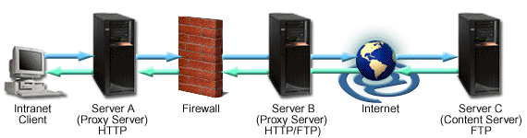
Proxies
Actions: Validate, Alter, Control, Monitor, Cache
Forward Proxy
  Acts on requests
Reverse Proxy
  Acts on responses
Combined in chains or redirections
Notes:
Forward proxy
Limit where requests go
Limit egress of data
Set state for inbound filtering
Normally visible to users
Reverse proxy
Limit where requests can come from
Data ingress controls
Malicious content (virus/trojan) controls
Invisible to users.

Slide 29
VPN
Site-to-Site
  Reliable and high-quality transport
  Mission-critical traffic (voice and client/server apps)
  Simplified network designs based on routing
Remote Access
  Remote user experience similar to being onsite
  Normally device independent
Notes:
Site-to-Site VPNs
Site-to-site VPNs provide an Internet-based WAN infrastructure to extend network resources to branch offices,
home offices, and business partner sites.
All traffic between sites is encrypted using IPsec or TLS protocols and integrates network features such as
routing, quality of service, and multicast support.
Reliable and high-quality transport of complex, mission-critical traffic, such as voice and client server applications
Simplified provisioning and reduced operational tasks for network designs
Integrated advanced network intelligence and routing for a wide range of network designs
Remote Access VPNs
Remote access VPNs extend almost any data, voice, or video application to the remote desktop,
emulating the main office desktop.
Provide highly secure, customizable remote access to anyone, anytime, anywhere, with almost any device.
Create a remote user experience that emulates working on the main office desktop
Deliver VPN access safely and easily to a wide range of users and devices
Support a wide range of connectivity options, endpoints, and platforms to meet your dynamic remote access needs

Slide 30
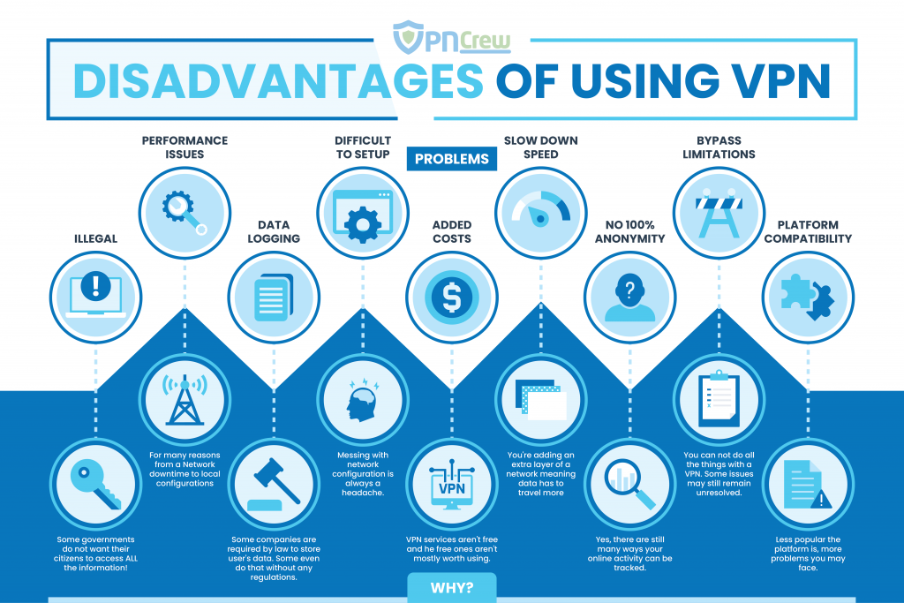
Notes:
Step thru when the assumptions are or aren’t true

Slide 31
Other Appliances
Intrusion Detection Systems (IDS)
  Focus on alerting
  Often a passive (sniffing) device
Intrusion Prevention Systems (IPS)
  Detect and block attacks focused on vulnerabilities that exist in systems and applications.
  Normally an active inline deployment

Slide 32
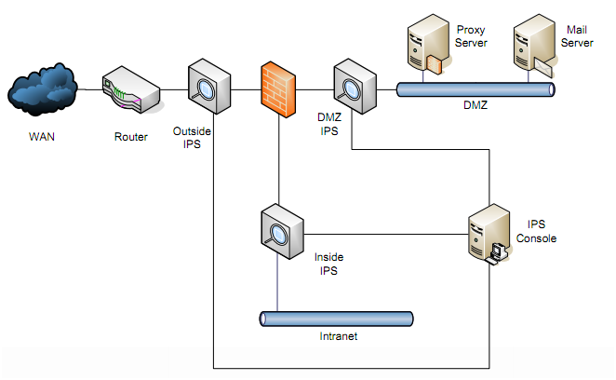
Active – Inline Monitoring
From: Pivot Group
Notes:
Proactive Response to Attack
Centralized Monitoring and Management – Critical for multi-sensor environments
Tuning Required
Redundancy / Fail-open Required
What types of protection do I need?
The amount of time allow before response
Signature or anomaly based
Size and number of network segments to monitor
Bandwidth
How do I want to manage it?
Minimize false positives or false negatives
Monitoring done on or off site
Update management

Slide 33
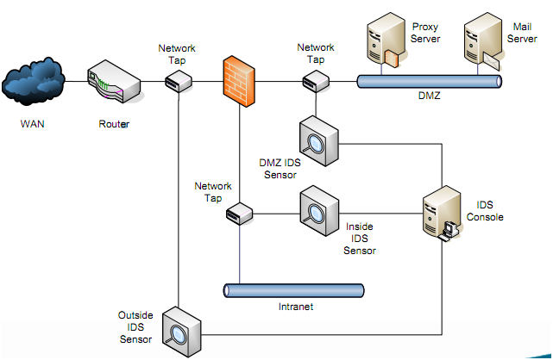
Passive Monitoring
From: Pivot Group
Notes:
Rule-Based Detection
– Signatures produced for known attacks
– Traffic scanned for matches to signatures
Anomaly Detection
– Baseline of “normal” traffic produced
– Deviations from baseline flagged as intrusion
Reactive Response to Attack
Centralized Monitoring and Management – Critical for multi-sensor environments
Tuning Required
Constant Monitoring

Slide 34
Bayesian Modeling
Use the past to predict the future
  “Normal” behavior processes along a predictable path of states.
  Attacks exhibit a “normal” behavior
States can be very complex
  Classification systems used to reduce number
Types
  Naïve, Learned, Expert-elicited
Notes:
Naïve:
Can be automated
All child nodes share a parent and are conditionally independent
Learned:
Can be automated
Directed acyclic graph. Parameter driven
Expert-elicited:
Generate states by hand, using variable and classification of what intrusions look like.

