Slide 1
Cloud & Virtualization

Slide 2
Virtualization
Started as an automated testing tool
  Many versions of windows and Unix
  The time to reinstall and test was very expensive
Very slow
  A set of software emulating hardware behavior
  Usually a single instance at any one time

Slide 3
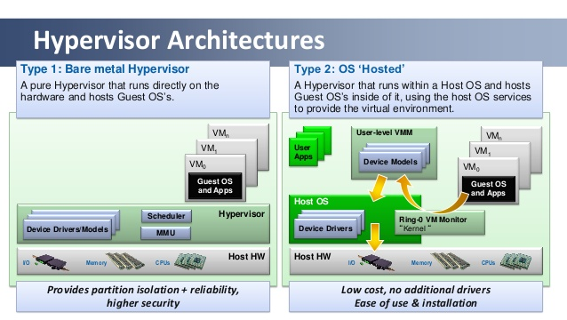

Slide 4
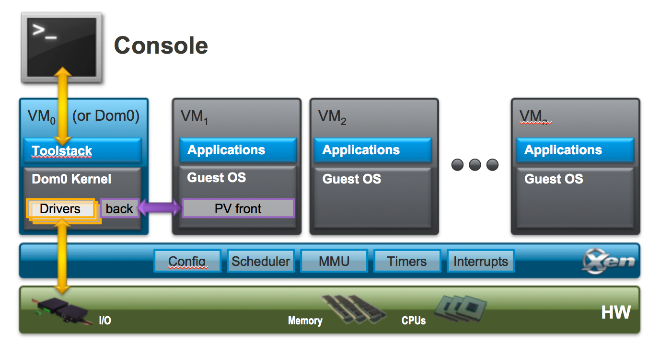
Xen: A variant is used by Amazon’s AWS

Slide 5
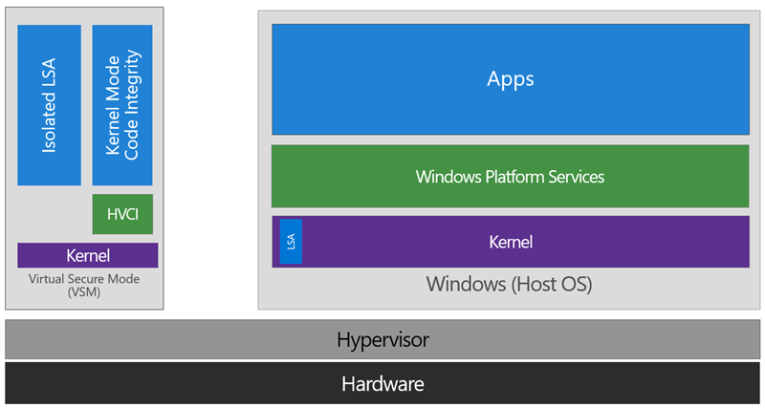
Microsoft’s Virtual Security Mode
Credential Guard: Storage and management of user and system credentials in the VSM

Slide 6
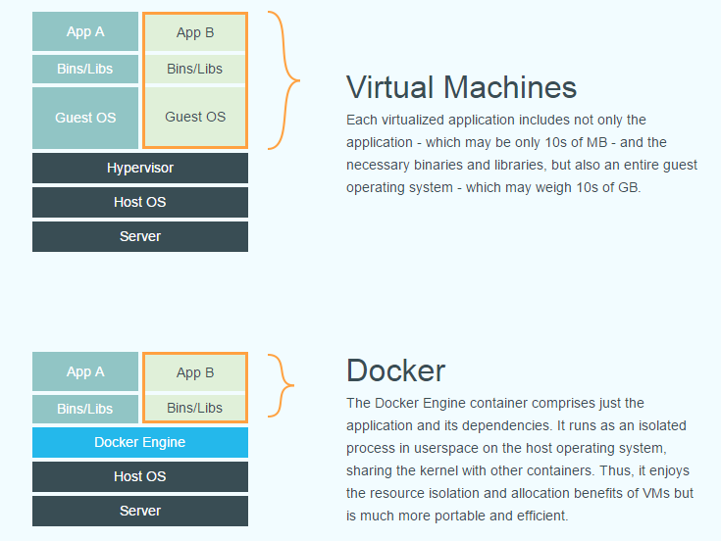
Containers

Slide 7
Cloud Service Models
SaaS (Software as a Service)
  The capability provided to the consumer is to use the provider’s applications running on a cloud infrastructure. The consumer does not manage or control the underlying cloud infrastructure: (i.e. network, servers, operating systems, storage)
PaaS (Platform as a Service)
  The capability provided to the consumer using programming languages and tools supported by the provider. The consumer has control over the deployed applications and possibly application-hosting environment conﬁgurations.
IaaS (Infrastructure as a Service)
  The capability provided to the consumer is to provision processing, storage, networks, and other fundamental computing resources where the consumer is able to deploy and run arbitrary software, which can include operating systems and applications. The consumer has control over operating systems, storage, deployed applications, and possibly limited control of select networking components (e.g., host ﬁrewalls)

Slide 8
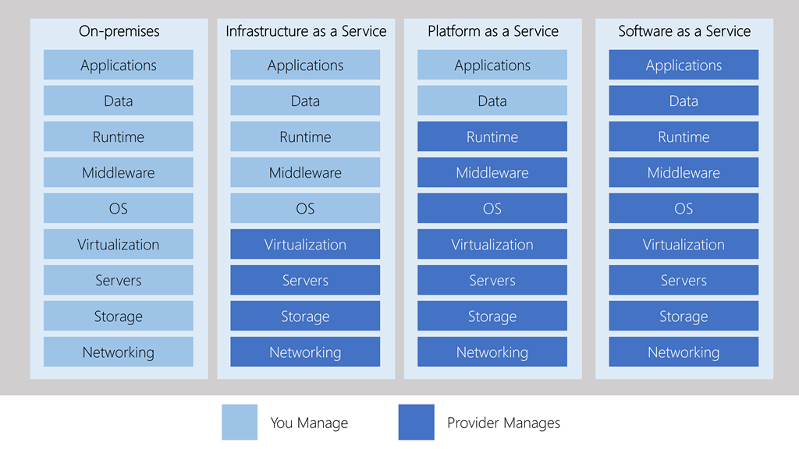
Management Responsibilities

Slide 9
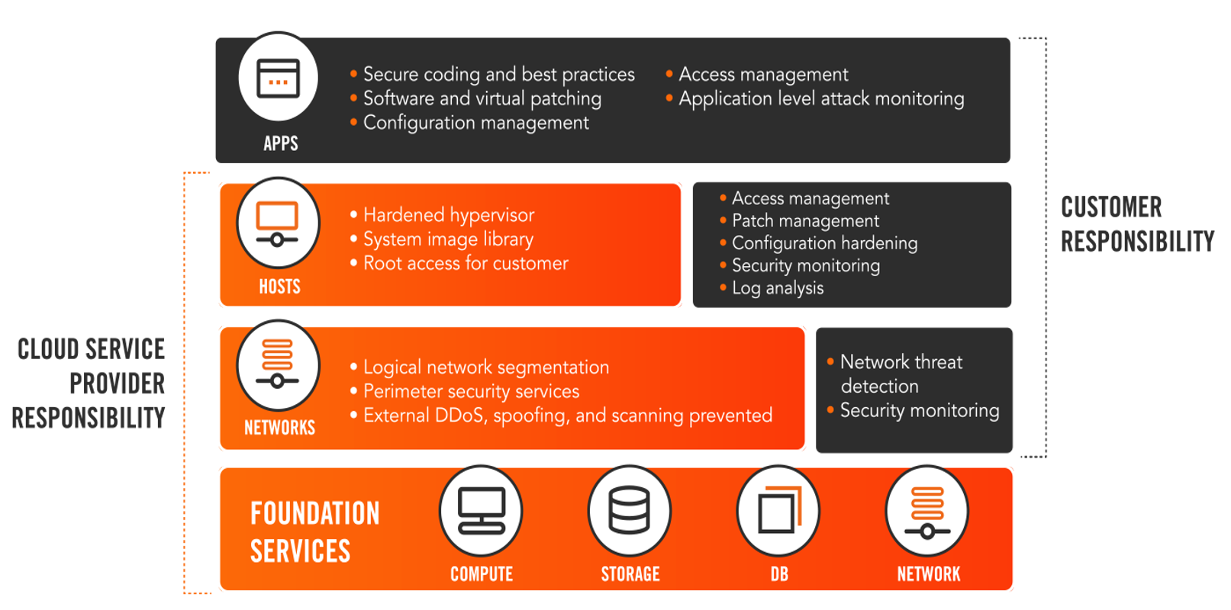

Slide 10
Cloud Deployment Models
Public cloud
  The cloud infrastructure is made available to the general public or a large industry group and is owned by an organization selling cloud services.
Private cloud
  The cloud infrastructure is operated solely for an organization.
  It may be managed by a third party and may exist on or off premise.
Hybrid cloud
  The cloud infrastructure is a composition of two or more clouds.
Community cloud
  The cloud infrastructure is shared by several organizations and supports a speciﬁc community that has shared concerns (e.g., mission, security requirements, policy, and compliance considerations).

Slide 11
Configuration Management
Automation at Scale
Desired State Configuration
Infrastructure as Code (software defined *)
Efficient
Repeatable
Cattle not Pets

Slide 12
Changing Role of Compliance
 | Manual Compliance | Compliance at Velocity
Engagement | Reactive | Proactive
Methodology | One off checks | Express policy as testable code
Focus | Short term compliance | Long-term process improvement
Audit Period | Point in time | Continuous

Slide 13
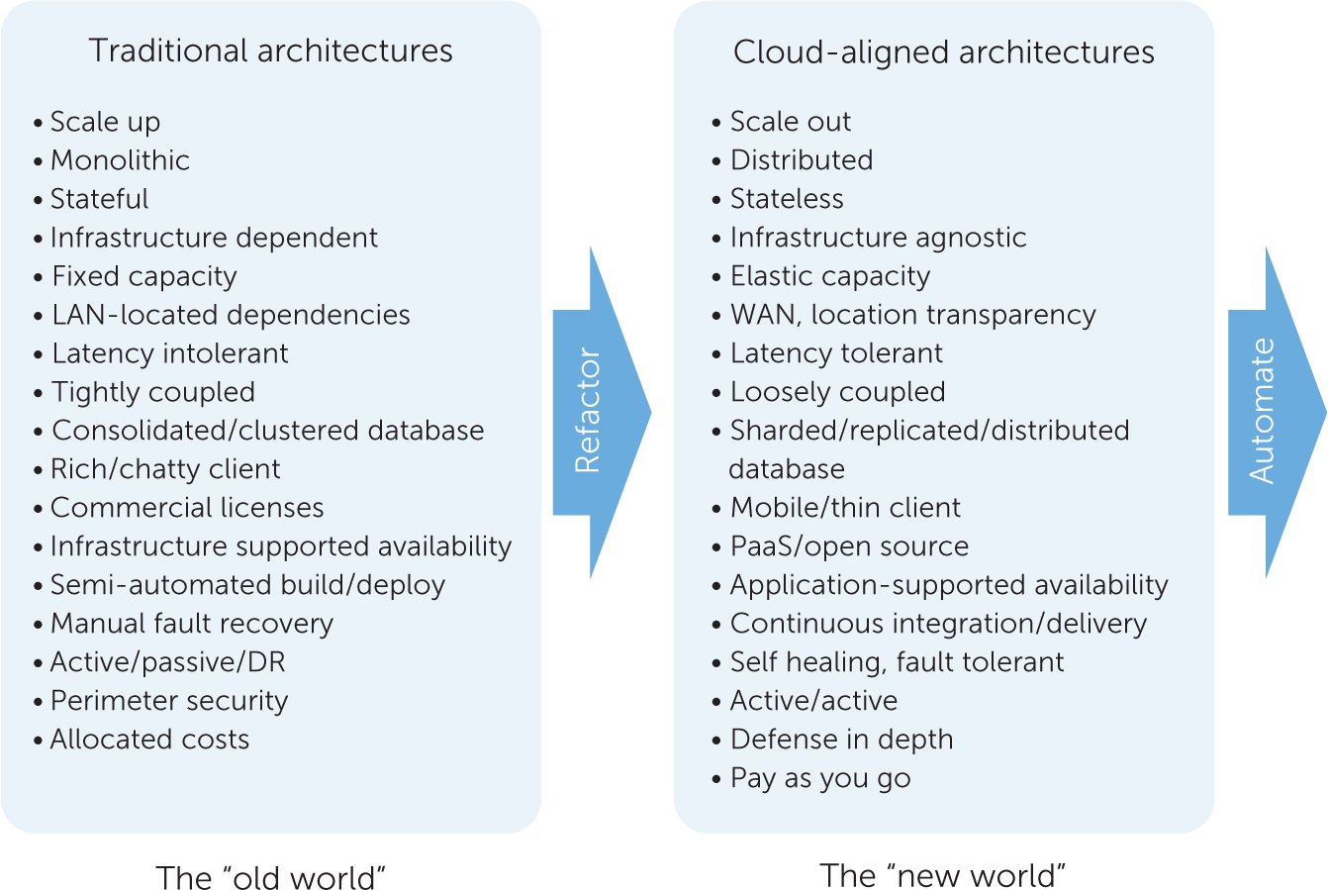
Cloud changes how software is built
Notes:
https://www.computer.org/csdl/mags/cd/2016/02/mcd2016020020.html

Slide 14
SANS Critical Controls
Critical Control | Legacy (Pets) | Cloud (Cattle)
1- Device Inventory | Audit list | API query
2 – Software inventory | Audit list | Pipeline manifests
3 – Secure configurations | System hardening processes | Only latest versions used at launch
4 – Continuous Vulnerability Assessment | Scheduled pen tests. Remediation? | Must pass to be deployed
5 – Control Administrative Privileges | Limit data center access, jump boxes | IAM
6 – Audit Logs | Splunk | CloudTrail, Splunk
7 – Email & Browser protections
8 – Malware defense | Network & Host IDS | Immutable systems
9 – Firewall configuration | Crunchy outside, soft center | API protocols only
10 – Data recovery | Tape | Auto replication of data
11 – Secure network devices | Hardening process | Provided by vendor
12 – Boundary defense | Firewall, WAF, Network | Security groups
13 – Data Protection | Network DLP | Storage service encryption, SSL
14 – Controlled access | Network enclaves, Network DLP | IAM, SSL, Host DLP
15 – Wireless Access
16 – Account Monitoring | Active Directory | SAML, OpenID, IAM
17 – Security Skills Assessment
18 – Application Security | WAF, Penetration tests | ELB/WAF, pipeline testing
19 – Incident Response | Logs | Logs, Vendor’s internet visibility
20 – Pen tests and red team

Slide 15
Log Everything
Monitor, identify and report security incidents and policy violations
Comply with industry regulatory requirements and internal policies
Maintain audit trails to support forensic investigations
Monitor system and network performance
Maintain records of user activity
Troubleshoot problems or unusual conditions

Slide 16
NIST – Log Management
Tier I: Log generation
  Includes the systems, networks, and applications that generate log data.
Tier II: Log analysis and storage
  Consists of the log servers, also known as log collectors, which receive the log data from Tier I.
Tier III: Log monitoring
  Includes administrative consoles used to monitor and review the log data.

Slide 17
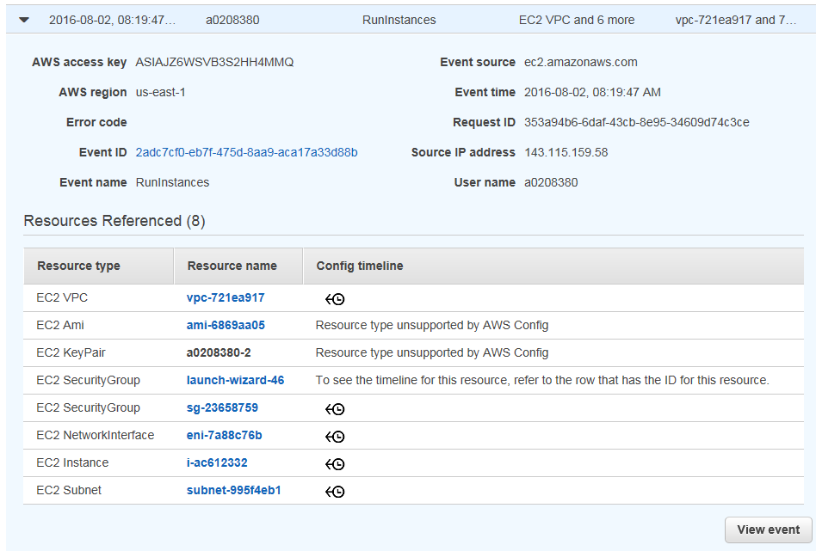
Very Detailed

Slide 18
Software Defined Networking (SDN)
Directly programmable:
  Network control is directly programmable because it is decoupled from forwarding functions.
Agile:
  Abstracting control from forwarding lets administrators dynamically adjust network-wide traffic flow to meet changing needs.
Centrally managed:
  Network intelligence is (logically) centralized in software-based SDN controllers that maintain a global view of the network, which appears to applications and policy engines as a single, logical switch.
Programmatically configured:
  SDN lets network managers configure, manage, secure, and optimize network resources very quickly via dynamic, automated SDN programs, which they can write themselves because the programs do not depend on proprietary software.
Open standards-based and vendor-neutral:
  When implemented through open standards, SDN simplifies network design and operation because instructions are provided by SDN controllers instead of multiple, vendor-specific devices and protocols.

Slide 19
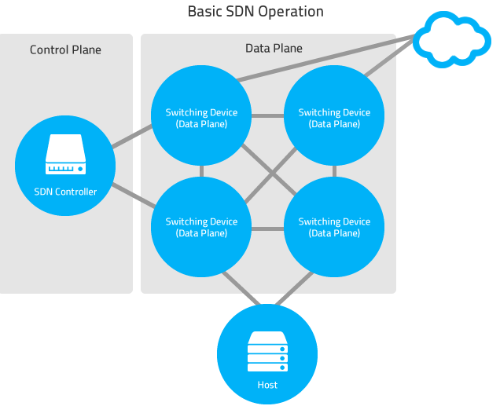
Notes:
Draw out a cloud datacenter scenario

Slide 20
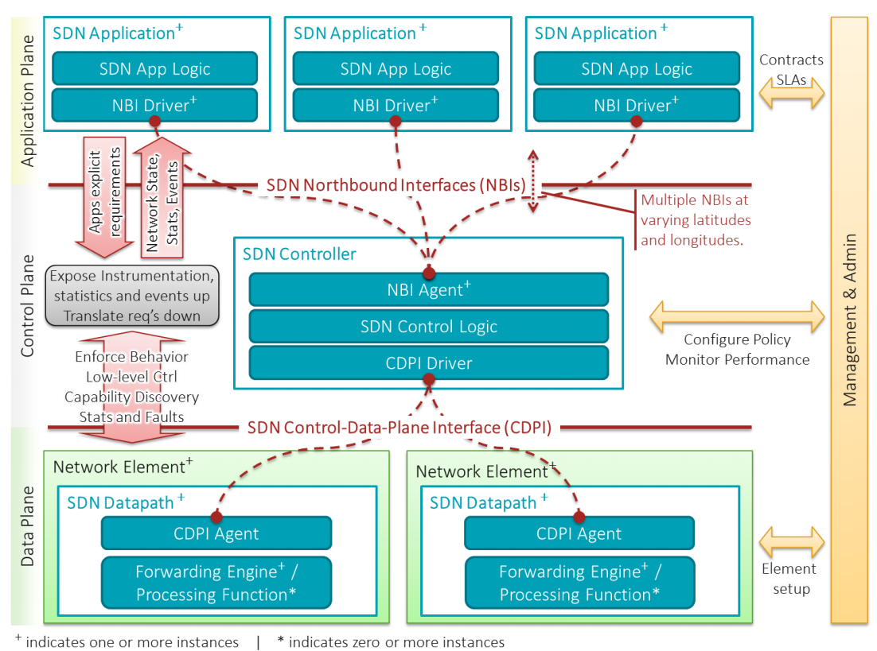
Open Networking : SDN 1.0
Notes:
Draw datacenter scenario

Slide 21
Cloud concepts to embrace
SDN
  VPC, SG, subnets, IGW are software constructs
Recyclable instances
  AWS recommends 24 hours
  Deployment by automation
Use only known and vetted components
Separation of duties
Minimize (eliminate) need for VPN access

Slide 22
Cloud Security Challenges
Data breaches
  It is easy to allow public access to your private data
Hijacking
  Attacker gaining access to your credentials
Indirect Vulnerabilities
  Insecure interfaces and APIs used to implement a cloud computing service
Bad Blood
  Admins can (if allowed) delete everything
Internal Deployment Expertise
  Incomplete development efforts will allow operational and architectural issues not seen with standard development projects
Public Point of Entry
  Deployment, monitoring, and use all done via APIs

Slide 23
Cloud Security Benefits
Mandatory Security
  Cloud providers are required to be ISO certified and adhere to regular security audits. Full separation of duties; no one has unfettered access
Global Accessibility
  Keeping all sensitive company information in the cloud allows access from any machine
Backup and Recovery
  Data sharding and replication allow recovery from disk and data center failure
Expert Support
  A cloud service provider is likely to have superior security technology and expertise than does a company that’s just protecting its own data
MFA – Multifactor Authentication
  MFA is a must-have for mitigating common cloud security challenges
Patching
  Security patching is often over-looked by resource challenged companies
Physical Security
  Cloud computing vendors have much stronger physical security controls with meaningful certifications that many smaller companies can’t afford

Slide 24
Cloud Questions to Ask?
Is it easier to make a big mistake on-premise or in the Cloud?
How many teams / people touch your on premise app? Cloud?

