Slide 1
Zero Days
Secure Design Principles

Slide 2
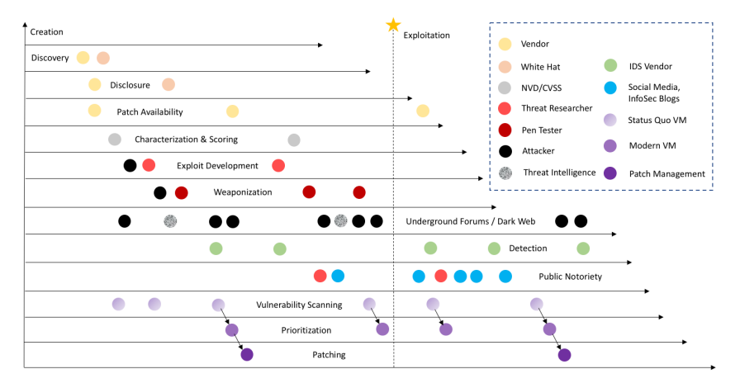
0-day Timeline

Slide 3
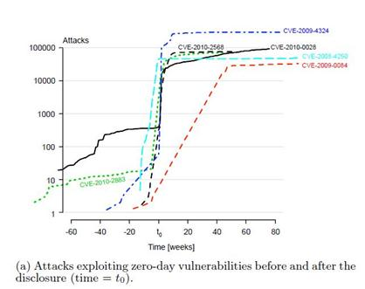
Disclosure Increases Attacks
Notes:
http://resources.infosecinstitute.com/a-world-of-vulnerabilities/

Slide 4
Bug Bounty Platforms
Platform name | Website
Tipping Point | http://zerodayinitiative.com/
HackerOne | https://www.hackerone.com/
Bugcrowd | https://www.bugcrowd.com/
Synack | https://www.synack.com/
Cobalt.io | https://cobalt.io/
Bounty Factory | https://bountyfactory.io/en/index.html
intigriti | https://www.intigriti.com/public/
Zerocopter | https://www.zerocopter.com/

Slide 5
Not Normally Accepted
Issue type
Network-level Denial of Service
Missing security headers
Content injection
Logout CSRF
Missing cookie flags on non-security-sensitive cookies
401 injection
Banner grabbing issues

Slide 6
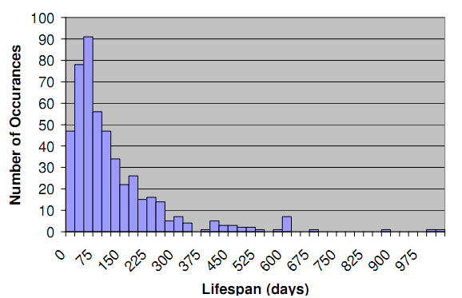
Discovery to Patch Lifetime

Slide 7
Digital Signatures
We know the result of a digital signature is an encrypted hash
  The result is unlikely to be remembered de0aa26b3e02ac7d5ccff900c2a0d064
The W3C standards group wanted to allow a signature representation that people could actually remember
Thus the standard recommended the hash be allowed to be truncated to 20 bits
  de0aa
Literally 1 in a million. Easier to remember than a real signature
Notes:
2 ^ 20 = 1048576

Slide 8
Implementation
XML includes the full MD5 or SHA hash
XML indicates truncation length
  20 “recommended”
XML libraries truncate to the number of bits the signatures specifies
What happens if the XML document specifies 1?

Slide 9
XML signature HMAC truncation
All popular XML libraries vulnerable
  Not all admitted to flaw
  Few libraries many vendors “customers”
Jan 6 – Discovery by Frederick Hirsch
Jan 8 – Validated 6 libraries affected including Intel’s
Jan 21 – W3C WG review
Feb 8 – W3C members notified under non-disclosure
Feb 18 – XML library manufactures notified
March 1 – Public disclosure schedule set
July 9 - CVE notification

Slide 10
Microsoft Disclosures
Monthly Security Bulletin Summary
  https://technet.microsoft.com/library/security/ms16-jul
Publicly recorded as a CVE
  http://www.cve.mitre.org/cgi-bin/cvename.cgi?name=CVE-2016-3274
Never discloses the actual attack
  Internet Explorer Security Feature Bypass Vulnerability - CVE-2016-3245
    A restricted ports security feature bypass vulnerability exists for Internet Explorer. An attacker could take advantage of the vulnerability to trick a user into connecting to a remote system.
    To exploit the vulnerability, an attacker would have to either convince a user to visit a malicious website or inject malicious code into a compromised website. The update addresses the vulnerability by correcting how Internet Explorer validates URLs for restricted ports.

Slide 11
Incident Response Plan Checklist (page 1) Before During After
Asset Discovery | Know what assets we must protect. Conduct an asset discovery scan and identify mission-critical data and IT assets
Risk Assessment | Conduct a risk assessment to identify likely risks and prioritize areas of concern. Understand the potential impact of a cybersecurity incident.
Response Team | Identify the key members of the response team and their backups (internal and external. Ensure that they know their roles and responsibilities.
Authority | Appoint an IR leader. Define when to activate the plan and establish authority to take actions, such as shutting down resources and notifying law enforcement.
Stakeholders | Identify stakeholders who must be notified and kept apprised throughout the incident response operation. Stakeholders can be external as well as internal.
Communications | Establish clear plan: who must be notified and when. Regulatory requirements may dictate mandatory notices.
External Contacts | Arrange IR contracts in advance if you lack sufficient internal resources. Establish when to enlist support if an incident occurs.
Test Your IR Plan | Test IR plan regularly via tabletop exercises, simulations, or actual incidents. Run scenarios based on risk assessment. Update IR plan to reflect lessons learned

Slide 12
Incident Response Plan Checklist (page 2) Before During After
Business Continuity | Coordinate IR plan with business continuity plan to ensure operational disruption caused by a cyber incident is addressed consistently with the continuity plan.
Training and Tools | Ensure your incident response team has the necessary training and tools to properly respond to security events and perform their designated roles.
Executive Support | Get executive buy-in and approval of the plan. Ensure proper level of funding.
Contact List | Keep an updated contact list of all IR plan participants and designated backups. ID alternate means of communication in the event that email, VoIP, etc. are down.
Containment | Establish effective means to isolate incident to minimize damage. Establish effective means to detect re-emergence of the incident.
Eradication | Eradicate residual artifacts. Restore system(s) to an operable, secure state.
Incident Event Log | Keep an incident event log to track and review pertinent information, such as how the incident was identified, assets affected, business operations impact, etc.
Forensic Evidence | Capture and preserve forensic evidence to determine scope of impact and how incident evolved. Evidence may be needed if criminal prosecution is warranted.
Retrospective | Conduct a thorough review to determine what went well and what didn’t. Update the incident response plan to reflect lessons learned.

Slide 13
Configuration Management

Slide 14
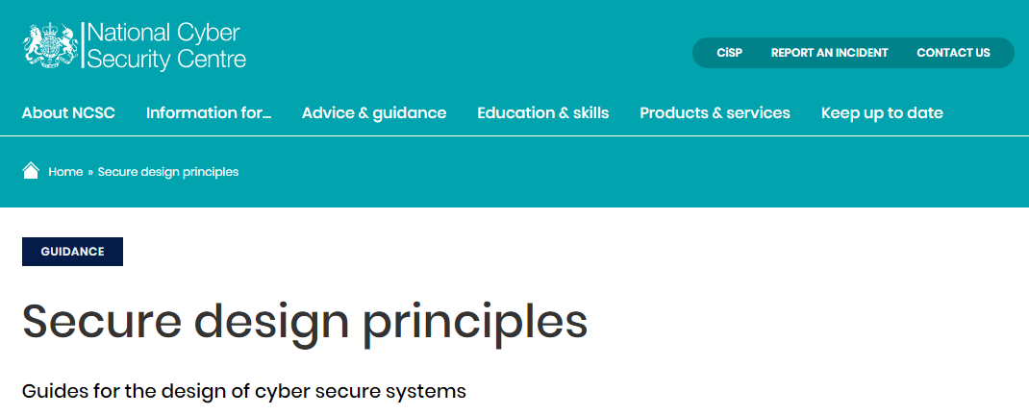
https://www.ncsc.gov.uk/collection/cyber-security-design-principles
https://www.ncsc.gov.uk/guidance/security-design-principles-digital-services-main

Slide 15
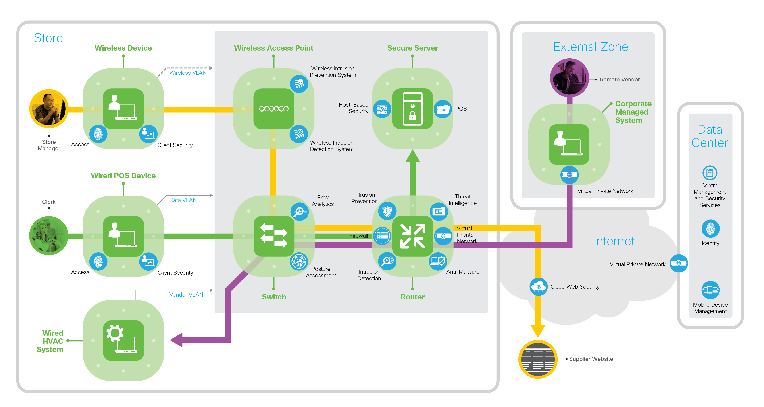
Generic Retail Outlet
Notes:
Principles for our retail operation
Least Privilege : Who needs access to secure server?
Fail Secure : Server failure = Failed transaction?
Complete Mediation : Refund or billing requests?
Open Design : Who gets to set this diagram?
Separation of Duties : Admins (network, system, manager)?
Psychological Acceptability : Virtual card numbers?
Usability : Why do debit cards need a pin?
Encapsulation : POS chip encryption
Modularity : Swap out the secure server?
Defense in depth : Multiple network services
Process Isolation : What happens if a router service fails?
Least Common Mechanism : Secure server in every store?
Economy of Mechanism : Same server in every store?
Trust : Store or Corporate managed authentication?

Slide 16
Security Design Principles for Digital Services
Establish the context
  Determine all the elements which compose your system, so your defensive measures will have no blind spots.
Making compromise difficult
  An attacker can only target the parts of a system they can reach. Make your system as difficult to penetrate as possible
Making disruption difficult
  Design a system that is resilient to denial of service attacks and usage spikes
Making compromise detection easier
  Design your system so you can spot suspicious activity as it happens and take necessary action
Reducing the impact of compromise
  If an attacker succeeds in gaining a foothold, they will then move to exploit your system. Make this as difficult as possible

Slide 17
Least Privilege
Each entity (user, process, or device) is granted the most restrictive set of privileges needed for the performance of that entity’s authorized tasks.
Application of this principle limits the damage that can result from accident, error, or unauthorized use of a system.
Least privilege also reduces the number of potential interactions among privileged processes or programs, so that unintentional, unwanted, or improper uses of privilege are less likely to occur.
Example: Normal users can't modify /usr/bin

Slide 18
Default to Fail-Secure
This principle calls for basing access decisions on permission rather than exclusion.
Thus, the default situation is lack of access, and the protection scheme identifies conditions under which access is permitted.
Example: Firewall DENY ALL

Slide 19
Verification - Complete Mediation
Every access to every (security-sensitive) object must be checked for proper authorization; and access denied if it violates authorizations.
Implies the existence and integrity of methods to:
  identify the source of every request,
  ensure the request is unchanged since its origination
  check the relevant authorizations.
Example: Certificate validation

Slide 20
Open Design
Security mechanisms should not depend on the ignorance of potential attackers, but rather on assurance of correctness.
This permits the mechanisms to be examined by a number of reviewers without concern that the review may itself compromise the safeguards.
Open “Design” not open “Transactions”
Example: SWIFT banking standard

Slide 21
Separation of Privilege | Separation of Duties
A protection mechanism that requires two keys(actors).
No one has unfettered access.
No single accident, deception, or breach of trust can lead to a compromise.
Redundancy is also used in the traditional “separation of duties” in human financial processes, e.g., the persons who fill out the check and sign it are two different people.
Example: Cloud datacenter controls

Slide 22
Psychological Acceptability
Security mechanisms should not make the resource more difficult to access than if the security mechanisms were not present.
Example: SSH keys

Slide 23
Usability
It is essential that the human interface be designed for ease of use, so that users routinely and automatically apply the protection mechanisms correctly
Example: OpenID logins

Slide 24
Information Hiding - Encapsulation
Do not allow the user to directly alter data, instead present objects, methods, services, processes that are logically well defined.
Example: encrypted session cookies

Slide 25
Modularity
Independent components that can be replaced.
Normally requires some level of abstraction or standard that allows selection of components
Example: Not relying upon a single cipher or authentication method.

Slide 26
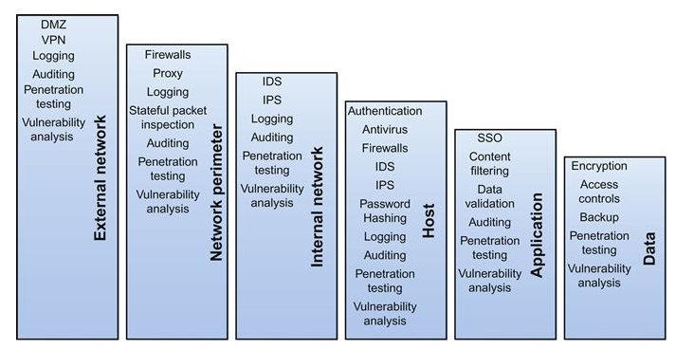
Defense in depth
Layered and complementary protections.
Different technology solutions not redundant implementations.

Slide 27
Sandboxing - Process Isolation
Separating process resources to prevent the failure of one process from negatively impacting another.
Example: Browser tabs

Slide 28
Least Common Mechanism
Do not share components across systems that operating at different security levels
Concern that compromise might allow access to a higher privilege level.
If one program can corrupt the shared state, it can then corrupt other programs which depend on it.
Example: DoD SIPRnet vs NIPRnet

Slide 29
Economy of Mechanism
“Keep the design as simple and small as possible”
Conflicts with “Least common mechanism”
Design and implementation errors that result in unwanted access paths may not be noticed during testing or normal use.
Example: Credit card processing

Slide 30
Trust
A relationship created at the direction of an entity, in which one or more entities hold the entity's property subject to certain duties to use and protect it for the benefit of others.
Be reluctant to trust
All types of entities:
  Individual, corporation, network, system, device
Example: Facebook is more than just friends

Slide 31
Hardware
Physical vs. Virtual
Hacking Cars
Systems / SCADA

Slide 32
Security problems have historical roots
You can do anything in assembly
Pointers, pointers, pointers
  FP, IP, SP, registers
Interrupts
  IP -> current state
  On return restore state
JMP*
  Go anywhere
Notes:
Simple computer concepts
i/o, memory, cpu

Slide 33
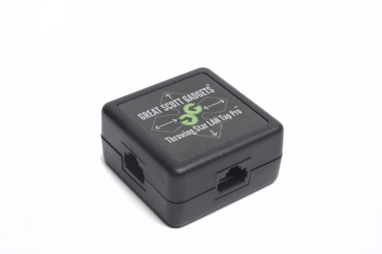
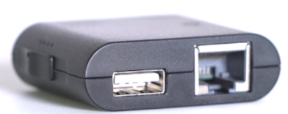
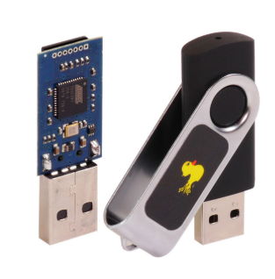
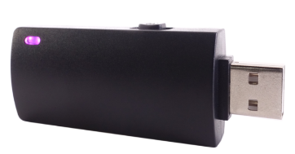


Inside an office = Inside the network
Install a LAN Tap or Packet Squirrel
  Undetectable Monitoring
  https://www.hak5.org
Installing software on unlocked laptops
  Memory sticks
  Keyboard controllers
  Rootkits and Bootkits
Bugs: Eavesdropping audio and video
LAN Star Tap Pro
$15
Packet Squirrel
$60
Rubber Ducky
$45
Bash Bunny
$100
www.spyville.com – Video Cameras, Audio Recorders

Slide 34
Rootkits
What is a rootkit?
  It’s stealth
  It’s a lot like a remote administration system – can access files, control hardware, control processes or start processes
Bootkits – an rootkit in your firmware
Real World Rootkits:
  HBGary Federal rootkits about $60k per license
  Lots of open source efforts; but tend to be incomplete, or special purpose
  European ATM hacks – attackers physically broke into ATM machines and installed customized rootkit
  Disclosures from the Snowden archives reveal these are more prominent that previously thought, especially in the intelligence community
Rootkits A Glance
Professional kits nearly impossible to detect with automated tools
First step to selling rootkit is to prove no current AV scanners can spot it
Payments are normally timed, based on keeping its stealth intact
Basic Features:
  Record what is on the screen
  Keystroke logger
  Record from microphone
  Record from select webcams without indication to end user
  Remote install to other devices
Weapons-Grade Packages:
  Jumping Air Gaps
  Convert Channels to exfiltrate data
  Cloud Virtualization Technology

Slide 35
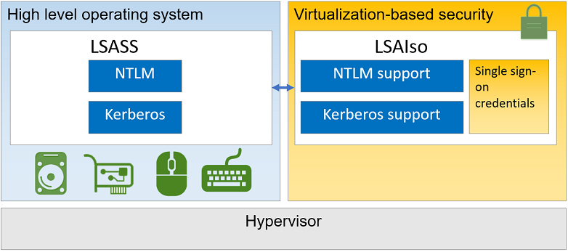
Microsoft – Virtualize security data
Notes:
MMU can have security controls.
TLB holds page table entries PTE
information about whether the page has been written to (the dirty bit)
when it was last used (the accessed bit, for a least recently used page replacement algorithm)
what kind of processes (user mode, supervisor mode) may read and write it,
whether it should be cached.
Can prohibit access to a virtual page
Signal a page fault to the CPU.
2^16 = 65536
2^32 = 4 gigabytes (10^9)
2^64 = 16 exabytes or (10^18)

Slide 36
Hardware Services
Full disk encryption
  Prevent disk swaps
Geofence
  GPS controls
Poison Pills
  Brick it when lost
Asset Recovery
  Preboot message on where to return
Notes:
Class suggestions

Slide 37
Trusted Processing Module (TPM)
Public standard (TCG)
Provide security functions
  Protected against manipulations
Responses only
  Does not initiate requests
Has a unique endorsement key and cert
Provides SECURE storage
  Keys, certs, platform metrics
RSA, SHA-1, RNG, Counter
Notes:
TCG http://www.trustedcomputinggroup.org/

Slide 38
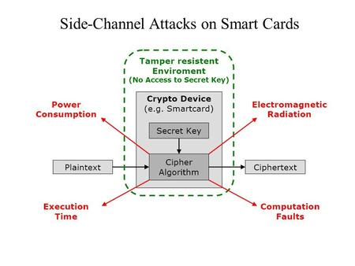

Slide 39
Simple Phone Privacy
Apps and personal
data (D) encrypted
K_{AES} = genkey( ID_{K}, “secret’ )
D’ = decrypt( D, K_{aes} )
H’ = sign( bytes, ID_{K} )
K_{AES} = genkey( ID_{K}, “secret’ )
X
D’ = sign( hash(D-D_{S}), K_{user} )
If D’ == D_{S} then load D
Secure Store (TPM)
(OS_{S}) OS signature
(OS) OS
Location of data (D)
K_{user}
OS’ = sign( hash(OS-OS_{S}), K_{supplier} )
If OS’ == OS_{S} then load OS
K_{supplier}
(B_{S}) boot signature
(B) Boot code
Location of OS (OS)
K_{product}
B’ = sign( hash(B-B_{S}), K_{product} )
If B’ == B_{S} then load B
Firmware
Location of boot (B)
Power ON

Slide 40
Crypto Instructions
2009 Intel added AES
Good
  Many applications: IP-Sec, SSL, Full disk encrypt
  10X faster
  Widely deployed: BSAFE, OpenSSL
Bad
  Import controlled (Russia, China)

Slide 41
ITA Committee Priority | Technology | Hard Problem | Solution themes
Authentication | Authentication, authorization, trust management, access control, and privilege management | Scalable trustworthy systems (including system architecture and the requisite development methodology) | Hardware-enabled trust (knowing when you’ve been had)
Secure software engineering | Large-scale cyber situational awareness; automated attack detection, warning, and response | Enterprise-level security metrics (measures of overall system trustworthiness)
Holistic system security | Insider threat detection, mitigation, forensics, traceback, and attribution | System evaluation life cycle (including approaches for sufficient assurance) | Cybereconomics (crime and fraud don’t pay)
Monitoring and detection | Secure Domain Name System and routing, and protocols and process control systems | Combating insider threats
Secure fundamental protocols | Domain-specific security (for example, wireless and RFID) | Combating malware and botnets | Moving-target defense (attacks work once if at all)
Mitigation and recovery | Detection of vulnerabilities and malicious code; metrics and software testing and assessment | Global-scale identity management
Cyberforensics | Secure OSs, software engineering, and information provenance | Survivability of time-critical systems | Digital provenance (basing trust decisions on verified assertions)
Modeling and testbeds | Cybersecurity, information assurance R&D testbeds, IT systems, Internet modeling, simulation, and visualization | Situational understanding and attack attribution
Metrics, benchmarks, and best practices | Trusted computing base architectures and composable, scalable, and secure systems | Provenance (relating to information, systems, and hardware) | Nature-inspired cyberhealth (moving from forensics to real-time diagnosis)
Nontechnology issues | Inherently secure, high-assurance, and provably secure systems and architectures | Privacy-aware security
 | Trust in the Internet and privacy | Usable security

Slide 42
Body system | Immune functions | Cyber
Circulatory | 1) Blood-distributed immune cells throughout the body 2) Recovery of immune cells through lymphatic flow | NIDS
Digestive | Continuous salivary cleansing of the mouth through lysozymes Pathogen destruction by HCl in the stomach | WAF
Endocrine | 1) T-lymphocyte programming messages through thymus hormone 2) Depression of immune activity through stress
Immune | 1) Capture and destruction of pathogens at surface membrane barriers by phagocytes 2) Natural-killer-cell attack of virus or cancer 3) Inflammation to isolate site, attract phagocytes, dispose of dead cells, and promote repair 4) Fever response by pyrogens to enhance repair and inhibit pathogens 5) Apoptosis 6) The major histocompatibility complex | Anti-Virus
Muscular | Movement to avoid or protect from pain, heat, or danger | Dashboards
Nervous | 1) Fight-or-flight response 2) Avoidance of unhealthy actions or promotion of healthy habits 3) Enhancement or inhibition of immune functions through serotonin, norepinephrine, or epinephrine 4) The blood-brain barrier | Event Logging
Reproductive | Inhibition of bacterial and fungal growth by the vagina’s acidic mantle | DevOps
Respiratory | 1) A physical barrier for and entrapment of microorganisms by mucous 2) Removal of debris-laden mucous from lower tract by cilia 3) Filtering and entrapment of microorganisms by nasal hairs | WAF
Sensory | 1) Cerumen and hairs as external barriers in the ear 2) Foul tastes to prevent eating unhealthy food 3) Continuous eye cleansing by tears with lysozyme | Advisors
Skeletal | Production of blood (immune) cells in bone marrow | Security Group
Skin | 1) A mechanical barrier against entry of pathogens and toxins 2) Perspiration as a bacterial growth inhibitor | Firewalls
Urinary | 1) The acidic pH of urine as a bacterial inhibitor 2) Cleansing of lower urinary tract with each voiding 3) A bactericidal chemical in sebum 4) Resistance against acids, alkalis, and bacterial enzymes in keratin | DLP
Notes:
Trustworthy Computing . Computer.org
https://www.semanticscholar.org/paper/Toward-Scalable-Trustworthy-Computing-Using-the-Hively-Sheldon/3d7933515efb2ee76008415e21452344c785e265

Slide 43
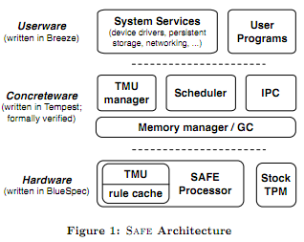
DARPA – CRASH : SAFE
Proofs for
  Hardware
  Services
Overhead OK
Tagged Memory
  pointer not bits
  Base and bounds
  Type safety
http://www.crash-safe.org/sites/default/files/plos11-submission.pdf
Notes:
Hardware:
The hardware layer consists of a microprocessor for a novel instruction set supporting object-level type safety with unforgeable pointers (capabilities), hardware-enforced distinctions between pointers, data, and instructions, and information flow tracking via fine-grained tagging. In our tagging scheme, every word in memory and registers includes both a data payload and a large (pointer-sized) tag which encodes information about its type, provenance, and access limitations.
Concreteware is a thin layer of software that wraps the facilities of the raw hardware into a clean abstract machine.
Assumes: well behaved hardware, read-only and valid concreteware load.

Slide 44
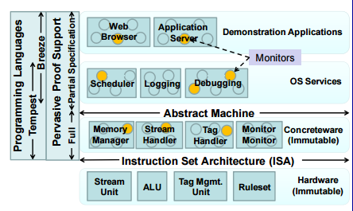
Does this start to look like containers?

