Slide 1
SDN & IoT

Slide 2
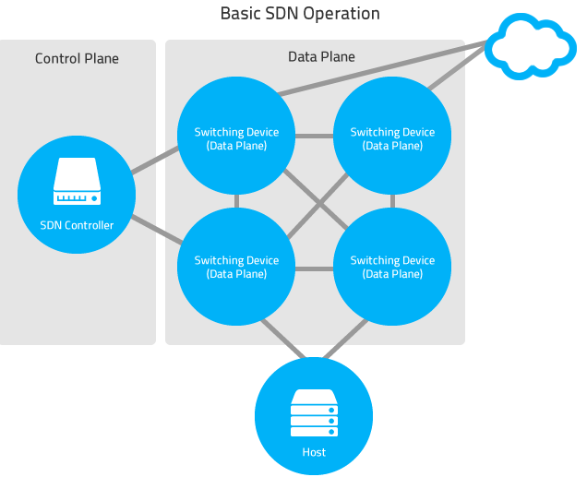
Notes:
Discuss mobile phone scenario

Slide 3
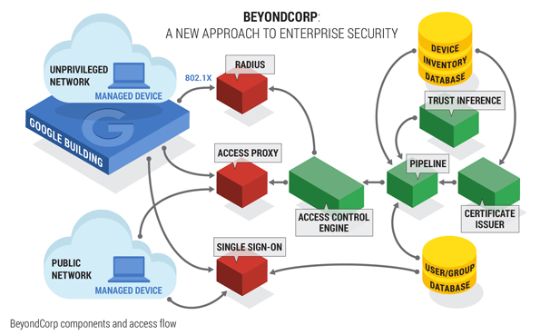
BeyondCorp (Google) https://www.beyondcorp.com/

Slide 4
Managed devices
From the Microsoft & Australian DOD study
  Control patching OS
  Control patching apps
  Run only known good software (whitelist)
  Limit administrative access
Securely store device/user credentials (TPM)
Eliminate/Minimize downloaded corporate data

Slide 5
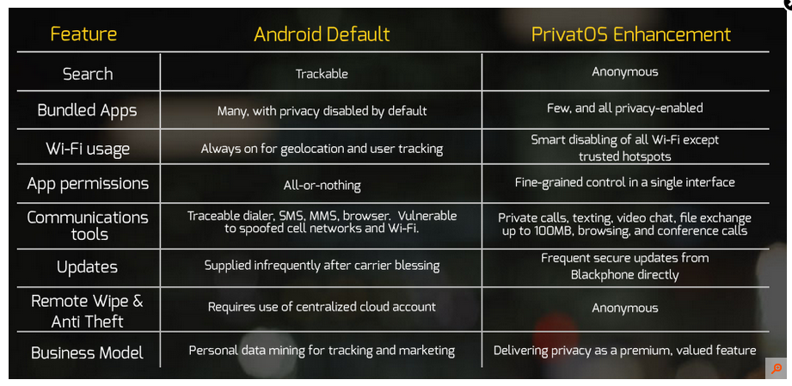
Blackphone features
Notes:
Creator: Phil Zimmerman (PGP creator)

Slide 6
Jailbreaking Definition
To gain full access to unlock all features of the said operating system, thereby removing limitations imposed by the manufacturer.
Once jailbroken, users are able to download additional applications, extensions and themes that are unavailable through official means.

Slide 7
Jailbreaking Pros vs. Cons
Pros
  User paid for it they should have ownership
  Tools have naïve users
  Breaking is often harmless
Cons
  Device is now in unknown state
  Jailbreaking may violate contract
  Jailbreaking may prevent support
  Jailbreaking bypasses OS controls

Slide 8
Mobility
Problems / Attacks
WEP / WPA

Slide 9
Mobile ≈ Wireless
Signals
  WiFi
  Bluetooth
  GSM
  EDGE
  RFID
  WIDI
Devices
  Laptop
  Phones
  Cars
  Surveillance
  Ids

Slide 10
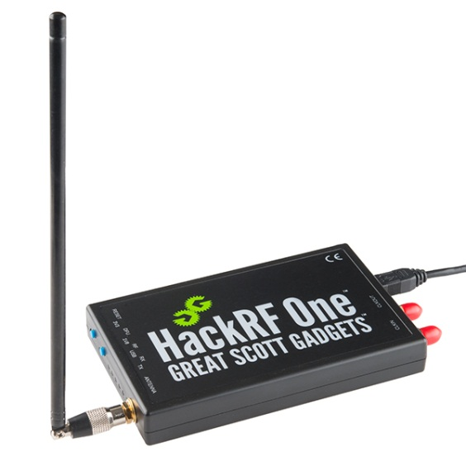
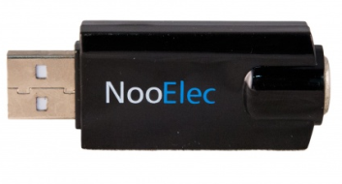
Mobile Security
Are Mobile phones secure?
  Modern cell phones are quite complex
  Lots of “standards” in play at various levels of security, some are easily broken others are not
Bluetooth
  Ubertooth One Interception
  Your car’s hands-free system likely has copies of your text messages on its flash memory
Software Defined Radios
  Cell Interception
  SMS Text Message Interception
  With Open Source software and high-quality SDR, a single laptop can emulate a cell tower and trick your phone into routing through it
Cryptanalysis of A5/1 (GSM Encryption)
“What's new about this attack is: 1) it's completely passive, 2) its total hardware cost is around $1,000, and 3) the total time to break the key is about 30 minutes. That's impressive.”
- Bruce Schneier

Slide 11
Wireless Problems
No physical protections
Your don’t know you are being watched
Bluetooth snarfing up to a 1 mile away
Can bridge “air gapped” networks
Device associations can be dynamic
Many mobile devices are multi-homed
Lots of easy to use attack tools/apps

Slide 12
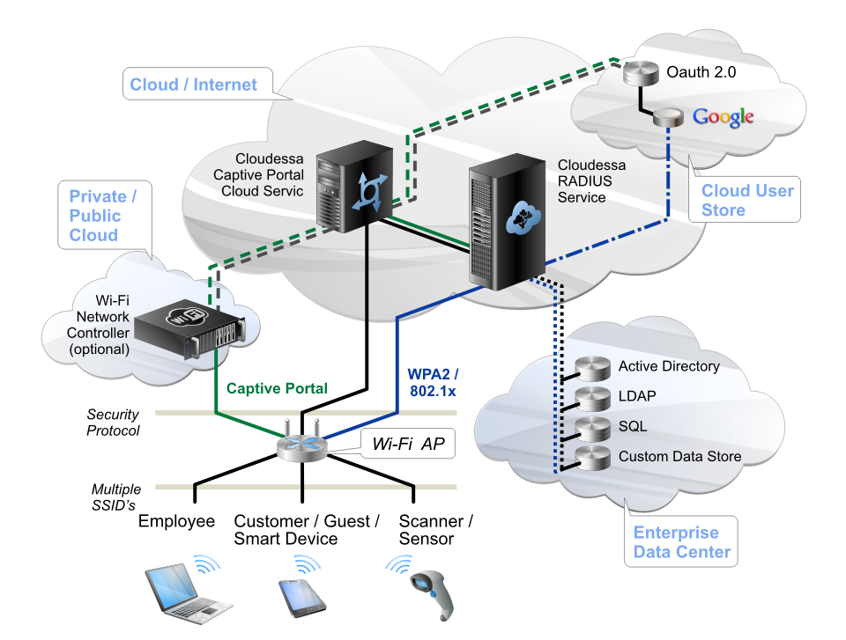
WPA2
Enterprise
PSK
Notes:
WPA-PSK (pre shared key) is vulnerable when weak/guessable keys are used.
4096 hashes per password attempt means brute force is slow (100s /sec)
802.1x authentication is port based NAC.
TKIP used. IV and key is mixed
RADIUS Remote AuthN. Dail In User Service
Diameter or Kerberos maybe used instead of Radius.

Slide 13
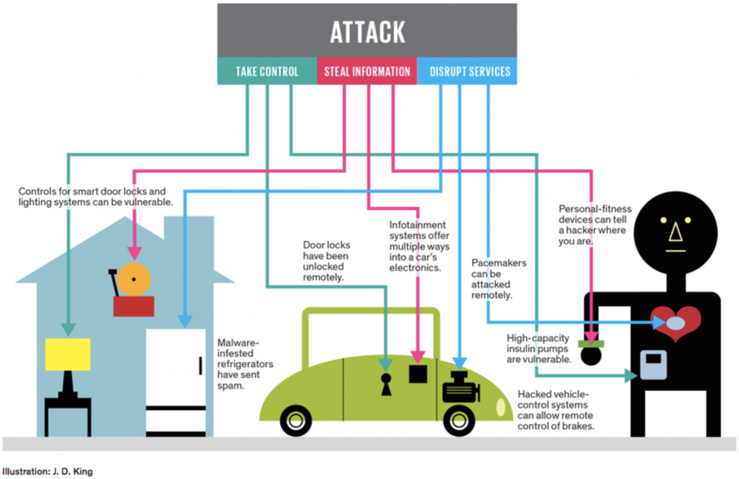
https://www.pubnub.com/blog/2015-05-04-10-challenges-securing-iot-communications-iot-security/

Slide 14
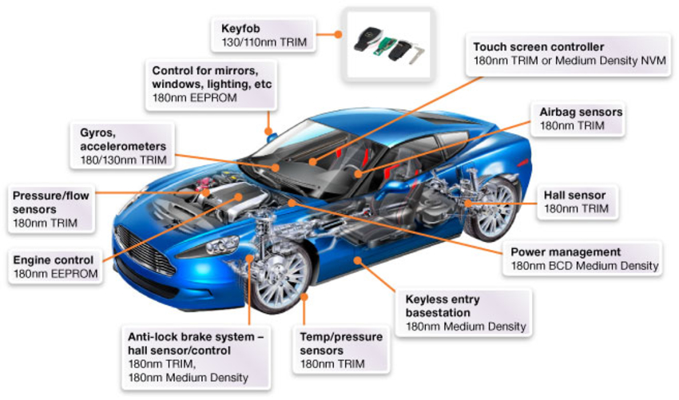

Slide 15
Carshark
CAN equivalent of Wireshark
Univ. Of Washington 2011
Breaks CAN rules
  Weak keys encryption used because car repair community needs to know
  Weak access control between components
  Cars deviate from standards (components behave differently)
  Co-operative components lead to poor HAZOP controls (more, none, reverse, etc)
  Assumed rules like no programming (reflashing) while car is running

Slide 16
Networks in Your Car
High Speed
  Engine, brakes, transmission, airbags
  Very time sensitive ( sub millisecond)
Low Speed
  Remote control (doors), HVAC, instrumentation, radio, telematics
  Controller Area Network
  Broadcast based
WIRED YouTube
  https://www.youtube.com/watch?v=MK0SrxBC1xs

Slide 17
What is possible?
Networks weakly segmented:
  ECU, telemetric weakly bridged. It is possible to upload to telemetric unit (low speed) then communicate to high speed
Arbitrary displays on instrument cluster
Complete control of locks and windows
Complete control of radio (including preventing user resets)
Reflashing engine at speed stops engine
Control of braking by individual wheel

Slide 18
Proactive or Reactive?
Surveillance camera
  Active feed to take action?
  Passive review to confirm something bad?
Sensors in a car
  Prevent an accident?
  Record the crash?
Home cable router
  Block attack?
  Capture traffic for analysis

Slide 19
Virtual
Virtual is often an overlay network or control plane. Anti lock brakes example
  Assess / Risk
    Report wheel rotation rates
  Inform / Governance
    Flash warning on dashboard
  Control / Compliance
    Stutter brakes
Notes:
Examples Physical -> Virtual(Computer)
(Do they Assess/Inform or Control?)
One way -> two way comms.
Antilock brakes systems
Stability Control
Active cruise control
fly by wire
inventory rfid
plug into the net network
phone move to new cell
electric power
manufacturing plant
traffic lights
lighting when no in room

Slide 20
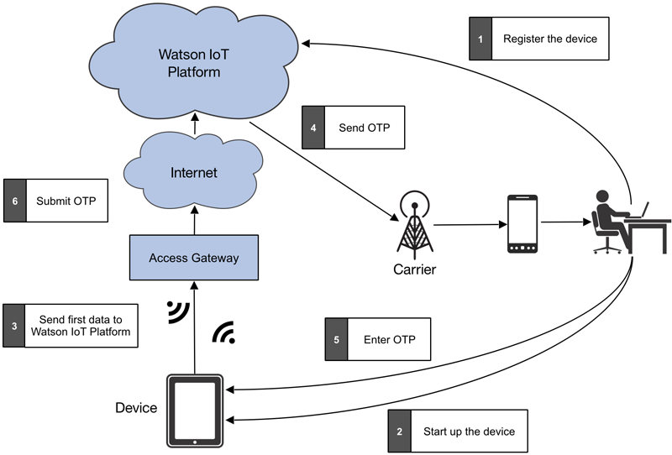
Secure IoT flow

Slide 21
BYOD and mobility
Need to address comingling of corporate and personal data
Vetted mobile applications
Device vulnerabilities need to managed

Slide 22
Supply Chain Risk
Historically an operational issue
Assurances of data integrity, provenance, security, and availability
Digital transaction security
  Identity of actors
  Audit of partner’s security
Outsourcing data processing out of country

Slide 23
SCADA
Supervisory Control And Data Acquisition
Industrial processes
  Manufacturing, production, power, fabrication, and refining
  Continuous, batch, repetitive, or discrete modes.
Infrastructure processes
  Public or private
  Water, wastewater, oil, gas, electrical power
  Civil defense siren systems, and large communication systems.
Facility processes
  Public facilities and private ones
  Buildings, airports, ships, and space stations.
  Monitor and control HVAC, access, and energy consumption.

Slide 24
Current Research
IoT device vs. a Browser
  Number of communications
  Length of transmissions
  Protocols used
  Frequency
  Amount of data transmitted

Slide 25
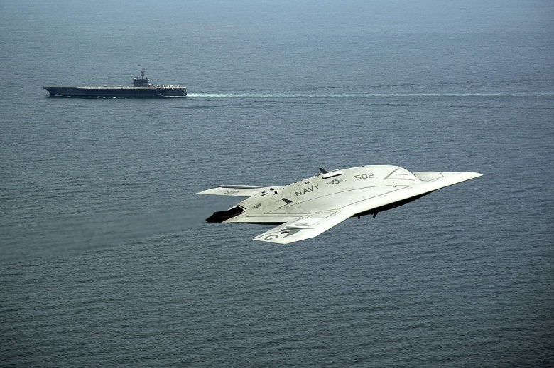
X-47B Drone
Payload: 4,500lbs Range: 2,100 miles

