Slide 1
Software Development LifeCycle (SDLC)
STRIDE
Agile
DevOps

Slide 2

Attacks have changed, prevention principles have not.
http://www.cs.unh.edu/~it666/reading_list/Web/microsoft_devcon_fy05.pdf

Slide 3
Secure Development (Vague, Incomplete)
Prevent vulnerabilities
Ensure CIA
Implement auditing/monitoring
Provide multi-level security
Provide trustworthy authentication
Follow the principle of least privilege
Fail securely
Be reluctant to trust
Use Community resources

Slide 4
Coding is just one phase in the process
Feasibility
Powerpoint
Need better artifacts from
each stage to reduce audit
expense enterprise wide
Requirements
Spreadsheet
Design
More docs
Coding
Audit
Code
Customers
Testing &
Integration
Secure Coding
tries to prevent/avoid
Coding failures
Not Design , Integration
or Requirement failures
Program
Delivery &
Maintenance
App Owner
Hosting
Notes:
Artifacts are targeted at next phase
poor reuse
poor automation
GRC needed to minimize audit expense by grouping technologies
As a project owner, how can I prove that my project’s code is secure?
To myself?
To my PM, Arch, Dev and QA teams?
To my manager?
To security, audit and compliance teams?
To operations when promoting to production?
To a 3rd party auditor?
To the customer?

Slide 5
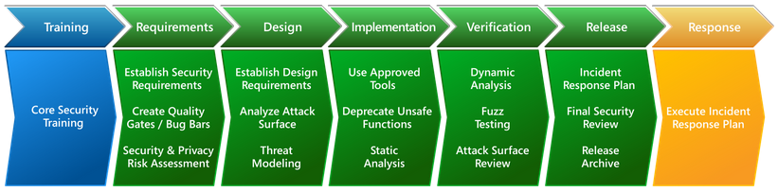
MICROSOFT - Security Development Lifecycle Process
https://www.microsoft.com/en-us/securityengineering/sdl/practices
Notes:
Diagram of skill demands by phase

Slide 6
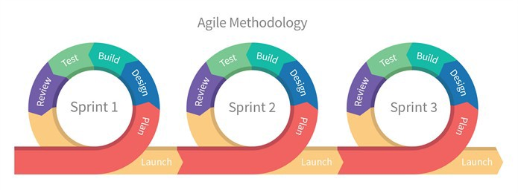
Agile Process
Each sprint completes a subset of the task/requirements backlog
Team focused: Everyone builds and tests

Slide 7
Agile Methodologies
Scrum
Extreme Programming (XP)
  http://en.wikipedia.org/wiki/Extreme_programming
Rational Unified Process (RUP)
  http://en.wikipedia.org/wiki/Rational_Unified_Process
Crystal Clear
  http://en.wikipedia.org/wiki/Crystal_Clear_(software_development)
Dynamic Systems Development Method (DSDM)
  http://en.wikipedia.org/wiki/Dynamic_systems_development_method
Feature-Driven Development (FDD)
  http://en.wikipedia.org/wiki/Feature-driven_development
Test-Driven Development (TDD)
  http://en.wikipedia.org/wiki/Test-driven_development

Slide 8
Scrum-specific Terminology
Daily Scrum or Daily Stand-up – The once a day meeting for the team
Backlog – The prioritized “pile” of feature requests for the team to work on
  Product Backlog – The entire set of features desired for a specific app or product
  Sprint Backlog – The set of features committed to being delivered in the current sprint
  Sprint – A one to four week iteration to deliver a set of features to the product owner
  Burndown – Visual representation of whether the team is ahead-, on-, or behind schedule per the velocity.
  Epic – A very large user story that is eventually broken down into smaller stories.
Story - A requirement, feature and/or unit of business value that can be estimated and tested.
Use Case – a description or diagram of a set of interactions between a system and one or more actors (where ‘actor’ can be people, or other systems)
Velocity – Average amount of story points or hours a team can successfully complete in a sprint.
Capacity – Time (in hours) a resource can actually spend on the project during a sprint.

Slide 9
Agile Roles
Product Owner (PO)
  Represents the customer & should be closest to the user
  Balances all priorities of a project & sequences work for the team continually
Scrum Master (SM)
  Servant-leader for the team; focuses on making the team more productive (enforces Agile rituals)
  Removes blockers for the team
Team (Team)
  Mix of roles (developer, DBA, QA, Release manager, etc.)
  Works in a fast-pace, constantly-changing environment

Slide 10
Agile User Stories
Short (can fit on a index card)
  As a ___________
  I would like to ___________
  So I can ______________
Front
  Name, number, size
  Story
  Conversation (diagram)
Back
  Confirmation (pass/fail tests)

Slide 11
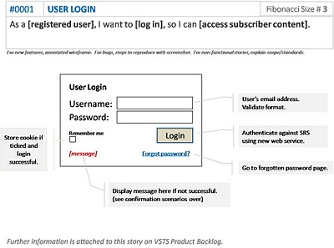

Slide 12
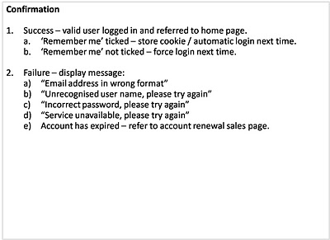

Slide 13
Class Exercises
As the security officer I would like to know when a developer has posted credentials to Github to prevent unauthorized access.
As the privacy officer I would like to know when an internal email address is exposed on the web site so I can notify the user
As a Facebook user I would to have a secure connection to the web site to protect my privacy

Slide 14
Open Source Security
  Building secure software is difficult, open source or not
Pro
  Linus Law “Given enough eyeballs all bugs are shallow“
  "Open source developers are more clued in to security issues due to a better sense of community, and their software is more secure as a result.“
Con
  “Too much hacker not enough engineer”
  “No structured engineering process”
  “Attackers have access to code”
Notes:
Don't Believe the Hype
Outside the open source community, the notion that open source is good for security--particularly when developers are diligent--often meets with extreme skepticism
Is the open source developer good at finding vulnerabilities? unclear
Open source selected based on functionality first.
Eyeballs that care about security want to make a name. Thus they focus on popular projects.
WU-FTPD around for a decade with a large number of buffer overflows.
Too many eyeballs = too many cooks = unfocused contribution
Good software auditors are in high demand and go to commercial shops

Slide 15
Impact of Schedules
Open Source (function over time)
  If an issue is found, justify the vulnerability than I will fix it.
Closed (time constrained)
  If we have a vulnerability just fix it and move on

Slide 16
Impact of Money
Closed has the money and will spend on security.
Serious customers demand security handled in a serious rather than ad-hoc way.
Closed will pay for 3rd party audits.

Slide 17
Design generating negative tests - HAZOP
Guide Word | Meaning
NO OR NOT | Complete negation of the design intent
MORE | Quantitative increase
LESS | Quantitative decrease
AS WELL AS | Qualitative modification/increase
PART OF | Qualitative modification/decrease
REVERSE | Logical opposite of the design intent
OTHER THAN | Complete substitution
EARLY | Relative to the clock time
LATE | Relative to the clock time
BEFORE | Relating to order or sequence
AFTER | Relating to order or sequence
Notes:
Used to model what happens to requirements when the guide word is applied. For example.
Requirement: User can request resource <xyz>.
User can NOT request resource <xyz>.
User can request resource <xyz> MORE than 2 times.
User can request resources OTHER THAN <xyz>.
User can request resource <xyz> BEFORE establishing an SSL connection.
User can request resource <xyz> AFTER loging out.
User can request resource <xyz> AS WELL AS <abc>.

Slide 18
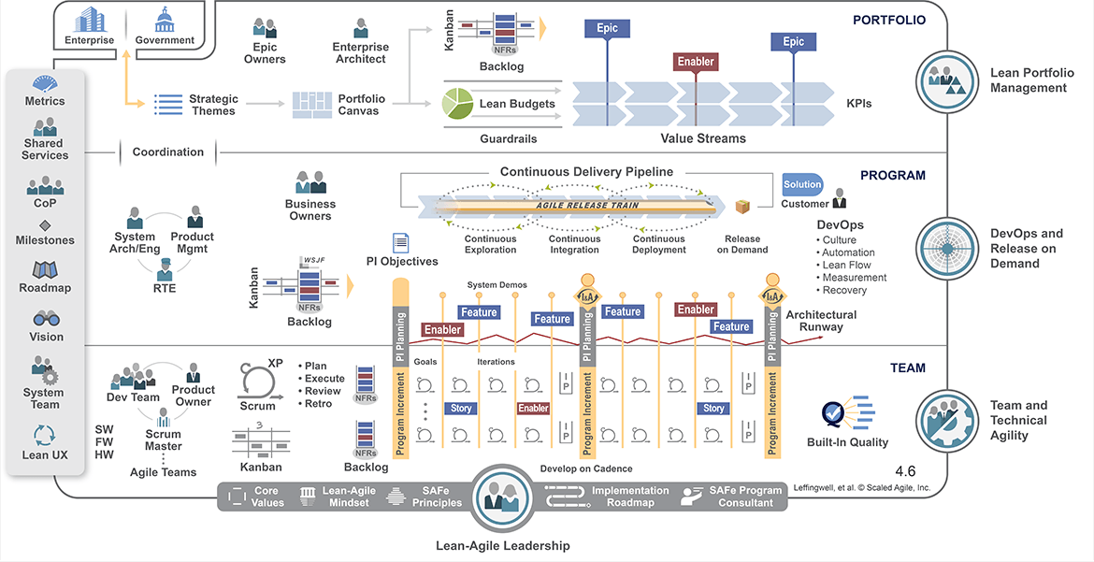
Scaled Agile Framework: https://www.scaledagileframework.com/

Slide 19
Dev Sec Ops
Put security testing into Dev terms
Quit trying to eliminate all vulnerabilities
Start with known/critical vulnerabilities
Pipeline runs security tests
Security awareness training for Dev
Eliminate known vulnerable components
Secure automation scripts
Strong version control
Adopt immutable infrastructure

Slide 20
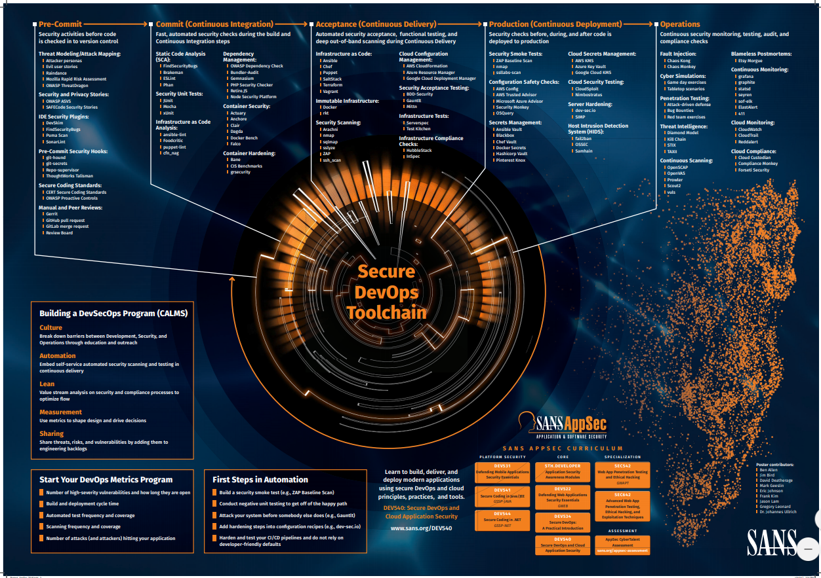
DevOps: https://www.sans.org/security-resources/posters/secure-devops-toolchain-swat-checklist/60/download

Slide 21
DevSecOps Behaviors
Separation of Duties | No individual acting without authorization can alter the services/protections provided by the cloud
Privilege Escalation | No individual will be able to escalate their assigned IAM privilege(s) by assuming the role of a higher privilege individual or instance
Integrity Management | All compute deployments will allow for integration at deployment time to facilitate automated security acceptance.
Compliance | Any individual or instance not adhering to published security guidelines may have their access terminated
Resiliency | A single compromise of an individual or instance shall not be allowed to impact resources managed by other entities.
Blast Radius | Cloud services shall provide customers sufficient separation of their data and compute from exposure to or impact by other consumers
Legacy System Impact | No public cloud deployment shall increase the security exposure of on-premise (private cloud) systems
Transparency | Classify all cloud security controls/processes as internal and publish for review by any employee or authorized customer
Automated Enforcement | Whenever possible enforcement of security policies shall be event driven and automated
Data Protection | All data access must be based on an appropriate role for the data classification and include logging for all access

Slide 22
STRIDE

Slide 23
Threat Model – STRIDE (Microsoft)
Threat | Security Property
Spoofing | Authentication
Tampering | Integrity
Repudiation | Validity
Information Disclosure | Confidentiality
Denial of Service | Availability
Elevation of Privilege | Authorization

Slide 24
STRIDE Threats by Type
Element | S Spoofing | T Tampering | R Repudiation | I Information Disclosure | D Denial of Service | E Elevation of Privilege
Common Mitigations | IPsec Digital signing HMAC | ACLs Digital signing HMAC | Strong AuthN Secure Logs Secure Audit | Encryption ACLs | ACLs Quotas HA Designs | ACLs RBAC Input validation
Entity |  |  | 
Process |  |  |  |  |  | 
Data Store |  |  |  |  | 
Data Flow |  |  |  |  | 
Refer to Chapter 9 of the Microsoft SDL for a more complete listing
  http://www.microsoft.com/learning/en/us/books/8753.aspx

Slide 25
Threat type: Spoofing
Applies to: Entities & Processes
Some questions to ask about this threat type
Spoofing is pretending to be something you’re not
Are credentials held on the server?
Are credentials held on the client?
Is there a key distribution center?
Are credentials protected in transmission by strong cryptography?
Is there a protocol for updating a credential?
Could an attacker guess credentials (online or off line)?
Could two credentials be mistaken for each other?
Does the app ever support anonymous users or accounts with no passwords?
Does the protocol have a backwards compatibility mode?
Are all credentials random and arbitrary?
Does the protocol always require authentication?

Slide 26
Threat Type: Tampering
Applies to: Data, Flows, Processes
Tampering is altering the bits for any reason
Is all input verified for correctness?
Are you trying to protect against memory access attacks?
Do you trust your callers?
Do you trust your callees?
Do you use shared memory? Is it protected from all users?
Do you use LinkDemand ¡n .NET to optimize caller verification?

Slide 27
Threat Type: Repudiation
Applies to: Entities & Processes
Repudiation is claiming you didn’t do something which you did.
Are you using a standard digital signature system?
Is the dataflow time stamped/sequenced and integrity protected?
Do you log?
If you have trust levels, is anyone other outside of the highest trust level allowed to log?
Do you accept logs from unknown or weakly authenticated users or systems?
Do you have enough data to deal with repudiation claims?
Do your log readers understand the security aspects of your logs?

Slide 28
Threat type: Information Disclosure
Applies to: Data, Flows, Processes
Information disclosure is when the information can be read by an unauthorized party.
Is all input verified for correctness?
Do you use shared memory? Is it protected from all users?
Have you performed a side channel analysis?
Are you trying to protect against memory access attacks?

Slide 29
Threat type: DoS
Applies to: Data, Flows, Processes
Denial of service is overloading or crashing the process.
Does the app validate all input is within range?
Can a small request create a very large workload?
Do failed requests lock the system?
How many requests slow/stop the system?

Slide 30
Threat Type: Elevation of Privilege
Applies to: Processes
Elevation of privilege against processes involve altering the flow of execution such that code running at a higher privilege level does what they want.
Does the app validate all input?
Do you use shared memory? Is it protected from all users?
Does the application rely on a “same origin” policy?
Do you trust your callers? Do you use LinkDemand in .NET to optimize caller verification?

Slide 31
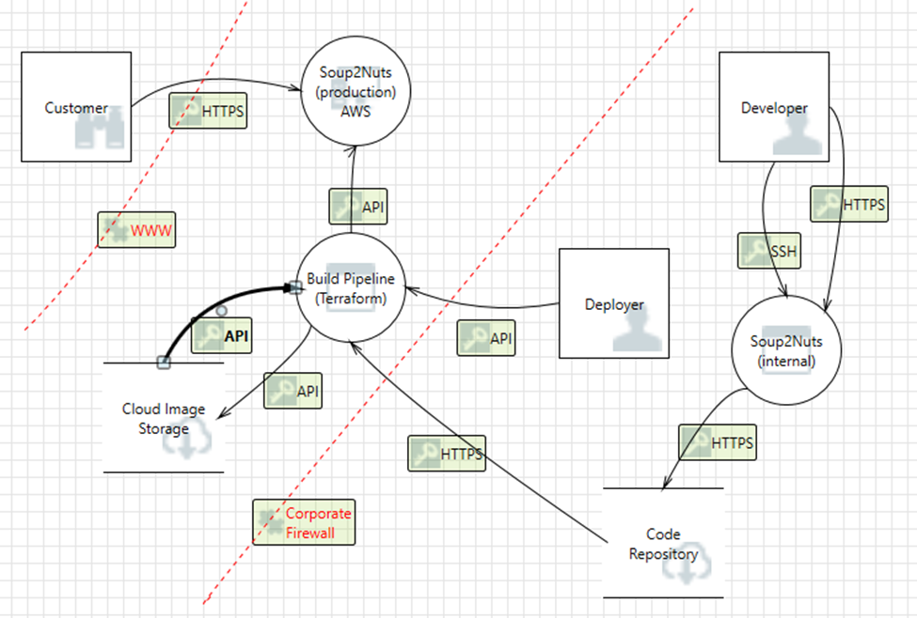
Example
https://www.owasp.org/index.php/Application_Threat_Modeling

Slide 32
Risk Modeling
FAIR
Microsoft’s DREAD
CVSS

Slide 33
Risk Management Strategies
Avoid
  Eliminate uncertainty by not undertaking the actions seen as too risky for the business
Transfer
  Ownership transfer, or by using insurance, guarantees or contractual clauses;
Accept
  Get approval from top management to accept the current level of risk, without implementing security measures.
  Preferable in the situations where the cost of implementing protective measures exceeds the benefits, or when the level of risk is necessary for business development.
Reduce
  Change the risk exposure (through impact and / or probability mitigation).
  Add or change controls to reduce the impact
  Take actions to reduce the probability
Notes:
Avoid: Local bank not using a cheap China based ISP
Transfer: Cyber insurance to cover data disclosure costs
Accept: most internal software development
Reduce: Adding DDoS protections

Slide 34
Risk Model – DREAD (Microsoft)
Damage potential
  How bad could an attack be?
Reproducibility
  How easy is it to reproduce the attack?
Exploitability
  How easy is it to launch an attack?
Affected users
  how many people will be impacted?
Discoverability
  How easy is it to find the vulnerability?

Slide 35
DREAD evaluation of Heartbleed (scale 1-10)
 | Assessment | UNH | Liberty Mutual
Damage | Loss of private TLS key | 8 | 8
Reproducibility | Remote, unauthenticated | 10 | 10
Exploitability | Single HTTP request | 10 | 10
Affected Users | UNH: Campus wide LM: 6 out of 5000 servers | 10 | 1
Discoverability | Public knowledge | 10 | 10
Add? | 48 | 39
Multiply? | 80000 | 8000
Percent? | 80% | 8%
Weighted/Minimum?

Slide 36
FAIR
Threat Event Frequency (TEF)
  How often?
Threat Capability (Tcap)
  How good are the attackers?
Control Strength (CS)
  How good are the defenses?
Loss Event Freq. (LEF) = TEF * Tcap * CS
  “sub-total”
Estimated Probable Loss (EPL)
  Rate the loss
RISK = EPL * LEF
Details in shared reading materials FAIR(Brag).pdf

Slide 37
FAIR Lite
Easy way, forget about attacker and control strength
Threat Event Frequency (TEF)
  How often?
Threat Capability (Tcap)
  How good are the attackers?
Control Strength (CS)
  How good are the defenses?
Loss Event Freq. (LEF) = TEF * Tcap * CS
  math
Estimated Probable Loss (EPL)
  Rate the loss
RISK = EPL * TEF

Slide 38
FAIR lite
HOW OFTEN?
Very Low | <0.1/year (less than 1/10yr)
Low | 0.1<>1/year
Moderate | 1<>10/year
High | 10<>100/year
Very High | >100/year
Remove control strength and attacker knowledge
Understand your deterrence controls. For example using Akamai would reduce the number/effectiveness of a DDoS attack.
If the attack is happening does it matter how smart you thought they were?

Slide 39
FAIR lite
HOW BAD?
INSIGNIFICANT | Impact absorbed by normal activities
DISTRACTING | Limited hard costs; not absorbed by normal activities
PAINFUL | More annoying than DISTRACTING
DAMAGING | Real/serious effect on the bottom line/revenue generation
CATASTROPHIC | Business-ending event

Slide 40
Heartbleed
Catastrophic | H | H | C | C | C
Damaging | M | M | H | H | C
Painful | L | M | M | H | H
Distracting | L | L | M | M | M
Insignificant | L | L | L | M | M
 | VL <every 10 years | L yearly | M monthly | H weekly | VH daily
UNH
LM
CRITICAL : Senior Management => Must Address Immediately
HIGH : Senior Business Management => Must take action to TRANSFER or REMEDIATE
MEDIUM : Asset Owner+[CIO|CISO] => REMEDIATE or ACCEPT
LOW : Asset Owner => Accept (for now)

Slide 41
Putting Loss (Impact) Into Perspective
INSIGNIFICANT
  Impact absorbed by normal activities
DISTRACTING
  Limited hard costs; not absorbed by normal activities
PAINFUL
  More annoying than DISTRACTING
DAMAGING
  Real/serious effect on the bottom line/revenue generation
CATASTROPHIC
  Business-ending event

Slide 42
What’s The Risk?
Frequency | V.Low | Low | Med | High | V.High
Catastrophic | H | H | C | C | C
Damaging | M | M | H | H | C
Painful | L | M | M | H | H
Distracting | L | L | L | M | M
Insignificant | L | L | L | M | M
CRITICAL
  Senior Management
  Must Address Immediately
HIGH
  Senior Business Management
  Must take action to TRANSFER or REMEDIATE
MEDIUM
  Asset Owner+[CIO|CISO]
  REMEDIATE or ACCEPT
LOW
  Asset Owner
  Accept for now

Slide 43
National Vulnerability Database - NVD
U.S. government repository of standards-based vulnerability management data
Using the Security Content Automation Protocol (SCAP)
March 2013 taking offline by Adobe ColdFusion vulnerability
NIST provides both CVE (via https://cve.mitre.org/ ) and CVSS data to the public

Slide 44
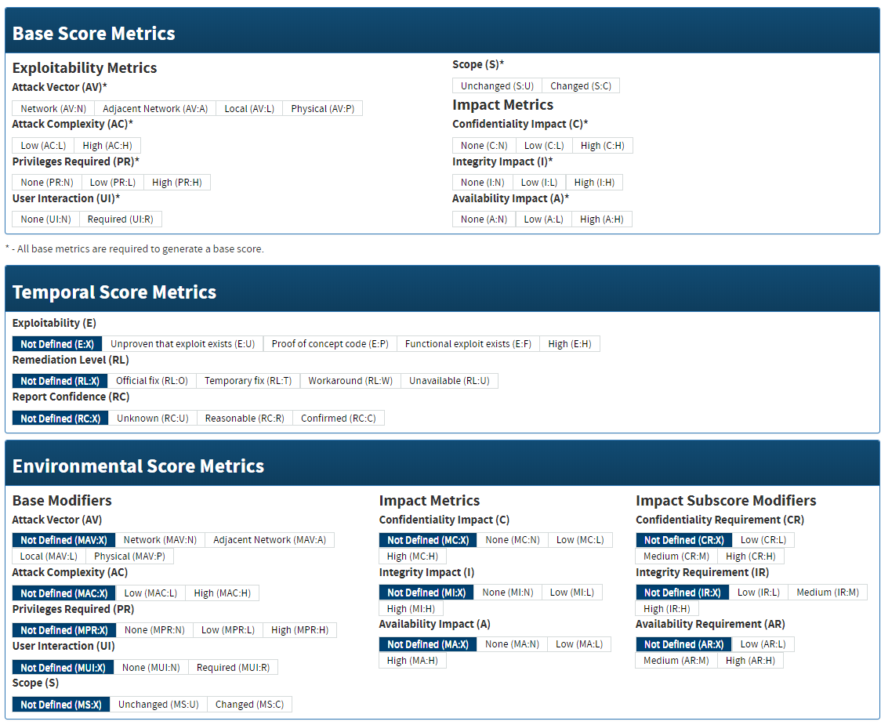
https://nvd.nist.gov/vuln-metrics/cvss/v3-calculator

Slide 45
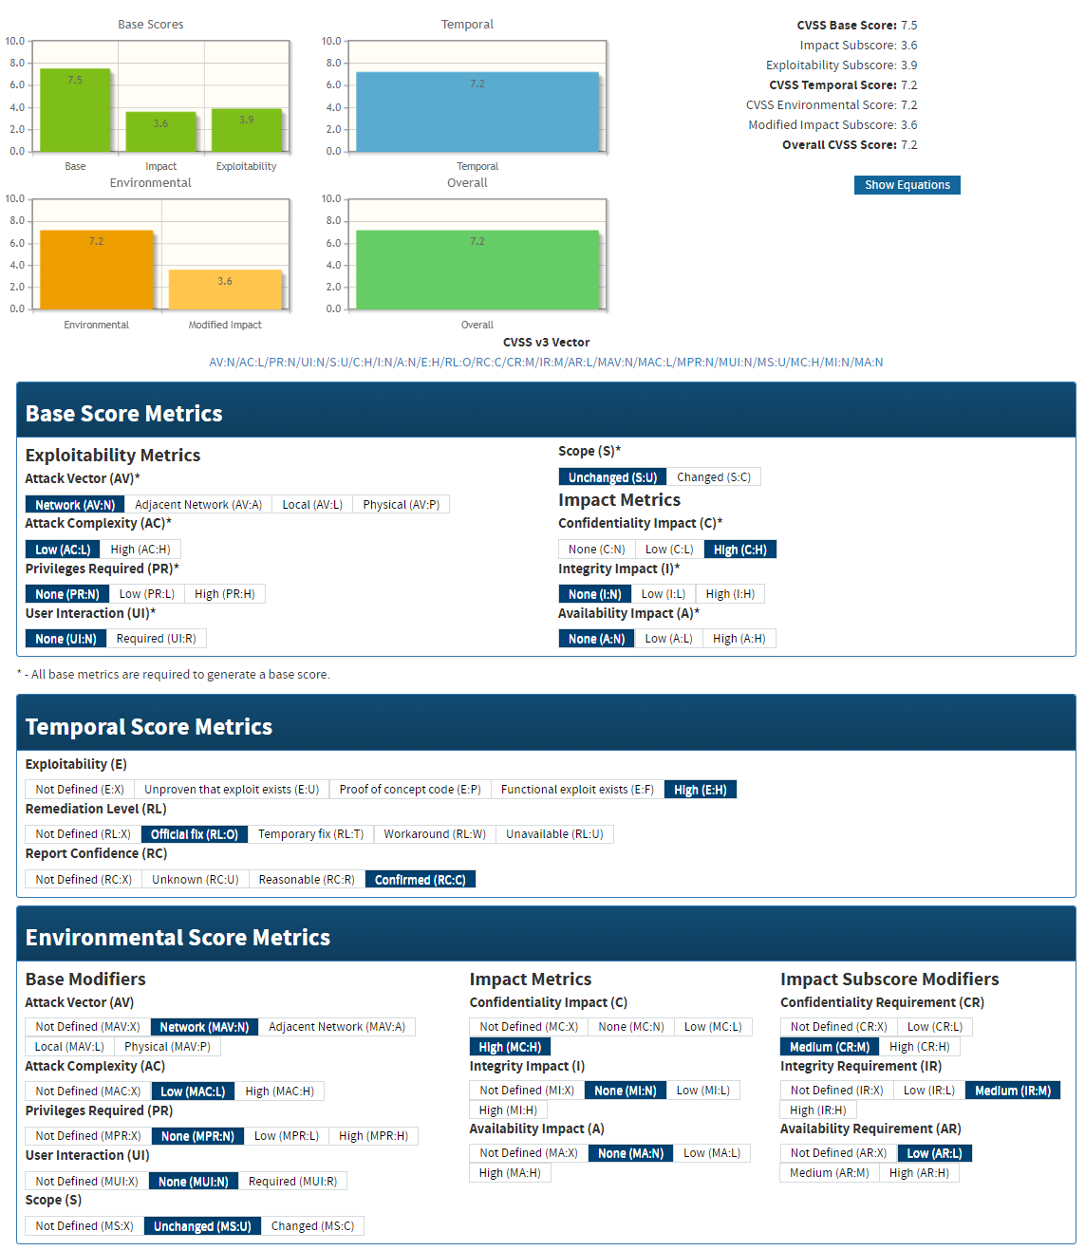
UNH – Heartbleed

Slide 46
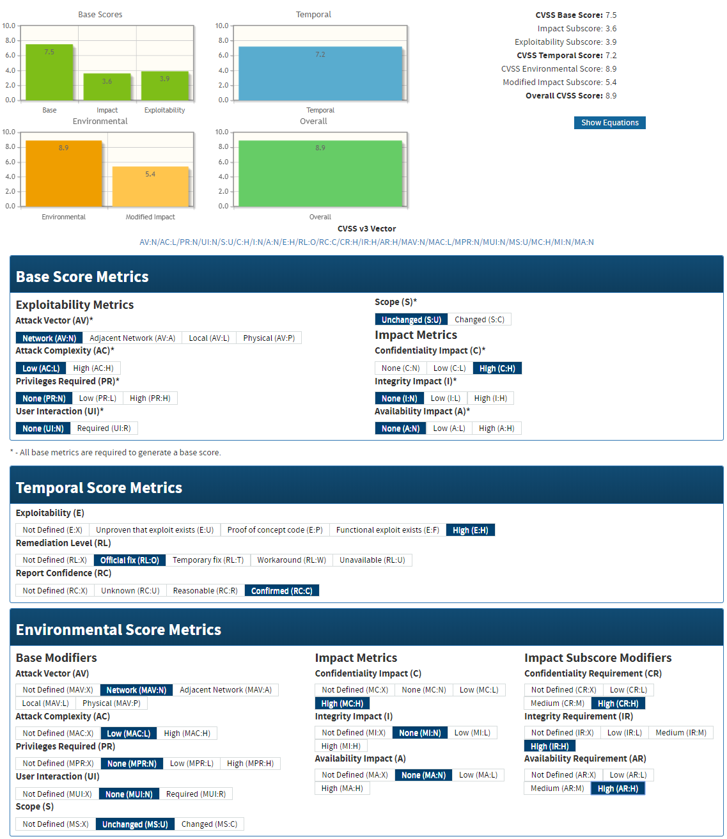
Liberty Mutual – Heartbleed

Slide 47
Risk Model Comparison
 | DREAD | FAIR | CVSS
Purpose | Fix a known flaw | Prepare for a potential attack | Standardized vulnerability reporting
Input factors or Components | Damage Reproducibility Exploitability Affected users Discoverability | Likelihood of event Potential damage | Exploitability Impact Temporal Environmental
Methodology | Score each on simple scale. Total determines priority | Coarse grain buckets for simple matrix | Score on groups. Scores weighted.
Primary use | Software bug fixing | Security team(s) setting priority | Patching priority
Source | Microsoft | The Open Group | NIST

Slide 48
OCTAVE – All risk not just cyber
http://www.cert.org/resilience/products-services/octave/
Must be ready to continue operations and meet their mission when disruption occurs.
Organizations must take a structured approach to managing security risks, business continuity, and information technology operations within the context of their business objectives.
Focus on managing risk to critical assets by optimizing both protection and continuity strategies to prepare for a broad range of outcomes.

Slide 49
OCTAVE Simplified

Slide 50
Team exercise
Create a threat scenario
Consider all four dimensions
  Impact
  Adversary’s
    Motivations
    Resources
    Approach
Must include some aspect of cyber security
Use card decks for ideas

Slide 51
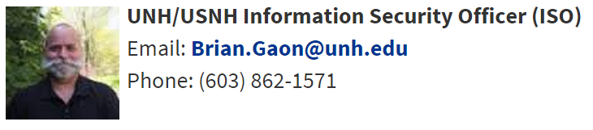
Team exercise #1
Create a scenario that might keep Brian Gaon awake at night.
UNH, Keene, Plymouth, Granite State
  28K students, >$1B economic impact

Slide 52
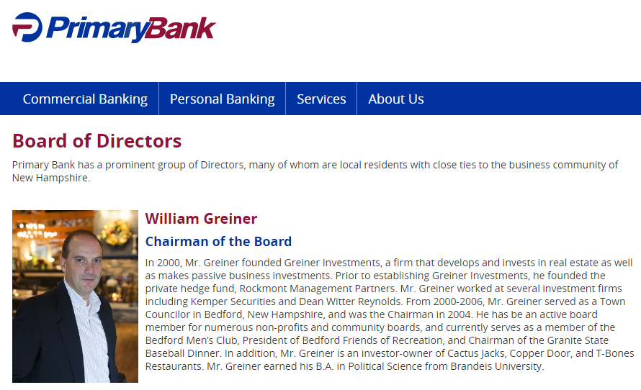
Team exercise #2

