Slide 1
IT666 : Cybersecurity Practices
Course Overview
Modules
Labs

Slide 2
ACM & IEEE Curriculum Recommendations
Chromium
Design & Testing
VPN
SDN
WiFi
HTTPS/TLS
Virtualization
Software
Network
Forensics
Docker
Crypto
Systems
Data
CYBER SAFETY
Blockchain
Components
Human
Social
Engineering
Supply Chain
Organizational
Societal
Privacy
Procurement
Crime/Law
Risk
GRC
Digital
Contracts
DR

Slide 3

Course Structure
CompTIA Security+ certification
Book provides terminology and questions
Generally, one chapter per lecture meeting
Typical class structure
Practical discussions from assigned chapter reading
Hands-on lab
Text
CompTIA Security+ Study Guide SY0-701, Ninth Edition
Authors: Mike Chapple, David Seidl
eBook ISBN: 9781394211432 is available on Safari

Slide 4
Lab tools used
Parrot OS virtual machine (VirtualBox/Parallels)
OpenSSL
OpenVPN
Wireshark
OWASP ZAP
Burpsuite
Cloud Account (AWS for labs)
You will need a public location to host your hackable machine
Various online resources

Slide 5
End-of-semester project
Build a flawed machine
Must be remotely accessible to the entire class
Should take 5-10 minutes to hack
Provide hints, story, and/or theme
Unauthenticated access or an escalation of privilege
Idea sites
https://portal.offsec.com/labs/play
https://book.hacktricks.xyz/welcome/getting-started-in-hacking

Slide 6
Keys to success
Do ALL work on-time
Do the readings prior to class/understand practice questions
Get an instance of Parrot OS running
Past students have preferred VirtualBox appliance
Dedicated, Live USB, and Cloud deployments are options
Create a Hack The Box “lab” (HTB) account
Create an AWS account
Needed for some labs
Your hackable machine can be hosted in free tier

Slide 7
Grading (NO CREDIT FOR LATE WORK)
Lab assignments are 50% of course grade
In class, one lab for each class
Lab walkthrough 10%
Present to the class the steps needed to complete the lab for that day
Hackable machine project 30%
White, Red, and Blue team roles
Walkthrough presentation to class, peer and instructor assessed
“Final” is based on Security+ exam questions 10%

Slide 8
Some of the questions answered by this class
What does the UNH AUP (dis)allow you to do?
Can you hack AGATE.cs.unh.edu while taking this class?
Linux file permission of 007 prohibits/allows what actions?
How do you defend against a DoS attack?
How can I attack serverless applications?
Is the cloud more secure?

Slide 9
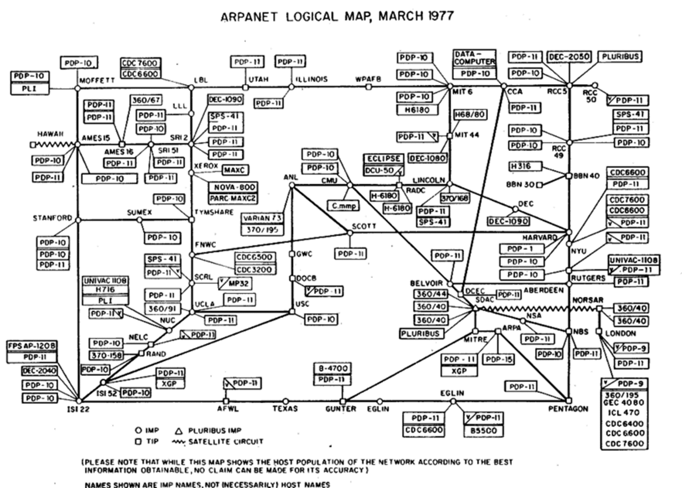

Slide 10
Top 100 Gawker passwords (+24K of 500K cracked / 1.3M total)
123456
password
12345678
qwerty
abc123
12345
monkey
111111
consumer
letmein
1234
dragon
trustno1
baseball
gizmodo
whatever
superman
1234567
sunshine
iloveyou
fuckyou
starwars
shadow
princess
cheese
123123
computer
gawker
football
blahblah
nintendo
000000
soccer
654321
asdfasdf
master
michael
passw0rd
hello
kotaku
pepper
jennifer
666666
welcome
buster
Password
batman
1q2w3e4r
maggie
michelle
pokemon
killer
andrew
internet
biteme
orange
jordan
ginger
123
aaaaaa
tigger
charlie
chicken
nothing
fuckoff
deadspin
valleywa
qwerty12
george
swordfis
summer
asdf
matthew
asdfgh
mustang
yankees
hannah
asdfghjk
1qaz2wsx
cookie
midnight
123qwe
scooter
purple
banana
matrix
jezebel
daniel
hunter
freedom
secret
redsox
spiderma
phoenix
joshua
jessica
asshole
asdf1234
william
qwertyui
Notes:
Gizmodo, gawker, kotaku, deadspin, valleywag, jezebel all gawker run blog sites
Truncation to 8 chars
Leeted variations of password
Almost 500K password analyzed, 180K unique
SONY: http://www.troyhunt.com/2011/06/brief-sony-password-analysis.html

Slide 11
Free training : Both Linux and Hacking
TryHackMe Classrooms
Linux
Hacking fundamentals
HackTheBox.eu (HTB)
Academy
Labs
Offensive Security
Let Me Play

Slide 12
Additional Security practice sites
OverTheWire : Cloud based linux & security concepts
Python Principles : Cloud python training
Blue Team Labs : Cloud hands-on defense labs
CyberDefenders : Cloud hands-on defense labs
VulnHub : Laptop downloadable VMs
OWASP Juice Shop : Cloud based e-commerce site to hack

Slide 13
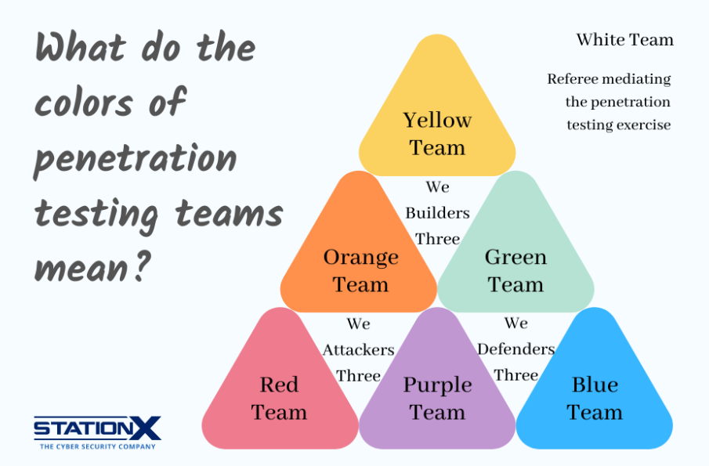

Slide 14
LAB - 1
Parrot Security Edition VM

Slide 15
Introduction & Setup
Discord
Join class server: https://discord.gg/w6QJZmSTJt
Change your handle to how you want to be addressed in class
DM me a selfie
In general channel, share/upvote topics you would like to see in class

Slide 16
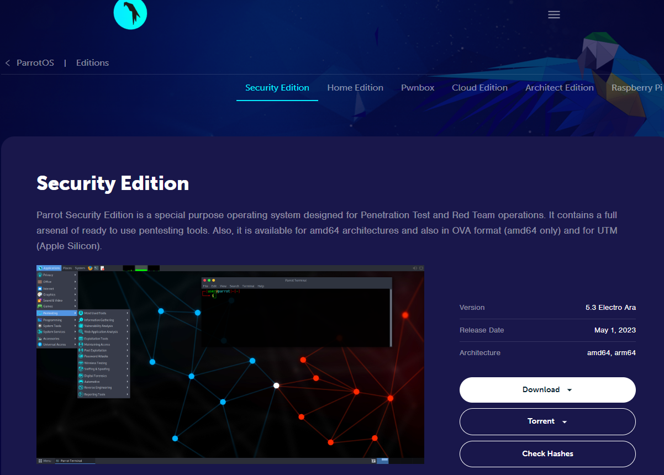
Parrot OS
VirtualBox Download
Download Security Edition
“ova” is a 6 Gb download
VirtualBox steps
Import Appliance
Add Guest Additions if “iso” download
Optional:
Configure a shared folder
Configure a second network to allow host → Parrot communications
Parrot OS commands
sudo –i
apt-get update && apt-get upgrade

Slide 17
LAB 2 - PREVIEW
Due at end of next class

Slide 18
