Slide 1
IT666 : Cybersecurity Practices
Chapter 1: Today's Security Professional

Slide 2
GOALS
Access Control
& Encryption
Hashing
Integrity
Confidentiality
Availability
Redundancy & Backups

Slide 3
THREATS
Alteration
Disclosure
Service Denial

Slide 4
Impacts/Risks
Financial
Direct (loss of asset, recovery costs)
Indirect (loss revenue, employee time, etc)
Operational
Compliance
Reputational

Slide 5
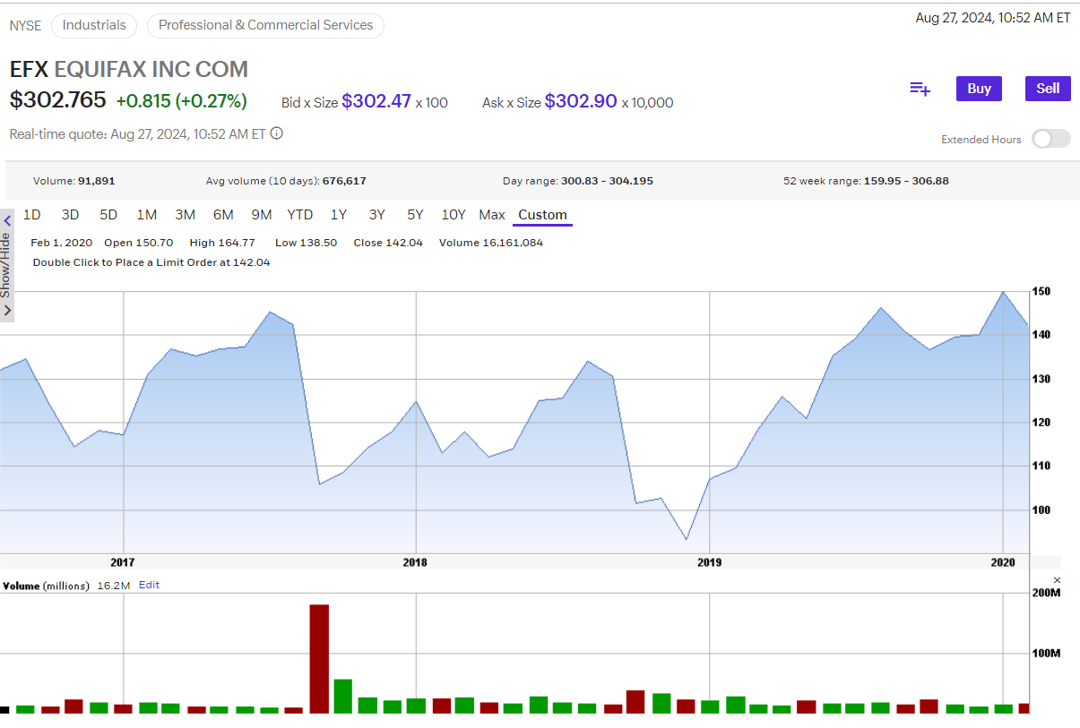
Long term reputation risk can be overblown

Slide 6
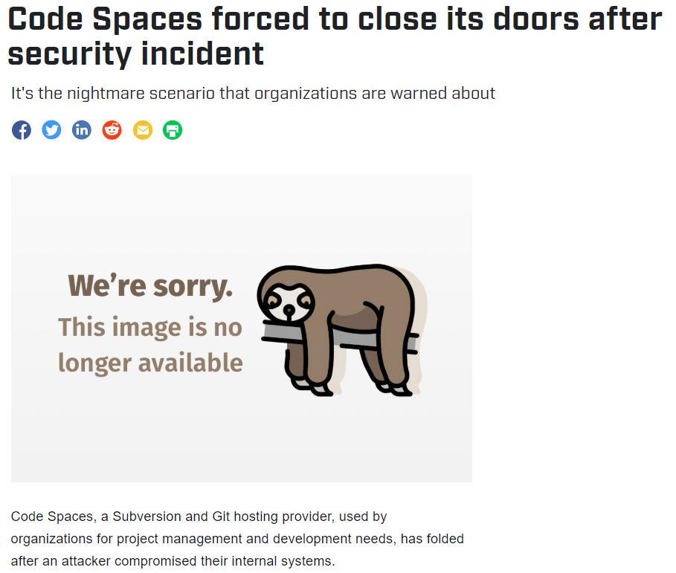
… or is it?
https://www.csoonline.com/article/2365062/code-spaces-forced-to-close-its-doors-after-security-incident.html

Slide 7
Security Controls (by mechanism)
Physical
Fences, Doors, cameras, alarms
Technical
Digital implementations
Operational
Daily processes and rules
Managerial
Determine effectiveness and update the other control types

Slide 8
Security Controls (by desired effect)
Preventive
Encryption, Intrusion Prevention System (IPS)
Deterrent
CDN
Detective
Intrusion Detection System (IDS)
Corrective
Backups
Compensating
Forced password resets every year

Slide 9
Data Protection
Data at Rest
Self Encrypting Drives
Data in Transit
Just use TLS everywhere
Data in Use
Who has access?
Confidentiality and Integrity focus. What about availability?

Slide 10
AWS S3 storage
General Service Level Agreement
Designed to provide 99.999999999% durability
99.99% availability of objects over a given year.
Less than 52 minutes downtime / year

Slide 11
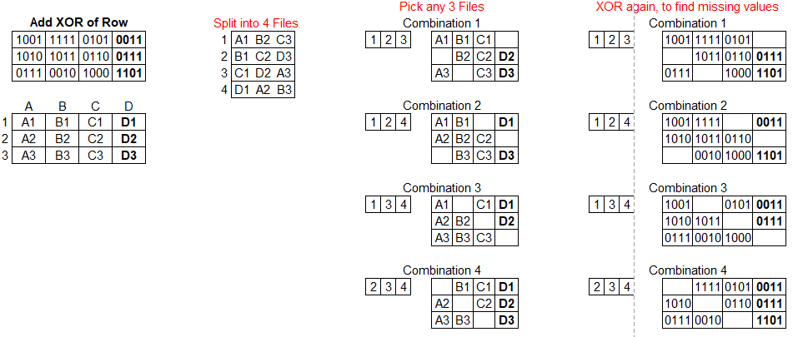
Reliable data storage: Forward Error Correction not Backups

Slide 12
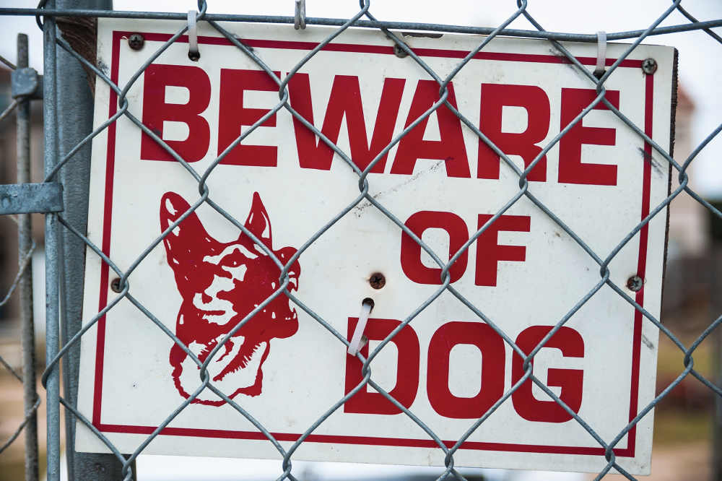
Lou mounted the sign below on the fence surrounding his organization's datacenter. What control type best describes this control?
Compensating
Detective
Physical
Deterrent
Notes:
D. This question is a little tricky. The use of an actual guard dog could be considered a deterrent, physical, or detective control. It could even be a compensating control in some circumstances. However, the question asks about the presence of a sign and does not state that an actual dog is used. The sign only has value as a deterrent control. Be careful when facing exam questions like this to read the details of the question.

Slide 13
Chris is responding to a security incident that compromised one of his organization's web servers. He believes that the attackers defaced one or more pages on the website. What cybersecurity objective did this attack violate?
Confidentiality
Nonrepudiation
Integrity
Availability
Tokenization
Notes:
C. The defacement of a website alters content without authorization and is, therefore, a violation of the integrity objective. The attackers may also have breached the confidentiality or availability of the website, but the scenario does not provide us with enough information to draw those conclusions.

Slide 14
Which one of the following data protection techniques is reversible when conducted properly?
Tokenization
Masking
Hashing
Shredding
Notes:
A. Tokenization techniques use a lookup table and are designed to be reversible. Masking and hashing techniques replace the data with values that can't be reversed back to the original data if performed properly. Shredding, when conducted properly, physically destroys data so that it may not be recovered.

Slide 15
What compliance regulation most directly affects the operations of a health-care provider?
HIPAA
PCI DSS
GLBA
SOX
Notes:
A. Although a health-care provider may be impacted by any of these regulations, the Health Insurance Portability and Accountability Act (HIPAA) provides direct regulations for the security and privacy of protected health information and would have the most direct impact on a health-care provider.

Slide 16
LAB
Pi Exam
https://pi.kengraf.com

