Slide 1
IT666 : Cybersecurity Practices
Chapter 2: Cybersecurity Threat Landscape

Slide 2
Threat Classification
Internal vs. External
Competitors, criminals, and the curious.
Some of the most dangerous threats come from within our own environments.
Level of Sophistication/Capability
Resources/Funding
Intent/Motivation
Unskilled into the thrill of the attack
Competitors engaged in highly targeted corporate espionage
Nation-states seek to achieve political objectives
Organized crime focused on direct financial gain.

Slide 3
Organized Crime Actors
Cyber-dependent crime
Ransomware, data compromise, distributed denial-of-service (DDoS) attacks, website defacement
Child sexual abuse material
Online fraud
Credit card fraud and business email compromises
Dark web activity
Sale of illegal goods and services

Slide 4
Business Email Compromise (BEC) in NH
New Hampshire businesses reported $6,995,441 in losses through business email compromise in 2023.
In 2021 the town of Peterborough, N.H., was targeted in a scam that cost $2.3 million
First point of entry for many scams is through email.
Scammers have become particularly good at making email look real.

Slide 5
Nation States
Advanced Persistent Threats (APT) and Zero-Days
They tend to be characterized as highly skilled
Significant resources
A nation has the labor force, time, and money to finance ongoing research and sophisticated attacks
Target intellectual property and/or infrastructure

Slide 6
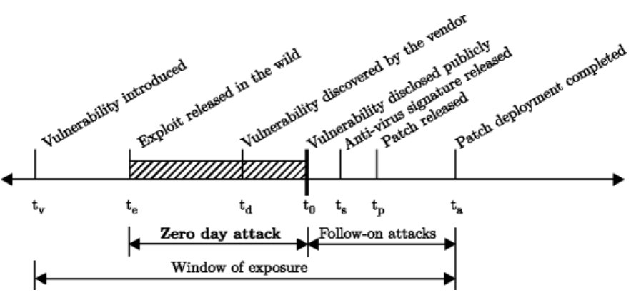
Zero Day Timeline

Slide 7
Market for Zero Days
Buyers
Governments
Product vendors (Google, Apple, Tesla prizes in Pwn2Own)
Organized crime for spyware
Resellers (Crowdfence, Zerodium, ZDI)
Sellers
Research firms
Individuals

Slide 8
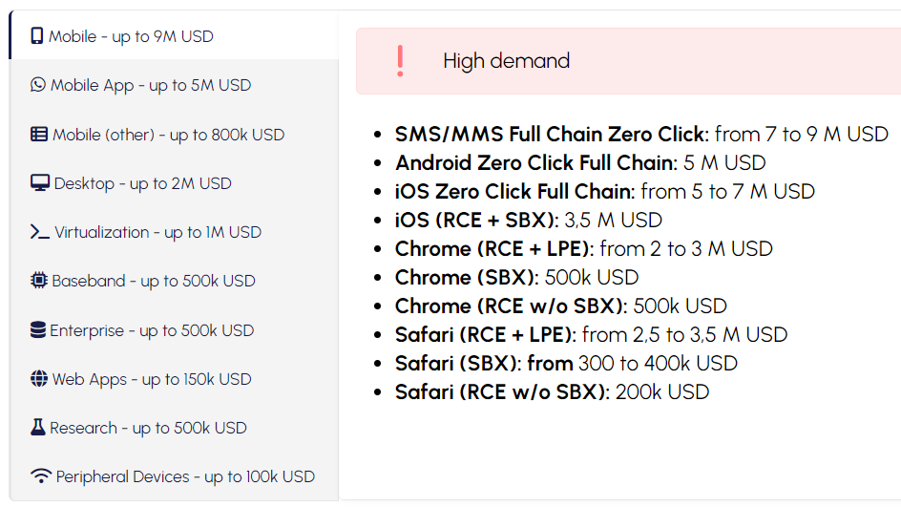
CrowdFence.com

Slide 9
Threat factors are hard to quantify
What could be the potential impact (magnitude)?
How likely is it to happen (probability)?
What level of confidence do we have in the answers (certainty)?

Slide 10
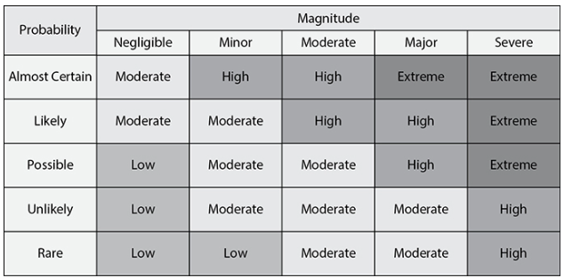

Slide 11
Of the threat vectors shown here, which one is most commonly exploited by attackers who are at a distant location?
Email
Direct access
Wireless
Removable media
Notes:
A. Email is the most common threat vector exploited by attackers who use phishing and other social engineering tactics to gain access to an organization. The other vectors listed here, direct access, wireless, and removable media, all require physical proximity to an organization and are not easily executed from a remote location.

Slide 12
What type of assessment is particularly useful for identifying insider threats?
Behavioral
Instinctual
Habitual
IoCs
Notes:
BOOK QUOTE: Behavioral assessments are a powerful tool in identifying insider attacks. Cybersecurity teams should work with human resources partners to identify insiders exhibiting unusual behavior and intervene before the situation escalates.
A. Behavioral assessments are very useful when you are attempting to identify insider threats. Since insider threats are often hard to distinguish from normal behavior, the context of the actions performed—such as after-hours logins, misuse of credentials, logins from abnormal locations, or abnormal patterns—and other behavioral indicators are often used.

Slide 13
Greg believes that an attacker may have installed malicious firmware in a network device before it was provided to his organization by the supplier. What type of threat vector best describes this attack?
Supply chain
Removable media
Cloud
Direct access
Notes:
A. Tampering with equipment before it reaches the intended user is an example of a supply chain threat. It is also possible to describe this attack as a direct access attack because it involved physical access to the device, but supply chain is a more relevant answer. You should be prepared to select the best possible choice from several possible correct answers when you take the exam. Security+ questions often use this type of misdirection.

Slide 14
Which one of the following information sources would not be considered an OSINT source?
DNS lookup
Search engine research
Port scans
WHOIS queries
Notes:
C. Port scans are an active reconnaissance technique that probe target systems and would not be considered open source intelligence (OSINT). Search engine research, DNS lookups, and WHOIS queries are all open source resources.

Slide 15
LAB
Hacksplaining
OWASP Top 10

