Slide 1
IT666 : Cybersecurity Practices
Chapter 4: Social Engineering And Password Attacks

Slide 2
Password Attacks: Brute-force
Iterate until a password is found
Password dictionaries (rockyou)
Base password modified a set of rules
Reality check on brute force in the wild
Failed online login time is measured in multiple seconds
Repeated failures can lock accounts and will show in logs
OpenID, PassKeys, MFA are reducing the use of passwords
Password resets can prohibit what brute force would find
To be successful, acquire the password hash(es)

Slide 3
Password spraying attacks
One password (or very small set)
Brute force across:
Machines
root : root all machines running SSH at UNH
Users
Wildcat25 : [a-z]{2,3}\d{1,4} against all UNH students
Websites (Credential Stuffing)
‘Disclosed password’ : ’compromised account’ on other websites

Slide 4
NIST Password recommendations
Use a password manager for increased password strength
Use MFA
Enable ‘Show Password’
Salt and hash passwords
Lock account after multiple attempts
DO NOT require frequent password changes
Emphasize password length over complexity requirements
Monitor new passwords automatically

Slide 5
UNH Policy
2.4.6 Users shall not use the "Remember Password" feature of web browsers to store USNH passwords.
WHY NOT ??? The feature allows for unique, strong, and encrypted passwords

Slide 6
Phishing

Slide 7
The FTC says red flags are emails that:
Say they’ve noticed some suspicious activity or log-in attempts
Claim there’s a problem with your account or your payment information
Say you need to confirm some personal or financial information
Include an invoice you don’t recognize
Want you to click on a link to make a payment
Say you’re eligible to register for a government refund
Offer a coupon for free stuff

Slide 8
Requirements of bulk email senders for GMAIL & YAHOO users
Authenticate all messages with DMARC (SPF or DKIM)
Send from a domain with a DMARC policy of at least p=none
Have valid forward and reverse DNS that match each other
Use the one-click unsubscribe header and a link in the footer
Maintain a low spam rate of < 0.1%
Encrypt your email (TLS)

Slide 9
Email Protections
Sender Policy Framework (SPF)
Authenticates the sender of an email
SPF record is a DNS TXT record containing a list of IP addresses
DomainKeys Identified Mail (DKIM)
Email is signed
DNS record containing public key
DKIM’s advantage is that it can survive forwarding

Slide 10
Email Protections
Domain-based Message Authentication Reporting and Conformance (DMARC)
Uses SPF and/or DKIM mechanisms
DNS TXT record containing a policy to instruct the receiver’s email server how to manage delivery
P=NONE
P=QUARANTINE
P=REJECT
DMARC domain checker

Slide 11
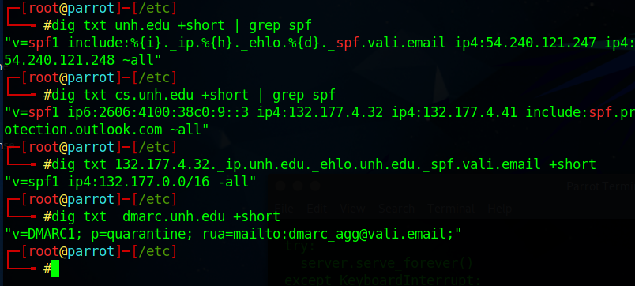
Spoofing email from the UNH.EDU domain

Slide 12
Joseph receives an email notifying him that he needs to change his password due to a recent account issue. He notices that the email links him to a website using the domain amaz0n.com. What type of attack should he describe this as?
Typosquatting
Phishing
Smishing
A watering hole attack
Notes:
B. This email is an attempt to get account information and is a phishing email. Joseph did not enter the URL himself, which is the behavior that a typosquatter relies on. A smishing attack relies on SMS, and a watering hole attack uses a frequently visited website.

Slide 13
Joanna wants to detect password spraying attacks. What type of rule should she deploy through her security systems?
Match attempts to log into many systems with the same username and password.
Match multiple attempts to log into the same user account using different passwords.
Match repeated use of the same password during failed login attempts for multiple usernames.
Match all attempts to use passwords with slight changes for the same account.
Notes:
C. Password spraying involves the use of the same password to attempt to log into multiple accounts. Joanna should search for uses of the same password for different accounts.

Slide 14
Jack's organization wants to prevent typosquatting. What option should he select to address this issue?
Copyright the domain name
Purchase the most common typos for his organization's domain
Trademark the domain name
Disable typo resolution for the domain
Notes:
B. While it's nearly impossible to prevent typosquatting, purchasing and registering the most common typos (typo-domains) related to your organization's domain and redirecting them to your real domain is the most effective option available. Copyrighting or trademarking the domain name does not prevent typosquatting, and typo resolution is not a feature or capability that is available.

Slide 15
Nation-state-driven social media campaigns about the trustworthiness of the U.S. election in 2016 are an example of what type of social engineering?
Smishing
Pretexting
Disinformation
Spraying
Notes:
C. Disinformation campaigns are used to shift public opinion or to accomplish other goals. They are not limited to nation-state actors but are an increasingly heavily used social engineering tactic at a broad scale. Smishing relies on SMS messages, pretexting involves using a reason that creates urgency or importance in a request from a social engineer, and spraying is a type of password brute forcing.

Slide 16
LAB
Phishing attack

