Slide 1
IT666 : Cybersecurity Practices
Chapter 5: Security Assessment And Testing

Slide 2
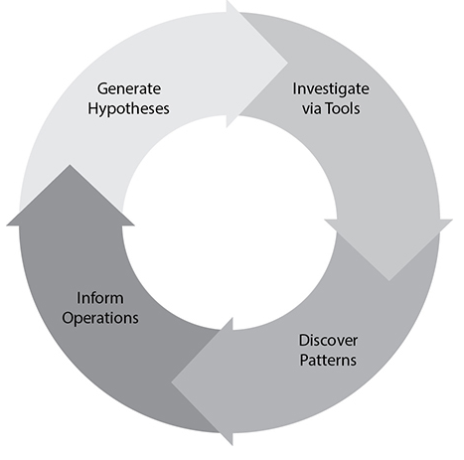
Threat Hunting
Proactive
Assume breach
Defined
Purpose/Outcomes
Conduct
Ownership/Responsibilities
Time boxed

Slide 3
Less Mature Organizations have Simpler Threats
Unpatched software
Unknown devices
Too many administrators

Slide 4
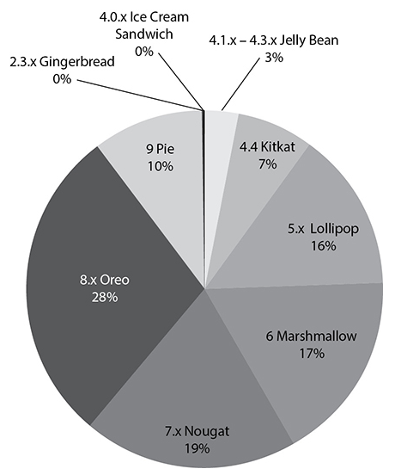
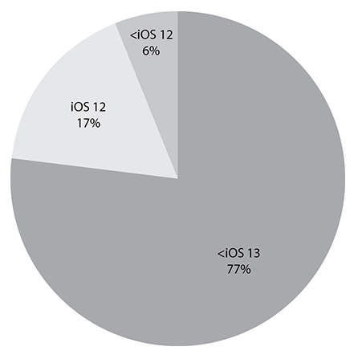
Attackers target unpatched and older systems

Slide 5
Bleeding Head Wounds
Remote
Unauthenticated
Allow privileged state
Access to sensitive data

Slide 6
Testing Methodologies
Dynamic (API) analysis a.k.a. Black box
Uses available inputs and expected outputs
Not concerned with (can not see) inner workings
Positive: Easier to use, Quicker test cases, Simplicity, No programming
Negative: You never ever see what is behind the curtain
Static (code) analysis a.k.a. White-box
Tester able to see “inside” an application
Able to interact with and manipulate runtime objects
Positive: Introspection, Code coverage, Instrumentation
Negative: 3rd party library behavior is unknown

Slide 7
Is this code safe?
public void operation(String str) {
int i = Integer.parseInt(str);
try {
String sql =
"DELETE FROM table WHERE id='" +str++ "'";
statement.executeUpdate( sql );
}
catch (SQLException se) {}
}

Slide 8
Hacking as a career
Bug Hunter Toolkit
HackerOne
https://hackerone.com/bug-bounty-programs
Uber: https://hackerone.com/uber?type=team

Slide 9
Bug Bounty Platforms
Platform name | Website
Tipping Point | http://zerodayinitiative.com/
HackerOne | https://www.hackerone.com/
Bugcrowd | https://www.bugcrowd.com/
Synack | https://www.synack.com/
Cobalt.io | https://cobalt.io/
Bounty Factory | https://bountyfactory.io/en/index.html
intigriti | https://www.intigriti.com/public/
Zerocopter | https://www.zerocopter.com/

Slide 10
Tester Engagement
Internal or External
Personnel
Network location
Blind or Informed
Source code
Credentials
Scope (Limitations on what, how, and when)

Slide 11
Types of audits and assessments
Internal
Compliance, Audit committee, Self-assessments
External
Regulatory, Independent third-party audit
Penetration testing
Physical, Social Engineering
Offensive | Defensive
(White | Grey | Black) knowledge of environment
(Passive | Active) Reconnaissance

Slide 12
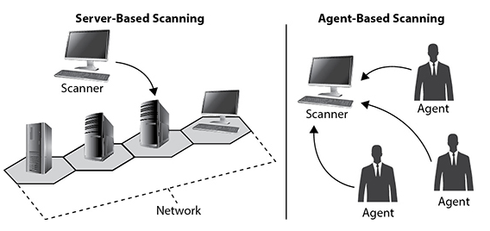
Scanner Knowledge
Remote (server-based) vs. Local (agent-based)

Slide 13
Key Terms
Tactics, Techniques, and Procedures (TTPs)
Common Weakness Enumeration (CWE)
Common Vulnerabilities and Exposures (CVE)
Common Vulnerability Scoring System (CVSS)
National Vulnerability Database (NVD)

Slide 14
Links
Att&ck: https://attack.mitre.org/
CWE: https://cwe.mitre.org/
CVE: https://cve.mitre.org/
CVSS: https://www.first.org/cvss/calculator/3.1
NVD: https://nvd.nist.gov/ (Heartbleed example)

Slide 15
DEMO
CVSS score Heartbleed

Slide 16
Which one of the following security assessment techniques assumes that an organization has already been compromised and searches for evidence of that compromise?
Vulnerability scanning
Penetration testing
Threat hunting
War driving
Notes:
C. Threat hunting is an assessment technique that makes an assumption of compromise and then searches the organization for indicators of compromise that confirm the assumption. Vulnerability scanning, penetration testing, and war driving are all assessment techniques that probe for vulnerabilities but do not assume that a compromise has already taken place.

Slide 17
Ryan is planning to conduct a vulnerability scan of a business-critical system using dangerous plug-ins. What would be the best approach for the initial scan?
Run the scan against production systems to achieve the most realistic results possible.
Run the scan during business hours.
Run the scan in a test environment.
Do not run the scan to avoid disrupting the business.
Notes:
C. Ryan should first run his scan against a test environment to identify likely vulnerabilities and assess whether the scan itself might disrupt business activities.

Slide 18
Brian ran a penetration test against a school's grading system and discovered a flaw that would allow students to alter their grades by exploiting a SQL injection vulnerability. What type of control should he recommend to the school's cybersecurity team to prevent students from engaging in this type of activity?
Confidentiality
Integrity
Alteration
Availability
Notes:
B. By allowing students to change their own grades, this vulnerability provides a pathway to unauthorized alteration of information. Brian should recommend that the school deploy integrity controls that prevent unauthorized modifications.

Slide 19
Which one of the following tools is most likely to detect an XSS vulnerability?
Static application test
Web application vulnerability scanner
Intrusion detection system
Network vulnerability scanner
Notes:
B. Intrusion detection systems do not detect vulnerabilities; they detect attacks. The remaining three tools could all possibly discover a cross-site scripting (XSS) vulnerability, but a web application vulnerability scanner is the most likely to detect it because it is specifically designed to test web applications.

Slide 20
LAB
HTB Two Million: foothold

