Slide 1
IT666 : Cybersecurity Practices
Chapter 6: Application Security

Slide 2
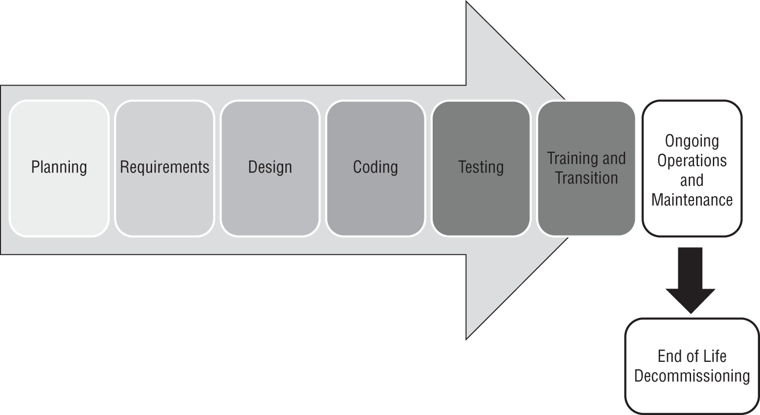
SDLC from the book

Slide 3
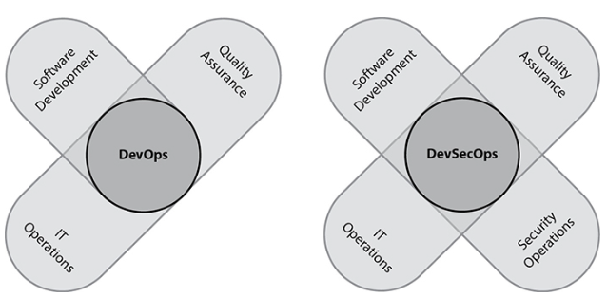
Bringing different viewpoints together

Slide 4
Is a Developer, IT, QA, or Security role responsible?
Can you identify the user or service you are doing work for? Do you know the message received was the one sent? Can someone send an old or duplicate message? Is user data executed (SQL|XML|javascript|PHP|shell)? Can a valid user or service deny they did something? Is there out-of-band access to app resources? How is access to credentials (passwords/keys) protected? Can an external agent interrupt a data flow? Can someone prevent access to a data store? Do you take explicit steps to control resource consumption? Does user data influence the flow of program execution? Can a user set admin rights?

Slide 5
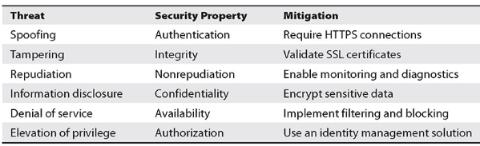
STRIDE (Microsoft)

Slide 6
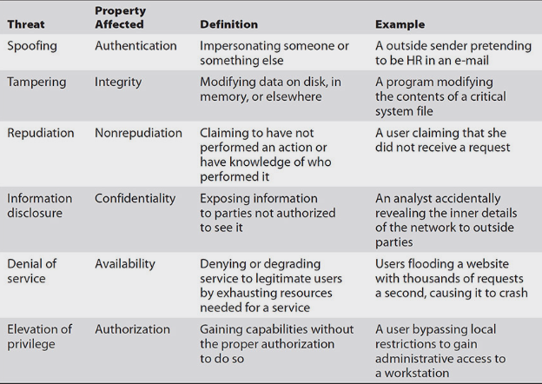
STRIDE

Slide 7
Handle all errors : HAZOP
Guide Word | Meaning
NO OR NOT | Complete negation of the design intent
MORE | Quantitative increase
LESS | Quantitative decrease
AS WELL AS | Qualitative modification/increase
PART OF | Qualitative modification/decrease
REVERSE | Logical opposite of the design intent
OTHER THAN | Complete substitution
EARLY | Relative to the clock time
LATE | Relative to the clock time
BEFORE | Relating to order or sequence
AFTER | Relating to order or sequence
Notes:
Used to model what happens to requirements when the guide word is applied. For example.
Requirement: User can request resource <xyz>.
User can NOT request resource <xyz>.
User can request resource <xyz> MORE than 2 times.
User can request resources OTHER THAN <xyz>.
User can request resource <xyz> BEFORE establishing an SSL connection.
User can request resource <xyz> AFTER loging out.
User can request resource <xyz> AS WELL AS <abc>.

Slide 8
Attack Types
OWASP
https://owasp.org/www-project-top-ten/
OWASP Security Cheat Sheets
Hacksplaining
https://www.hacksplaining.com/

Slide 9
OWASP Controls
C1: Define Security Requirements
C2: Leverage Security Frameworks and Libraries
C3: Secure Database Access
C4: Encode and Escape Data
C5: Validate All Inputs
C6: Implement Digital Identity
C7: Enforce Access Controls
C8: Protect Data Everywhere
C9: Implement Security Logging and Monitoring
C10: Handle All Errors and Exceptions

Slide 10
Every time Susan checks code into her organization's code repository, it is tested and validated, and then if accepted, it is immediately put into production. What is the term for this?
Continuous integration
Continuous delivery
A security nightmare
Agile development
Notes:
B. Although this example includes continuous integration, the key thing to notice is that the code is then deployed into production. This means that Susan is operating in a continuous deployment environment, where code is both continually integrated and deployed. Agile is a development methodology and often uses CI/CD, but we cannot determine if Susan is using Agile.

Slide 11
Tim is working on a change to a web application used by his organization to fix a known bug. What environment should he be working in?
Test
Development
Staging
Production
Notes:
B. Developers working on active changes to code should always work in the development environment. The test environment is where the software or systems can be tested without impacting the production environment. The staging environment is a transition environment for code that has successfully cleared testing and is waiting to be deployed into production. The production environment is the live system. Software, patches, and other changes that have been tested and approved move to production.

Slide 12
Ricky is concerned that developers in his organization make use of third-party code in their applications, which may introduce unknown vulnerabilities. He is concerned about the risk of the organization running code that it is not aware it is using. Which one of the following activities would best address this risk?
Web application firewalls
Package monitoring
Static analysis
Dynamic analysis
Notes:
B. All of the activities listed here may reduce the risk of the vulnerabilities created by the code. However, Ricky is specifically concerned about the fact that the organization may not be aware of all of the code that it is running. Package monitoring would inventory and monitor these third-party libraries, so that is the best answer here.

Slide 13
Wendy is a penetration tester who wishes to engage in a session hijacking attack. What information is crucial for Wendy to obtain if her attack will be successful?
Session ticket
Session cookie
Username
User password
Notes:
B. Websites use HTTP cookies to maintain sessions over time. If Wendy is able to obtain a copy of the user's session cookie, she can use that cookie to impersonate the user's browser and hijack the authenticated session.

Slide 14
LAB
HTB Two Million: escalation

