Slide 1
IT666 : Cybersecurity Practices
Chapter 7: Cryptography and the PKI

Slide 2
Encryption
Symmetric (DES, AES)
Asymmetric (RSA, ECC)
Hash (MD5, SHA)

Slide 3
Cryptographic Types
Symmetric
Based on transposition and/or substitution
C = encrypt (M, k) and M = decrypt( C, k )
Asymmetric
Based on discrete mathematics or primes
C = encrypt (M, k1) and M = decrypt( C, k2)
Secure Hash
One-way reduction functions based XOR
C = hash (M) there is no M = unhash(C)

Slide 4
Symmetric Algorithms
Substitution
Typically an “S-BOX” message bytes used as index to table of new value
New values in given order
Transposition
Rotations and shifts of bytes
New order with given values
Diffusion operations
Vector multiplication, XOR
AES Animation
http://www.formaestudio.com/rijndaelinspector/archivos/Rijndael_Animation_v4_eng.swf
Notes:
Most algorithms designed to very efficient in hardware
Need to balance speed and strength

Slide 5
Symmetric Encryption
Alice
Bob
Message
E
Cipher text
D
Message
K
K
Alice shares a key K with Bob.
K is used to both encrypt and decrypt

Slide 6
Asymmetric Algorithms
Based of the presumed hardness of a mathematical problem, for example:
Factoring the product of two large primes (RSA)
Computing discrete logarithms (ECC)
Keys are generated together (paired)
One key is kept secret (Private key)
One key is “given” to everyone (Public Key)
Certificates associate a specific user with a specific public key.
Notes:
Most algorithms designed to very efficient in hardware
Need to balance speed and strength

Slide 7
Asymmetric Encryption
Alice
Bob
Message
E
Cipher text
D
Message
Bob_{public}
Bob_{private}
Alice encrypts with Bob’s public key.
Bob uses his private key to decrypt.
The keys are mathematically related.

Slide 8
Digital Signatures
Alice
Bob
Message
E
Cipher text
D
Message
Alice_{private}
Alice_{public}
Alice encrypts with her private key.
Bob uses Alice’s public key to decrypt.
The keys are mathematically related.

Slide 9
RSA
Key Generation Algorithm
Generate two large random primes, p and q, of approximately equal size such that their product n = pq is of the required bit length, e.g. 1024 bits.
Compute (φ) phi = (p-1)(q-1).
Choose an integer e, 1 < e < phi, such that gcd(e, phi) = 1
Compute the secret exponent d, 1 < d < phi, such that ed ≡ 1 (mod phi)
The convention is the public key is (n, e) and the private key is (n, d) because “e” is normally assigned rather computed.
Keep all the values d, p, q and phi secret (discard).
n is known as the modulus it determines the number of bits (size).
e is known as the public exponent or encryption exponent or just the exponent. (Convention: e=65537 or 2^16 + 1)
d is known as the secret exponent or decryption exponent.
Encrypt, c = m^{e} mod n
Decrypt, m = c^{d} mod n
Notes:
Example
Select 2 primes (p,q) p=211 q=233
Compute n = p*q = 49163
Compute phi = (p-1)(q-1) = (211-1)(233-1) = 48720
Select e such that gcd(e,phi) = 1. e=17
Compute d such that (e * d ) mod phi = 1; d=25793

Slide 10
Crack a simple RSA private key
Public key:
N =33 (computed) E =3 (assigned)
Private key:
N =33 D =?
Such that
X = Y^{D} mod 33
Y = X³ mod 33
Notes:
Sample encrypt/decrypt:
14⁷ mod 33 = 20
20³ mod 33 = 14
Choose p = 3 and q = 11
Compute n = p * q = 3 * 11 = 33
Compute φ(n) = (p - 1) * (q - 1) = 2 * 10 = 20
Choose e such that 1 < e < φ(n) and e and n are coprime. Let e = 3
Compute a value for d such that (d * e) % φ(n) = 1. One solution is d = 7 [(7 * 3) % 20 = 1]
Public key is (e, n) => (3, 33)
Private key is (d, n) => (7, 33)

Slide 11
Hashing
C = hash( M )
There is no “unhash”
Birthday attacks – MD5 “broken” in Dec ’08
Hash algorithms are the weak link (SHA1 ~70 bits)
Strength need is different for signature vs. nonce
SHA-3 selection
KECCAK http://keccak.noekeon.org/
BLAKE http://www.131002.net/blake/
Grostl http://www.groestl.info/
JH http://www3.ntu.edu.sg/home/wuhj/research/jh/
Skien http://www.skein-hash.info/
Notes:
NIST has selected five SHA-3 finalists - BLAKE, Grøstl, JH, Keccak, andSkein to advance to the third (and final) round of the SHA-3competition. The email announcement was sent to the hash-forum listserv on December 9, 2010.[PDF]
NIST hosted a one-year public comment period in 2012
The SHA-3 standard (KECCAK) was released by NIST on August 5, 2015.
SHA-3, the state consists of a 5 × 5 array of 64-bit words, 1600 bits total.

Slide 12
XOR
11 11 00 00 <- original text
00 11 11 00 <- key<- “key”
11 00 11 00 <- cipher text <- result
If the “key” is unknown you can not reverse the XOR operation

Slide 13
HTTP Digest Authentication Response
GET /dir/index.html HTTP/1.0
Host: localhost
Authorization: Digest
username="Mufasa", realm="testrealm@host.com",
uri="/dir/index.html",
nonce="dcd98b7102dd2f0e8b11d0f600bfb0c093", qop=auth,
nc=00000001,
cnonce="0a4f113b", response="6629fae49393a05397450978507c4ef1"
Client request (user="Mufasa", pwd="Circle Of Life")
Notes:
HA1 = MD5 ( username, realm, password )
HA2 = MD5 ( method, uri )
Response = MD5 ( HA1, nonce, nc, cnonce, qop, HA2 )
value is calculated in three steps, as follows. Where values are combined, they are delimited by colon symbols.
HA1 = MD5( "Mufasa:testrealm@host.com:Circle Of Life" ) =
939e7578ed9e3c518a452acee763bce9
HA2 = MD5( "GET:/dir/index.html" ) =
39aff3a2bab6126f332b942af96d3366
Response = MD5( "939e7578ed9e3c518a452acee763bce9:\
dcd98b7102dd2f0e8b11d0f600bfb0c093:\
00000001:0a4f113b:auth:\
39aff3a2bab6126f332b942af96d3366" ) =
6629fae49393a05397450978507c4ef1
The MD5 hash of the combined username, authentication realm and password is calculated. The result is referred to as HA1.
The MD5 hash of the combined method and digest URI is calculated, e.g. of "GET" and "/dir/index.html". The result is referred to as HA2.
The MD5 hash of the combined HA1 result, server nonce (nonce), request counter (nc), client nonce (cnonce), quality of protection code (qop) and HA2 result is calculated. The result is the "response" value provided by the client.

Slide 14
Algorithm Comparison
Type | Common | Keys | Input | CPU | Output
Symmetric | AES 3DES | 1 | Block Stream | Fast | Input + padding
Asymmetric | RSA ECC | 1 pair | Small <keysize | Slow | keysize
Hash | SHA MD5 | 0 | Any | One Way | MD5 = 128 bits SHA1 = 160 SHA2 = 256/512 SHA3 = 1600

Slide 15
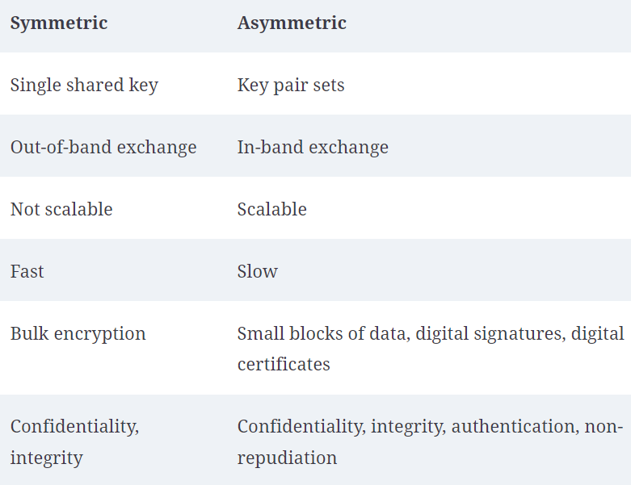

Slide 16
Message Protection: Alice Sends...
Session Key (symmetric)
Bob’s
Public Key
From Somewhere
Data
Encryption
Encrypted
Session Key
Key
J(fS_=2j!jsd@nm%Deh
Cleartext
Ciphertext
H4*m£h0D(h$hjoNm3_hf9)H’Jley6LLv+gf^~`9Cl3d
Encryption
To Bob
Notes:
In this next example we are going to use Alice & Bob who are trying to communicate with one another over an insecure channel.
They want to achieve message protection:
“sealed” so that only they can read it
“hashed” so that Bob knows it wasn’t modified enroute.
Alice therefore uses a session key and encrypts using Bob’s public key.

Slide 17
Message Protection: Bob Receives
Bob’s
Private Key
Encrypted
Session Key
Decryption
Session Key
J(fS_=2j!jsd@nm%Deh
H4*m£h0D(h$hjoNm3_hf9)H’Jley6LLv+gf^~`9Cl3d
Ciphertext
Decryption
Cleartext
From Alice
Notes:
When Bob receives Alice’s message he applies his private key to decrypt the message.

Slide 18
Digital Signatures: Alice Signs
Alice’s Private Key
Message Digest
Hash
M(&g$Xs?7
Sign
Signature
Cleartext
The quick brown fox jumped over the...
&G0:8j4C+p
To Bob
Encrypt if required
Notes:
Now lets modify the process to introduce digital signature. Alice will create a message AND a hashing function. She will sign both the message and the hash with her private key.
If one can decrypt something with Alice’s public key, then in means only Alice’s private key could have encrypted it.
Assuming Alice has done a good job of protecting her private key (such that no one else could have used it, the message must be from Alice.

Slide 19
Digital Signatures: Bob Verifies
Message Digest
Alice’s
Public Key
Decrypt
M(&g#$Xs?7
From Alice
Compare
The quick brown fox jumped over the
&G0:8j4C+p
Signature
Hash
M(&g$Xs?7
Message Digest
Notes:
If one can decrypt something with Alice’s public key, then in means only Alice’s private key could have encrypted it.
Assuming Alice has done a good job of protecting her private key (such that no one else could have used it, the message must be from Alice.

Slide 20
Keeping secrets, secret
Trusted Processing Modules (TPM)
System security
Typical use is to secure the boot process
Hardware Security Modules (HSM)
Provide a common key to many systems
Example: TLS private key for a webserver farm
Key Management Service (KMS)
API to manage secrets

Slide 21
IT666 : Cybersecurity Principles
Practical applications of Crypto
PKI
Bitcoin
Distributed Identity

Slide 22
PKI Certificates
Browser certificate lists
Adding ZAP and/or Burp as secure proxies

Slide 23
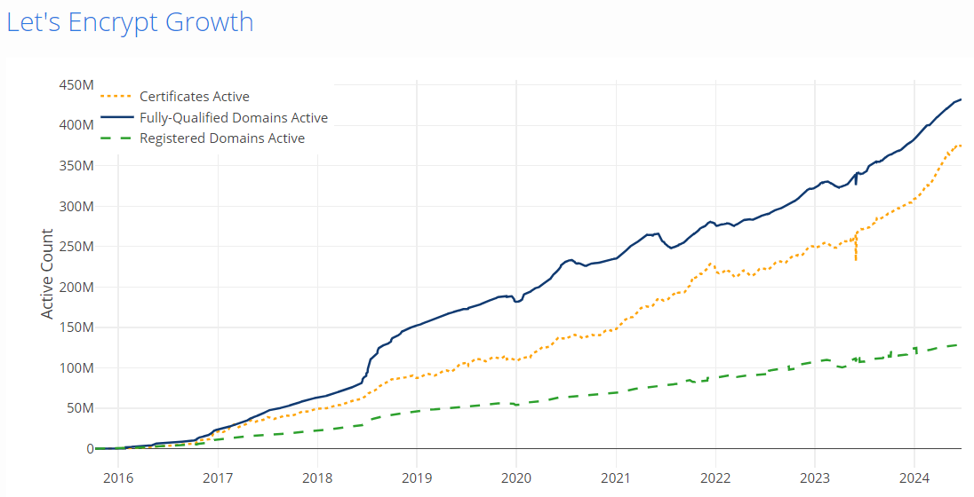

Slide 24
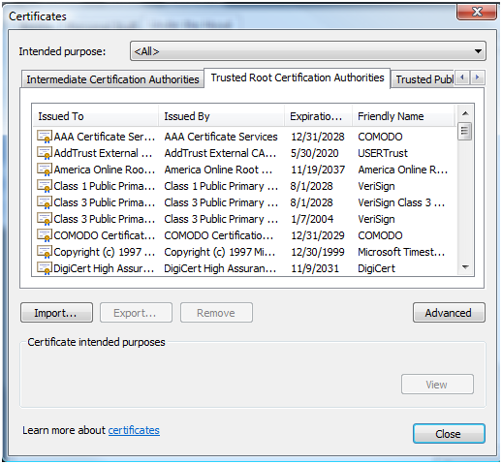
Trust: System’s configuration and the browser’s cache

Slide 25
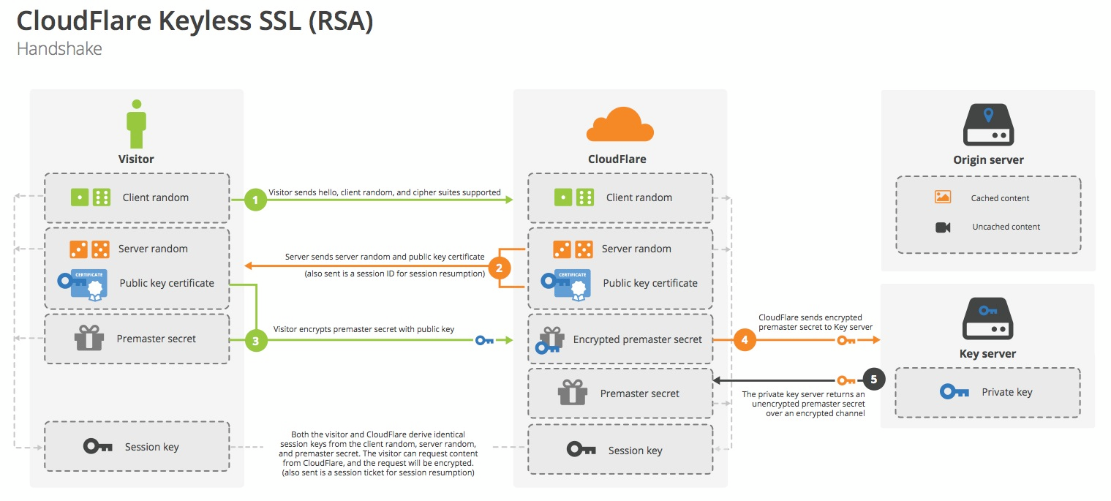
Content Delivery using TLS without the server’s private key

Slide 26
Basic Blockchain
Block_{n}
Block_{n+1}
Block_{n+2}
Data_{n}
Data_{n+1}
Data_{n+2}
Hash₀
Hash_{n}
Hash_{n+1}
Hash( Data_{n}+Hash₀)
Hash( Data_{n+1}+Hash_{n})
Hash( Data_{n+2}+Hash_{n+1})

Slide 27
PKI: Certificate “Block”chain
Cert_{root}
Cert_{subCA}
Cert_{n+2}
Data_{root}
Data_{subCA}
Data_{server}
Key_{root}
Key_{subCA}
Key_{server}
Sign(Key_{root},Blob_{root})
Sign(Key_{root},Blob_{root})
Sign(Key_{subCA},Blob_{server})

Slide 28
Bitcoin extends Blockchain
Merkle trees for transactions
Distributed Ledger
Proof of work

Slide 29
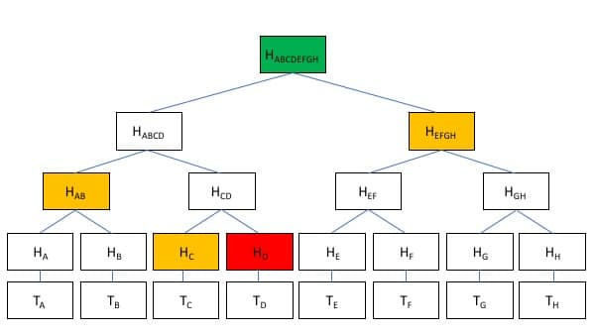
Merkle Tree (Bitcoin averages 2K transactions / block)

Slide 30
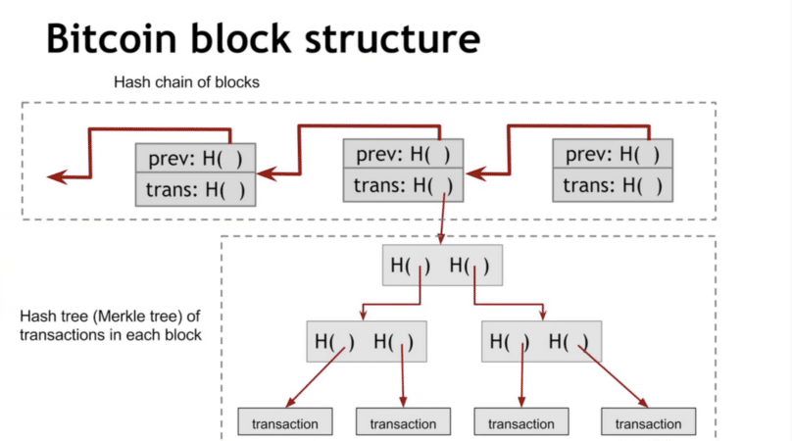

Slide 31
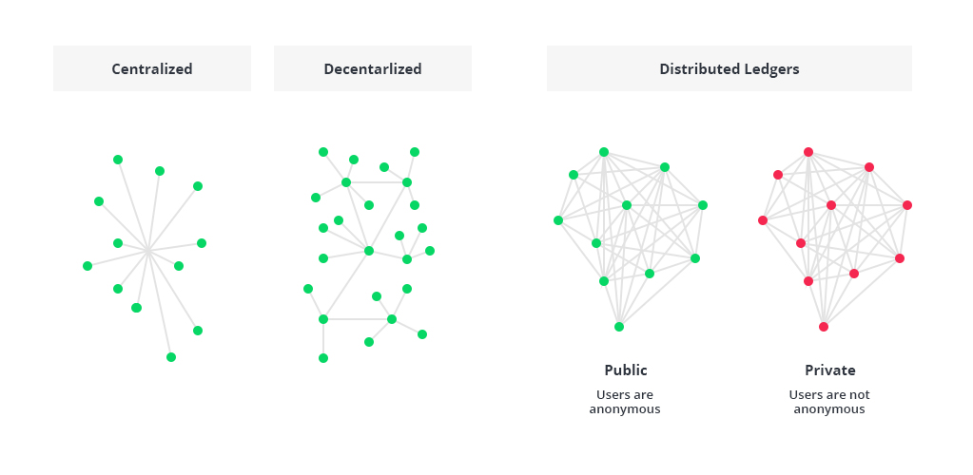
Ledger types

Slide 32
Bitcoin proof of work
Block_{n}
Magic# (0xD9B4BEF9)
Version
Data_{n}
Blocksize
hashPrevBlock
Block Header
hashMerkleRoot
Transaction#
Timestamp
Transactions
Bits of Difficulty
Nonce
Hash( Data_{n} )
00000000000000001e8d6829a8a21adc5d38d0a473b144b676578e61f98bd1d

Slide 33
Distributed Identity
3 Actors
Owner (the user)
Issuer (trusted party)
Verifier (consumer of identity)
Identity references, not the actual identity information, on the blockchain

Slide 34
Key Terms
Trusted Platform Module (TPM)
Hardware Security Module (HSM)
Unified Extensible Firmware Interface (UEFI)
Full-disk encryption (FDE)
Self-encrypting drive (SED)
trusted execution environment (TEE)

Slide 35
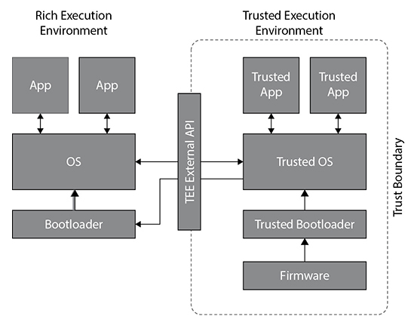

Slide 36
If David wishes to digitally sign the message that he is sending Mike, what key would he use to create the digital signature?
David's public key
David's private key
Mike's public key
Mike's private key
Notes:
B. The sender of a message may digitally sign the message by encrypting a message digest with the sender's own private key.

Slide 37
Glenn recently obtained a wildcard certificate for *.mydomain.com. Which one of the following domains would not be covered by this certificate?
mydomain.com
core.mydomain.com
dev.www.mydomain.com
mail.mydomain.com
Notes:
C. Wildcard certificates protect the listed domain as well as all first-level subdomains. dev.www.mydomain.com is a second-level subdomain of mydomain.com and would not be covered by this certificate.

Slide 38
Which one of the following statements about cryptographic keys is incorrect?
All cryptographic keys should be kept secret.
Longer keys are better than shorter keys when the same algorithm is used.
Asymmetric algorithms generally use longer keys than symmetric algorithms.
Digital certificates are designed to share public keys.
Notes:
A. All of these statements are correct except for the statement that all cryptographic keys should be kept secret. The exception to this rule are public keys used in asymmetric cryptography. These keys should be freely shared.

Slide 39
Shahla recently discovered an attack where the attacker managed to force a network user to use weak encryption and was then able to decrypt that content. What term best describes this attack?
Downgrade
Collision
Homomorphic encryption
Birthday attack
Notes:
A. Downgrade attacks try to remove or lower the strength of encryption to allow the decryption of sensitive information. Birthday attacks find collisions where two different inputs produce the same hash value output, but there is no discussion of that in this scenario. Homomorphic encryption is not an attack but a technology that protects privacy by encrypting data in a way that preserves the ability to perform computation on that data.

Slide 40
LABS
Blockchain &
Authentication (SSH)

