Slide 1
IT666 : Cybersecurity Practices
Chapter 8: Identity And Access Management

Slide 2
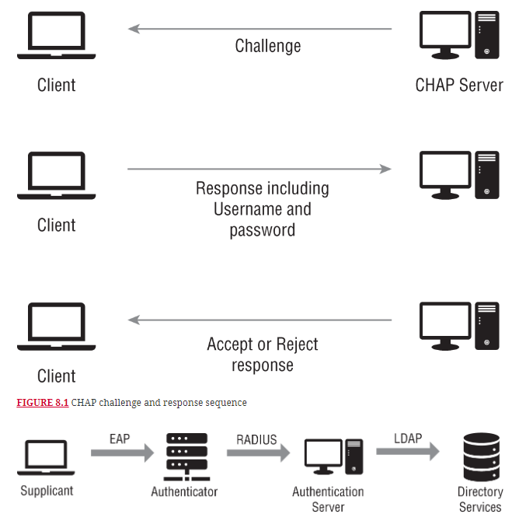

Slide 3
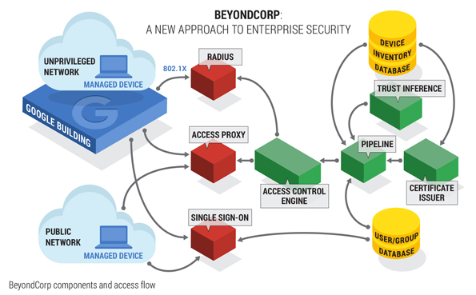
BeyondCorp (Google) https://www.beyondcorp.com/
Notes:
Guiding Principles:
Perimeter less Design
Connecting from a particular network must not determine which services you can access.
Context-Aware
Access to services is granted based on what we know about you and your device.
Dynamic Access Controls
All access to services must be authenticated, authorized and encrypted.

Slide 4
What’s wrong with passwords? (Management)
Many are guessable or published defaults
Too many complex passwords
forcing people to cope
Shared secret (server-user and groups)
Don’t know when they been stolen
Broken recovery process when forgotten
Need secure transmit and storage
KBAs are guessable

Slide 5
Identity Questions to ask UNH IT?
Has anyone tried to login to my UNH account today?
How many places is my UNH password stored?
Who accessed my data last month?
Does UNH IT follow what Google, Apple, Microsoft, or Facebook are doing?

Slide 6
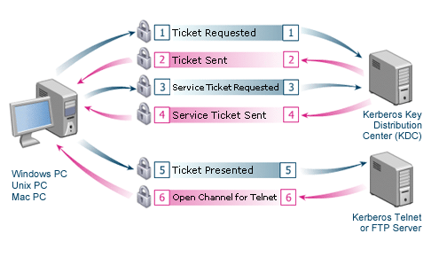
Kerberos

Slide 7
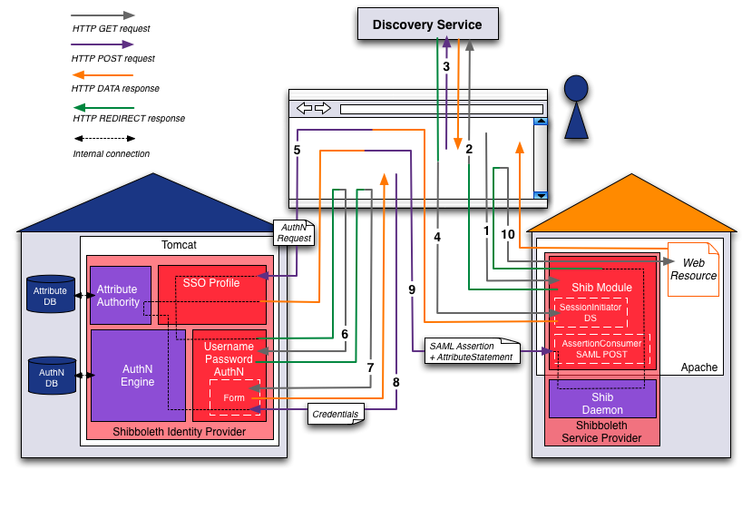
SAML (Shibboleth) request flow
Notes:
Step 1 (User ⇔ Browser ⇔ Service Provider):The user opens a web browser and accesses the Service Provider
Step 2: (Browser ⇔ Discovery Service) SP redirects the web browser to send a new request to the Discovery Service
Step 3: (User ⇔ Browser ⇔ Discovery Service) the user makes Identity Provider selection
Step 4 (Browser ⇔ Service Provider): Directory service redirects back to SP, to initiate session
Step 5 (Browser ⇔ Identity Provider):The browser posts AuthN request
Step 6 (Browser ⇔ Identity Provider):The web browser is redirected to the username/password login handler
Step 7 (Browser ⇔ Identity Provider):The browser redirected to login page
Step 8 (User ⇔ Browser ⇔ Identity Provider):The user types his username and password credentials and submits them to the IP
Step 9 (Browser ⇔ Service Provider):Assertion redirect to SP
Step 10 (Browser ⇔ Service Provider): Repeat step 1, request to SP this time resource is returned

Slide 8
SAML Limitations
XML can be greater than 10K bytes
Too large for URL or HTTP headers in most browsers
Runtimes required for parsing and canonicalization (not mobile friendly)
Certificate chain validation often requires a service call

Slide 9
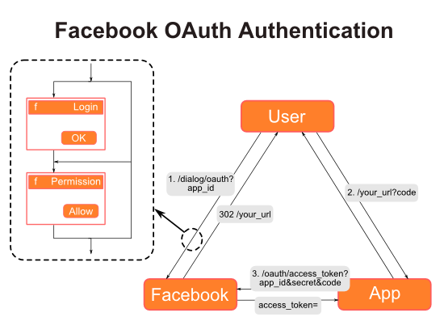
OpenID : Your identity is the resource being requested
OpenID is based on OAuth 2 - http://oauthbible.com/

Slide 10


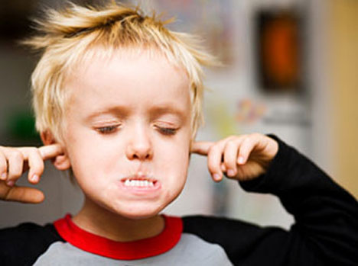
Developers : “But I hate OAuth !”
More complex message flows compared to passwords
Must manage additional registration, grant and revocation processes
Confusion due to multiple token & credential patterns
Crypto and metadata registration required
Need to expose a unique URL for every resource

Slide 11
So why suffer the pain?
Empower the customer
Let the customer, partner or employee determine the type access allowed to their data
Embrace the notion of devices “clients” initiating actions for customers “resource owners”
Alerts and notifications may happen when a customer is not present or willing to authenticate
Access tokens
Cryptographically stronger than passwords
Stateless; no session management or artifact resolution
No PKI (beyond TLS)
No prescribed authentication process
No centralized authorities, services or gateways required
Numerous lightweight implementations to choose from
Java, .Net, Python, Ruby, PHP
Designed for browser, mobile, cloud and micro-service deployments

Slide 12
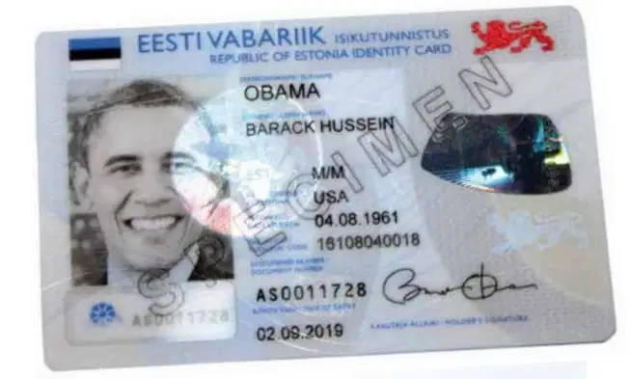
Examples 0f National Identities (Federated or Single provider?)
Estonia: e-identity, 98%, public issued
Finland: TUPAS, 87%, bank based
Denmark: NemID, 85%, public issued
Sweden: BankID, 74%, bank based
UK: gov.uk, 3%, public issued, scrapped
EU: European identity card, biometric, August ‘21
US: SSN, Real ID (state issued)
Worldwide ids

Slide 13
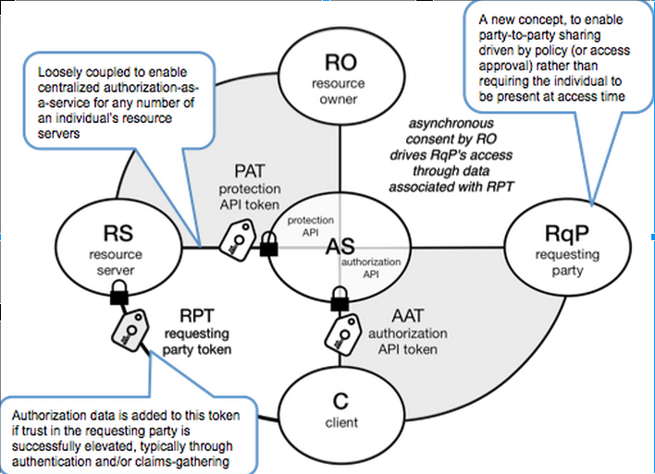
User Managed Access (UMA)
https://en.wikipedia.org/wiki/User-Managed_Access

Slide 14
Trust models - Summary
Implementation | Authentication | Authorization | Deployment
Kerberos/RADIUS | Integrated |  | Workgroups/Domains
SAML/Shibboleth | External | Internal | Federations
OAuth/OpenID | External | Delegated (Human) | Web apps/API
UMA | Delegated | Delegated (API) | API

Slide 15
Access Control
Mandatory access control (MAC)
Enforce control as set by a security policy administrator
Users do not have the ability to grant access or change policy
Discretionary access control (DAC)
Assigns owners for objects like files and directories
Allows the owner to delegate rights and permissions to those objects
Role-based access control (RBAC)
Roles are matched with privileges
Permissions are granted only to roles not users

Slide 16
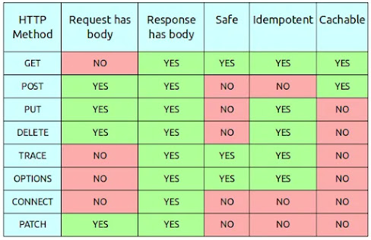
CRUDE (Map to REST HTML verbs for single resources)
Create (PUT)
Read (GET)
Update (PATCH)
Delete (DELETE)
Execute (POST)

Slide 17
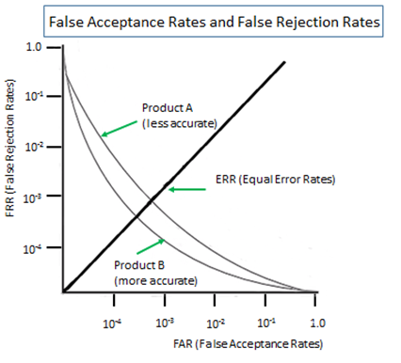
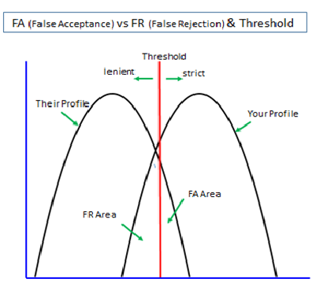
Biometrics
https://duo.com/labs/research/the-good-and-bad-of-biometrics

Slide 18
Marie is implementing a PAM solution and wants to ensure that root passwords are available in the event of an outage. Which PAM-related tool is most likely to be useful in this situation?
Ephemeral accounts
Just-in-time permissions
Password vaulting
Token-based authentication
Notes:
C. Password vaulting, which stores passwords for use with proper authentication and rights, is the most appropriate solution for Marie's needs. Ephemeral accounts and just-in-time permissions are typically used under normal circumstances to provide least privilege access as needed. Token-based authentication is not specifically a PAM solution.

Slide 19
Which of the following biometric technologies is most broadly deployed due to its ease of use and acceptance from end users?
Voice print recognition
Gait recognition
Retina scanners
Fingerprint scanner
Notes:
D. Fingerprint scanners are found on many mobile devices and laptops, making them one of the most broadly deployed biometric technologies. Facial recognition is also broadly deployed, but it is not mentioned in this question or offered as an option.

Slide 20
Which type of multifactor authentication is considered the least secure?
HOTP
SMS
TOTP
Biometric
Notes:
B. SMS messages are not secure and could be accessed by cloning a SIM card or redirecting VoIP traffic, among other possible threat models. Both HOTP and TOTP tokens and applications as well as biometric factors are generally considered more secure than an SMS-based factor.

Slide 21
Which of the following technologies is the least effective means of preventing shared accounts?
Password complexity requirements
Requiring biometric authentication
Requiring one-time passwords via a token
Requiring a one-time password via an application
Notes:
A. Password complexity requirements do not prevent sharing of complex passwords, making it the least effective option from the list. Biometric authentication measures will require the enrolled user to be there, although in some cases such as fingerprint systems, multiple users could each enroll a valid fingerprint for a single account. Both types of one-time passwords could be shared but make it harder and less convenient to share accounts.

Slide 22
LAB
Authentication (Events & OpenID)

