Slide 1
IT666 : Cybersecurity Practices
Chapter 10: Cloud And Virtualization Security

Slide 2
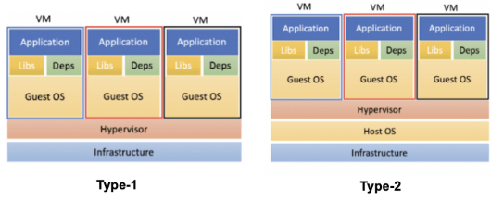
Hypervisor Types

Slide 3
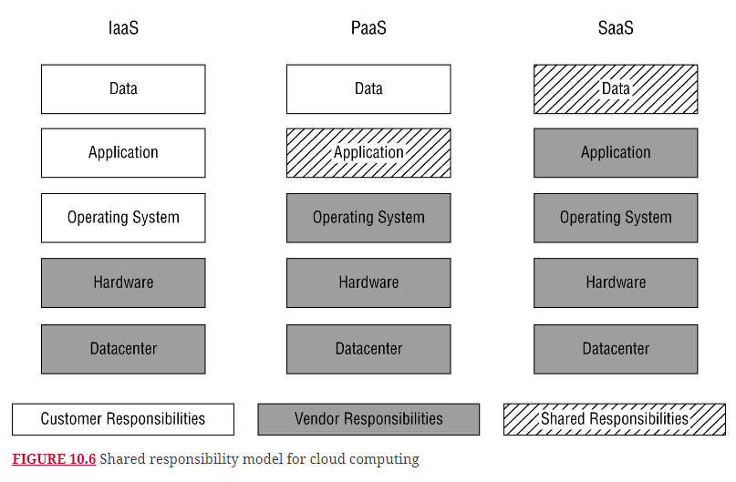
Cloud Models

Slide 4
In the cloud …
Every action (create, update, delete) is an API call
Every API call is logged (tracked for billing)
Every resource consumption is measured
Every API call requires authorization (by role)
Machines and services can have a role
Value is driven by economy of scale
100K machines optimized for computer yield in a data center
Expert team overhead allocated across entire customer base
Compliance with Security & Privacy standards in a business

Slide 5
Software Defined Networking (SDN) concepts
Control Plane
Manages URN mapping to IP address
Collects data about network behavior
API to monitor and dynamically change mappings and behavior
Data Plane
Delivers packets
TCP/IP based
Flat Network

Slide 6
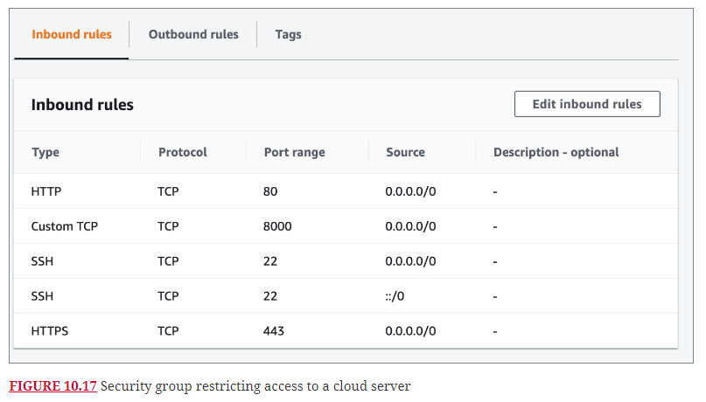
Security Groups not Firewalls

Slide 7
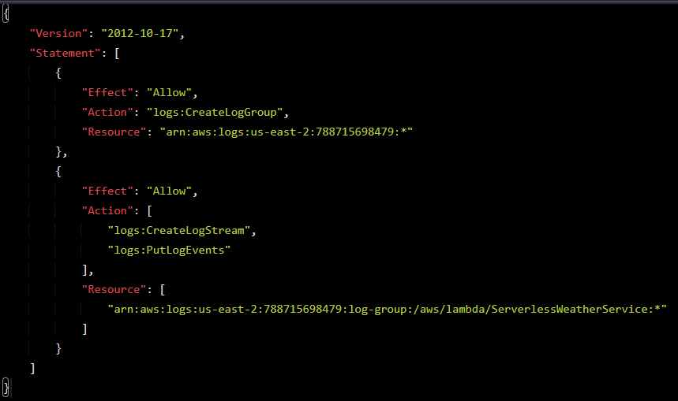
Resource Policy Example

Slide 8
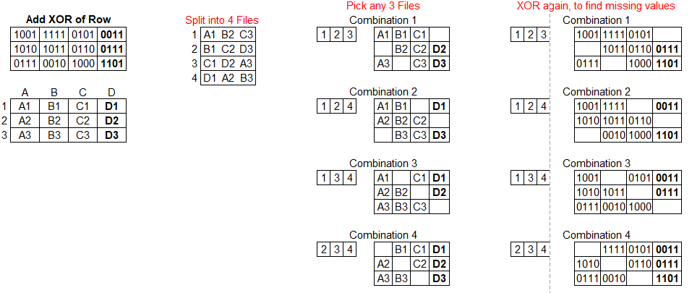
Reliable, Available, Secure data storage
Reliable
Use Forward Error Correction not backups
Available
Regions vs Global storage
Secure
Self-encrypting disk drives
API level encryption
Blob based storage

Slide 9
SANS Center of Internet Security Controls
Critical Control | Legacy (Pets) | Cloud (Cattle)
1- Device Inventory | Audit spreadsheet | API query
2 – Software inventory | Audit spreadsheet | Pipeline manifests
3 – Data Protection | Network DLP | API, Storage sharding, Self encryption
4 – Secure configurations | System hardening processes | Only latest versions used at launch
5 – Account Management | Active Directory | SAML, OpenID, IAM
6– Access Control Management | Limit data center access, jump boxes | IAM
7 – Continuous Vulnerability Assessment | Scheduled pen tests. Remediation? | Dedicated team monitoring events
8 – Audit Log Management | Splunk | CloudTrail, CloudWatch
9 – Email & Browser protections
10 – Malware defense | Network & Host IDS | Immutable systems
11 – Data recovery | Tape | Auto replication of data, versioning
12 – Network Infrastructure Management | Firewall, WAF, Network | SDN (perimeter), Security groups
13 – Network Monitoring | Crunchy outside, soft center | SDN (perimeter), API based WAF
14 – Security Skills Assessment
15 – Service Provider Management |  | SLA, Contracts, Monitoring
16 – Application Software Security | WAF | WAF
17 – Incident Response Management | Logs | Logs, Vendor’s internet visibility
18 – Pen tests and red team

Slide 10
Cloud deployment laws to live by
Cattle not Pets
Dynamic deployments
Systems, once deployed, are immutable
No SSH/RDP/Admin access to production systems
Infrastructure as managed code
Assets managed via an API not a spreadsheet

Slide 11
IT666 : Cybersecurity Practices
Chapter 10: Docker

Slide 12
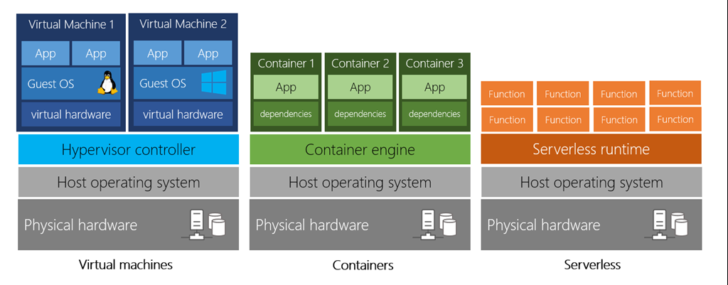

Slide 13
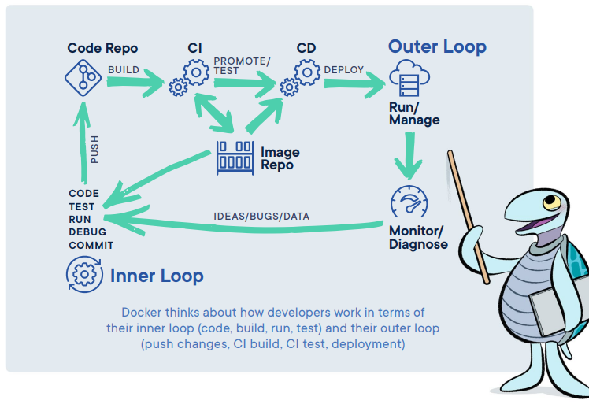
Docker’s view of CI/CD

Slide 14
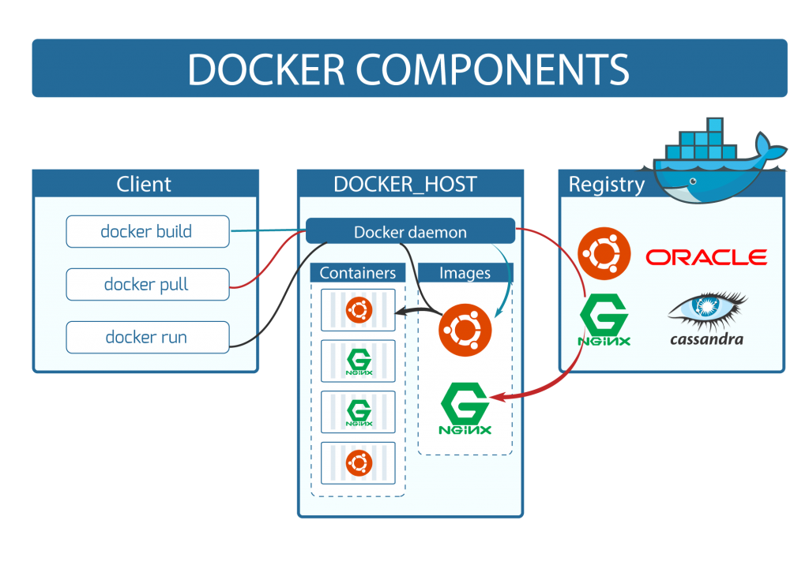

Slide 15
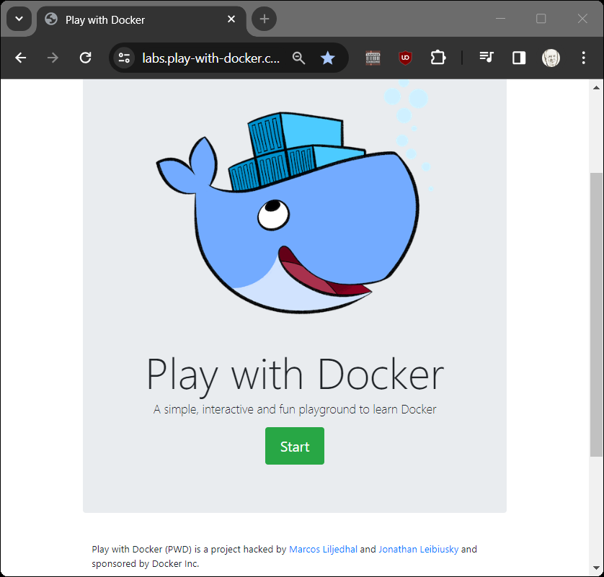
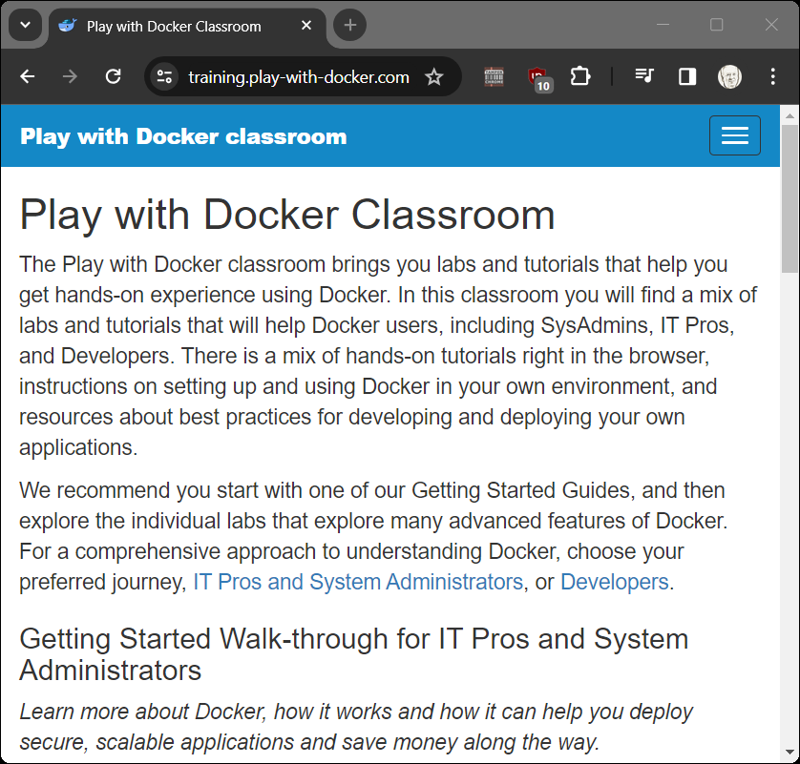
Interactive Training Sessions: https://play-with-docker.com https://training.play-with-docker.com/

Slide 16
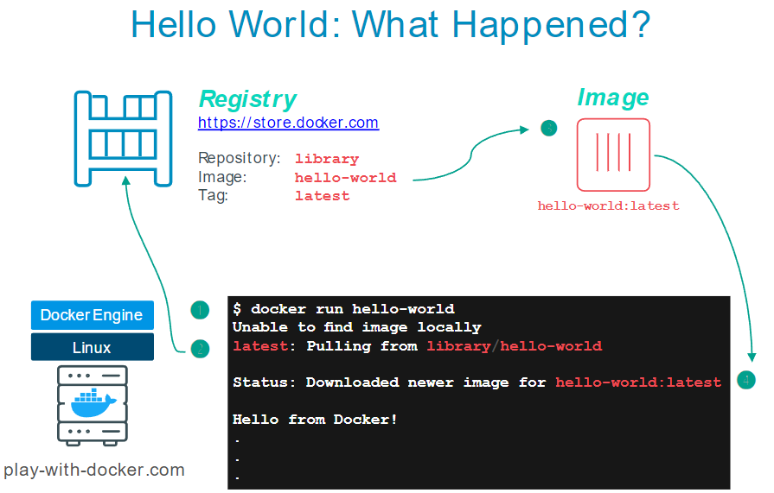

Slide 17
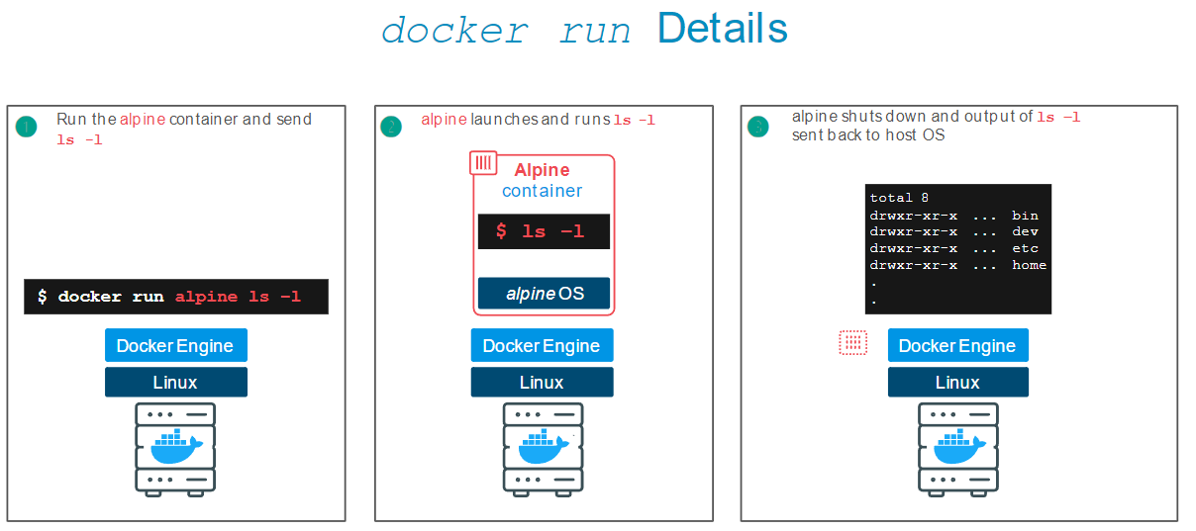

Slide 18
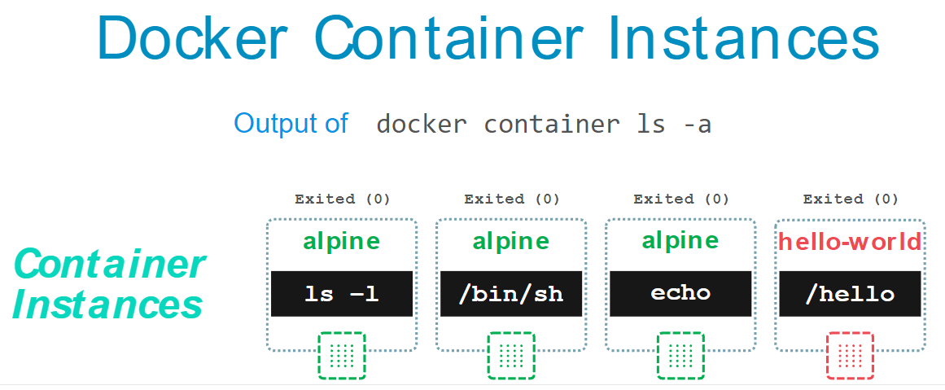

Slide 19
In which of the following cloud categories are customers typically charged based on the number of virtual server instances dedicated to their use?
IaaS only
SaaS only
IaaS and PaaS
IaaS, SaaS, and PaaS
Notes:
C. Customers are typically charged for server instances in both IaaS environments, where they directly provision those instances, and PaaS environments, where they request the number of servers needed to support their applications. In an SaaS environment, the customer typically has no knowledge of the number of server instances supporting their use.

Slide 20
Which one of the following would not commonly be available as an IaaS service offering?
CRM
Storage
Networking
Computing
Notes:
A. Customer relationship management (CRM) packages offered in the cloud would be classified as software-as-a-service (SaaS), since they are not infrastructure components. Storage, networking, and computing resources are all common IaaS offerings.

Slide 21
Wanda is responsible for a series of seismic sensors placed at remote locations. These sensors have low-bandwidth connections, and she would like to place computing power on the sensors to allow them to preprocess data before it is sent back to the cloud. What term best describes this approach?
Edge computing
Client-server computing
Fog computing
Thin client computing
Notes:
A. This approach may be described as client-server computing, but that is a general term that describes many different operating environments. The better term to use here is edge computing, which involves placing compute power at the client to allow it to perform preprocessing before sending data back to the cloud. Fog computing is a related concept that uses IoT gateway devices that are located in close physical proximity to the sensors.

Slide 22
Fran's organization uses a Type I hypervisor to implement an IaaS offering that it sells to customers. Which one of the following security controls is least applicable to this environment?
Customers must maintain security patches on guest operating systems.
The provider must maintain security patches on the hypervisor.
The provider must maintain security patches on the host operating system.
Customers must manage security groups to mediate network access to guest operating systems.
Notes:
C. Type I hypervisors, also known as bare-metal hypervisors, run directly on top of the physical hardware and, therefore, do not require a host operating system.

Slide 23
LAB
STRIDE
Docker

