Slide 1
IT666 : Cybersecurity Practices
Chapter 11: Endpoint Security

Slide 2
Firmware
Embedded software is tightly connected to the device hardware
May not be possible to update depending on the design/implementation
May require manual updates rather than automated process.
Attacks on any path that allows access
Executable updates
User downloads of malicious firmware
Remote network-enabled updates for devices that provide networked access to their firmware or management tools.

Slide 3
Firmware Impacts
Persist after reboot
Invisible to OS based anti-malware
Can create/alter hypervisor behavior

Slide 4
Firmware Controls
Secure Boot
Validate signature against database of known good components
Measured Boot
Measure components to create signatures
Both methods require a root of trust (TPM)

Slide 5
Antivirus Approaches
Signature-based
Uses hashes or pattern-based signatures to detect previously observed malware.
Polymorphism mitigates effectiveness
Behavior-based
Monitors actions and matches them to profiles of unwanted activities
Sandboxing
A protected environment where untrusted code can be observed
Instrumented to document all actions taken by the malicious code

Slide 6
DLP on the endpoint
Data classification on intake is critical to DLP success
Hard to prevent privacy breaches when sensitive data is sent to an endpoint
Audit controls are required
Analysis required for who/what has access to large data sets
Backups
Enterprise API services
Partners
Service providers

Slide 7
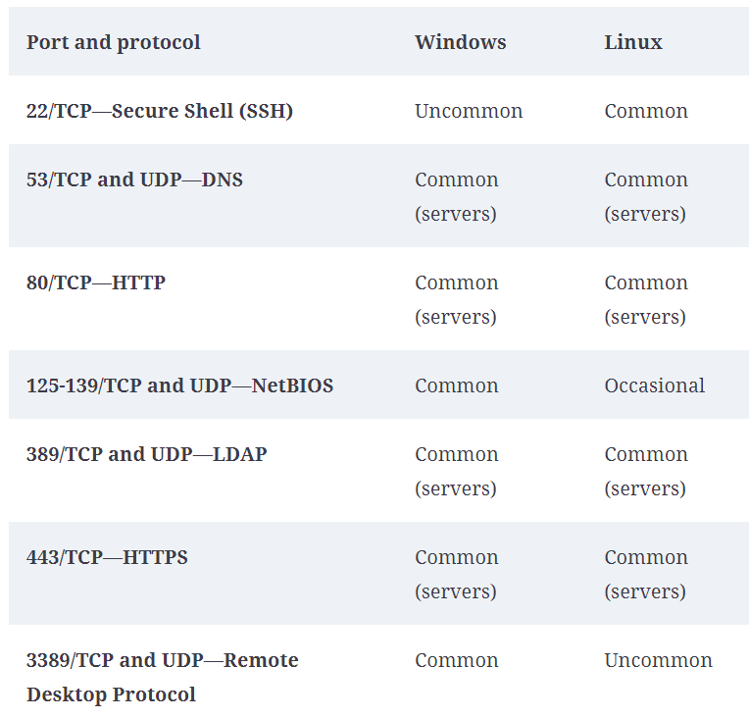

Slide 8
Embedded Devices (examples in the wireless lecture)
Medical systems
Devices like pacemakers, insulin pumps, and other external or implantable systems can also be attacked
Smart meters
Track utility usage typically use a wireless control network managed by the utility
Remotely accessible and controllable providing a new attack surfaces
Interfere with power, water, or other utilities
Provide information about the facility or building.
Vehicles (cars, ships, planes)
Frequently are directly Internet connected
Attackers can take control, monitor, or otherwise seriously impact them.

Slide 9
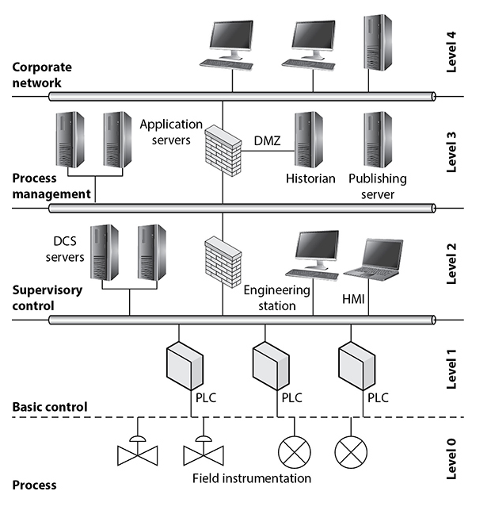
SCADA at UNH?

Slide 10
Chris wants systems that connect to his network to report their boot processes to a server where they can be validated before being permitted to join the network. What technology should he use to do this on the workstations?
UEFI/Trusted boot
BIOS/Trusted boot
UEFI/Measured boot
BIOS/Measured boot
Notes:
C. Chris knows that BIOS-based systems do not support either of these modes, and that trusted boot validates every component before loading it, whereas measured boot logs the boot process and sends it to a server that can validate it before permitting the system to connect to the network or perform other actions.

Slide 11
Helen's organization is planning to deploy IoT devices across their buildings as part of a HVAC system. Helen knows that the vendor for the IoT devices does not provide regular security updates to the device's web interfaces that are used to manage the devices. What security control should she recommend to help protect the devices on the network?
Install host-based firewalls.
Deploy the IoT devices to a protected VLAN.
Install host-based IPS.
Disable the web interfaces for the IoT devices.
Notes:
B. Since the web interfaces are needed to manage the devices, Helen's best option is to place the IoT devices in a protected VLAN. IoT devices will not typically allow additional software to be installed, meaning that adding firewalls or a HIPS won't work.

Slide 12
Allan is preparing to harden his organization's network switches. Which of the following is not a common hardening technique for network devices?
Removing unnecessary software
Installing patches
Administrative VLANs
Changing default passwords
Notes:
A. Unlike computers and mobile devices, switches and other network devices typically do not have additional software that can be removed. Installing patches, placing administrative interfaces on protected VLANs, and changing default passwords are all common hardening techniques for network devices like switches.

Slide 13
Oliver wants to store and manage secrets in his cloud service provider's environment. What type of solution should he look for as part of their offerings?
A TPM
A secure enclave
A KMS
A Titan M
Notes:
C. Oliver should look for a key management system, or KMS, which will allow him to securely create, store, and manage keys in a cloud environment. TPMs, secure enclaves, and Google's Titan M are all local hardware solutions.

Slide 14
LAB
Internet Scanning

