Slide 1
IT666 : Cybersecurity Practices
Chapter 12: Network Security

Slide 2
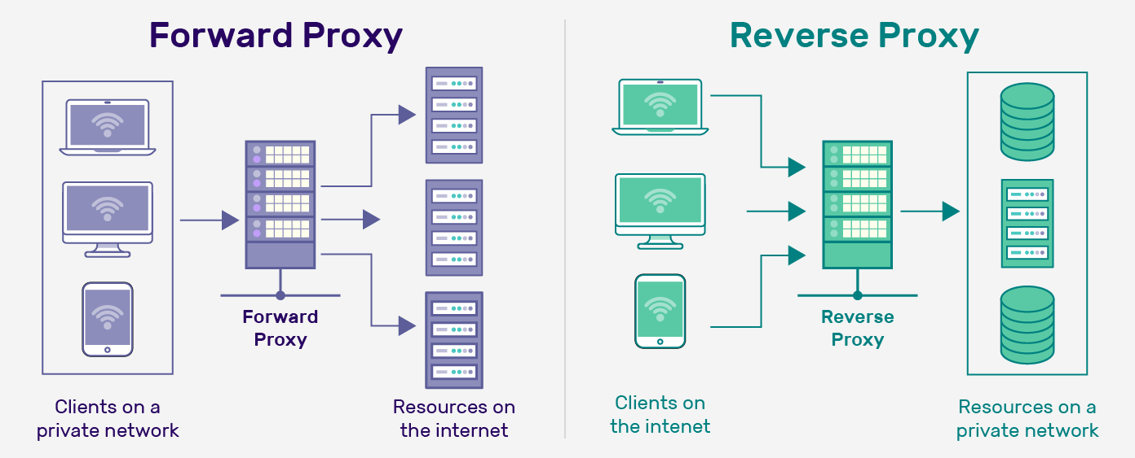
Proxies (NAT, WAF, VPN, SDN, CDN, TOR, Load Balancers, etc)
A forward proxy is primarily used to provide privacy to the client and implement network restrictions
A reverse proxy is used mainly to improve the server’s performance, security, and scalability

Slide 3
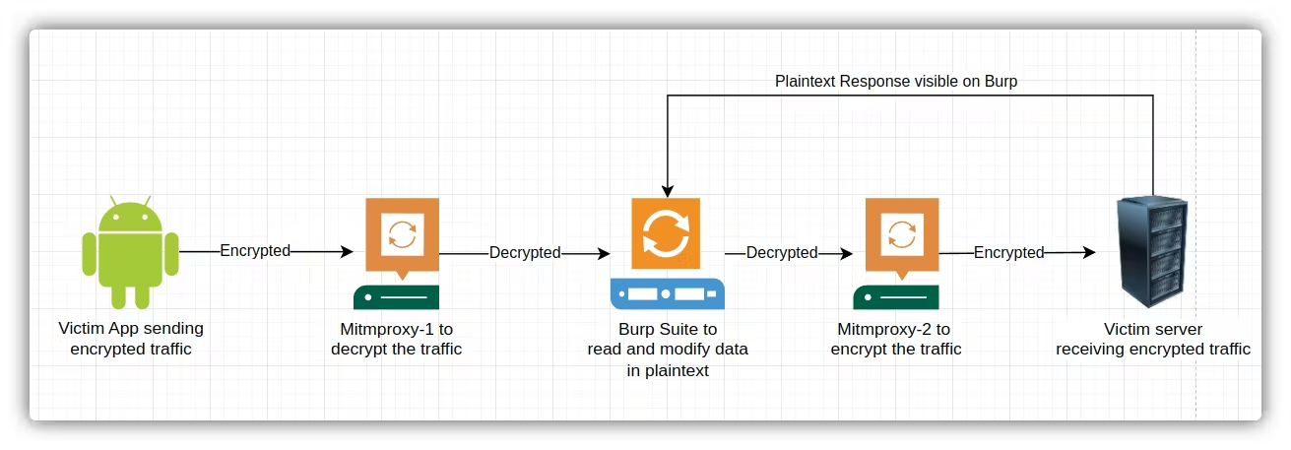
Burp Proxy
Actions: Validate, Alter, Control, Monitor, Cache
Example of one possible configuration
Notes:
Forward proxy
Limit where requests go
Limit egress of data
Set state for inbound filtering
Normally visible to users
Reverse proxy
Limit where requests can come from
Data ingress controls
Malicious content (virus/trojan) controls
Invisible to users.

Slide 4
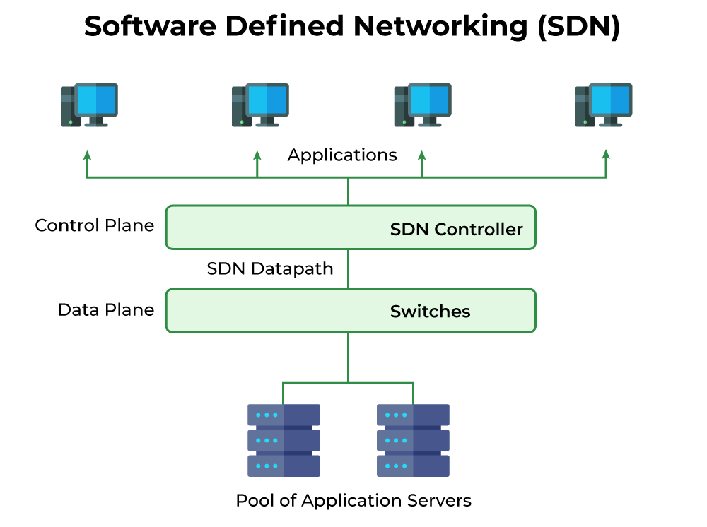
Source: https://www.geeksforgeeks.org/software-defined-networking/

Slide 5
Software Defined Networking (SDN)
Decoupled Architectural Planes
Control Plane: Centralizes network intelligence
Data Plane: Forwarding layer (switches) to deliver traffic
Manages and enforces organizational policies
Allows for real-time network changes
Runs on commodity hardware

Slide 6
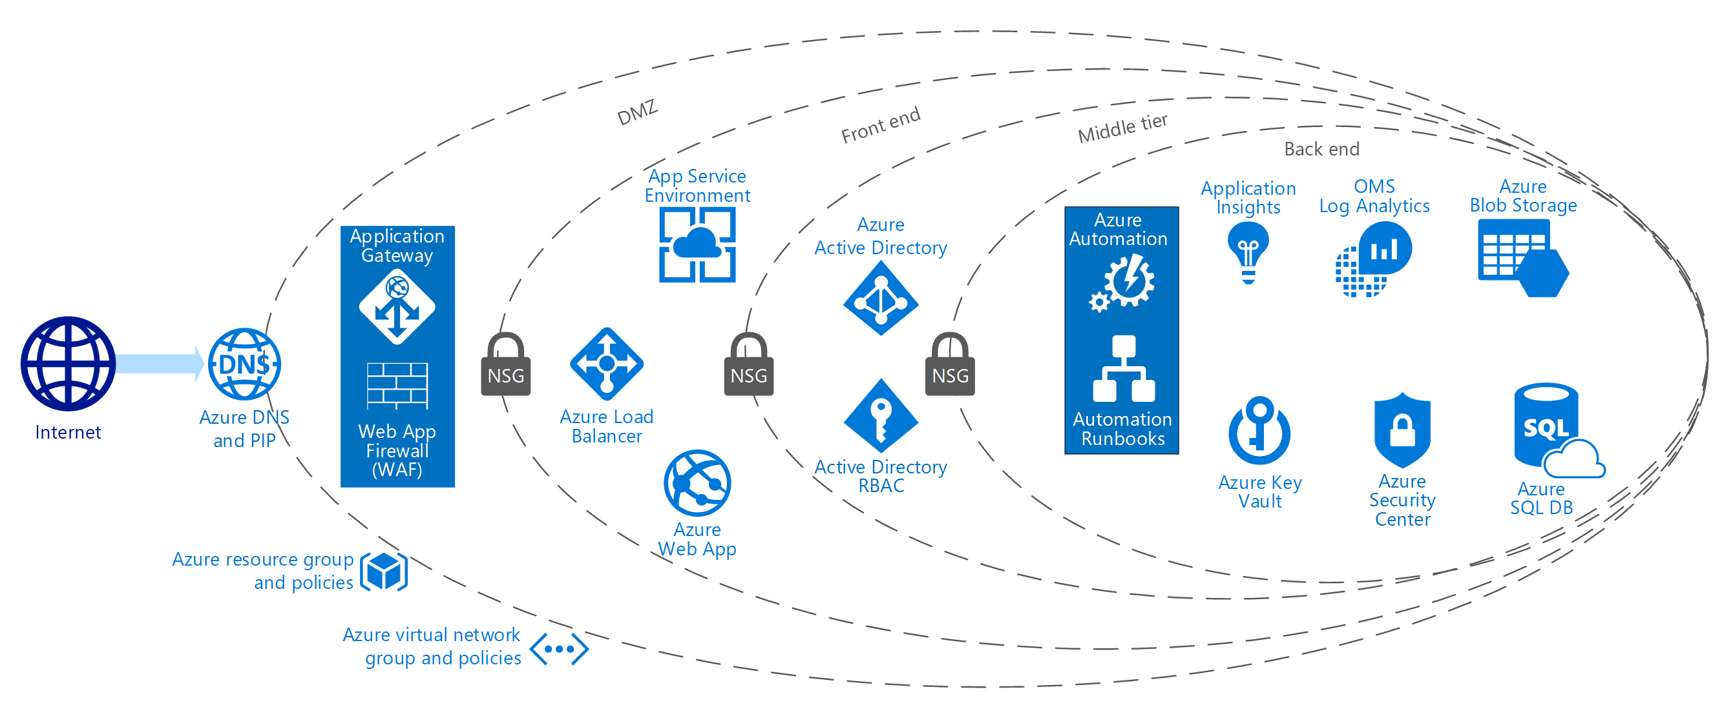
PCI – Protecting data with an “enclave”

Slide 7
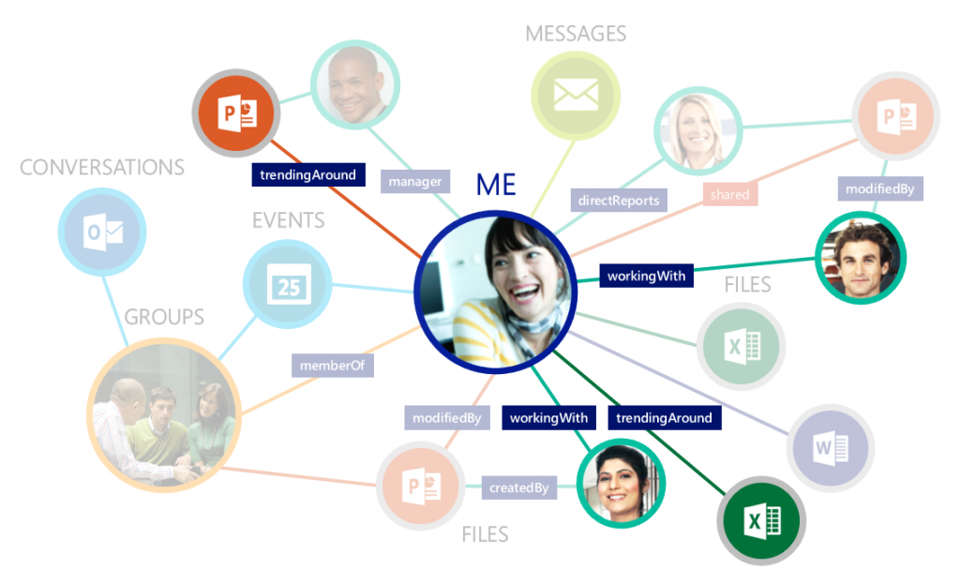
Relationships are complex/temporal not hierarchical/fixed

Slide 8
Virtual Private Network (VPN)
Two popular and incompatible VPN protocols
IPsec
Requires client software
TLS VPNs (OpenSSL)
Can operate via a portal or with client software
Site-to-site
Usually, fixed connections to extend a corporate network
Remote Access
Temporal connections for remote employees

Slide 9
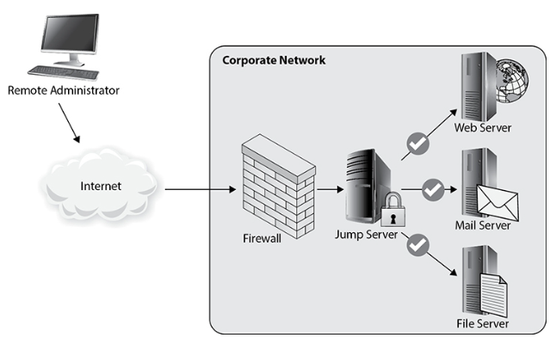
Jumpbox: Antiquated concept in the Cloud

Slide 10
Load Balancing
Present a virtual IP (VIP) then distributes those requests to servers in a pool or group
Active/Active or Active/Passive
Scheduling
Round robin
Least connections
Weighted
Source affinity

Slide 11
Web (Content) Filters
Simple blocking specific URLs, domains, or hosts
Complex blocking with pattern matching or IP reputation
Typically, a centralized proxy using a DHCP gateway route
Can be an agent-based deployment
Content categorization lists maintained by vendor
Adult material
Non-business (gaming)
Child-friendly material
Reputation, threat, or other reasons

Slide 12
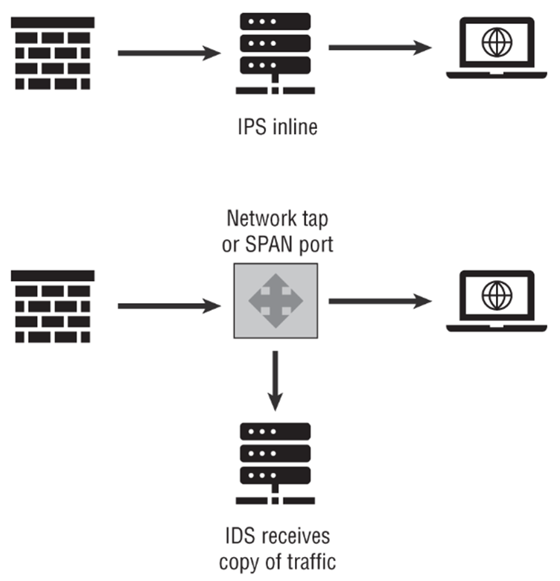
Intrusion Detection|Prevention Systems (IDS|IPS)
Signature-based detections rely on a known hash or signature matching to detect a threat.
Anomaly-based detection establishes a baseline for an organization or network and then flags when out-of-the-ordinary behavior occurs.

Slide 13
Firewalls (Legacy)
Decision based on only TCP|IP headers
Modes
Stateless firewalls (sometimes called packet filters) decisions are made packet by packet. No request/response correlation
Stateful firewalls maintain a state table and decisions are based on a conversation

Slide 14
Next Generation Firewalls (NGFW)
20+ year old technology based on “deep packet inspection”
Includes Web Application Firewalls (WAF) and Unified Threat Management (UTM) devices
Optional Features
IDS/IPS functionality
Antivirus and antimalware
URL and email filtering
Security policy enforcement
Data loss prevention
VPN
Monitoring and analytics capabilities

Slide 15
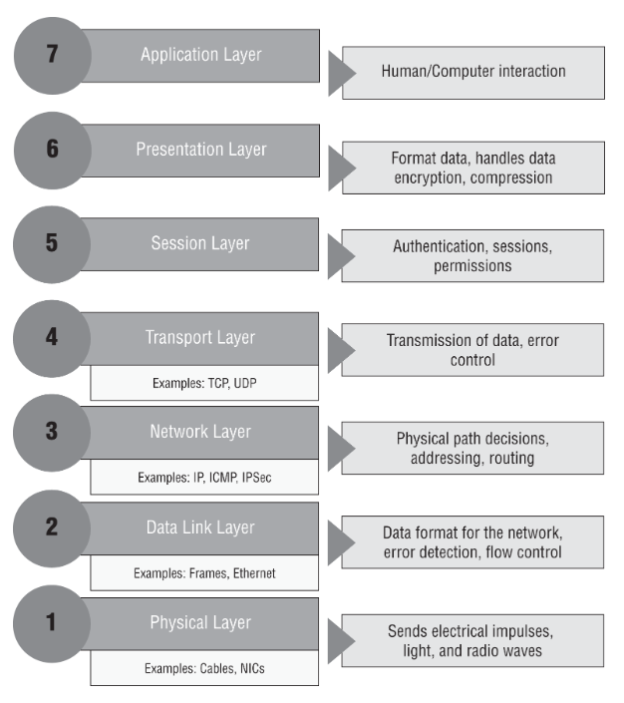
WAF focus is HTTP ➔
Legacy Firewalls ➔

Slide 16
ACLs
Allow List (Whitelisting)
Define good and block everything else (Implicit Deny)
Deny List (Blacklisting)
Define bad and allow everything else (Explicit Deny)
How does that impact rules for: Firewalls, DLP, or Policies

Slide 17
Rules for rule processing
Differ by implementation
Possible
First match
Most specific match
Handling deny/allow conflicts

Slide 18
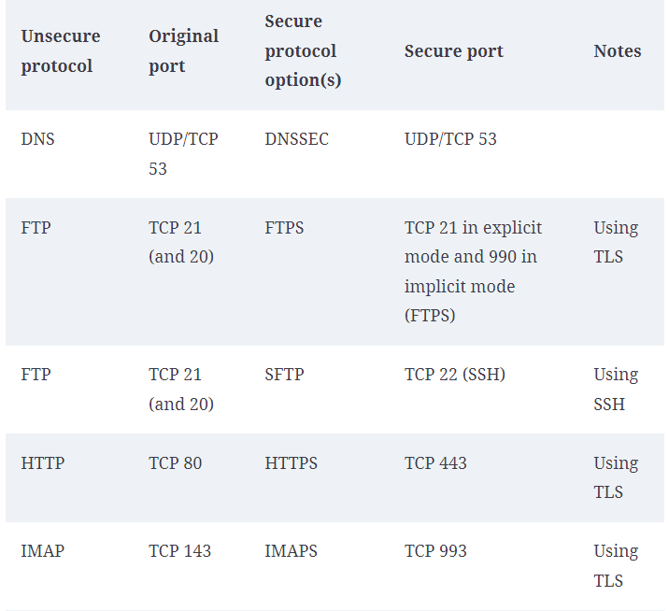
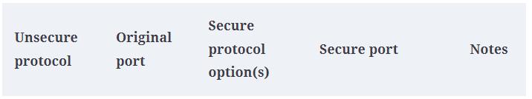
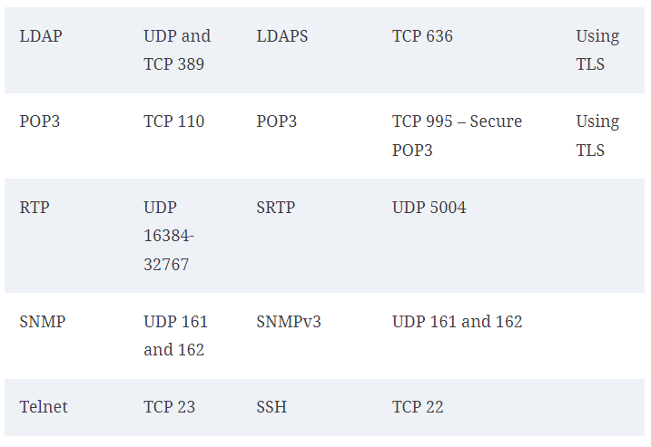
Secure Protocols

Slide 19
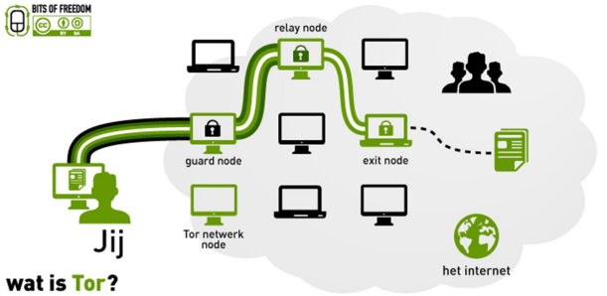
TOR
How to use TOR
TOR browser
TOR button
.onion sites
duckduckgo.onion
AHMIA
.ONION
YOU

Slide 20
Elle has scanned her organization from an external IP address and has identified all of the services that are visible from the public Internet. What does this enable her to describe?
If the organization is a fail-open organization
Her organization's OSINT report
Her organization's attack surface
If the organization is a fail-closed organization
Notes:
C. Understanding what services your organization offers to the outside world is an important step in describing the organization's attack surface. Fail open and fail closed describe what happens when devices or systems fail, not vulnerability and service availability information. OSINT is a passive process and scanning is not a passive activity.

Slide 21
What protocol is used to securely wrap many otherwise insecure protocols?
ISAKMP
SSL
IKE
TLS
Notes:
D. Transport Layer Security (TLS) is commonly used to wrap (protect) otherwise insecure protocols. In fact, many of the secure protocols simply add TLS to protect them. ISAKMP and IKE are both used for IPSec and can be used to wrap insecure protocols, but they aren't used alone. SSL is no longer used; TLS has almost entirely replaced it, although SSL is still often casually referred to as TLS.

Slide 22
Kathleen wants to deploy a firewall that can handle large amounts of network traffic while performing advanced firewalling tasks. What type of device should she select?
A NGFW
A WAF
A UTM
A SD-FW
Notes:
A. A next-generation firewall (NGFW) device is typically designed and built to be more capable at high speeds and throughput than a universal threat management device. Since UTM devices provide such a wide array of services that consume CPU and memory resources, this performance gap can also sometimes be due to the broad set of services that a UTM device provides. A WAF (web application firewall) is specialized in web traffic, and SD-FW was made up for this question.

Slide 23
Jill wants to use DNS filtering to prevent users in her organization from visiting potentially malicious sites. What type of service should she use to obtain this information?
An OSINT service
A STP feed
An ACL monitoring service
A reputation service
Notes:
D. DNS reputation services can provide Jill with an automated feed of malicious sites that she can include in her DNS filter. OSINT (open source intelligence) is gathered without scans but typically won't provide DNS block lists. STP (Spanning Tree Protocol) prevents loops in networks and is not relevant to DNS filtering, and an access control monitoring service will not be either.

Slide 24
LAB
Application Security Testing
TOR

