Slide 1
IT666 : Cybersecurity Practices
Chapter 13: Wireless And Mobile Security

Slide 2
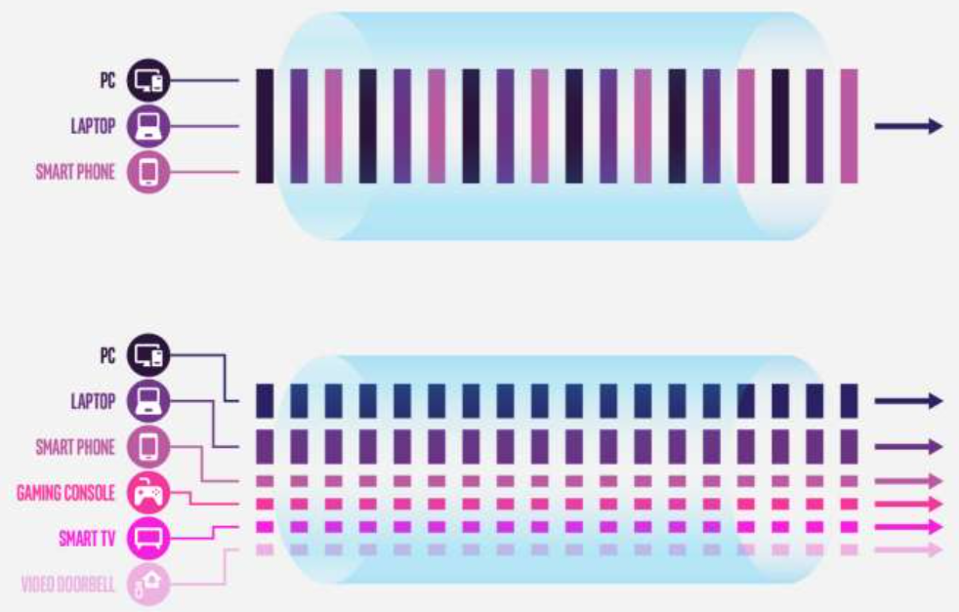
Mobile Communications
Cellular : Signaling System No. 7 (SS7)
Bluetooth
Use Wi-Fi Protected Access 2 (WPA2) DO NOT USE WEP
WiFi-6 (Faster, Mesh networking, WPA3)

Slide 3
Wireless Problems
No physical protections
You don’t know you are being watched
Bluetooth snarfing up to a 1 mile away
Can bridge “air gapped” networks
Device associations can be dynamic
Most mobile devices are multi-homed
Lots of easy-to-use attack tools/apps

Slide 4
WPA 3
“Enhanced open” for public networks
Encryption is individualized
Attackers with the WPA3-PSK password can NOT snoop on other users
192-bit security mode for sensitive environments
Requires both laptop and access point supported hardware

Slide 5
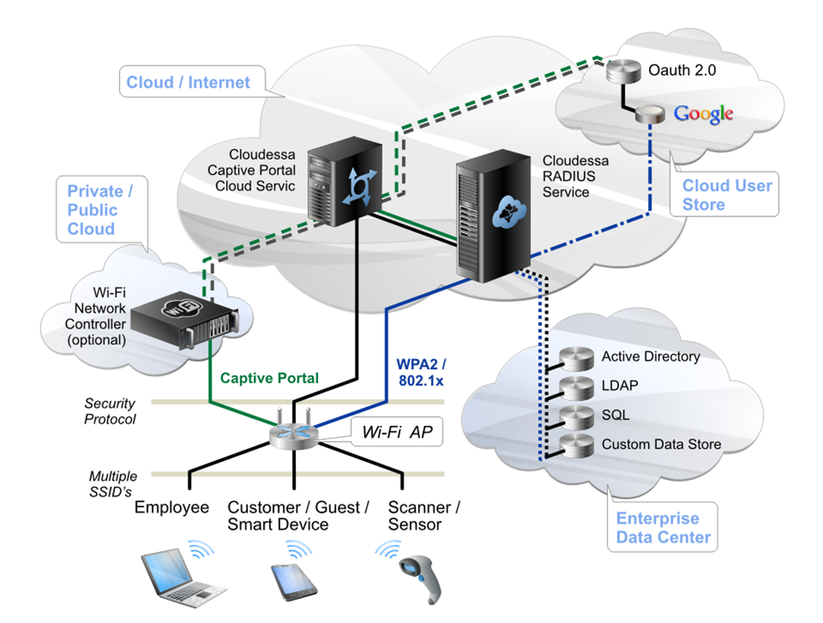
WPA2 Modes
Enterprise
PSK
Notes:
WPA-PSK (pre shared key) is vulnerable when weak/guessable keys are used.
4096 hashes per password attempt means brute force is slow (100s /sec)
802.1x authentication is port based NAC.
TKIP used. IV and key is mixed
RADIUS Remote AuthN. Dail In User Service
Diameter or Kerberos maybe used instead of Radius.

Slide 6
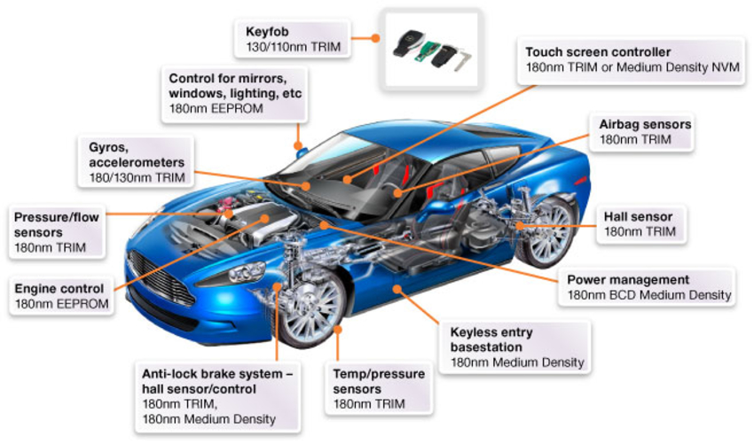

Slide 7
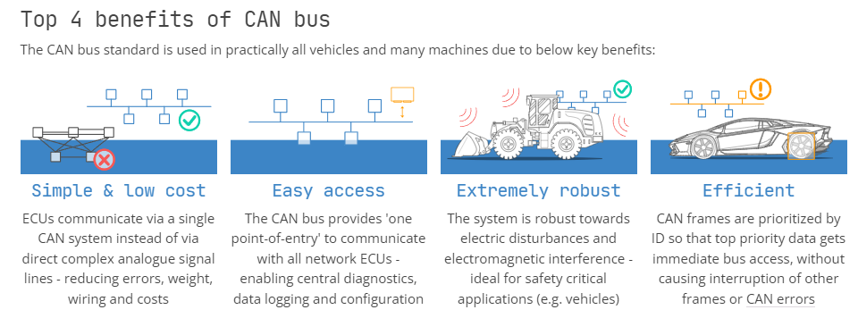
Automotive networking: Where does security rank?
WIRED: Jeep hack on YouTube: https://www.youtube.com/watch?v=MK0SrxBC1xs

Slide 8
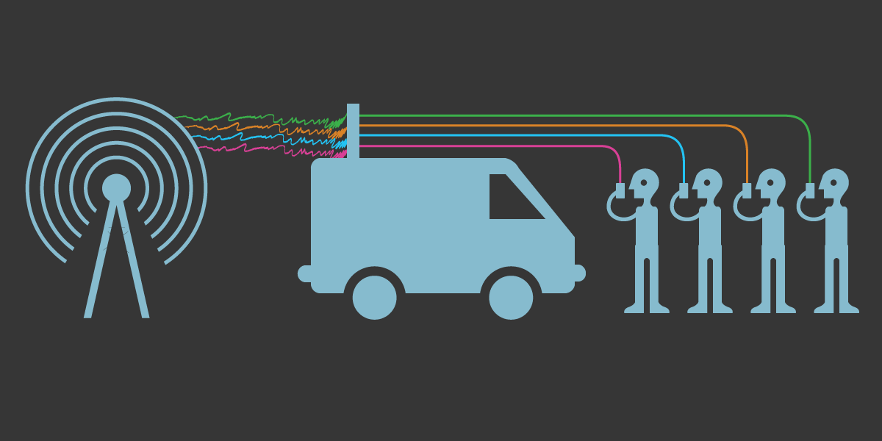
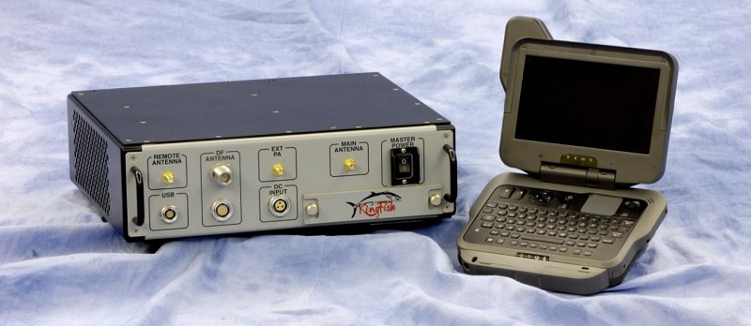
Cell Traffic
Stingray
Fake cell tower
Expensive $100K
iMSI Catchers
Locate phone
Limited range
Apps can detect

Slide 9
Radio frequency identification (RFID)
Short range (1 foot to few meters)
Powered
Offer longer ranges
Broadcast information
Higher frequency
Uses: Inventory, anti-theft, highway tolls
Unpowered
Proximity readers
Uses: Access badges, passports, credit cards

Slide 10
Near-field communication (NFC)
Apple Pay, Google Pay
Range limited to less than 4 inches
Unlike RFID, allows for two-way communication
Attacks:
Short range means attacks must short range also
Intercepting NFC traffic
Replay attacks and spoofing

Slide 11
Wireless Attacks
Evil Twins
Rouge Access Points
Controller Attacks

Slide 12
Mobil Device Deployments
BYOD
Example: Use your phone to read corporate email
Corporate may require apps to be installed: VPN, MDM, etc
Corporate owned
May allow personal connectivity and some minor configuration changes
MDM required for corporate connectivity
Jailbreaking is prohibited
Updates automatically pushed

Slide 13
Mobile Device Management (MDM)
App Management
Content Management
Remote Wipe
Geo-location and Geo-fencing
Screen Locks
Push Notifications
Secure Boot Attestation

Slide 14
What are the two most commonly deployed biometric authentication solutions for mobile devices?
Voice recognition and face recognition
Fingerprint recognition and gait recognition
Face recognition and fingerprint recognition
Voice recognition and fingerprint recognition
Notes:
C. Current mobile device implementations have focused heavily on facial recognition via services like Apple's Face ID and fingerprint recognition like Android's fingerprint scanning and Apple's Touch ID. Gait recognition is not a widely deployed biometric technology and would be difficult for most mobile device users to use. Voice recognition as a biometric authenticator has not been broadly deployed for mobile devices, whereas voice-activated services are in wide usage.

Slide 15
What is the most frequent concern that leads to GPS tagging being disabled by some companies via an MDM tool?
Chain of custody
The ability to support geofencing
Privacy
Context-aware authentication
Notes:
C. Geotagging places a location stamp in documents and pictures that can include position, time, and date. This can be a serious privacy issue when pictures or other information are posted, and many individuals and organizations disable GPS tagging. Organizations may want to enforce GPS tagging for some work products, meaning that the ability to enable or disable it in an MDM tool is quite useful. Chain of custody is a forensic concept, the ability to support geofencing does not require GPS tagging, and context-aware authentication may need geolocation but not GPS tagging.

Slide 16
Chris wants to use geolocation technology to find where phones issued by his organization are located. Which of the following is not commonly used as part of geolocation techniques?
Bluetooth
GPS
NFC
Wi-Fi
Notes:
C. Nearfield communication (NFC) is not typically used for geolocation because of its extremely short range. Geolocation services may use GPS, Wi-Fi, and Bluetooth to identify areas, access points, Bluetooth beacons, and other items that help with location services.

Slide 17
Michelle has deployed iPads to her staff who work her company's factory floor. She wants to ensure that the devices work only in the factory and that if they are taken home they cannot access business data or services. What type of solution is best suited to her needs?
Context-aware authentication
Geofencing
Geolocation
Unified endpoint management (UEM)
Notes:
B. Geofencing will allow Michelle to determine what locations the device should work in. The device will then use geolocation to determine when it has moved and where it is. In this case, the correct answer is therefore geofencing—simply having geolocation capabilities would not provide the solution she needs. Context-aware authentication can help by preventing users from logging in when they aren't in the correct location, but a device that was logged in may not require reauthentication. Finally, UEM, much like mobile device management, can be used to enforce these policies, but the most correct answer is geofencing.

Slide 18
LAB
Network Forensics

