Slide 1
IT666 : Cybersecurity Practices
Chapter 14: Monitoring And Incident Response

Slide 2
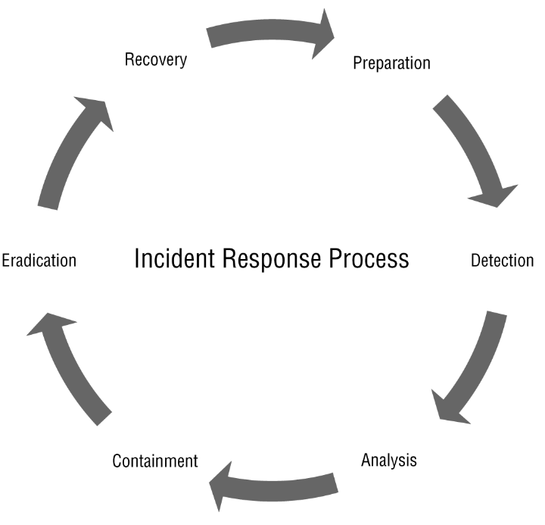

Slide 3
IR Team Makeup
Management
Security
Technical leads
Communications/PR
HR
Legal
Law Enforcement?

Slide 4
Preparation Exercises
Tabletop
On paper : Work through various scenarios
Simulations (require serious planning)
Isolation area
Live fire

Slide 5
Plans
Communications
Stakeholders
Business Continuity
Disaster Recovery (DR)

Slide 6
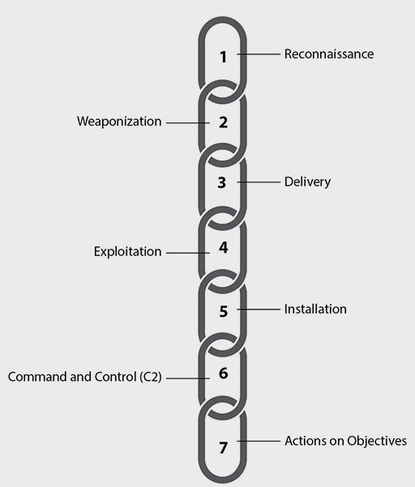
Cyber Kill Chain (link)
Different defense-based origin
Remote (Historic focus for defense)
Internal (Motivation for Zero Trust)

Slide 7
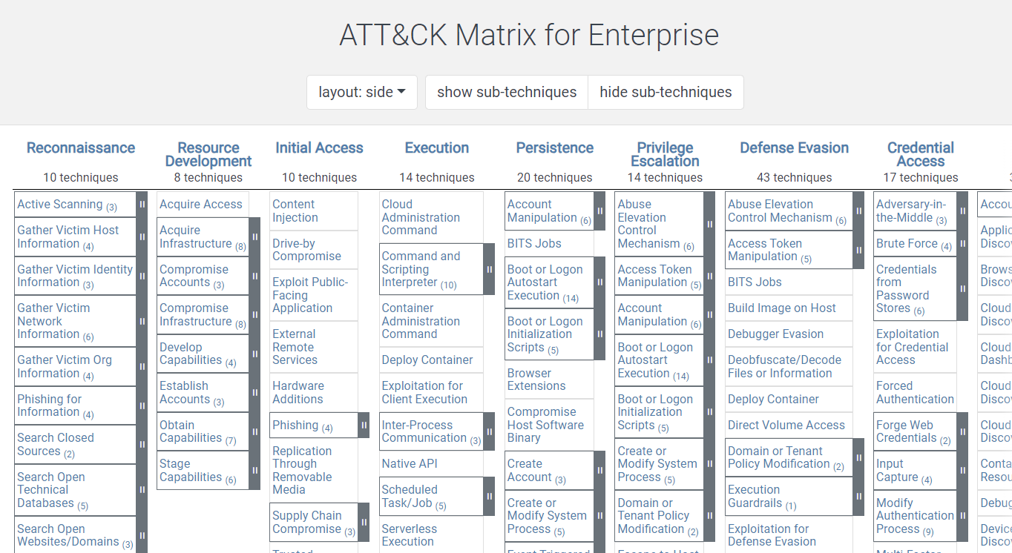
Mitre Att&ck

Slide 8
Security Information and Event Management (SIEM)
Collect and aggregate log data
Perform correlation and analysis activities
Information from systems, network security devices, network infrastructure, and many other sources
Apply rules, analytical techniques, and machine learning or artificial intelligence to the data
Packet captures correlated with IDS and Firewalls

Slide 9
Minimal Response Plan
Detect the incident
Analyze the incident
Implement communications plan
Contain or eradicate the problem
Restore, Rebuild, Patch
Prevent re-infection
Log recovery events
Preserve evidence
Conduct a post-mortem
Apply lessons learned

Slide 10
Selah wants to ensure that users in her organization can only install applications that are evaluated and approved by the organization's security team. What should she use?
A SIEM
An application deny list
An application allow list
sFlow
Notes:
C. Application allow lists are used to ensure that only allowed applications are installable on systems. A deny list specifically identifies programs that aren't allowed. A SIEM doesn't provide application management capabilities, and sFlow is a flow tool like NetFlow.

Slide 11
Alyssa has identified malware on a system. She removes the system from the network to ensure that it cannot impact other systems. What technique has she used to deal with this system?
Quarantine
Segmentation
Converted it to agentless
Deny listing
Notes:
A. Alyssa's has quarantined the machine, ensuring it cannot reach other systems or impact the rest of her organization. Segmentation would involve putting the system in protected network zone. Agentless tools are used to send data without a separate program or agent deployed to allow that. Deny lists are used to prevent specific programs or files from being used or deployed to systems.

Slide 12
Kristen discovers missing logs as part of her threat hunting activities. What has most likely happened?
The logs hit the end of their life cycle and were rotated.
The system is a newly deployed system.
An attacker wiped the logs to hide evidence.
An attacker encrypted the logs as part of their process.
Notes:
C. Missing logs are often associated with an attacker attempting to hide evidence of their actions. Log rotation will typically remove the oldest log items and replace them with new log items rather than wiping a log, or will archive the old log file and create a new one. A newly deployed system typically has at least some logs from booting and running. Encrypting logs would leave a file in place even if it couldn't be read.

Slide 13
Jayne wants to determine why a ransomware attack was successful against her organization. She plans to conduct a root cause analysis. Which of the following is not a typical root cause analysis method?
Root/branch review
Five whys
Event analysis
Diagramming
Notes:
A. Five whys, event analysis, and diagramming are all common methods of performing root cause analysis. Root/branch review is not a typical process for this.

Slide 14
LAB
Chromium Policy

