Slide 1
IT666 : Cybersecurity Practices
Chapter 15: Digital Forensics

Slide 2
Attribution is hard
The investigation of a security incident need not end up in a courtroom
You need to know what normal is to declare anything abnormal
Maintaining a timeline is critical

Slide 3
Sources of forensic information
Packet captures
Browser history
Windows registry
Wireless Networks
Logs/Event Streams
Security devices/systems
Authentication systems

Slide 4
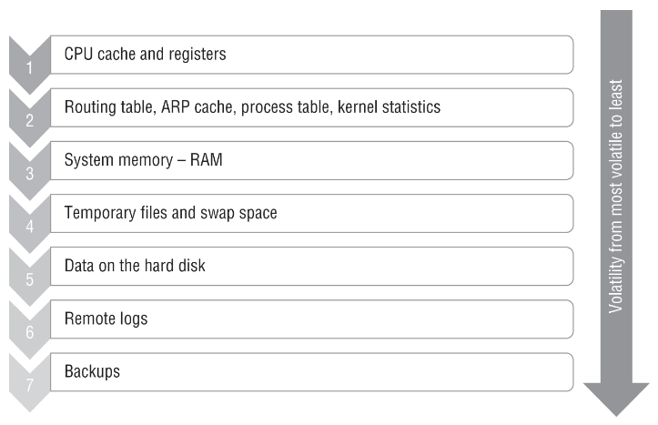
Do you let the suspect system continue to run?

Slide 5
Cloud Forensics
Right to Audit needs to be added to contract
Regulatory/Jurisdiction can vary based on data center location
Breach notification based on data location

Slide 6
Maria has acquired a disk image from a hard drive using dd, and she wants to ensure that her process is forensically sound. What should her next step be after completing the copy?
Securely wipe the source drive.
Compare the hashes of the source and target drive.
Securely wipe the target drive.
Update her chain-of-custody document.
Notes:
B. Once a copy is made, hashes for the original and target drive should be compared to ensure that the copy was successful. After that, the chain-of-custody document can be updated to note that a copy was made and will be tracked as it is analyzed while the original is preserved. Wiping either drive after a copy is not part of the process, although a target drive may be wiped after a case is complete.

Slide 7
Michael wants to acquire the firmware from a running device for analysis. What method is most likely to succeed?
Use forensic memory acquisition techniques.
Use disk forensic acquisition techniques.
Remove the firmware chip from the system.
Shut down the system and boot to the firmware to copy it to a removable device.
Notes:
A. Firmware can be challenging to access, but both memory forensic techniques and direct hardware interface access are viable means in some cases. Firmware is not typically stored on the disk and instead is stored in a BIOS or UEFI chip. Removing the chip from the system will leave it unable to run and thus this is not a preferred method. Also, many chips are not removable. Shutting down the device and booting it to the firmware does not provide a means of copying the firmware for most devices. Although the firmware is likely to allow updates, most do not allow downloads or copying.

Slide 8
Charles wants to obtain a forensic copy of a running virtual machine. What technique should he use to capture the image?
Run dd from within the running machine.
Use FTK Imager from the virtual machine host.
Use the VM host to create a snapshot.
Use WinHex to create a copy from within the running machine.
Notes:
C. Creating a snapshot will provide a complete copy of the system, including memory state that can then be analyzed for forensic purposes. Copying a running system from a program running within that system can be problematic, since the system itself will change while it is trying to copy itself. FTK Imager can copy drives and files, but it would not handle a running virtual machine.

Slide 9
Mike's organization has recently moved to a SaaS cloud service and needs to collect forensic data from the cloud service. What process can Mike use to gather the information he needs?
Install forensic imaging software on the cloud service's servers.
Identify the log information available and request any other desired information from the cloud service provider.
Engage law enforcement to acquire the forensic data.
Request the forensic information from third-party auditors.
Notes:
B. Mike's best option is to identify the log information available from the provider and to request any additional information knowing that he may not receive more detail unless there is contractual language that specifies it. SaaS vendors typically won't allow installation of forensic tools, law enforcement does not perform forensic acquisition for third parties upon request, and auditors don't provide forensic data acquisition either.

Slide 10
LAB
Rhino Hunt

