Slide 1
IT666 : Cybersecurity Practices
Chapter 16: Security Governance And Compliance

Slide 2
GRC
Governance
Define the policies for how the organization will operate
Management focus
Risk
Inform the organization of potential technical/operational challenges
Technical focus
Compliance
Reviews/Audits to ensure policies are being followed
Legal focus

Slide 3
GRC Documents
Policies
Statements of intent
Standards
Mandatory requirements to implement policies
Procedures
Checklists or playbooks to ensure a consistent process
Guidelines
Best practices and recommendations

Slide 4
Change Management
The primary goal of change management is to ensure that changes do not adversely impact operations.
Change management processes ensure that appropriate personnel review and approve changes before implementation.

Slide 5
Personnel Management
Least privilege
Individuals should be granted only the minimum set of permissions necessary to carry out their job functions
Separation of Duties
Two different tasks that, when combined, have great sensitivity and creates a rule that no single person may have the privileges required to perform both tasks
Job Rotation and Mandatory Vacations
The motivating force behind is that many types of fraud require ongoing concealment activities

Slide 6
Standards
National Institute for Standards and Technology (NIST)
Cybersecurity Framework (CSF)
Risk Management Framework (RMF)
Acceptable Use Policy (AUP)

Slide 7
Regulations
Health Insurance Portability and Accountability Act (HIPAA)
Payment Card Industry Data Security Standard (PCI DSS)
General Data Protection Regulation (GDPR)
Family Educational Rights and Privacy Act (FERPA)

Slide 8
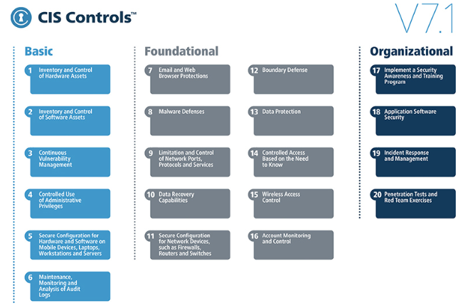
V8

Slide 9
Control Types
Preventative controls
Intended to avoid an incident from occurring
Detective controls
Help identify an incident’s activities and potentially an intruder
Corrective controls
Repair or restore components or systems after an incident has occurred
Deterrent controls
Intended to discourage a potential attacker
Compensating controls
Controls that provide an alternative measure of control

Slide 10
UNH AUP
Information Technology Acceptable Use Policies
Acceptable Use Policy
Defines “Acceptable Use”
Defines “Prohibited Use”
Unauthorized
Illegal
Inappropriate
Damaging
Disguised
Disruptive

Slide 11
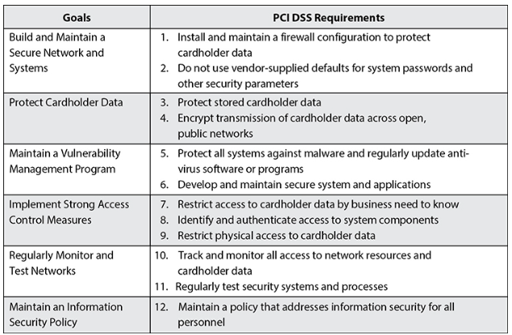

Slide 12
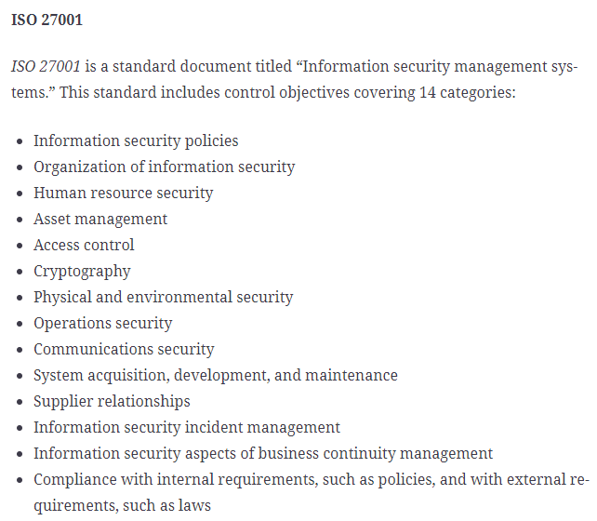

Slide 13
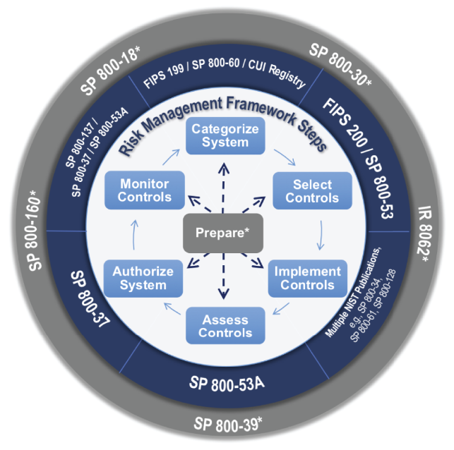
NIST

Slide 14
Joe is authoring a document that explains to system administrators one way in which they might comply with the organization's requirement to encrypt all laptops. What type of document is Joe writing?
Policy
Guideline
Procedure
Standard
Notes:
B. The key phrase in this scenario is “one way.” This indicates that compliance with the document is not mandatory, so Joe must be authoring a guideline. Policies, standards, and procedures are all mandatory.

Slide 15
What law creates privacy obligations for those who handle the personal information of European Union residents?
HIPAA
FERPA
GDPR
PCI DSS
Notes:
C. The General Data Protection Regulation (GDPR) implements privacy requirements for handling the personal information of EU residents. The Health Insurance Portability and Accountability Act (HIPAA) includes security and privacy rules that affect health-care providers, health insurers, and health information clearinghouses. The Family Educational Rights and Privacy Act (FERPA) applies to educational institutions. The Payment Card Industry Data Security Standard (PCI DSS) applies to credit and debit card information.

Slide 16
What organization is known for creating independent security benchmarks covering hardware and software platforms from many different vendors?
Microsoft
Center for Internet Security
Cloud Security Alliance
Cisco
Notes:
B. All of these organizations produce security standards and benchmarks. However, only the Center for Internet Security (CIS) is known for producing independent benchmarks covering a wide variety of software and hardware.

Slide 17
Tonya discovers that an employee is running a side business from his office, using company technology resources. What policy would most likely contain information relevant to this situation?
NDA
AUP
Data ownership
Data classification
Notes:
B. An organization's acceptable use policy (AUP) should contain information on what constitutes allowable and unallowable use of company resources. This policy should contain information to help guide Tonya's next steps.

Slide 18
LAB
Cloud Operational Security (OpSec)

