Slide 1
IT666 : Cybersecurity Practices
Chapter 17: Risk Management And Privacy

Slide 2
Approaches to Risk Mitigation
Avoid
Usually means get out of that business
Use OpenID instead of username/password
Mitigate / Reduce
Do the things we have talked about this semester
Transfer
3rd party (Cloud)
Insurance
Accept
Ignore, Cost of business

Slide 3
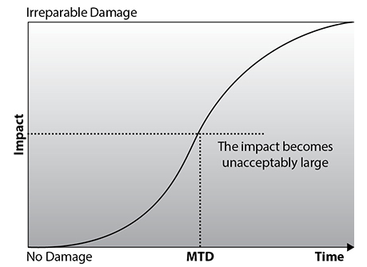
Key Terms
Maximum tolerable downtime (MTD)
Recovery time objective (RTO)

Slide 4
Risk Model Comparison – small sample; lots of models
 | DREAD | FAIR | CVSS
Purpose | Fix a known flaw | Prepare for a potential attack | Standardized vulnerability reporting
Input factors or Components | Damage Reproducibility Exploitability Affected users Discoverability | Likelihood of event Potential damage | Exploitability Impact Temporal Environmental
Methodology | Score each on simple scale. Total determines priority | Coarse grain buckets for simple matrix | Score on groups. Scores weighted.
Primary use | Software bug fixing | Security team(s) setting priority | Patching priority
Source | Microsoft | The Open Group | NIST

Slide 5
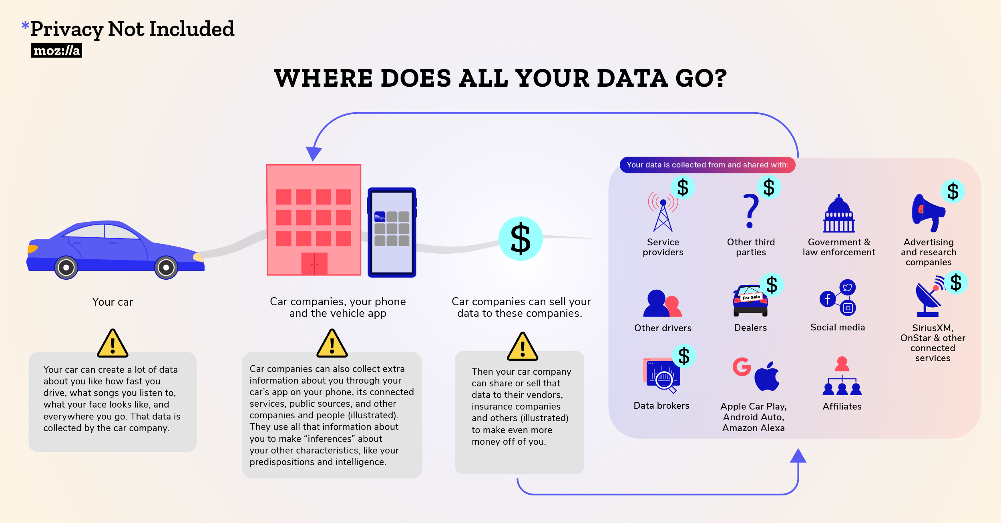
Mozilla Foundation: “Privacy Not Included” Image source
Notes:
All 25
“inferences” about your intelligence, abilities, and interests
6 of 25
“genetic information” or “genetic characteristics”
Nissan
Sexual activity

Slide 6
Do you have a right to privacy?
Part of the constitution in 150 countries
Not specifically mentioned in the USA
The Supreme Court has ruled for implied rights
Does the right to privacy need to be forfeited as part of the social contract to bolster national defence?
A legal mind field we will not cover in class

Slide 7
History: US laws started as crypto = munitions
US export laws
Flawed belief that US was “the source of all crypto”
Chinese law limits import
Fundamentally governments want to spy on others
Snowden effect:
Foreign trend is toward regulations that keep information about citizens in country or at least outside of the USA.

Slide 8
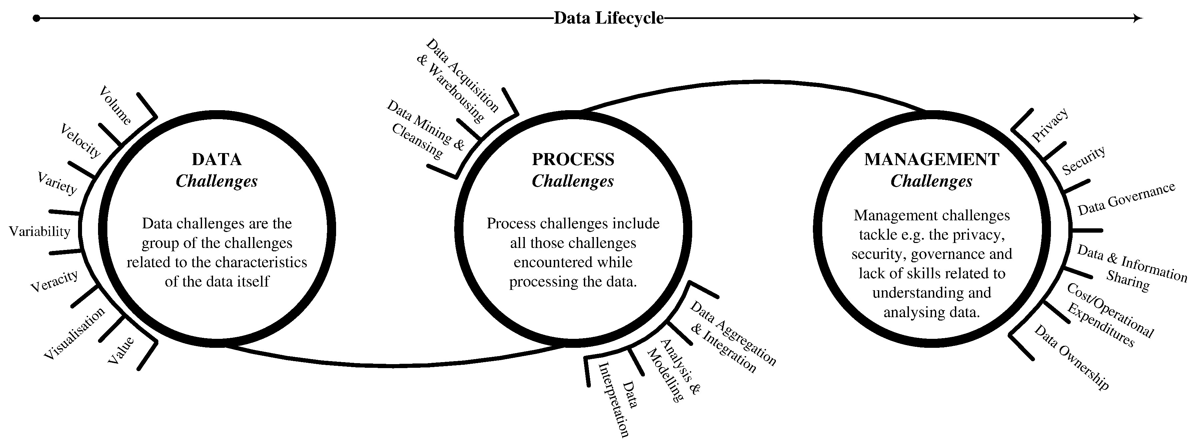
Disconnection of data collection and privacy
https://www.sciencedirect.com/science/article/pii/S014829631630488X#f0005

Slide 9
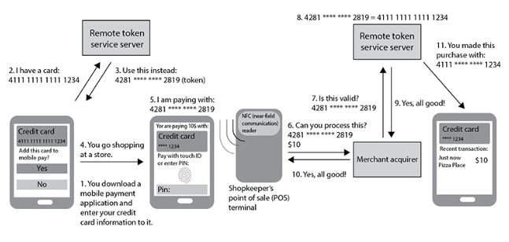

Slide 10
Collecting and Processing Sensitive Data
You must be particularly careful when collecting and processing a specific category of personal data called sensitive data.
Sensitive data is personal information that reveals a person's:
medical information
sexual preference
racial or ethnic origin
political opinions
religious or philosophical beliefs
criminal record
trade union membership

Slide 11
PII Principals
Notice— subjects should be given notice when data is being collected;
Purpose— only purpose stated and not for any other purposes;
Consent— should not be disclosed without the data subject’s consent;
Security— collected data should be kept secure;
Disclosure— subjects should be informed as to who is receiving their data;
Access— subjects should be allowed to access and make corrections to any inaccurate data;
Accountability— subjects should have a method available to them to hold data collectors accountable for following the above principles

Slide 12
Equifax:
After being hacked created a privacy policy
Customers could create an account
Get a free credit report (1 per month)
Place a reporting freeze
Does the promised service uphold the PII Privacy Principles?
http://webreprints.djreprints.com/4197300009442.html

Slide 13
Equifax: Does the promised service uphold privacy?
Notice— No: a freeze does not stop data collection
Purpose— No: if unfrozen who gets your data?
Consent— Yes, but customer action required
Security— No commitment to best practices, peer reviews, or publishing audits of operations
Disclosure— No: still unknown requestors
Access— No statement about fixing inaccurate data
Accountability— No: commitment should be (SMART) Specific, Measurable, Assignable, Relevant, Timely
http://webreprints.djreprints.com/4197300009442.html

Slide 14
What’s The Risk?
Frequency | V.Low | Low | Med | High | V.High
Catastrophic | H | H | C | C | C
Damaging | M | M | H | H | C
Painful | L | M | M | H | H
Distracting | L | L | L | M | M
Insignificant | L | L | L | M | M
CRITICAL
Senior Management
Must Address Immediately
HIGH
Senior Business Management
Must take action to TRANSFER or REMEDIATE
MEDIUM
Asset Owner+[CIO|CISO]
REMEDIATE or ACCEPT
LOW
Asset Owner
Accept

Slide 15
In the end, Grace's risk managers found that the insurance policy was too expensive and opted not to purchase it. They are taking no additional action. What risk management strategy is being used in this situation?
Risk acceptance
Risk avoidance
Risk mitigation
Risk transference
Notes:
A. When an organization decides to take no further action to address remaining risk, they are choosing a strategy of risk acceptance.

Slide 16
Helen's organization maintains medical records on behalf of its customers, who are individual physicians. What term best describes the role of Helen's organization?
Data processor
Data controller
Data owner
Data steward
Notes:
A. In this case, the physicians maintain the data ownership role. They have chosen to outsource data processing to Helen's organization, making that organization a data processor.

Slide 17
Asa believes that her organization is taking data collected from customers for technical support and using it for marketing without their permission. What principle is most likely being violated?
Data minimization
Data retention
Purpose limitation
Data sovereignty
Notes:
C. Organizations should only use data for the purposes disclosed during the collection of that data. In this case, the organization collected data for technical support purposes and is now using it for marketing purposes. That violates the principle of purpose limitation.

Slide 18
Which type of analysis uses numeric data in the analysis, resulting in assessments that allow the very straightforward prioritization of risk?
Qualitative
One-time
Recurring
Quantitative
Notes:
D. Quantitative risk analysis uses numeric data in the analysis, resulting in assessments that allow the very straightforward prioritization of risks. Qualitative risk analysis substitutes subjective judgments and categories for strict numerical analysis, allowing the assessment of risks that are difficult to quantify. A one-time risk assessment offers the organization a point-in-time view of its current risk state. Recurring risk assessments are performed at regular intervals, such as annually or quarterly.

Slide 19
LAB
HTB: Paper

