Slide 1

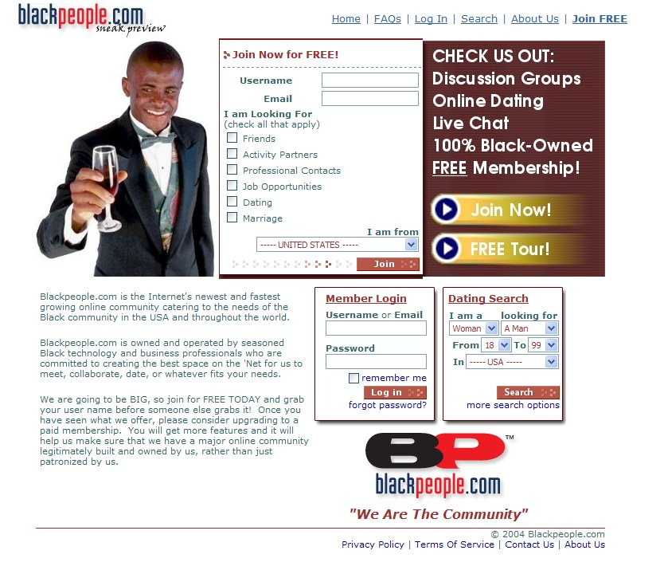
‘We Are the Community’
Q4 ’05 Overview

Slide 2
Business Concept
To Provide a State-of-the-Art Personal and Professional Matching Site Targeting the Global Black Community
Leverage Experience, Track Record and Innovative Incentive Programs to Create a Fiercely Loyal Membership

Slide 3
Competitive Advantages

Slide 4
Business Objectives
Create Passive Income Vehicle for Founders & Investors
Provide alternative means of social connection for Black people
Establish Significant Black-Owned Online Community
Notes:
Create Passive Income Vehicle for Founders
After an initial period of establishing BPC and growing the membership to a critical mass, the ongoing maintenance to maintain a baseline membership level will be reduced to a point where the founding team replaces itself with a permanent staff, freeing the founding team to focus on other ventures.
Provide alternative means of social connection for Black people
Online dating has several advantages over conventional offline dating, which is the reason that it has become a popular social alternative in mainstream society. BPC has an opportunity to establish itself as a vehicle at the forefront of this new social vehicle.
Establish Significant Black-Owned Online Community
All of the leading Black-oriented web sites are non-Black owned. BPC can establish itself as the first major Black-owned community and set a standard of excellence for Black online offerings.

Slide 5
Why Online Dating
(As a Business)?
Growing Audience
Paying Customers
Simple Business
Notes:
Why select Online Dating as a product?
Growing Audience
Online dating represents one of the fastest growing segments of Internet usage.
38 million Americans visited Match, Yahoo Personals and other such sites in October, up from 35 million a year ago. That's about 25% of the Internet population, says researcher comScore Networks. Consumers spent $214 million on online personals in the first half of this year, up from $121 million a year ago, comScore says
Paying Customers
Within an online culture that expects everything to be free, online dating represents one of very few arenas where web users are spending significant amounts of money on an ongoing basis.
According to Jupiter Research analyst, quoted in the News.com article on Match.com, online dating sites will generate $398 mln in revenues this year. They are, according to Jupiter, one of the major markets for online content spending, and will generate $642 mln by 2008.
Simple Business
Online dating represents a very simple business model and operation compared to many online and offline businesses. There is no physical product to deliver, no accuracy or performance to guarantee, and the majority of the financial transactions can be performed electronically and securely through third parties. The site content is provided by the membership, so the content development costs associated with conventional online communities are avoided.

Slide 6
Why Online Dating
(As a Product)?
Convenience
Efficiency
Safety
Notes:
Why do people use Online Dating?
Convenience
For busy people, online dating provides an always-available alternative to social events that may not fit their schedule. Online dating sites also offer a way to meet potential matches who are located in remote locations that conventional offline social events would not provide an opportunity to meet.
Efficiency
Traditional dating forces daters to spend significant amounts of ‘face time’ with a person in order to get to know them, and many people are too nervous in face-to-face scenarios to show any aspects of themselves that may make them subject to rejection by a prospective match. On the contrary, online dating enables a person to select from people who share similar interests and values, and then communicate with them electronically at their own pace to further determine their compatibility before investing ‘face time’ with them.
Safety
When done appropriately, online dating can be much safer than the common practice of meeting total strangers in bars and other offline social venues. Online dating enables one to have extended conversations with a potential date anonymously before sharing any personal information such as a phone number or address. In fact, for many people, the anonymous nature of online dating tends to instill safer dating habits (like not sharing home addresses) than traditional offline dating.

Slide 7
Why The Online Black Community?
Tightly Connected Niche Market
Black Culture Drives Popular Culture
Black Sites Not Black-Owned
URL Has Instant Name Recognition
Notes:
Why are we targeting the Black online community?
Tightly Connected Niche Market
The online Black community is a market that, as in the offline world, is tightly connected. This tight connection makes it easier to deploy unconventional marketing strategies like word-of-mouth and build brand loyalty. While considered a niche market, the online Black community is of a size that is more than adequate to build a significant business on top of. Also, the founding team has significant experience in the Black online world, as well as affiliations with several national predominantly Black fraternal organizations that collectively represent close to a million potential customers.
Black Culture Drives Popular Culture
Black culture is a strong influencer of the arts and fashion in mainstream culture. Thus, in addition to the Black community, many people outside the Black community have a strong enough interest in Black people and culture to join Black-oriented web sites.
The following demographics from Blackplanet.com demonstrate this fact:
Black 11,706,857 90%
White 1,761,023 14%
Latino 1,743,755 13%
Native American 1,321,064 10%
Asian 781,079 6%
Black Sites Not Black-Owned
The most popular Black-oriented web sites are not Black-owned. This represents a unique opportunity to create marketing strategies based on Black self-pride from self-ownership. Also, many users of these sites are not aware of their ownership, and this represents an opportunity to create controversy and ‘buzz’ by publicizing these facts and presenting Blackpeople.com as the replacement product of choice for those who feel tricked or betrayed by their Black-oriented web site.
URL Has Instant Name Recognition
The name Blackpeople.com leverages the fact that ‘Black people’ is a common phrase in language and thus, the name of the web site is already being spoken millions of times each day without us expending a cent in marketing. In fact, without any publicity, over 1500 people have found the existing site on their own and filled out an online survey over the past 2½ months. We expect that we will be able to leverage the familiarity of the name to get significant mileage from our marketing strategies.

Slide 8
The Startup Team
Ken Granderson
Erick Jean
Dale Dowdie
York Eggleston

Slide 9
Online Community Success Philosophy
Features, Strategies, Decisions MUST be either:
  Membership Building, or
  Revenue Building
Most Other Activity Leads to Bankruptcy

Slide 10
Membership Acquisition Plan
Group Owner Incentive Plan
Contests
Life Membership
Do It Now Incentives
Network Marketing Program
Notes:
BPC will use a variety of techniques to build memberships, including:
Group Owner Incentive Plan
Owners of Black-oriented Yahoo Group are directly connected to over a million Yahoo members. Currently, Yahoo offers zero compensation or incentives to Group owners. Our Group Owner Incentive Plan will offer sales commissions to Yahoo group owners who move their groups to BPC. We will provide Yahoo Group owners with software that will collect the e-mail addresses of all of their group members and join them to BPC as free members. Then, when any of their members become paid subscribers, we will pay them a commission on their monthly membership for as long as they remain a paying subscriber.
Contests
Contests will be used to drive membership at zero risk to BPC.
Life Membership
Do It Now Incentives
Network Marketing Program

Slide 11
Revenue Streams
Subscriptions
Strategic Partnerships
Advertising
Affiliate Programs
Paraphernalia
Notes:
Subscriptions
BPC’s primary source of revenue will come from subscriptions, paid on a monthly, quarterly or annual basis. The monthly subscription rate will be around $20.00 per month and wil be discounted for longer terms.
Strategic Partnerships
BPC will form strategic partnerships with other firms that have complementary products and services to BPC’s features and/or membership base. Two examples under consideration are Nia Online, who sells access to its 40,000 woman membership as a panel for firms needing market research, and Tag Team Marketing, a Black-owned network marketing firm.
Advertising
While not anticipated to be a major source of revenue for BPC, once the membership base has grown to a critical mass, BPC will be able to attract significant online advertising contracts. During the membership ramp-up phase, several innovative no-risk advertising strategies may be deployed where the advertiser will only be billed after advertising coverage has been delivered.
Affiliate Programs
BPC may elect to participate in affiliate programs (i.e. Amazon) and strategically place links to affiliate partner’s web sites to generate sales commissions from BPC member purchases on affiliate sites.
Paraphernalia
As the blackpeople.com brand name is established, it will crate a market for promotional paraphernalia, including t-shirts, baseball caps, other garments and promo items.

Slide 12
Revenue Model - Subscription Plan
‘Membership’ is Free
For $20/month
Discount For Longer-Term Subscription Commitments
Basic and Premium Subscription Levels
Life Membership Option
Notes:
‘Membership’ is Free
Following the most common model used in online dating sites, a free basic membership level will be offered. This basic membership will enable the member to post a profile and search other profiles, but they will have severely limited abilities to contact other members. This membership level will boost our membership numbers and provide free members a zero-risk way to preview the site.
Subscriptions Cost Monthly Fee
In order to contact other members, members will have to become paid subscribers. Several subscription terms will be offered, with discounts offered for longer term commitments. Also, a lifetime subscription option will be provided as a single flat fee as an early membership booster. All subscriptions will be paid via electronic transactions (credit/debit card, EFT from checking account, etc).
Subscription Levels
In addition to several subscription terms, several subscription levels will be offered that will provide different features (i.e. advanced search features, search result rankings) to different subscriber levels. We will use a variety of incentives and other techniques to encourage subscribers to upgrade to the highest (= most expensive) subscriber levels.

Slide 13
Revenue Model - Strategic Partnership Plan
Identify Complementary Partners To:
  Leverage Our Membership Numbers or
  Increase Our Membership Numbers
Notes:
Identify Complementary Partners
We will look to partner with other firms where there are complementary products or needs.
For example, we are in discussions with Nia Online, who uses their Black female membership of 40,000 as a consumer focus group panel and sells consumer marketing services to companies looking to market to the Black female demographic. We are also looking at Tag Team Marketing, a Black network marketing organization who we are considering collaborating with to deploy a network marketing strategy for our subscriptions.
To Leverage Membership Numbers
A partnership with a firm like Nia will be based on the fact that they provide a way to derive additional value from our membership after we have gotten them to become subscribers and have nothing else to offer them, and we will provide them with an order of magnitude larger membership than they currently have.
To Increase Membership Numbers
A partnership with a firm like Tag Team Marketing will help us increase our membership numbers, while providing significant revenue for the partner as they help us build our membership.

Slide 14
Revenue Model - Advertising Plan
Leverage Network Hubs, Centers of Influence, Niche Targeting Techniques
‘Incentivize’ Affinity Yahoo Group Owners to Move Groups to BPC
Encourage Third-Party E-Mail Chain Letters Supporting BPC
Conduct Affinity Market-Oriented Contests
Do Conventional Online Advertising when Membership Reaches Critical Mass
Until Then, Use ‘Zero-Risk Advertising’ Techniques
Notes:
Do Conventional Online Advertising on Critical Mass
Once our membership base has achieved a critical mass (of about 1 million members), BPC will be an attractive place for national advertisers to place online ads.
Do Zero-Risk Advertising Until Then
Until that critical mass has been reached, online advertising programs can be conducted in a zero-risk manner, where the advertisement will be placed on the site and tracked, but the advertiser only pays when predetermined exposure thresholds are achieved. Another method of zero-risk advertising is to conduct contests where by the time BPC has to pay out the prize, so much revenue has been collected that the cost of the prize is inconsequential, and the maker of the prize pays BPC for advertising and gives us the prize for promotional consideration anyway.

Slide 15
Revenue Model - Affiliate Program Plan
Join Selected Affiliate Programs
  Amazon, etc.
Create Affiliate Program for 3rd Parties Wanting to Promote BPC
Notes:
Join Selected Affiliate Programs
BPC may elect to participate in affiliate programs (i.e. Amazon) and strategically place links to affiliate partner’s web sites to generate sales commissions from BPC member purchases on affiliate sites.

Slide 16
Revenue Model - Paraphernalia Plan
Sell Branded Para on Site
  T-Shirts
  Baseball Caps
  Underwear
  Mugs
  Bumper Stickers
Give Away Para at Strategic Events
  Greek Shows
  Penn Relays
  Spring Break
Get Celebrities to Wear Gear
  Target Black-Conscious Celebs
Notes:
As the blackpeople.com brand name is established, it will crate a market for promotional paraphernalia, including t-shirts, baseball caps, other garments and promo items.

Slide 17
Membership / Revenue Goals
Free Basic Membership
(Look but Can’t Talk)
Basic Monthly Subscription - $20/mo
2006 Goal – 10,000 Subscribers
2006 Goal => $200K/mo
2007 Goal – Multiply via MLM
2007 Goal => $600K/mo
Notes:
2005 - $200K/mo
Our 2005 goal is to build a membership of 10,000 paying subscribers. Based on free member to paying member ratios from the American Singles IPO document, we estimate that we will need to have 420,000 to one million subscribers to achieve a paying membership of 10,000.
At a basic subscription price of $20.00 per month, 10,000 paying subscribers represents a $200,000 per month revenue stream.
2006 - $800K/mo
Based on the plan to launch a network marketing program in 2006 to sell subscriptions and maintain the subscriber base, our 2006 revenue goal is to generate $800,000 per month from a paying subscriber membership of 40,000.

Slide 18
Membership - Building Features
Discussion Groups
Branded E-Mail
Chats
Surveys
Blogs
News/Events
Notes:
Groups
BPC will offer free online Discussion groups (made popular by Yahoo and MSN) organized by Discussion Topic
Dating
Online dating, the ability to post and search personal profiles, will be the primary revenue driver for BPC.
Messages
A key feature of online dating, the messaging system will enable members to make anonymous contact with each other before deciding to share personal information with a potential match.
Chat
Live chat services will enable members to talk with each other in real-time in groups of two or more.
Surveys
Group owners will create online surveys to get feedback from their group members and improve their groups (this is really big in the Yahoo Group world). BPC management will also utilize surveys to gather marketing intelligence from the membership.
Blogs
Members will be able to create web logs (a/k/a Blogs) of their thoughts and/or daily lives for others to read (don’t ask, it’s one of the hottest things out there)
News /Events
Members will be able to post news and events to inform other members of things going on in their area.

Slide 19
Revenue - Building Features
Searchable Personal Profiles
Separate Lifestyle Communities
Searchable Professional Profiles
Reverse Profile Matching
Safe Messaging
Match Agents
Notes:
Groups
BPC will offer free online Discussion groups (made popular by Yahoo and MSN) organized by Discussion Topic
Dating
Online dating, the ability to post and search personal profiles, will be the primary revenue driver for BPC.
Messages
A key feature of online dating, the messaging system will enable members to make anonymous contact with each other before deciding to share personal information with a potential match.
Chat
Live chat services will enable members to talk with each other in real-time in groups of two or more.
Surveys
Group owners will create online surveys to get feedback from their group members and improve their groups (this is really big in the Yahoo Group world). BPC management will also utilize surveys to gather marketing intelligence from the membership.
Blogs
Members will be able to create web logs (a/k/a Blogs) of their thoughts and/or daily lives for others to read (don’t ask, it’s one of the hottest things out there)
News /Events
Members will be able to post news and events to inform other members of things going on in their area.

Slide 20
Business Operation Principles
Low Overhead
Guerilla Marketing
Minimal Staffing
Virtual Staffing
(‘Not Com’)

Slide 21
2-Year Plan
Launch ‘Sneak Preview’ in January ’06
Soft Launch in July ’06 (Maybe June)
Grand Opening in September ’06
Community Spin-Offs in September ‘07

Slide 22
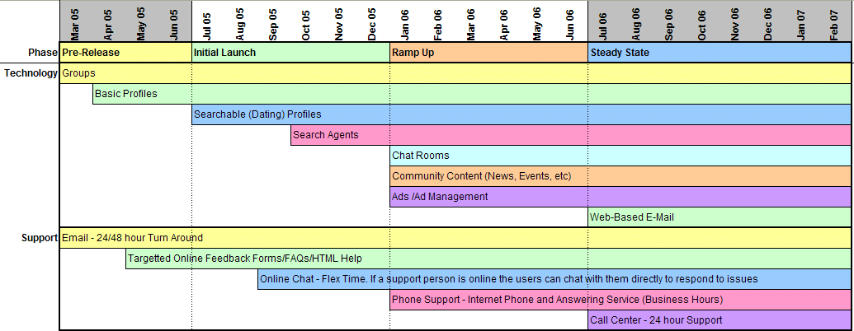
2-Year Plan – Technology/Support

Slide 23
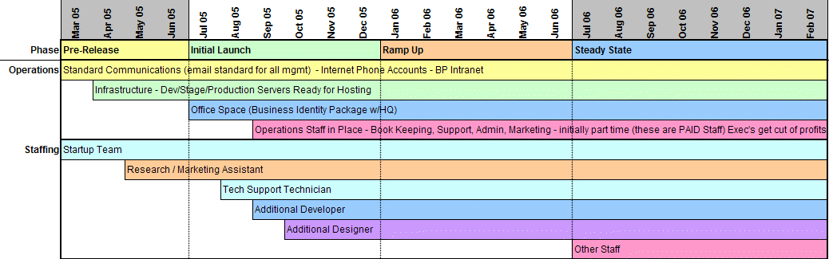
2-Year Plan – Operation/Staffing

Slide 24
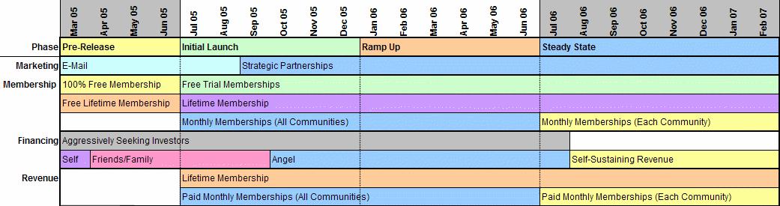
2-Year Plan – Marketing, Membership & Finance

Slide 25
Long-Term Plan
Hire (Small) Permanent Staff, Retain as Passive Income Vehicle
Sale to Larger Firm

Slide 26
Conclusions
Hot Industry
Unique Offering for Niche Market
Perfect Timing
Solid Team
Excellent Investment Opportunity

