Slide 1

44 Wolcott St. ♦ Dorchester, MA 02121 (617) 740‑9339/VOICE ♦ (617) 740-9653/FAX
http://www.blackpeople.com
BUSINESS PLAN
Kenneth Granderson: kennyg@blackpeople.com
Martin Welch: mwelch@blackpeople.com
Luis Barros: lbarros@blackpeople.com
Randal Pinkett: rpinkett@blackpeople.com
Confidential
September 15, 1999
© 1999 blackpeople.com

Slide 2
Contents
Contents
I. Summary
II. Management Team
III. Opportunity Conditions
IV. Product and Service
V. Market Research and Target Market
VI. Competitive Analysis
VII. Entry Strategy and Growth
VIII. Financial Analysis
IX. Risks and Problems
X. Appendix

Slide 3
Summary
Contents
I. Summary
II. Management Team
III. Opportunity Conditions
IV. Product and Service
V. Market Research and Target Market
VI. Competitive Analysis
VII. Entry Strategy and Growth
VIII. Financial Analysis
IX. Risks and Problems
X. Appendix

Slide 4
Summary
What is the problem that blackpeople.com
is trying to solve?
The Problem: An estimated 10 million sites exist on the Web of which only 500 to 1,500 are Black oriented. To date, no on-line content provider has emerged as the Internet site of choice for obtaining information related to Black history and culture and offering e-commerce.
The Solution: blackpeople.com will fill this void by offering a comprehensive, “state of the art” content, commerce, and community offerings aimed specifically at people of African descent.

Slide 5
Is this an important problem to solve? blackpeople.com is an Internet portal targeted towards people of African descent throughout the world. Our unique combination of the right content, the right services and the right people will fill four needs in the marketplace:
Summary
The need for more Black-oriented online content to cater to the current population of 5 million Blacks online, which is expected to reach 12 million in the year 2000*
The need for segments of this same population to see themselves represented in the high-tech industry, as stakeholders.
The need for timely, personalized information to be delivered to its membership via the World Wide Web.
The need to assist “grass roots” minority-owned content providers an automated methodology for streamlining content for more widespread access and distribution.
Source: Forrester Research

Slide 6
blackpeople.com will also provide community building and shopping features, with an emphasis on Black empowerment and prosperity:
Summary
We will distinguish ourselves from other present and upcoming Black-oriented web sites by a strong participatory and group-oriented focus.
We will leverage our technology expertise to incorporate and use member feedback in every area of the site, recruit members to moderate content areas, and track all member activity.
We will use this information to reward members with prizes, including merchandise and eventually shares of stock in the company.

Slide 7
Summary
What is the solution? The KILLER APP… the 6 C’s
Content by Black, local, grass roots content providers (publishers, newspaper entities, and music broadcasting)
Commerce partnership with minority-owned entities
Community Authoring Model, enabling a site “created for you, by you”
Culturally and Locally Focused: Web Search, Events Calendar, Viral Marketing, News Alert, Job Posting, Games and Fantasy Leagues
Controlled and operated by Black people
Capitalized by Black people

Slide 8
Management Team
Contents
I. Summary
II. Management Team
III. Opportunity Conditions
IV. Product and Service
V. Market Research and Target Market
VI. Competitive Analysis
VII. Entry Strategy and Growth
VIII. Financial Analysis
IX. Risks and Problems
X. Appendix

Slide 9
Why this Team? The founding team has extensive experience in startups, internet and software programming and development, and sales and marketing (see Exhibit A for resume and biographies)
Management Team
Kenneth Granderson: CEO of Inner-City Software since 1992; Board of Directors Urban League of Eastern Mass; MIT, BS, Computer Science; five years of Black online community building on CompuServe and the Internet, along with its technical expertise in building online community technology; MIT Community Fellow; Honorary Doctorate in Humane Letters from Salem State.
Martin Welch: Born, raised and currently residing in Cambridge, Massachusetts, Martin Welch is ICS’ Senior Analyst. Self-taught Martin specializes in dynamic intra/internet application development enterprise class database development and desktop application development.
Randal Pinkett: Ph.D. Candidate, MIT Media Lab; MIT, MBA and MS Electrical Engineering; Rhodes Scholar, MS Computer Science, University of Oxford. Research focused on technology and African-Americans; worked at AT&T Bell Laboratories; President and CEO of MBS Enterprises, an educational services and training firm that targets African-Americans.
Luis Barros: 12 years of sales, mktg, business development in high-tech; MIT, MBA; Adjunct E-Commerce Professor @ UHartford. Prior experience in launching 3 e-commerce entities; Has consulted several leading media organizations on various aspects of e-commerce and internet marketing, including one of Internet’s leading portals; Co-author of published paper on B2B e-commerce and B2C personalization and portal strategy. Advisory Board of 2 dotcoms: ZipLip.com and Colleges.com.

Slide 10
What prior experience does the team have in this area? Inner City Software and its CEO have a track record of successful initiatives with technology and with Black people:
Management Team
Inner City Software Projects since 1992
  Operates Boston’s #1 e-mail discussion group for blacks, Boston Blacks Online
  Designed and developed Black Facts Online, Black History CD ROM, New England Black Pages Online
  Inner City Software’s Press includes: Black Enterprise, Ebony Man, NY Times, Washington Post, Boston Globe, Boston Herald, All Major Network Television News in Boston
  CEO received honorary doctorate form Salem State College in 1999 in recognition for his leadership and vision in bringing communities of color into the Information Age

Slide 11
Opportunity Conditions
Contents
I. Summary
II. Management Team
III. Opportunity Conditions
IV. Product and Service
V. Market Research and Target Market
VI. Competitive Analysis
VII. Entry Strategy and Growth
VIII. Financial Analysis
IX. Risks and Problems
X. Appendix

Slide 12
Why Now? Portals, aka, gateways to the Internet, are designed to be the first entry point for users going on-line. Portals are amongst the hottest locations on the World Wide Web, representing seven out of the top ten visited sites.
Opportunity Conditions
Most of today’s portals are horizontally focused, or targeted to a general audience, with little specialization or consideration for difference in demographics. They are trying to be all things to all people (e.g., AOL & Netscape, MSN sites, Yahoo, Lycos, GO Network, Geocities, , and Excite).
Our market research indicates that a need for super segmentation, or a vertical portal opportunity exists for the special interests and needs of black people.
The market has validated a vertical portal for women, ivillage.com
The BET.com venture secured more than $35M in financing from Microsoft, AT&T Liberty Media, Newscorp, and USA Networks
Major backers such as Tribune Company (Blackvoices.com), AOL (NetNoir) and Cox Communications (Blackfamilies.com) have invested millions to develop portals for the African-American community.

Slide 13
Product and Service
Contents
I. Summary
II. Management Team
III. Opportunity Conditions
IV. Product and Service
V. Market Research and Target Market
VI. Competitive Analysis
VII. Entry Strategy and Growth
VIII. Financial Analysis
IX. Risks and Problems
X. Appendix

Slide 14
What is the Solution? An overview of the website layout of blackpeople.com showcases the “sticky” features (keep the customer coming back), “non-sticky” features, and e-commerce offerings… members are issued an affinity card for usage when offline.
Product and Service
Sticky
  B-Mail™
  Chats
  Relationships
  Local/National Ethnic News
  Local/National Ethnic Events
  Local Resource Listings
  Games & Fantasy Leagues
Non-Sticky
  Business Certification
  Black History Section
  Culturally Focused Web Search
  Stock Listings
  Travel and Weather
E-Commerce
  African American Shopping Mall
  Auctions
  Books and Book Clubs
  Music
  Insignia
  Movies/DVD
  Job Posting

Slide 15
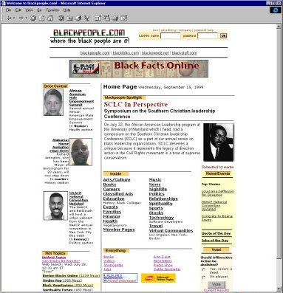
Website Demo
Product and Service

Slide 16
Market Research and Target Market
Contents
I. Summary
II. Management Team
III. Opportunity Conditions
IV. Product and Service
V. Market Research and Target Market
VI. Competitive Analysis
VII. Entry Strategy and Growth
VIII. Financial Analysis
IX. Risks and Problems
X. Appendix

Slide 17
Why this demographic? The Black community has substantial buying power that is growing:
Market Research and Target Market
According to American Demographics Magazine Blacks are becoming increasingly powerful. Recent estimates show that the buying power of blacks is between $380B and $480B.
A study by Target Market News called "The Buying Power of Black America" reports the earnings of African Americans increased in 1996 by 13%.
The buying power (as measured by disposable income) is growing almost two and a half times as fast as inflation; this accounted for 8.2% of U.S. consumer power and stood at $469B in 1997.
Between 1990 and 1997 buying power increased 54 percent for blacks, as compared to 41 percent for all U.S. residents.
According to the Chicago Tribune, although Black consumers represent only 12% of the U.S. population Blacks provide 31% of the revenues for cosmetics and 35% of the revenues for soft drinks, and 40% of the revenues for compact discs, cassettes, and movie tickets.

Slide 18
Why this demographic? Young, middle-class and upper-class Blacks represent the strongest segment of this population:
Market Research and Target Market
The nation’s African American population is much younger on average than most other segments of the population. Blacks are younger than the general U.S. population -- median age in 1999 29.9 and the entire US population was 35.2; Blacks are also becoming a larger percentage of the US population.
Young, Internet savvy consumers will be the focus of major Internet and electronic commerce marketing efforts because these groups will be more likely to shop online.
There is an increasing number of middle and upper income African American households. Generally, the personal income of Blacks has steadily risen over the last few years. Though obtaining consistent data on this trend is difficult, some studies suggest that average annual income of African Americans signing up for African American targeted-content sites is between $55,000 to $60,000.

Slide 19
Why this demographic? The profile of Blacks and minorities online is promising:
Market Research and Target Market
According to IDG…
African-American adults are the largest minority group online, accounting for 36% of minorities on the Internet (24% Hispanic, 10% Asian, 5% Native American).
There are approximately 4M Black adults using the web in the US (7% of the 55.9M US adults overall).
Minorities with incomes of $50,000 or higher are almost as likely to go online from home as whites (53% vs. 63%).
Minorities’ propensity to click on online advertisements is twice that of whites (41 clicks per month vs. 24 clicks per month).
Minorities are more likely to value the Internet for information access than are whites (75% vs. 68%).

Slide 20
Why this demographic? The profile of Blacks and minorities online, and their spending related to technology is strong:
Market Research and Target Market
African Americans now account for 25% of all online spending. AOL estimates that it has 500,000 Black subscribers which translates into $117 million/year in subscription revenues for AOL.
According to several recent articles and reports, owners of various World Wide Web sites targeted toward African Americans have seen huge increases in hits as Blacks search the Web for information about their communities.
According to the Augusta Chronicle Online…
Black spending on computer hardware and software has doubled every year from 1993-95, totaling $741M in 1996.
Black household spending on consumer electronics rose 18% to $3.8B, while white household spending in that area was unchanged at $49B.
According to the Los Angeles Times, middle-class Blacks in the US are the fastest growing segment of first-time buyers of home computers.

Slide 21
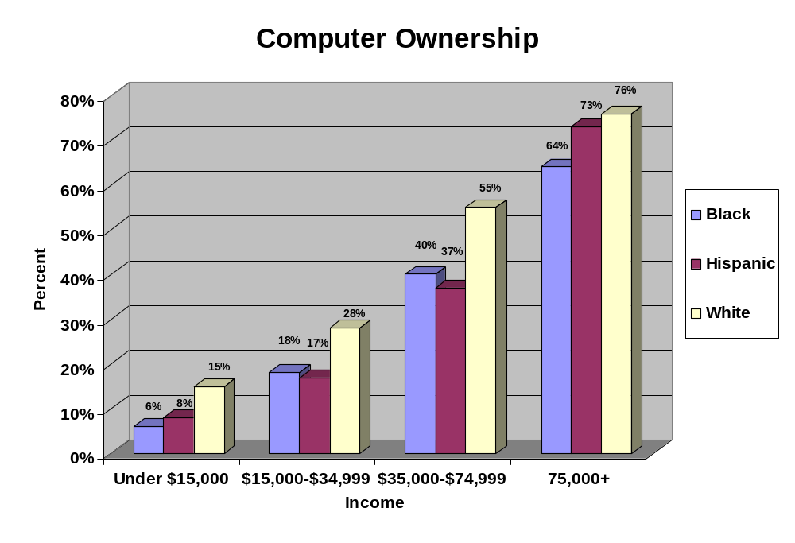
What is the target market? The penetration of computers is highest amongst middle-class ($35,000 - $74,999) and upper-class ($75,000+) Blacks:
Market Research and Target Market

Slide 22
Competitive Analysis
Contents
I. Summary
II. Management Team
III. Opportunity Conditions
IV. Product and Service
V. Market Research and Target Market
VI. Competitive Analysis
VII. Entry Strategy and Growth
VIII. Financial Analysis
IX. Risks and Problems
X. Appendix

Slide 23
Are there competitors? Competitive Analysis of the online African American suggests that the market has players, but there is still room for “state of the art” innovation. Our recent research identified the following websites:
Competitive Analysis
1. http://www.msbet.com
2. http://www.netnoir.com
3. http://www.tbwt.com
4. http://www.aumagazine.com
5. http://www.blackvoices.com
6. http://www.essence.com
7. http://www.vibe.com
8. http://www.blackenterprise.com
9. http://www.wanonline.com
10. http://www.ebonymag.com
11. http://www.everythingblack.com
12. http://www.afroam.org
13. http://www.platform.net
14. http://www.urbansportsnetwork.com
15. http://www.losnegroes.com
…barriers to entry include branding via advertising and IT costs. Amazon.com spent $32M or 24 cents/dollar for advertising in 1998 to brand its site; IT costs are estimated to be $2M to start the company

Slide 24
What is the state of the art of what’s out there? None of the existing our upcoming portals seem to have developed the “killer app” for them to become the site of choice
Competitive Analysis
Insert competitive analysis results here

Slide 25
Entry Strategy and Growth
Contents
I. Summary
II. Management Team
III. Opportunity Conditions
IV. Product and Service
V. Market Research and Target Market
VI. Competitive Analysis
VII. Entry Strategy and Growth
VIII. Financial Analysis
IX. Risks and Problems
X. Appendix

Slide 26
What’s the execution model? We will target middle-class ($35,000 - $74,999) and upper-class ($75,000+) Black people from the following groups, in the following order:
Entry Strategy and Growth
African-American Professionals (age 21-45)
African-American College Students (age 17-21)
African-American Teens (age 13-19)
African-American Children (age 8-12)
African-Caribbean
Africans

Slide 27
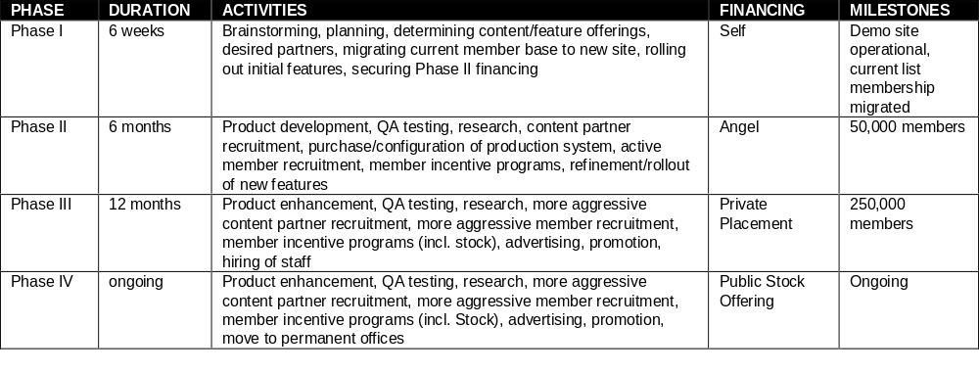
What’s the execution model? blackpeople.com will be developed in four phases:
Entry Strategy and Growth

Slide 28
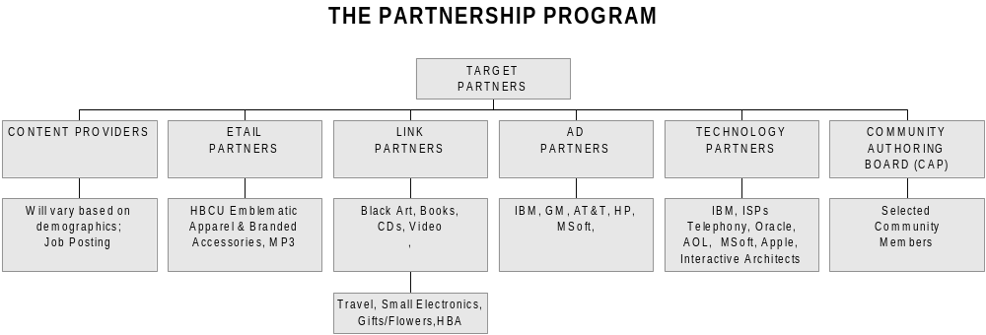
What’s the execution model? The Partnership Program is designed to provide a complete solution to all major stakeholders…
Entry Strategy and Growth

Slide 29
What are the key next steps? In order to create significant value and capitalize blackpeople.com with angel and venture financing the key next steps are:
Entry Strategy and Growth
Sign up key content providers and publishers to centralize and be the conduit for ethnic content delivery on blackpeople.com and their site; create affiliate type section to allow content providers and publishers to feed news to blackpeople.com.
Secure 6 major advertisers (including major credit cards, major periodicals, major content provider, and major corporation); investigate possible media partner.
Develop software to enable content news feeding, news alert technology, job posting, provide survey capabilities, community calendar and offer games and fantasy leagues online.
Establish radio program content with WBLS, 107.5 FM or local DJs from stations such as WILD, WERS or WBUR (commercial free).
Establish channel for independent urban music online via streaming local content.
Secure relationship with insignia manufacturer for apparel, accessories, etc.; investigate affinity or co-brand programs in credit card and insurance.
Secure affiliate relationship with major e-merchants in the black art, book, music and movie/DVD category; investigate free-pc/ISP joint marketing.

Slide 30
Financial Analysis
Contents
I. Summary
II. Management Team
III. Opportunity Conditions
IV. Product and Service
V. Market Research and Target Market
VI. Competitive Analysis
VII. Entry Strategy and Growth
VIII. Financial Analysis
IX. Risks and Problems
X. Appendix

Slide 31
How do you make money? membership in blackpeople.com will be free. Revenue will be generated through a variety of means, including:
Financial Analysis
E-commerce Transaction Fees:
  and rebates from online purchases completed on the site or referred from the site
E-commerce E-Tail & Link Partners:
  percentage of transaction on Black Art, Music, Books, HBCU Apparel and Branded Accessories, Video Tapes/DVDs
Partner E-commerce Transaction Fees:
  charges and rebates from other transactions such as job placements and classified ads
Banner Advertising (click-thru rates):
  paid advertising targeted to members based on preference data mined over time
Partner Member Fees:
  charges for premium services and joint marketing efforts
Membership Subscription Fees (long-term):
  charges for premium services

Slide 32
What’s the major variable cost? One of the unknowns is how much blackpeople.com will have to spend on direct to consumer advertising in comparison to the Internet norm:
Financial Analysis
On average, on-line retailers spent $26 on marketing and advertising
per sale in 1998, while the brick and mortar retailers spent only $2.50...
until Internet retailers can find a way to attract and keep customers without
such an enormous outlay, they are all going to have a hard time making any money.”
NY Times Magazine, March 14, 1999, Section 6 “Amazon.com, Earth’s Biggest What, Exactly?”

Slide 33
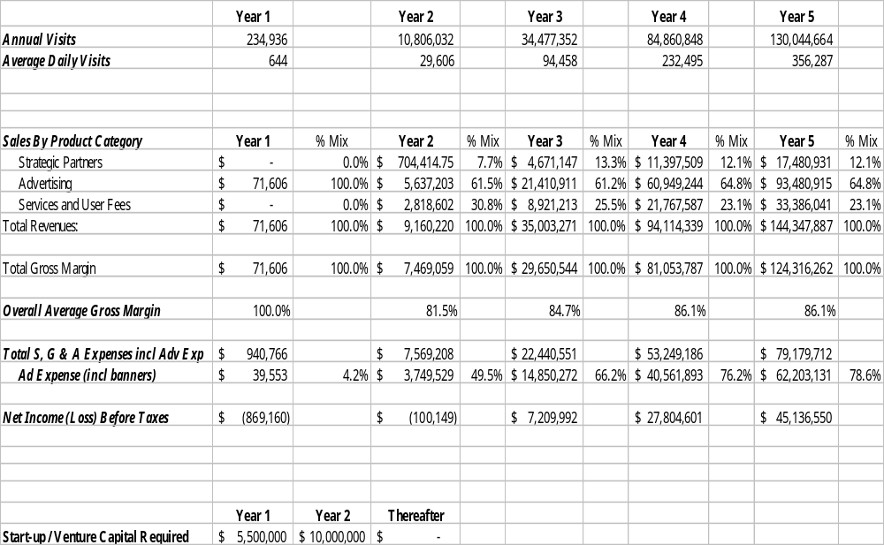
Financial Analysis

Slide 34
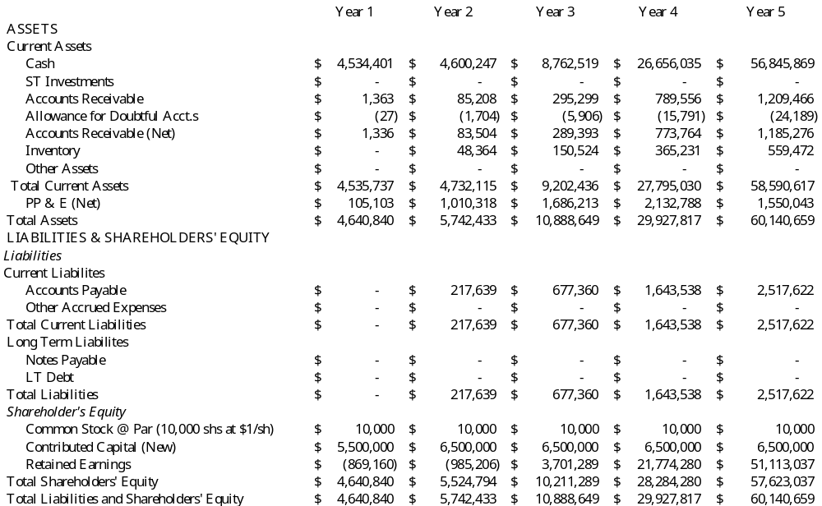
Financial Analysis

Slide 35
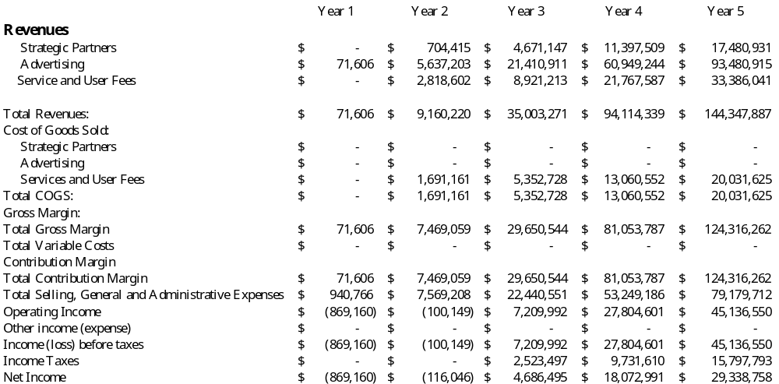
Financial Analysis

Slide 36
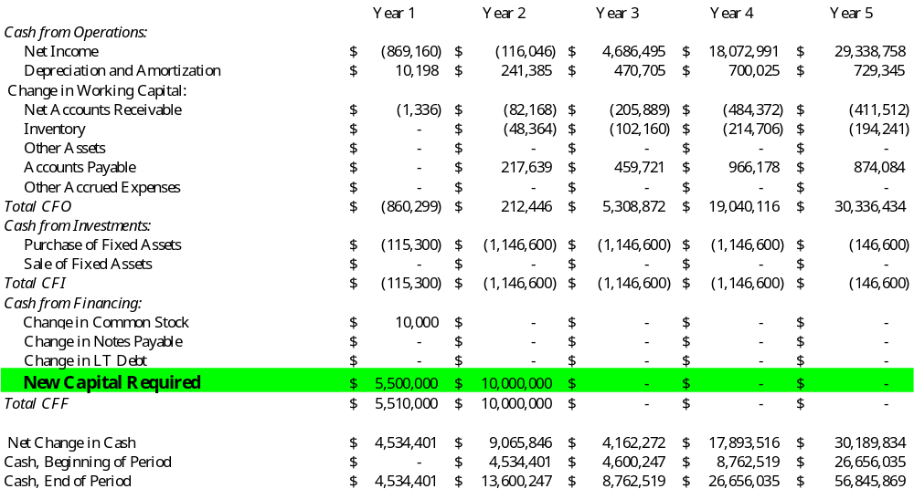
Financial Analysis

Slide 37
Investment Proposal
Financial Analysis
Option 1
      Invest $5M for 30% of blackpeople.com
      The capital will be utilized for forming management team, setting up company infrastructure, and acquiring customers
      blackpeople.com will execute a secondary offering upon achieving milestones set out after 1st round of financing
Option 2
      Invest $2.5M for 15% of blackpeople.com
      The capital will be utilized for forming management team and acquiring customers
      blackpeople.com will execute a secondary offering upon achieving milestones set out after 1st round of financing; with this level of funding the company infrastructure will not be fully built

Slide 38
Risks and Problems
Contents
I. Summary
II. Management Team
III. Opportunity Conditions
IV. Product and Service
V. Market Research and Target Market
VI. Competitive Analysis
VII. Entry Strategy and Growth
VIII. Financial Analysis
IX. Risks and Problems
X. Appendix

Slide 39
There are challenges to growth in online retailing:
Risks and Problems
More black people need to be online
Increasing Consumer Comfort Level of convenience, customization, selection, service and pricing.
Resolving Technology Limitations with increase in traffic and “hits”
Scaling rapidly internal operations in fulfillment, customer service, and database technology and management.
Developing low-cost distribution
Resolving perceived channel conflicts
Overcoming online credit card 2orries
Addressing the return hassle
Providing sufficient service for “the want to see in person” market
Ensuring privacy and confidentiality and ensuing junk e-mail
Sources: Shop.org/BCG Survey http://www.shop.org/research/reschallenge.html and http//www.emarketer.com/enews/022299_icono.html

Slide 40
There are risks associated with the market, technology and people:
Risks and Problems
Competitive threats
  Competitor getting to market faster and eating our lunch
  Competition from incumbent players who have big media backing
Technological/product uncertainty
  getting the systems and technology to work
Internet uncertainty
  susceptible to any change in the adoption of the Internet, catastrophic breakdown or failure for whatever reason including regulation and taxes
Financial uncertainty
  stock market may crash or the internet bubble may burst
  Venture funding for internet companies may dry up
  IPO prospects will be lower
  Downturn in stock values will affect others’ abilities to acquire the company
People uncertainty
  company might not be able to find or retain the right mix of people outside of the core team to execute on this idea

Slide 41
Contents
I. Summary
II. Management Team
III. Opportunity Conditions
IV. Product and Service
V. Market Research and Target Market
VI. Competitive Analysis
VII. Entry Strategy and Growth
VIII. Financial Analysis
IX. Risks and Problems
X. Appendix

Slide 42
Appendix
Appendix
Exhibit A: Biographies and Resumes
Exhibit B: Website Layout

Slide 43
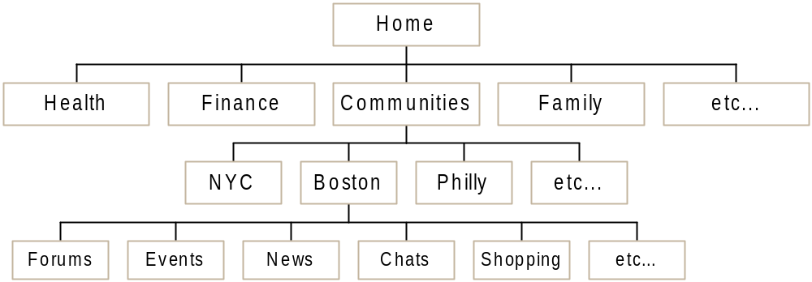
Website Layout
Appendix
Boston Blacks Online
Bay State Banner
Unity First
Online News
The Black Library
Black Talk Radio

Slide 44
Key Components
Appendix
Advertisers
Purchase Ads
Companies looking to market to Black community
Content
Partners
News | Personals
Events | Shopping
Discussions | Private Clubs
Chats/Instant Messaging | Personal Home Pages
Classified Ads | Auctions
Games | Music
Jobs | E-Mail
Read
Chat
Debate
Buy
Sell
Author
Post
Members
Grassroots and large media companies who create Black content
Griots
People interested in Black culture and affairs
Approve
Author
Post
People interested in Black culture and affairs
Vendors
Create Stores
Sell Products
Companies looking to sell products
directly to Black community

