Slide 1
ROXBURY.COM

Slide 2
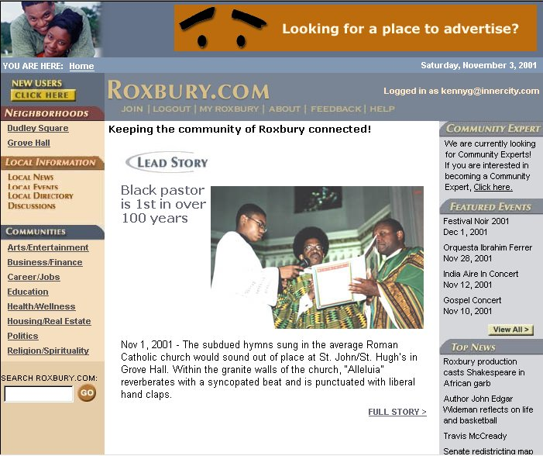
What is ROXBURY.COM?

Slide 3
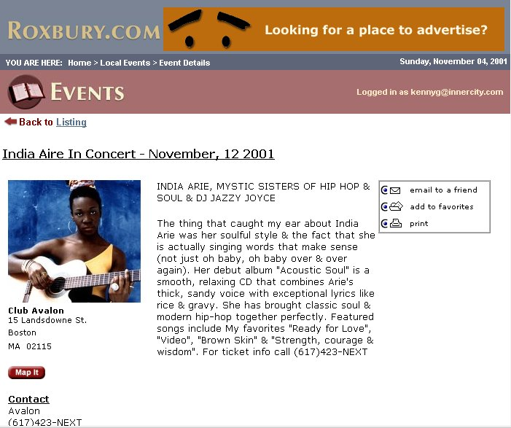
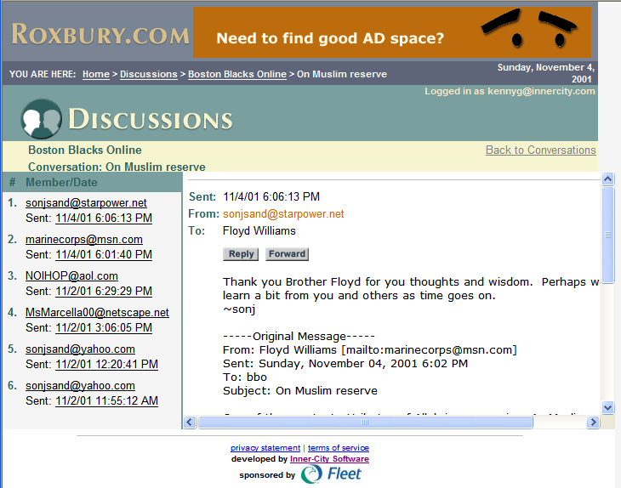
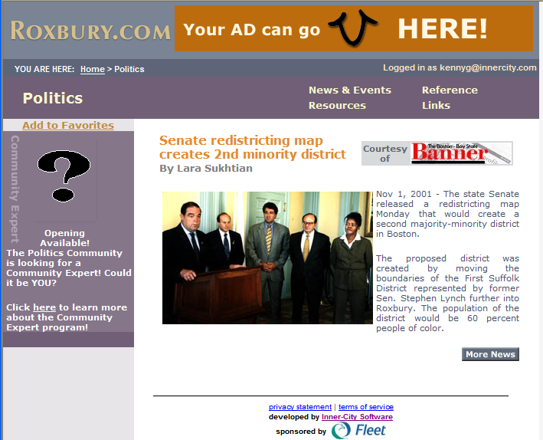
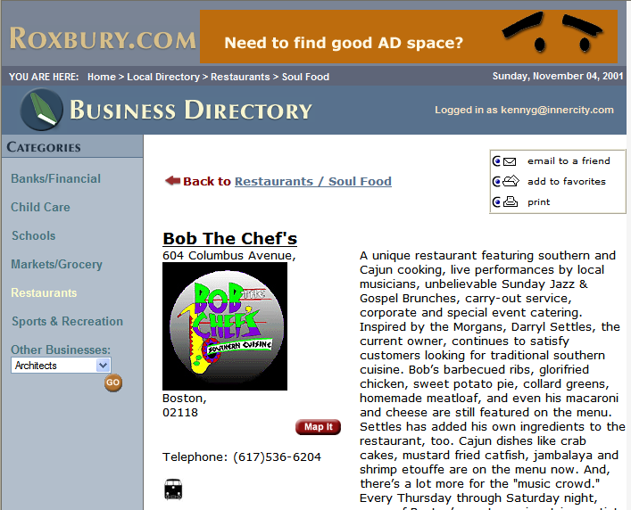
ROXBURY.COM IS:

Slide 4
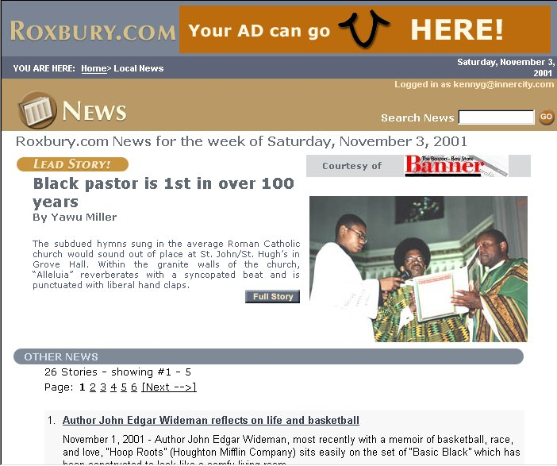
COMMUNITY NEWS

Slide 5
COMMUNITY EVENTS

Slide 6
COMMUNITY DIRECTORY

Slide 7
COMMUNITY DISCUSSIONS

Slide 8
SPECIAL INTEREST AREAS

Slide 9
ROXBURY RESIDENTS
Read Local News
Find Out About Local Events
Look Up Local Businesses
Look Up Local Organizations
Talk to Neighbors
FREE Membership

Slide 10
ROXBURY ORGANIZATIONS
FREE Event Posting
FREE Announcement Posting
FREE Directory Listing
FREE Web Space

Slide 11
ROXBURY BUSINESSES
FREE Event Posting
FREE Announcement Posting
FREE Directory Listing
FREE Web Space
FREE Advertising

Slide 12
See Roxbury.com on January 8th!
Freedom House
6:30pm - 8:30pm

