Slide 1

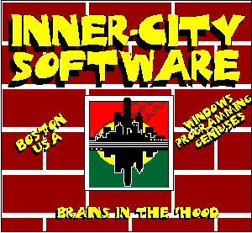
Visual Basic for Fun & Profit
NSBE National Conference
March 29, 1997
Notes:
This presentation was delivered to an audience of approximately 40 engineering students and technical professionals at the National Society of Black Engineers 23rd Annual National Convention on March 29th, 1997.
The presentation, entitled “Visual Basic for Fun and Profit,” described and demonstrated the features and benefits of Microsoft’s Visual Basic programming environment. The presenter, Kenneth Granderson of Inner-City Software, combined lecture with a hands-on demonstration of the ease of use of Visual Basic by guiding a volunteer from the audience (who had had some programming experience but had never used Visual Basic previously) through the creation of their first Visual Basic application.
The application, a program launcher that reads its data from an Access database, was built from scratch by the volunteer in front of the audience, and was then used to launch the sample applications used during the rest of the presentation.

Slide 2

AGENDA
Introduction to ICS
Why Visual Basic?
Visual Basic History
Visual Basic Programming Model
Things To Do With Visual Basic
Your First Visual Basic Application
Programming Demonstrations
Product Give-Aways
Visual Basic Resources
Notes:
Place holder

Slide 3
Introduction to ICS
ICS History
  Began Selling Software via CompuServe in 1991
  C Language
  C++, VB2
  VB3, Database, VBX
  VB4, Web
ICS Skillsets
  C++
  Visual Basic
  VBX Controls
  ActiveX Controls
  Databases
  ASP Web Sites
Notes:
While ICS has only been officially in existence since 1993, ICS founder Ken Granderson began selling software back in 1991. While we began using the C language, we moved to C++ around the same time that we started working with Visual Basic, then in its second release.
Later, with Visual Basic 3.0, we moved into database development and creating VBX controls.
For the past year, we have been doing most of our work in Visual Basic 4 and the web.
ICS’s current skill sets include C++, Visual Basic, developing VBX and ActiveX controls, databases, and developing interactive web sites using Active Server Pages.

Slide 4
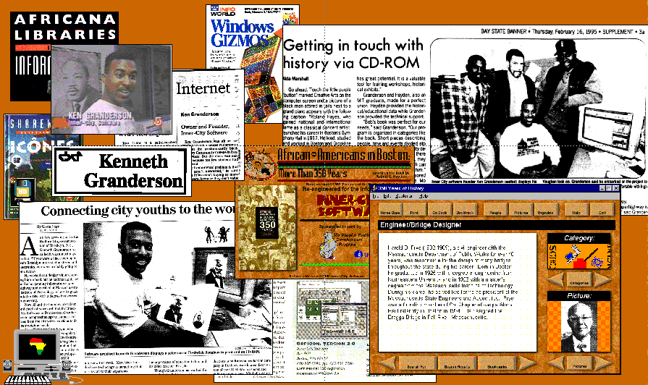
Inner-City Software:
Bringing Computer Technology to the People
Notes:
ICS’s slogan is “Bringing Communities of Color Into the Information Age.”
In the Boston area, ICS has brought community-oriented technology products and services to Boston’s communities of color since 1995, with our landmark multimedia adaptation of noted historian Robert Hayden’s 1992 book “African Americans in Boston: More Than 350 Years”
Since then, our neighborhood web sites set up in 1996 and our Black Facts Online interactive web site (http://www.blackfacts.com) have taken Boston’s black community online and created a global resource for learning about the events and contributions of people of color.

Slide 5
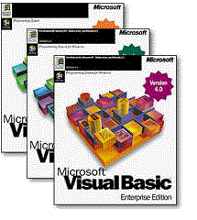
Why Visual Basic?
Visual Basic Advantages
  RAD
  Visual Programming
  Visual/Interactive Debugging
  Interactive Editing Environment
  Easy Language Features
  Extensive Third-Party Support
  Cross-Application Flexibility
Visual Basic Disadvantages
  Execution Speed
  Language Limitations
  Single Platform Support
Notes:
Visual Basic Advantages
RAD
Visual Basic is a Rapid Application Development (RAD) environment that enables you to quickly prototype the interface of an application and incrementally fill in the functional details.
Visual Programming
The Visual Programming paradigm allows you to design most, if not all, of the application interface in WYSIWYG mode, rather than designing the look and feel via textual definitions of visual components.
Visual/Interactive Debugging
Visual Basic lets you debug your application in the same graphical environment that you design in. When errors occur, you can stop the program, change the offending code and continue without restarting the program in most cases. You can also examine and modify the values of most variables and call system and user defined functions in the middle of program execution.
Interactive Editing Environment
Far more than just another text editor, the Visual Basic development environment watches while you type and alerts you to any syntax errors.
It also helps you write functions by interactively displaying possible options and showing you function parameter lists as you type.
Easy Language Features
Based on the classic BASIC programming language, Visual Basic maintains the syntactical simplicity of BASIC (no semicolons, lots of English keywords), along with programmatic simplicity (no pointers, automatic memory management and variable declaration) while supporting advanced programming language features (user-defined types and classes, scoped variables, modular programming).
Extensive Third-Party Support
Designed to be extendable via components developed by outside vendors, Visual Basic has created the world’s largest third party add-in market with many thousands of VBX and ActiveX controls available to perform everything from displaying pictures to performing voice recognition and statistical analysis.
Cross-Application Flexibility
With each revision of Microsoft Office, the world’s most popular suite of office software, the programming languages embedded in the Office applications and the Visual Basic programming language converge more and more. Major blocks of VB code can be dropped into Word, Access and other Office applications and will run without any alterations. The original VBX control specification has matured into the ActiveX specification, which now allows any 32-bit application to extend its capabilities via ActiveX just like Visual Basic. Also, the Visual Basic engine is being embedded in many third party products, making it possible to control and get data from these other applications without learning proprietary scripting and macro languages.
Visual Basic Disadvantages
Execution Speed
Up until Version 5.0, Visual Basic has produced semi-compiled executables that have suffered greatly from performance problems. Version 5.0 brings new compilation options that claim to bring VB application execution speed into the same ballpark as C and C++ applications.
Language Limitations
While many object-oriented extensions have been added to the language, the Visual basic language is not completely OOP as it does not support inheritance.
Also, while the lack of pointers makes VB programs virtually crashproof, it also makes certain programming tasks difficult or impossible without the help of extension DLLs or ActiveX controls.
Single Platform Support
Visual Basic is currently only available on the Windows platform, and no plans seem to be in the works to port it to Macintosh or Unix. However, with statistic after statistic showing 90+% of all computers running some version of Windows (and more moving to Windows every day), this may not be a problem unless you or your target user is in that other 10% of the market.

Slide 6
Visual Basic History
Version 1.0
  May 1991
  Visual Programming Environment
Version 2.0
  October 1992
  More Controls
  256 Color Support
Version 3.0
  April 1993
  Third Party Matures
  Database Support
Notes:
This is a brief overview of the history and features of each version of Visual Basic.

Slide 7
Visual Basic History
Version 4.0
  August 1995
  32-bit Version
  More Object Oriented
  OLE DLLs
  Source Control
Version 5.0
  April 1997
  32-bit Only
  ActiveX Controls
  Internet Integration
Notes:
This is a brief overview of the history and features of each version of Visual Basic.

Slide 8

VB Programming Model
Event-Driven Programming
Controls
Forms, Modules, Objects, Classes
Properties, Methods, Events
Notes:
Event-Driven Programming Model
In more traditional programming environments, nothing happens unless you write code to make it happen. Your functions do not get called unless you call them. In the event-driven model, things happen all the time whether you write code or not. Most of your code is either overriding default behaviors or performing a task when the operating system calls your function.
Controls
Controls are pre-built widgets or gizmos that provide specific functionality to your application, such as the ability to display and print charts and graphs. Many Visual Basic programs are little more than just enough code to manage communication between the controls that do all of the work of the application.
Forms, Modules, Objects, Classes
Forms are the windows and dialog boxes that comprise the visual display of your program (if any).
Modules are units of programming code intended to be called from any point in your program.
Objects are abstractions of functional units that other programmers have developed such as database query results, word processing documents or web browsers. Objects expose various functions and other attributes that the programmer can use to utilize the functionality of the object.
Classes are objects that you create in Visual Basic code yourself. You define the programming interface and control the object via other Visual Basic code. You can also create classes that can be called by other Visual Basic and non-Visual basic applications.
Properties, Methods, Events
Properties are attributes of forms, controls and objects that let you discover something about the item and/or control a setting of the item. Common properties include Background color, Caption and Height. More specialized properties include the number of items in a list, the field in a database that a control is linked to, or an error code denoting the last error that occurred in the control.
Methods are essentially object-defined functions that generally cause something to happen to a form, control or object, such as moving its screen position or setting the keyboard focus to a control.
Events are things that happen to your form, control or object from both user actions and automatically. For instance, when a form (window) is created and shown on the screen, the Load event gets fired in the form. When the form closes, the Unload event is fired. Events happen whether or not you have written any code to handle them. If you do have some event code, it gets executed when the appropriate event happens.

Slide 9

Things To Do With VB
Tool Development
Database Development
Game Development
Advanced (API) Development
Object-Oriented Development
Internet Development
OLE Development
Component Development
Notes:
Tool Development
Visual Basic is perfect for writing small tool applications that automate repetitive tasks that can be easily modeled in software.
Database Development
Visual Basic’s database features make it possible to view, edit and delete data without writing a single line of code. While the greatest support is available for the Microsoft Access database file format, any database that has ODBC drivers (basically all databases with significant market share) can be used with Visual Basic.
Game Development
While performance issues have kept Visual basic from becoming a tool of choice for action game developers, strategy and board games can be easily created with Visual Basic.
Advanced (API) Development
Almost all of the thousand or so functions that comprise the Windows Application Programming Interface (API) are callable directly from Visual Basic. This capability opens VB programs up to the full depth of programming options available in the Windows environment, though it becomes very easy to make errors that will crash your application when you start messing with the API.
Object-Oriented Development
You can create functional objects that handle a specific task, like sending Internet mail for someone who does not have an e-mail account, or calculating the result to a complex problem based on user inputs. You can then distribute your object to others within your organization, or even allow access to its functionality via the Internet.
Internet Development
Visual Basic 5.0 comes with controls that let you add FTP and other Internet functionality to your applications in seconds. If you have Internet Explorer installed on your system, with a single line of code, you can embed a web browser directly into your application.
OLE Development
The perfect glue to connect the Microsoft Office suite of applications, Visual Basic fully supports OLE in-place activation to let you embed Word, Excel and other application views directly within your Visual Basic application.
Component Development
Visual Basic 5.0 now lets you create ActiveX controls that you can distribute to the general public to enable specific functionality in their stand-alone applications or web pages.

Slide 10
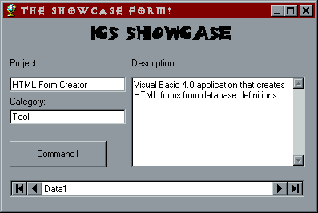
Your First VB Application
ICS Showcase
Notes:
Here is what you missed if you were not at the workshop.
Randy, a member of the audience who has done some programming but had never worked with Visual Basic before, volunteered to help us out.
With some guidance from the presenter, Randy was able to create a Visual Basic program launcher application that connected to a previously built Access database that contained the program names and parameters for demonstration programs used during the rest of the presentation.

Slide 11
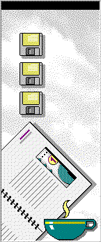
Programming Demonstrations
Tool Application
  HTML Form Creator
  Image Master
Corporate Application
  Accounting System
End-User Application
  350 Years
Game
  Reversi (aka Othello)
Internet Application
  Black Facts Online
Notes:
We demonstrated several applications developed in various versions of Visual Basic:
Tool Application
HTML Form Creator
A very simple tool that opens Access and ODBC database tables and creates HTML code for input forms based on a selected database table.
Image Master
Used with our multimedia title on Boston’s Black History, Image Master was created to automate the process of merging, centering and color balancing the 120 images used in the “350 Years of History” title.
Corporate Application
Accounting System
Created as a demo for a major Internet service company, this advanced database application combines user interface paradigms of the Windows Explorer and Intuit’s Quickbooks.
End-User Application
350 Years
“African-Americans in Boston: More Than 350 Years” uses Microsoft’s MediaView multimedia authoring libraries along with a VBX control that ICS developed to deliver a fully searchable and indexed multimedia version of historian Robert Hayden’s book on Boston’s Black History.
Our MediaView VBX is also used in all of NEC’s recent notebook models as part of their System Tour application.
Game
Reversi (aka Othello)
This public-domain game is a Visual Basic version of the game well known as Othello, which was included in Windows 2.x and 3.x as “Reversi.” Note: This game was not written by ICS,
Internet Application
Black Facts Online
Using Microsoft’s Active Server Pages (ASP) technology, Black Facts Online (http://www.blackfacts.com) is a complex cleint-server database application with a web interface. ASP uses server-side Visual Basic (VBScript) to enable robust, full featured interactive web applications in fractions of the time needed using other client server and scripting technologies.

Slide 12
Product Give-Aways
Notes:
Thanks to the generosity of Microsoft, we were able to give away a copy of the Visual Basic Control Creation Edition to 13 lucky workshop attendees.
One very lucky winner won a full copy of Visual Basic 5.0!

Slide 13

Visual Basic Resources
Microsoft Visual Basic Home Page
  http://www.microsoft.com/vbasic/
  http://www.microsoft.com/vbasic/links/
Carl & Gary’s
  http://www.apexsc.com/vb/
Books
  Doing Objects in Visual Basic
  Visual Basic Internet Programming
  Black Art of Visual Basic Game Programming
  Using VBScript
  Special Edition Using Visual Basic 4
  Visual Basic 4 Secrets
  User Friendly Using Visual Basic 4
  Visual Basic 4 How-To
CD-ROM Training
  Mastering Microsoft Visual Basic 4.0
Notes:
Here are some online, printed and software resources for Visual Basic developers.

Slide 14

ICS Resources
Black Developer’s List
92 Black Engineering Students
and Technical Professionals
blackdev@innercity.com
Send Mail to:
adrienne@innercity.com
Notes:
We at ICS would like to be a resource for up and coming Visual Basic developers, so we established an Internet listserv to serve as a communication vehicle for developers of color throughout the world. Known as the BlackDev list, it is a FREE, private listserv that you can join by sending mail to the address listed above.

Slide 15
Notes:
Well, that’s all for now! Keep coming back to innercity.com to stay up to date on what ICS is doing. You never know, we may be in your neighborhood sooner than you think and we would love to meet you!

