Slide 1
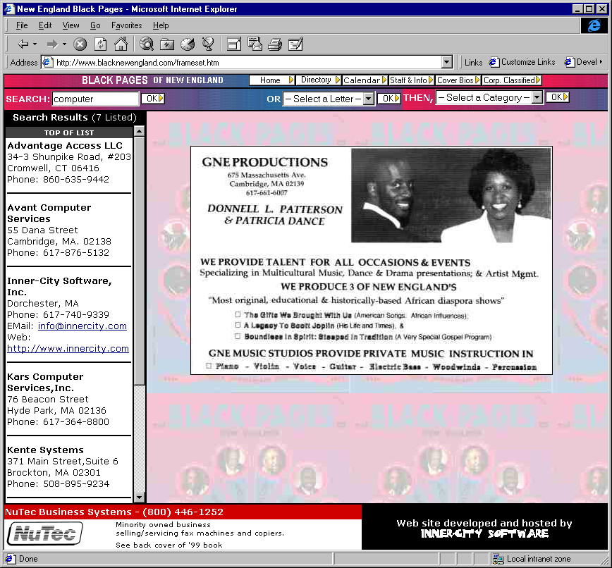
1998
New England Black Pages
The Internet’s First Searchable Black Business Directory

Slide 2
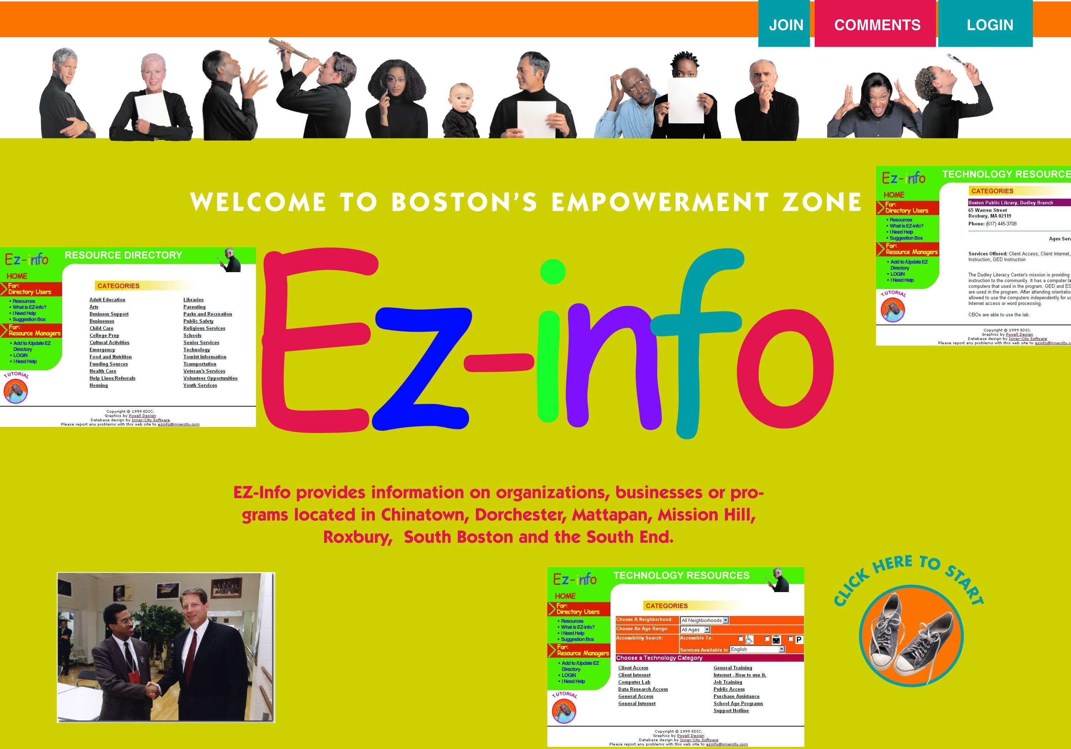
1999
Boston’s Empowerment Zone
Put Thousands of Boston Businesses online
Presented to Vice President Al Gore

Slide 3
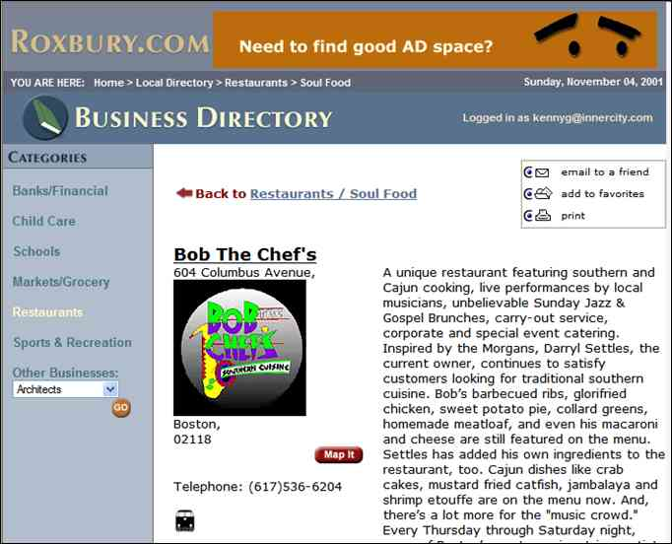
2002
Roxbury.com Business Directory
Self-Service Business Directory
2 Years Before Yelp.com was Founded

Slide 4
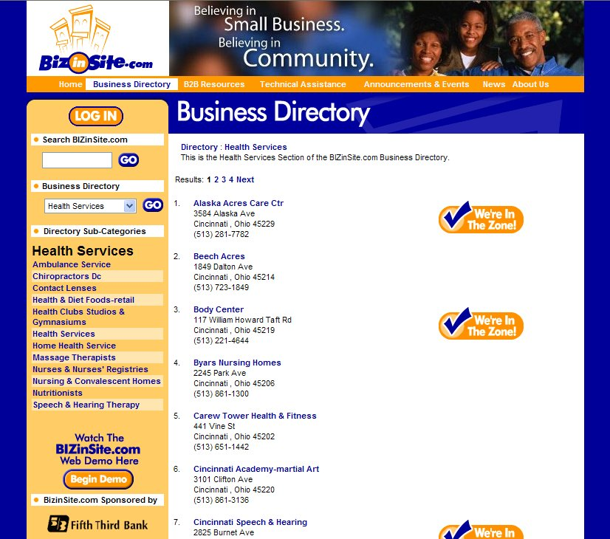
2004
Cincinnati Biz-In-Site Business Directory
Online Directory of Empowerment Zone and Minority Businesses
Community Reinvestment Act Project

Slide 5
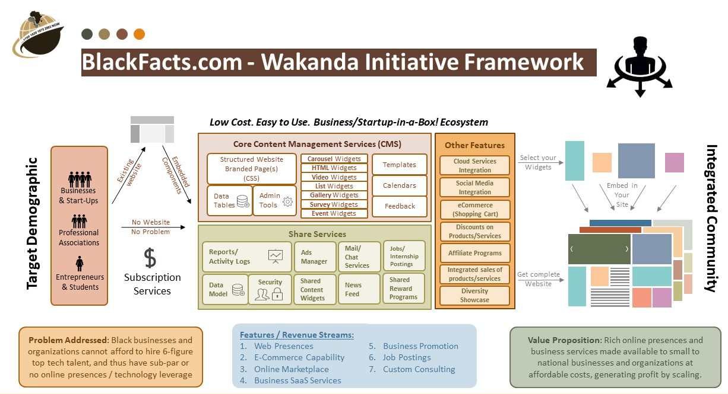
2022
Wakanda Marketplace Business Directory
(Concept)
Digital presence for businesses without websites
Integration with social media
Promotion on third-party sites
Advertising and commerce for businesses w/existing sites
Crypto token-based loyalty programs
Generative Artificial Intelligence Powered
Multilingual Speech Recognition

