Slide 1
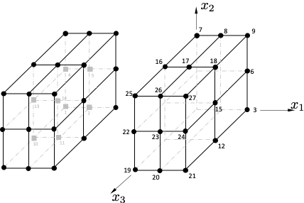
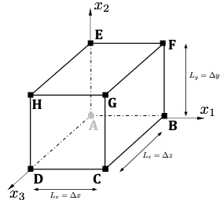
Node Sets
Vertex
(A node can appear only once)
Edge
Face
A 1
B 3
C 21
D 19
E 7
F 9
G 27
H 25
FG 18
AD 10
HG 26
AB 2
GC 24
EA 14
BC 12
EH 16
FE 8
CD 20
FB 6
HD 22
EHDA 13
FGCB 15
BADC 11
FEHG 17
FEAB 15
GHDC 23
Internal
14

