Slide 1
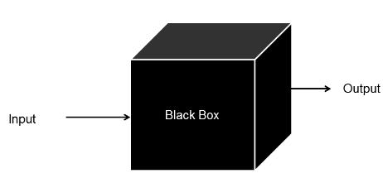
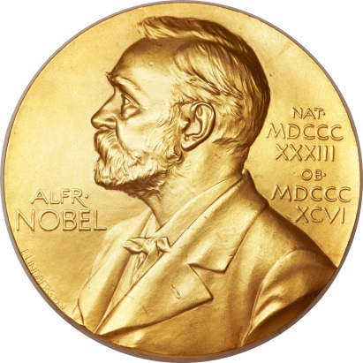
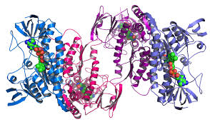
Mass Spectrometry
and
Proteomics
Mark M. Ross (mmr6q@virginia.edu)
Mass
spectrometer

Slide 2
Research Plan
What is the research objective/hypothesis?
What is the experimental strategy and why?
What are the expected results, new information, impact?
What can go wrong, and what to do when it does?

Slide 3
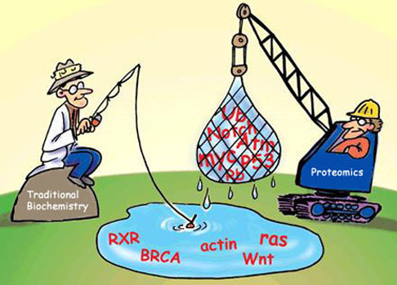
Protein Analysis (now Proteomics)
Proteomics (M. Wilkins, 1994) is the study of proteins, for example, identification, modification, expression, interaction, role in biological processes, and usually on a large scale (class, function, organelle, cell, fluid, tissue, species)
Genome -> Proteome
Genome Proteome
20K-30K genes (known) 100Ks (unknown)
“Static” (essentially) Dynamic
Not site specific Site specific
Amplification possible No amplification
Instructors Effectors
"Proteomics includes not only the identification and quantification of proteins, but also the determinations of their localization, modifications, interactions, activities, and, ultimately, their function."
- Stanley Fields , Science, February 16, 2001.
Notes:
"-ome" and "-omic" mania kicked off with the genome, a neologism which today describes the complete DNA sequence of an organism. The term itself, however, was coined as early as 1920 by German botanist Hans Winkler as a portmanteau of the words gene and chromosome. The genome was soon followed by the transcriptome (a term for all RNAs encoded by the genome) and the proteome (the translated and modified protein products of these transcripts).
More than 100 “-omes or -omics” at http://www.genomicglossaries.com/content/omes.asp
Transcriptome, peptidome, metabolome, kinome, secretome
Diseaseome, systeome, psychiatome…unknome

Slide 4
Example: Proteomics Research Plan
What is the research objective (“unmet need”)?
Identify and quantify proteins with altered properties
due to a biochemical perturbation (e.g., cells -/+ drug)
What is the experimental strategy and why?
Develop and implement a mass spectrometric (MS)
method (cite similar studies)
Other methods will not provide adequate data
Sample complexity, sensitivity, specificity, dynamic range
What are the expected results, new information, impact?
Differentially expressed or modified proteins (phosphorylation)
Insights into a biological process (signaling)
Biomarkers of disease or drug treatment (aberrant signaling)
What can (will) go wrong, and what to do then?
Limited phosphopeptide identification efficiency
Try a different enrichment or fragmentation methods

Slide 5
A Component of the Research Plan: Mass Spectrometry
Why mass spectrometry?
What are the advantages/disadvantages v. other methods?
What should be understood of the technology?
How is instrument/method performance evaluated?
How are the data converted to results?
How are the results converted to information?

Slide 6
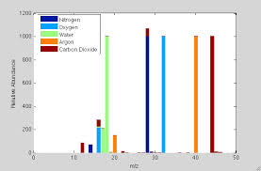
Mass Spectrometry 101
Source
EI, CI
SIMS, FD/FI, FAB
MALDI, ESI
Fractionation
Peptide, protein, lipid
Off-/On-line LC
Analyzer
Sector, TOF, Quad
Trap (Quad, FT)
Detector
Electron multiplier
FT
N₂⁺, CO⁺
1. Sample preparation
Complexity, concentration, contaminants
Assays (gel)
2. Sample analysis/data acquisition
LC: column, solvents, gradient
MS: m/z range, mass accuracy/resolution
MS^{n}: ion fragmentation (CAD, ETD)
3. Data analysis
Qualitative – What is it?
Quantitative – How much?
4. Results analysis
Information -> New knowledge
18
28
32
40
44
Computer #1
Instrument control
Mass
spectrum
Relative Abundance
m/z
Computer #2, #3,…
Informatics
Bioinformatics
Infx: Qual. (ID – Air); Quan. (%/ppm)
BioInfx: Function, (re)activity, etc.
“…in essence, a glorified scale that weighs molecules."

Slide 7
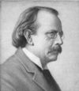
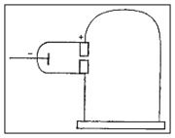
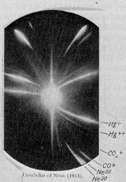
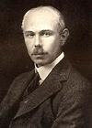
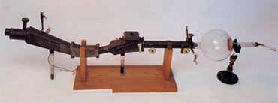
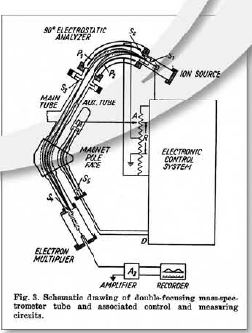


MS History
1900s
J.J. Thompson, “Father of MS”
1906 NP physics - electron
F.W. Aston
1922 NP chemistry - isotopes
Mattauch, Herzog
Double-focusing MS (B and E)
1940s
Calutron (Lawrence)
Neir, isotope separation
First commercial MS – gas analysis
1950s
Gas discharge, FI, SIMS
First GC-MS (McLafferty)
Increasing technology
1960s
High resolution MS (B/E sectors)
CI (Munson and Field); ESI (Dole)
First commercial quadrupole MS
Peptide sequencing (Biemann)
Notes:
http://masspec.scripps.edu/mshistory/perspectives/timeline.php

Slide 8
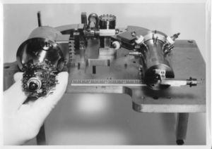
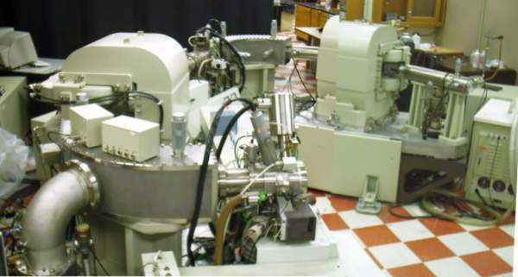
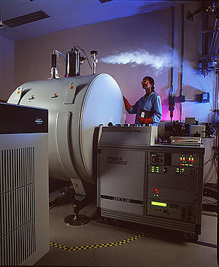
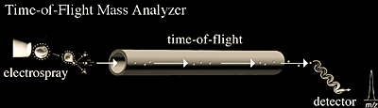
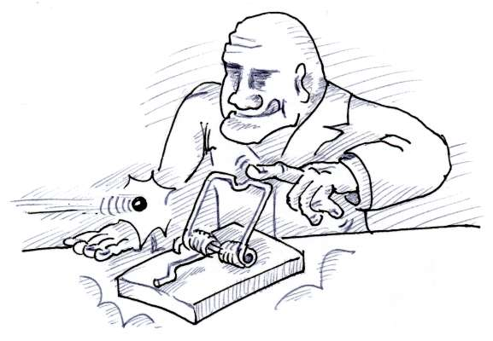
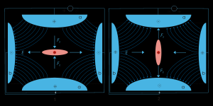
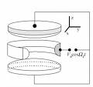

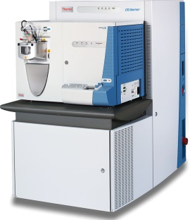

MS History
1970s
Desorption ionization (PD, FAB)
Fourier transform, TSQ MS
Tandem MS (MS/MS)
1980s
MALDI, ESI (2002 NP chemistry)
TOF, Quadrupole, Sector MS, QTOF
Advanced peptide sequencing (MS/MS)
1990s
Ion trap MS (W. Paul, 1989 NP physics)
Biological applications
Proteomics begins
2000s
Linear trap MS
Orbitrap (A. Makarov)
Proteomics
http://masspec.scripps.edu/mshistory/
Notes:
http://masspec.scripps.edu/mshistory/perspectives/timeline.php

Slide 9
MS History and Applications
Early 1900s: Physics
Small gaseous atoms/molecules, isotopes
Simple, limited instruments (B, E fields)
J.J. Thompson, F.W. Aston
Biology
Clinical
Defense
Environmental
Food and drug safety
Forensics
Materials
Meteorology
Pharmaceutical
Space exploration
Future
Miniaturization
Sensors
Clinical diagnostics
?
1940s-1970s: Chemistry
-Larger gases/volatile molecules, surfaces
-More complex instruments
-GC/MS, MS/MS
-Environmental & Petroleum (McLafferty)
1970s – present: Biology
-Non-volatile, macro-molecules
-Peptide sequencing (Biemann)
-Even more (overly) complex instruments
-Bench-top (simpler?) instruments
-LC/MS, MALDI, ESI
1/19/2015

Slide 10
Proteins Structure, Function, Analysis
[French protéine; Late Greek prōteios, of the first quality;
Greek prōtos, first; ]
Any of a group of complex organic macromolecules that contain
carbon, hydrogen, oxygen, nitrogen, and usually sulfur and are
Composed of one or more chains of amino acids.
Proteins are fundamental components of all living cells and
include many substances, such as enzymes, hormones, and
antibodies, that are necessary for the proper functioning
of an organism.
http://www.thefreedictionary.com/protein

Slide 11
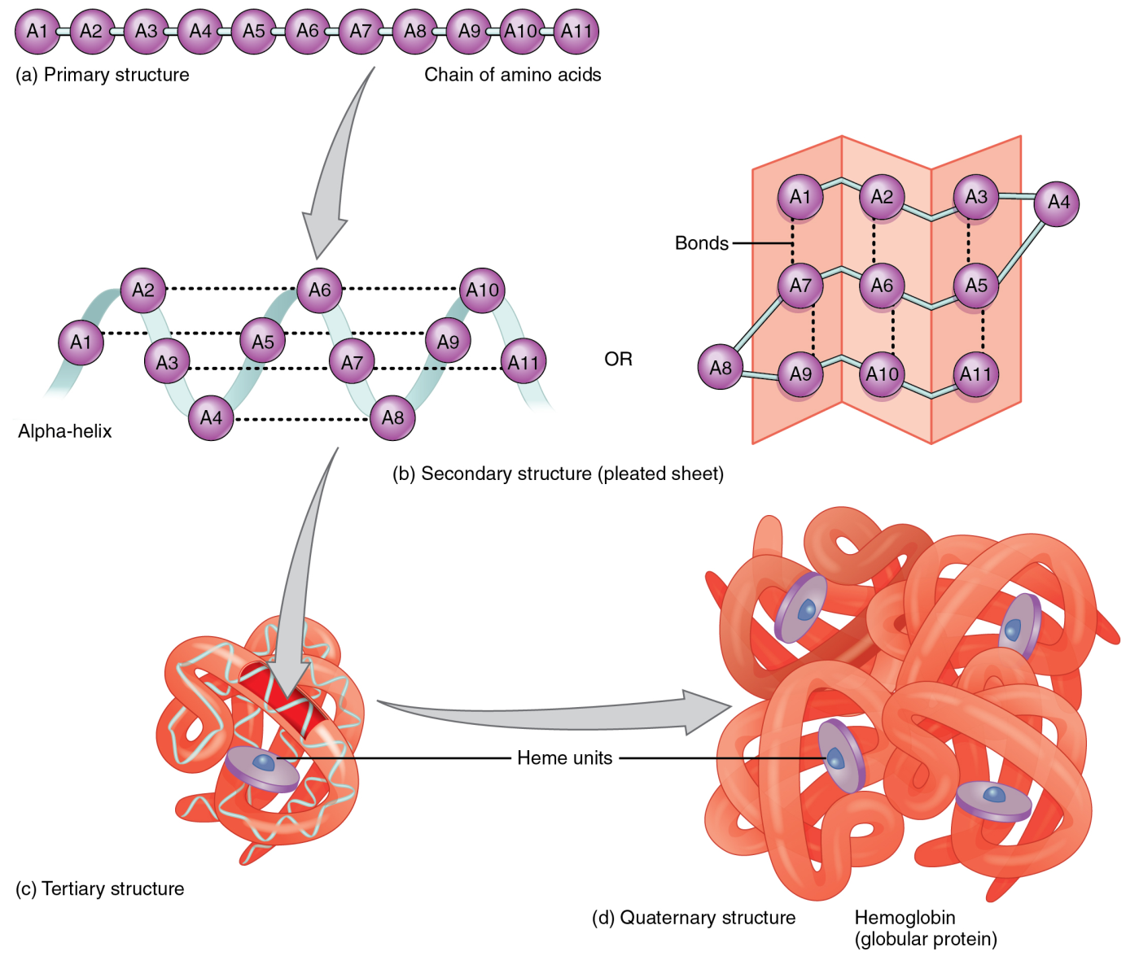
Protein Structure
Primary structure
Amino acid chain
(20 common,
21 proteinogenic AAs)
A-C-D-E-F-G-H-I-K-L-M-N-P-Q-R-S-T-V-W-Y
Secondary structure
Helices, sheets
Tertiary structure
Folded protein
Quaternary structure
Globular protein
Notes:
Proteinogenic: precursors to proteins
20 common amino acids (encoded by DNA): A=alanine; C=cysteine; D=aspartic acid; E=glutamic acid; F=phenylalanine; G=glycine; H=histidine; I=isoleucine; L=leucine; M=methionine; N=asparagine; P=proline; Q=glutamine; R=arginine; S=serine; T=threonine; V=valine; W=tryptophan; Y=tyrosine
9 essential amino acids: H, I, K, L, M, P, T, V, W (need to consume in diet; cannot be synthesized in humans)

Slide 12
Protein Function
Structure – collagen, keratin, elastin
Metabolism – digestive enzymes
Defense - antibodies, cell receptors
Storage/Regulation – ferritin, albumin; minerals, energy, fluid/pH balance, protein turnover
Transport – hemoglobin/O₂, calbindins/Ca⁺²
Receptors – cell entry/exit control; signaling
Motors – myosin, actin

Slide 13
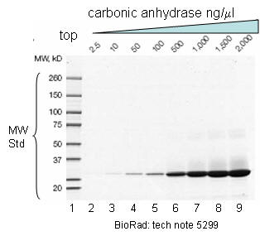
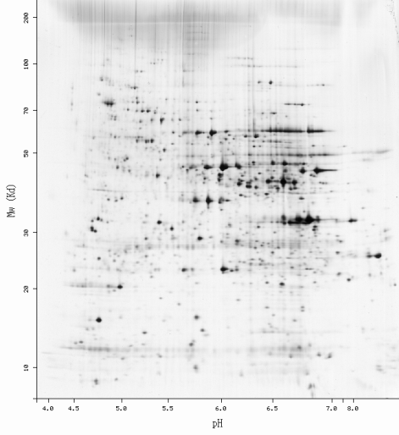
Protein Analysis Pre-Mass Spectrometry
pre-1900
- Vauguelin, Robiquet (1806): asparagine from asparagus
Threonine (1930)
- Mulder: albuminous substances contain proteins
- Berzelius: protein; primitive substance
1900-1950s Primary structure analysis
- Centrifugation, purified enzymes, labeling, chromatography
- F. Sanger (Nobel Prize/chemistry)
1951; insulin; proteins have definite structure
- P. Edman - Edman degradation - Amino acid analyzer
1930-1970 Secondary and tertiary structure analysis
- X-ray diffraction, spectroscopy
1970- Gel-based methods (1D & 2D gel electrophoresis)
- Protein separation based on size and charge
- Dyes for visualization, “quantitation”
- Excise bands for identification (or blot with antibodies)
- “Gold standard” method but has many limitations
1-D Gel
Electrophoresis
2-D Gel
Electrophoresis
MW
pI
Notes:
Albuminous substances = casein, fibrin, gelatin
Sanger was awarded a second chemistry Nobel Prize in 1980 for DNA sequencing (“Sanger method”)
He is one of two persons to win two Nobel Prizes in the same category (and the only one for chemistry)
He died in 2013 at 95 years of age.

Slide 14
Protein Analysis By Mass Spectrometry?
1980- Mass spectrometry (MS) methods
How can a protein be analyzed by a method that requires an ion in the gas phase?
Protein size, vapor pressure, complex structure and chemistry
What means can be used to impart energy to the protein to effect desorption and ionization?
Heat, fast ions/atoms (KeV), nuclear decay fission fragments (MeV), electric field, photons/lasers
Can protein separation and identification be combined?
Connect an HPLC with a MS (as GC-MS)?
What analytical performance is required?
Mass resolution, accuracy, sensitivity and throughput

Slide 15
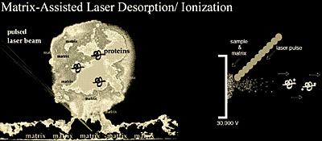

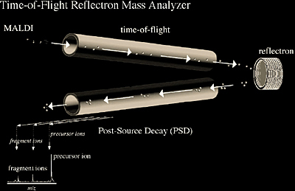
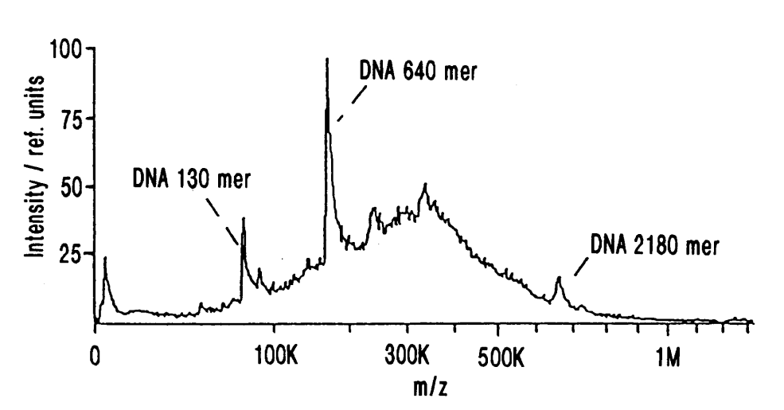

MS Biological Revolution - 1
K. Tanaka, J. Fenn, K. Wuthrich
Nobel Prize, Chemistry, 2002
Koichi Tanaka
Shimadzu
“Soft Laser
Desorption”
F. Hillenkamp, M. Karas
“Matrix-Assisted
Laser Desorption”

Slide 16
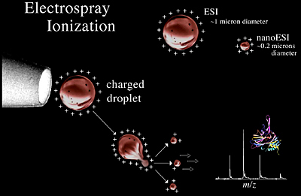
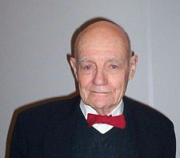
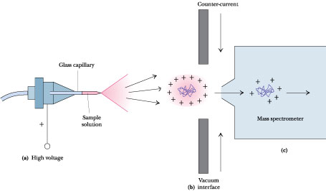
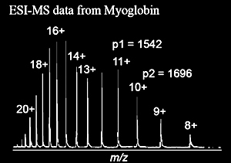

MS Biological Revolution - 2
John Fenn
Yale/VCU
Electrospray
Ionization
Desolvate->
Bare Ions
Spray->
Charged
Droplets
Syringe or LC
Sample
in solution
MS
High
voltage
Atmosphere
Vacuum
ESI MB (MW~17,000 Da) -> M^{x+}

Slide 17
Protein Analysis by Mass Spectrometry
1980- Mass spectrometry methods
MALDI and ESI
MS technology advances
Coupling of HPLC and MS
High-resolution, -sensitivity and –throughput instruments
e.g., MALDI/TOF, Q-TOFMS, ion traps (linear and Orbitrap)
MS – high accuracy molecular weight, relative abundance
MS^{n} – primary sequence, post-translational modifications
Ideal technology for large-scale protein analysis research
Identification and quantitation
Initial application: SDS-PAGE fractionation and MS analysis

Slide 18
Mass Spectrometry Applied to Protein Analysis (Proteomics) Methods

Slide 19
MS Proteomics
Proteomics is possible because of advances in:
Genomics
Gene databases; protein databases
Computer hardware and software
Informatics, bioinformatics
Protein/peptide preparation methods
Isolation, enrichment, fractionation
Mass spectrometry technology
Ion production, separation, transmission, detection
Sensitivity, mass measurement accuracy & resolution
MS: mass (m/z) and abundance
MS/MS: peptide amino acid sequence

Slide 20
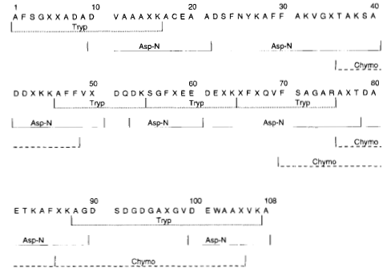
Proteomics History
D.F. Hunt, J.R. Yates et al.
“Protein sequencing by mass spectrometry”
Proc. Natl. Acad. Sci. 83, 6233 (1986)
Method
-CNBr/trypsin digest
-HPLC
-FAB-CID/MS/MS (TSQ)
-Edman
Low-energy CID
Peptide Sequence
Identification
b-type
fragment
ions
y-type
fragment
ions
Full protein sequence determined
Manual interpretation of MS/MS spectra
Notes:
apoB (apolipoprotein B)
Cyanogen bromide and trypsin digest
HPLC fractionation of peptides
Fast-atom bombardment (FAB)-CID-tandem mass spectrometry (MS/MS) with a triple stage quadrupole (TSQ)

Slide 21
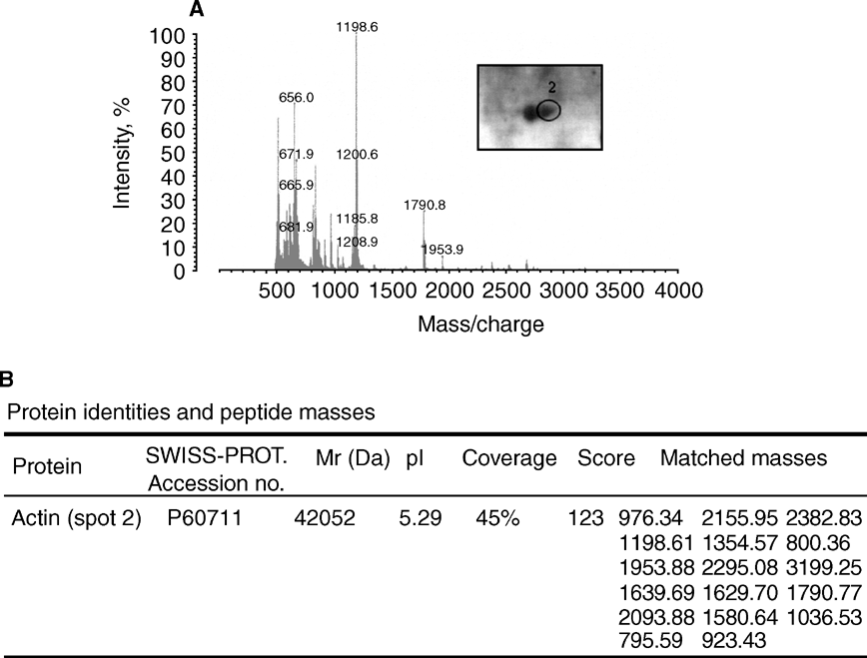
Proteomics History
W.J. Henzel, J.T. Stults and C. Watanabe
“Identifying proteins from two-dimensional gels by molecular
mass searching of peptide fragments in protein sequence databases”
Proc. Natl. Acad. Sci. 90, 5011 (1993)
2D gel spot
MALDI Method
-1D gel band or 2D gel spot
-Trypsin digest
-Mix with matrix
-Match measured masses
to peptide fragments
from database proteins
MALDI
Mass spectrum

Slide 22
Proteomics History
J. Eng, J.R. Yates, R. Aebersold
“High throughput protein characterization by automated reverse
Phase chromatography/electrospray tandem mass spectrometry”,
Prot. Sci. 7, 706 (1998)
Method
-Gel spots
-Digest
-HPLC-ESI-MS/MS (TSQ)
-SEQUEST
-Increased throughput
with automation
-Database-MS/MS searches
-90 yeast proteins “identified”

Slide 23
Proteomics History
D. Wolters, M.P. Washburn, J.R. Yates
“An automated multidimensional protein identification technology for shotgun proteomics”, Anal. Chem., 73 (23), 5683, (2001)
“Large-scale analysis of the yeast proteome by multidimensional protein identification technology” Nat Biotechnol. 19(3):242 (2001)
Method
-Gel free
-No pre-MS fractionation
-2D (SCX/HPLC) online peptide
fractionation
-ESI-MS/MS (ion trap)
-Database search
-1,484 proteins “identified”

Slide 24
Proteomics Strategy
Global Proteomics (Untargeted analysis)
Sample preparation
Protein isolation
Reduce Cys-Cys bonds and alkylate
Protein digestion
Sample analysis/data acquisition
LC-ESI-MS/MS
Data analysis
Informatics (MS, MS/MS)
Peptide identification
Protein inference
Bioinformatics (PTMs, interactions, regulation)
Determine biological relevance
Cellular location, function, association
Notes:
Focus on proteomics methods that use online liquid chromatography and electrospray ionization.

Slide 25

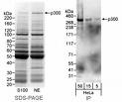





















Proteomics Method Steps
1. Sample
Preparation
Cell culture
Protein extraction
Proteins
Protein
fractionation
Digestion (trypsin; -K/R)
Proteins
State 2
Peptides
Gels
Peptide
fractionation
Digestion

Slide 26
Proteomics Method Steps
2. Sample
Analysis/
Data
Acquisition
Peptides
LC-MS & MS/MS
4 MS/MS of the
top 4 more abundant peptides in MS
MS (peptide m/z and abundance)
MS/MS (peptide fragmentation – sequence ID)

Slide 27

Proteomics Method Steps
MS and MS/MS Data
3. Data
and results
analysis
Informatics
Database search
Peptide identification
Protein inference
Pathway, signaling,
interactions
Bioinformatics
New biological insights
Current MS proteomics capabilities:
10,000s peptides/1,000s proteins measured/sample

Slide 28
MS Data Example
Tryptic
peptides
HPLC gradient
% MeCn
HPLC
Time (min.)
Gradient elution
.
.
A. Ion Current Chromatograms
1. Total Ion Current (TIC – all ions m/z 400-1600)
.
.
.
.
+
MS
+
C18 RP-HPLC
+
100
Electrospray
ionization
80
PC
60
40
20
2. Reconstructed Ion Current (RIC)
m/z 910.44
0
Relative Abundance
100
Elution profile for m/z 910.44 ion
80
MS Scan #5867
60
40
20
0
30.0
30.1
30.2
30.3
30.4
30.5
30.6
30.7
30.8
30.9
31.0
31.1
31.2
31.3
31.4
31.5
31.6
31.7
31.8
31.9
32.0
32.1
B. Mass spectrum
Time (min)
910²⁺ ion selected
for MS/MS
100
455.9732
607.6287
910.4402
910.9415
90
Δm=0.5Da
+2 ion
80
70
60
Relative Abundance
50
40
910.4415
Expanded
view
30
20
470.2304
538.7806
626.6352
740.8562
10
573.6124
712.3457
796.8612
849.3757
880.4389
939.4517
995.9545
1044.5449
1073.4894
1168.5178
1213.9177
1307.6847
1388.6981
1480.7053
1527.8060
0
400
500
600
700
800
900
1000
1100
1200
1300
1400
1500
1600
m/z
MS: Peptide molecular weight and relative abundance

Slide 29
MS Data Example
Data Dependent Acquisition (DDA) - “Top 5 method”
TIC
100
95
1 MS Scan
MS/MS
based
on MS ion
abundance
90
85
80
75
70
65
60
Relative Abundance
55
50
5 MS/MS
Scans
45
40
35
30
25
20
15
10
5
5797
0
MS
30.63
30.64
30.64
30.65
30.66
30.67
30.68
30.69
30.70
30.71
30.72
1. MS-MS 910.94
Time (min)
100
470.2288
626.6356
2. MS-MS 519.26
90
712.3458
3. MS-MS 489.24
80
4. MS-MS 570.31
70
485.7762
5. MS-MS 573.61
Relative Abundance
60
607.6291
50
455.9736
499.2962
729.3666
40
740.8558
30
569.8100
804.4256
939.4512
20
536.6187
10
645.6426
786.3691
842.4164
910.9407
967.4455
1457.7279
0
1044.5447
1138.6152
1224.5548
1269.4844
1382.7244
1571.7335
400
500
600
700
800
900
m/z
1000
1100
1200
1300
1400
1500
1600

Slide 30
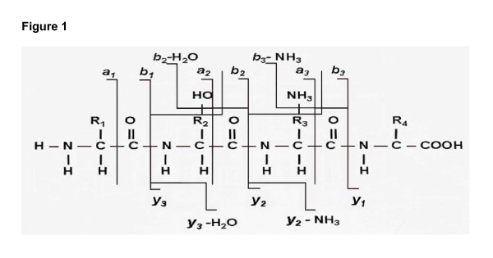
MS Data Example
m/z 910.44⁺²
peptide
CID
100
MS/MS 910.44⁺²
Collision-induced
dissociation
95
90
85
Peptide amino acid sequence is determined
by fragment ion mass differences.
b ions: 509 646 793
TYF- P - H - F -DVSHGSAQVK
y ions 1408 1311 1174 1027
80
75
70
65
60
Relative Abundance
55
50
Δm=147
F
Δm=137
H
Δm=97
P
45
40
35
30
b
+2
25
b
15
y₁₀⁺
1027
y₁₃⁺
1408
y
+2
y
14
837.4
y₁₁⁺
1174
20
y
+2
778.4
y
12
15
656.4
y₁₂⁺
1311
y
+1
+1
y
b
+1
10
b
7
b
b
4
y
+1
726.4
8
509.3
y
6
1007.3
b
+1
589.4
b
+1
b
10
+1
+1
+1
b
b
y
9
b
+1
y
y
y
b
5
3
b
+1
1231.5
13
b
b
+1
b
5
1094.4
14
b
2
374.3
3
532.4
1446.5
1574.7
0
264.6
412.1
0
100
200
300
400
500
600
700
800
m/z
900
1000
1100
1200
1300
1400
1500
1600
Search vs. protein database using a software algorithm
This MS/MS spectrum and peptide precursor ion mass
were matched to: TYFPHFDVSHGSAQVK,
which is part of the Hemoglobin alpha 1 chain sequence
MS/MS: Peptide identification and protein inference

Slide 31
MS Data Example
Resolution
Mass Accuracy
Dynamic Range
+/- 5-10 ppm
mass measurement
High resolution allows
distinguishing peptides
with similar m/z
494Da/0.04Da=~12,000
Single Mass Spectrum
493.5656
575.3066
(1e9 signal)
Δm~0.33
3⁺ ion
100
100
95
90
90
80
493.8997
85
70
493.7722
80
75
60
Δm~0.5; 2⁺ ion
Lower
Resolution
Analysis
70
Relative Abundance
65
50
60
40
494.2336
494.2747
Relative Abundance
55
30
50
20
494.5686
494.7637
(5e5 signal)
45
40
10
35
0
493.3
493.5
493.7
493.9
494.1
494.3
494.5
494.7
494.9
30
m/z
25
2000x
Dynamic
Range
20
15
10
5
0
400
500
600
700
800
900
1000
1100
1200
1300
1400
1500
1600
m/z
M/ΔM = Resolving Power; 1,000/0.1 Da = 10,000 R.P.
ΔM/M = Resolution; 0.01/1,000 Da = 1x10⁻⁵ Res.

Slide 32
MS Proteomics Data Analysis
Peptide identification
Match MS data with predicted data from database proteins
Precursor and fragment ion masses
Software and manual analysis
Protein “identification” (inference)
Software and manual analysis
Determine most likely proteins using parsimony rules/analysis
Peptide/protein “quantitation”
Differential protein expression
Two or more samples/analyses/data files
Measure peptide relative abundances
Label: mass tag chemical derivatives
Label-free: spectral counting, spectral feature
Notes:
Parsimony: Determine the smallest set of proteins that accounts for all peptides identified.
Deal with peptides that are contained in multiple proteins
ftp://chemdata.nist.gov/download/Sara/DBParser2.0/ParsimonyDefinition.html
MassSieve software:
http://www.ncbi.nlm.nih.gov/staff/slottad/MassSieve/parsimony.html
Since a given peptide sequence can map to more than one protein, a method is desired to reduce the complexity of the resulting set of proteins. The following parsimony rules and definitions are designed to reduce the number of proteins and yet still account for all of the observed spectra and isoforms.

Slide 33
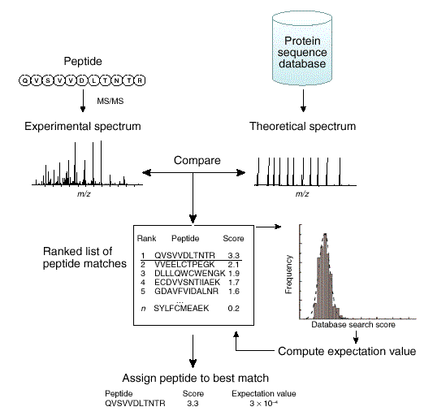
MS Proteomics Data Analysis
Peptide
Identification
Effect of Mass Accuracy/Tolerance
on Database (Db) Search Result
Search Mass No. Db
m/z Tolerance(Da) Matches
1529 1 478
1529.7 0.1 164
1529.73 0.01 25
1529.734 0.001 4
1529.7348 0.0001 2
N.E. Sherman, Intro. to MS Course,
UVa W.M. Keck Lab, 2010.
R. Aebersold, Nature Methods 4(10) 787 (2007).
Notes:
Increase search result (peptide identification) with larger database (more possibilities) and search versus a “decoy” database (reversed protein sequences), to determine a “false discovery rate” (frequency of incorrect matches to reversed, “false” sequences).

Slide 34
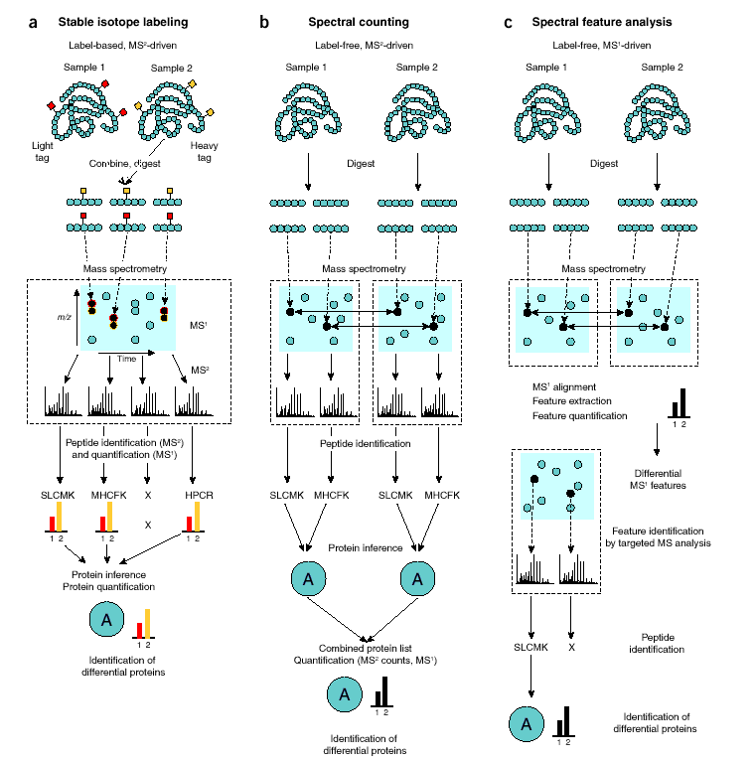
Quantitative Proteomics
Label
SILAC (MS)
iTRAQ (MS/MS)
Limited sample number; chemistry
Label-free
Spectral count
Spectral feature
No sample number limit; no chemistry
Requires high reproducibility
R. Aebersold, Nature Methods 4(10) 787 (2007).
Notes:
SILAC=stable isotope labeling with amino acids in cell culture. Two populations of cells are cultivated in cell culture. One of the cell populations is fed with growth medium containing normal amino acids. In contrast, the second population is fed with growth medium containing amino acids labeled with stable (non-radioactive) heavy isotopes. For example, the medium can contain arginine labeled with six carbon-13 atoms (13C) instead of the normal carbon-12 (12C). When the cells are growing in this medium, they incorporate the heavy arginine into all of their proteins. Thereafter, all peptides containing a single arginine are 6 Da heavier than their normal counterparts. Alternatively, uniform labeling with 13C or 15N can be used. The trick is that the proteins from both cell populations can be combined and analyzed together by mass spectrometry. Pairs of chemically identical peptides of different stable-isotope composition can be differentiated in a mass spectrometer owing to their mass difference. The ratio of peak intensities in the mass spectrum for such peptide pairs reflects the abundance ratio for the two proteins.
iTRAQ=isobaric tag for relative and absolute quantitation; the method is based on the covalent labeling of the N-terminus and sidechain amines of peptides from protein digestions with tags of varying mass. The fragmentation of the attached tag generates a low molecular mass reporter ion that can be used to relatively quantify the peptides and the proteins from which they originated.
(Wikipedia)

Slide 35
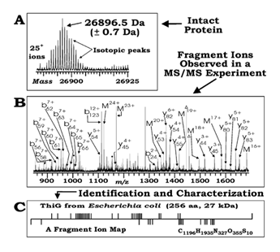
“Top Down” Proteomics
Contrast to “Bottom Up”
Peptides
Intact protein analysis
LC-ESI-FTMS
Electron capture/transfer
dissociation
Data analysis
Capabilities
PTMs, protein variants
Intact endogenous
molecules
Application
Bacteria identification
Verify/expand genomic
analysis
N.L. Kelleher, Nature Methods, 4(10) 817 (2007).
Notes:
FTMS=Fourier transform mass spectrometry
PTMs=Post-translational modifications (additions of chemical groups to proteins after DNA translation that generates the proteins)

Slide 36
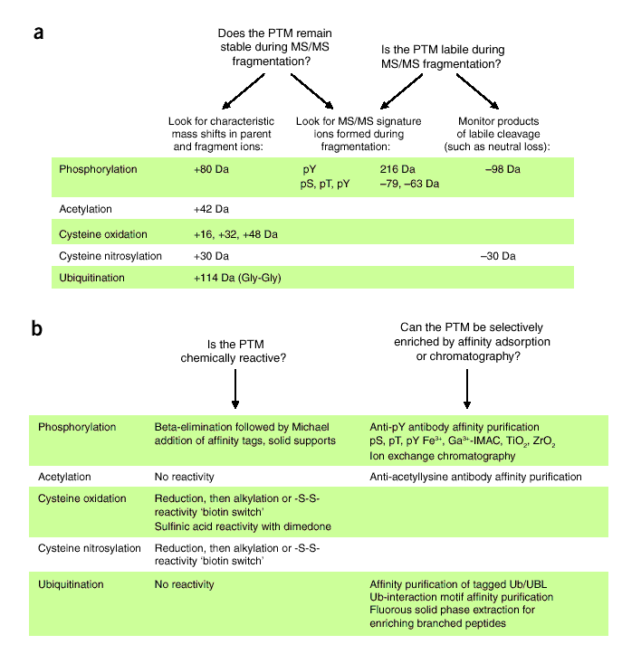
Targeted Proteomics
Selected sub-proteome
- Cell compartment
Protein characteristics
- PTMs: How many?
Protein-protein
interactions
Activity
- Enzyme, secretion,
receptor
Best use of MS?
N.G. Ahn, Nature Methods, 4(10) 798 (2007).
Notes:
It is estimated that the number of protein isoforms might be 100-1000x the number of human genes.
More than 5% genome encodes for enzymes.

Slide 37
References
Mass spectrometry basics
The basics of mass spectrometry in the twenty-first century, G.L. Glish and R. W. Vachet, Nature Reviews Drug Discovery 2, 140-150 (February 2003), doi:10.1038/nrd1011.
http://science.howstuffworks.com/mass-spectrometry1.htm
American Society for Mass Spectrometry: http://www.asms.org/about/about-mass-spectrometry
Mass spectrometry history
http://masspec.scripps.edu/mshistory/mshistory.php
A brief history of mass spectrometry, J. Griffiths, Anal. Chem., 2008, 80, 5678–5683
A century of mass spectrometry: from atoms to proteomes, J.R. Yates III, Nature Methods 8, 633–637, (2011) doi:10.1038/nmeth.1659.
Nature Milestones, Mass Spectrometry, www.nature.com/milestones/mass-spec
Proteomics history and introduction
Proteomics: the first decade and beyond, S.D. Patterson, R.H. Aebersold, Nat Genet. 2003 Mar;33 Suppl:311-23.
http://en.wikibooks.org/wiki/Proteomics/Introduction_to_Proteomics

Slide 38
References
Mass spectrometry proteomics
Applying mass spectrometry-based proteomics to genetics, genomics and network biology, M. Gstaiger and R. Aebersold, Nature Reviews Genetics 10, 617-627 (September 2009) | doi:10.1038/nrg2633.
Proteomics by mass spectrometry: approaches, advances, and applications, J.R. Yates, C.I. Ruse, A. Nakorchevsky, Annu Rev Biomed Eng. 2009;11:49-79. doi: 10.1146/annurev-bioeng-061008-124934.
Mass Spectrometry–Based Proteomics and Network Biology Annual Review of Biochemistry, Vol. 81: 379-405 (Volume publication date July 2012), A. Bensimon, A.J.R. Heck, and R. Aebersold, DOI: 10.1146/annurev-biochem-072909-100424.
Tutorial Review: Mass spectrometry-based proteomics: existing capabilities and future directions, T.E. Angel, U.K. Aryal, S.M. Hengel, E.S. Baker, R.T. Kelly, E.W. Robinson and R.D. Smith, Chem. Soc. Rev., 2012,41, 3912-3928.
Quantitative mass spectrometry in proteomics: critical review update from 2007 to the present, Bantscheff M, Lemeer S, Savitski MM, Kuster B., Anal Bioanal Chem. 2012 Sep;404(4):939-65. doi: 10.1007/s00216-012-6203-4.

Slide 39
Hsu Lab Proteomics

Slide 40
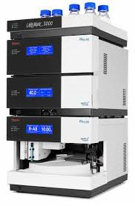
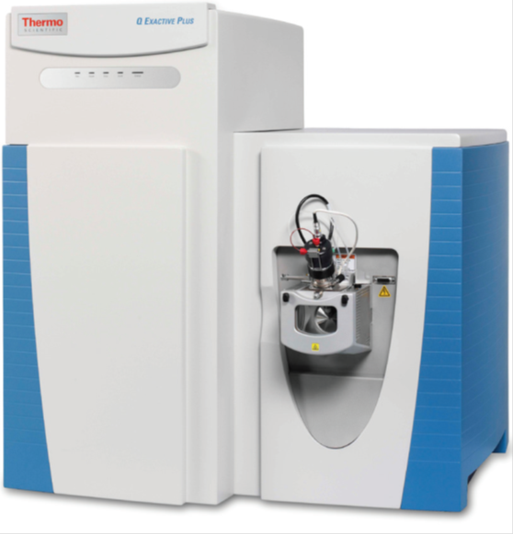
Hsu Lab Proteomics
Instrumentation:
High-Performance Liquid Chromatograph (HPLC)/Mass Spectrometer (MS)
HPLC
1. Pumps
2. Columns
3. Autosampler
MS
1. ESI source
2. Quadrupole
mass filters
3. Orbitrap
analyzer
Dionex Ultimate 3000 RSLCnano
Thermo Q Exactive Plus

Slide 41
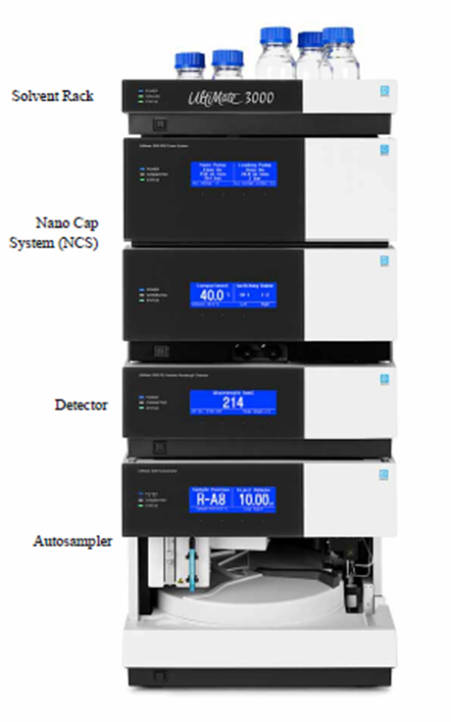
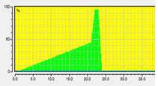
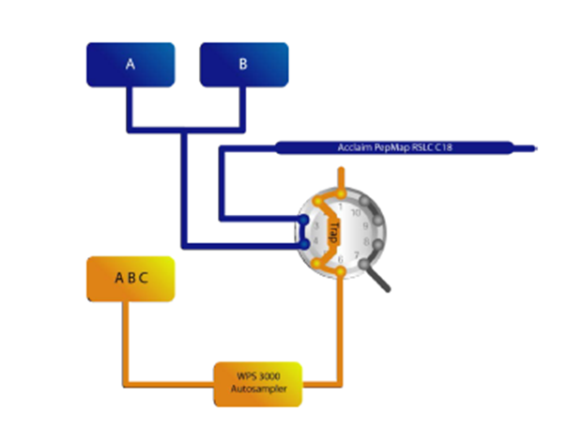
Hsu Lab Proteomics
LC-MS-MS/MS: LC
Nanoflow
Pumps
A:H2O B:ACN
4. Sample eluted
from analytical
column into MS
Loading
Pump
3. Sample eluted
from trap column
2. Sample loaded
onto trap column
1. Sample loaded
into the loop

Slide 42
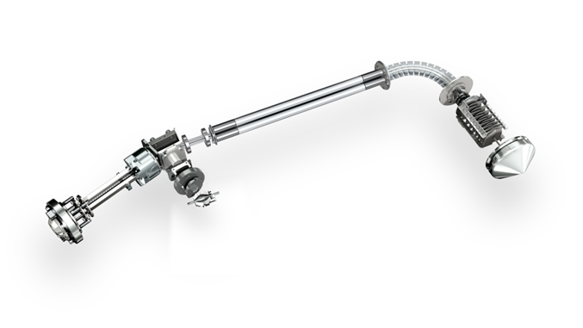
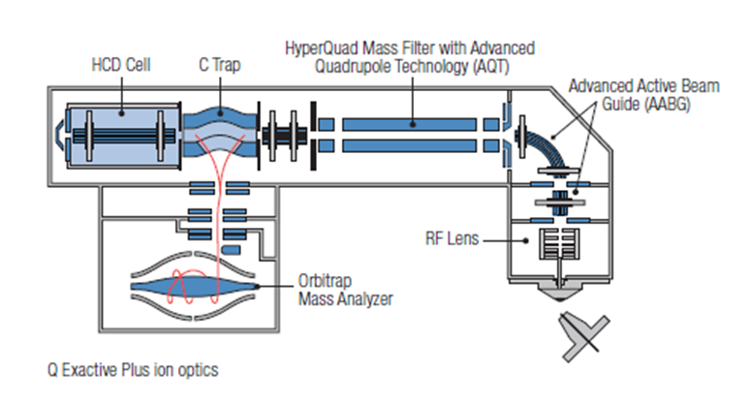
Hsu Lab Proteomics
LC-MS-MS/MS: MS
MS/MS ion
fragmentation
Ion filter
MS, MS/MS
ion detection
Ions
ESI

Slide 43
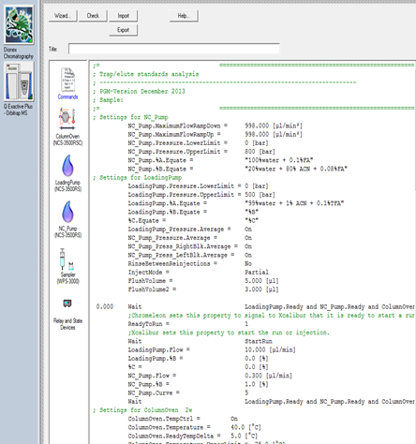
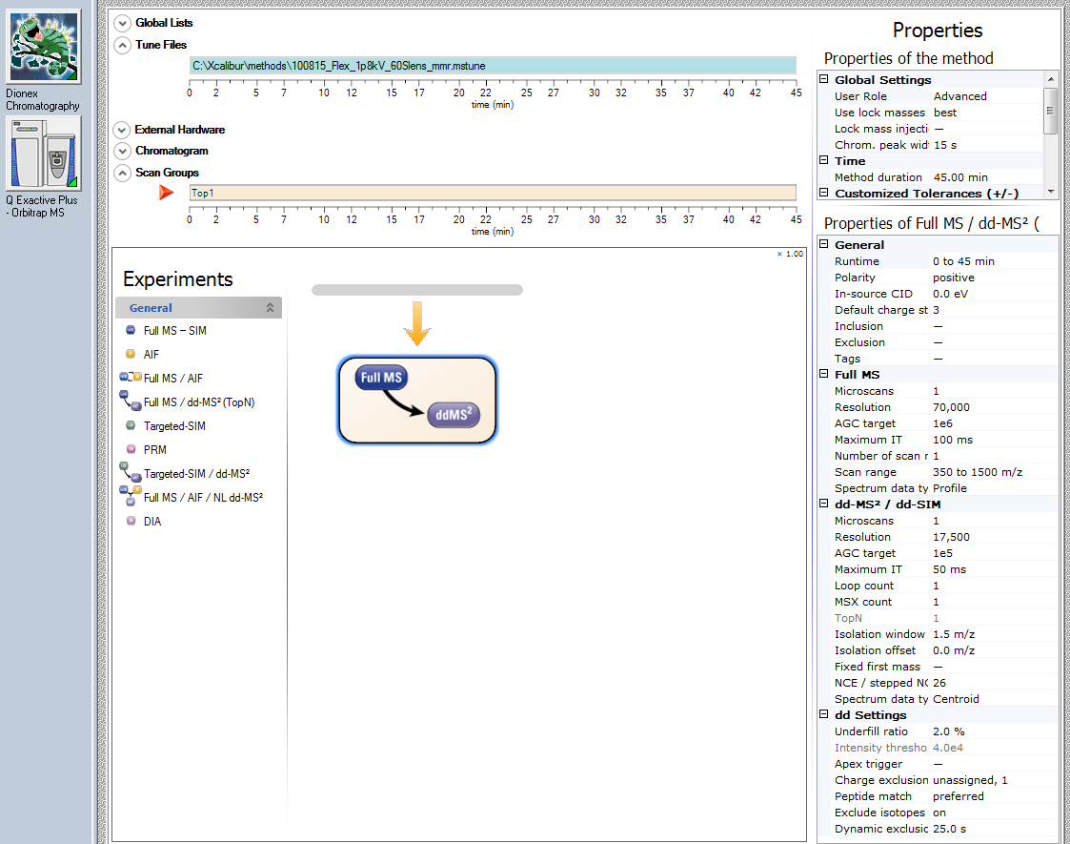
Hsu Lab Proteomics
LC method
MS-MS/MS method

Slide 44
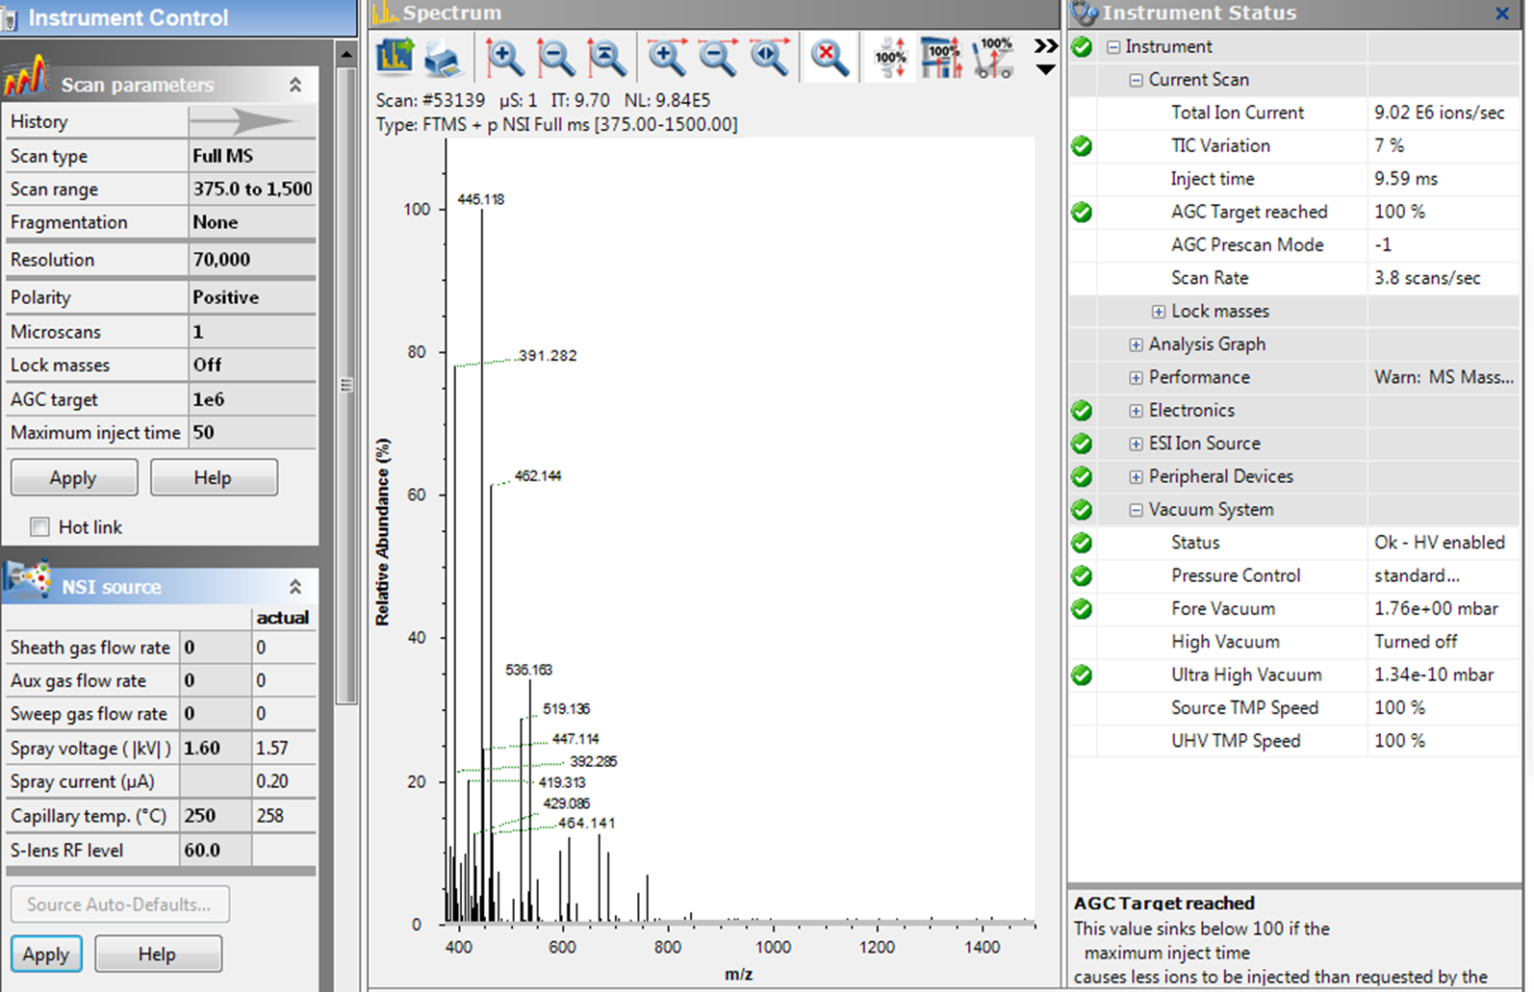
Hsu Lab Proteomics
MS instrument control

Slide 45
Hsu Lab Proteomics
LC-MS-MS/MS method performance assessment
Standards
2-peptide mixture (“AV”)
Angiotensin I (A) and vasoactive intestinal (V) peptides
15-peptide mixture (“PRTC”)
Peptide retention time calibration mixture (Thermo)
Synthetic isotopically-labeled peptides
LC and MS data evaluation
LC retention times and peak shapes
MS masses and abundances
Mass measurement error <5ppm

Slide 46
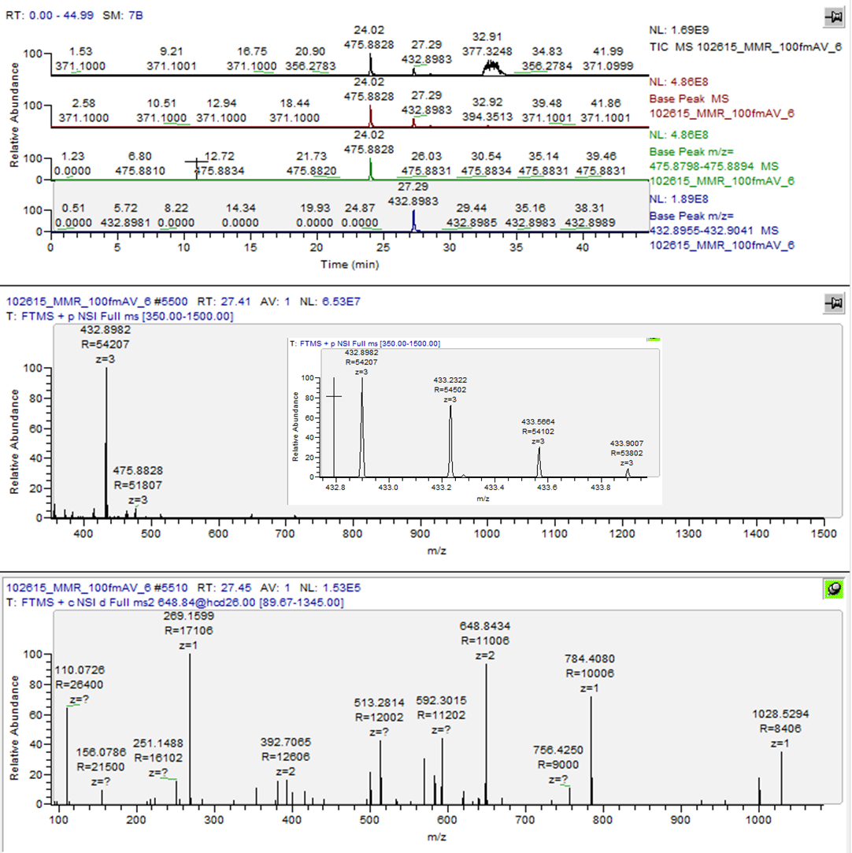
Hsu Lab Proteomics
“AV”
2-peptide
mixture
TIC
BPC
V
A
Angiotensin I
[M+3H]⁺³
ΔM/M=3.7ppm
MS/MS
[M+2H]⁺²

Slide 47
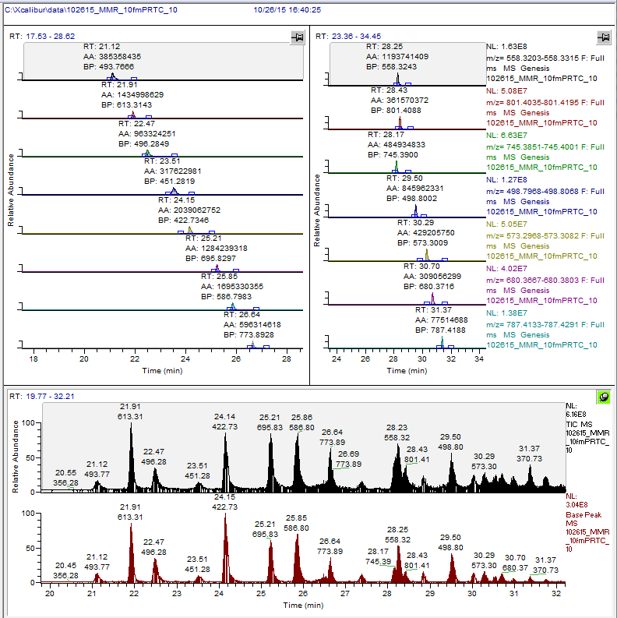
Hsu Lab Proteomics
“PRTC”
15-peptide
mixture

Slide 48
Hsu Lab Proteomics
Experimental approach
Samples
Cells grown in ¹³C/¹⁵N-labeled K/R media -/+ drug
Protein extraction and enrichment
Trypsin digestion
Sample cleanup
Sample analysis
LC-MS-MS/MS of light/heavy-labeled peptides
Data analysis
Search MS data v. protein database
Search results analysis
Peptide/protein assignment evaluation
Analytical and biological replicates
Results confirmation

Slide 49
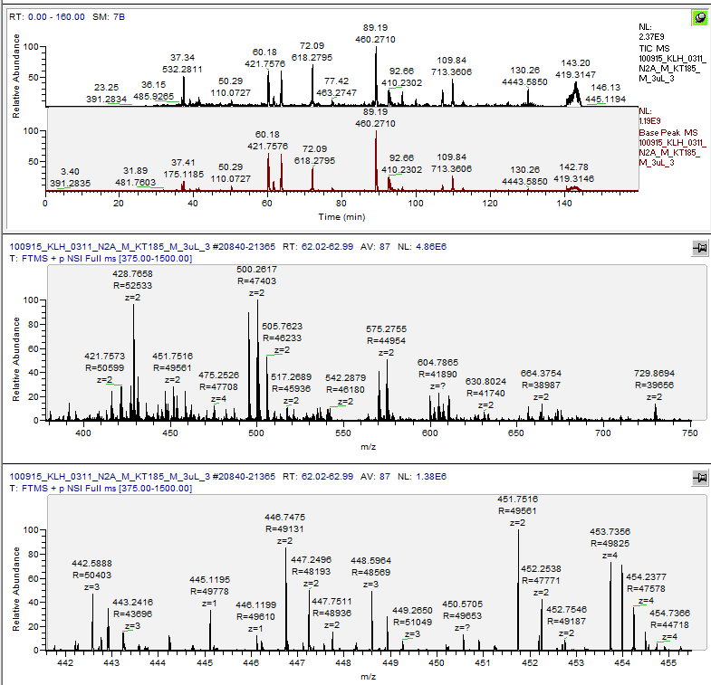
Hsu Lab Proteomics
N2A cells,
-/+ KT185,
membrane
fraction,
3/100uL?,
[protein]/c.e.?,
(int. stds)
TIC
MS
m/z 375-1500
MS/MS
Top 10 HCD
100 min.
or
6000 sec. x
10 MS2/sec. =
60,000 MS2
(~47,000)
BPC
MS
Averaged MS ~1 minute
MS

Slide 50
Hsu Lab Proteomics
Data analysis - informatics
Peptide identification
Search MS data v. protein database (“IP2”¹; ProLuCID² program)
Search parameters: enzyme, mass tolerances, modifications
Search 10,000+ spectra per experiment
Protein inference
Analyze search results/raw data
“Unique” peptides
Parsimony
Peptide/protein “quantitation”
Determine relative peptide/protein amounts
Ion abundances
Spectral (MS2) or peptide counts
¹IP2: Integrated Proteomics Applications; http://integratedproteomics.com/
²J. Proteomics. 2015 Jul 11. pii: S1874-3919(15)30059-2. doi: 10.1016/j.jprot.2015.07.001.
ProLuCID: An improved SEQUEST-like algorithm with enhanced sensitivity and specificity. Xu T. et al.

Slide 51

Hsu Lab Proteomics
MS-Database
Search Results –
Proteins
Results analysis -
score/filter matches:
Correlation
Probability
False discovery rate
Diacylglycerol
lipase beta

Slide 52





Hsu Lab Proteomics
MS-Database
Search Results –
Peptides
DAGL-β
MS/MS 419.72⁺² TTGLQYR
?

Slide 53



Hsu Lab Proteomics
TIC
BPC
RIC
419.7245+/-2ppm
MS (averaged)
y1
y5
M+2H⁺²
b2
y2
y3
y4
y6

Slide 54
Hsu Lab Proteomics
Future
Bioinformatics
Improved sample preparation
Peptide label v. label-free
Whole cell lysate analysis (no enrichment)
Advanced LC-MS technology/method
Targeted MS/MS

Slide 55
“Take-Home” Messages
Simplified but complex instrumentation
Identify peptides, infer proteins
“Quantitate” peptides not proteins
Manual raw data/search results analysis
Validate results

