Slide 1
3-HOUR TRAINING | 60 SLIDES
Build Reliable Claude Code Workflows with Guardrails and Tests
Harness engineering for safer AI coding agents, tool ecosystems, compound workflows, and reviewable autonomy.
Build Reliable Claude Code Workflows
1 / 60

Slide 2
SESSION ARCHITECTURE
Three Hours, Three Layers
1 Hour 1 Reliable agent workflows
2 Hour 2 Skills, MCP, and plugins
3 Hour 3 Compound engineering and agent dreaming: orchestrated systems that rehearse before they act.
specs, permissions, hooks, tests, and review.
extending the agent without losing control.
Build Reliable Claude Code Workflows
2 / 60

Slide 3
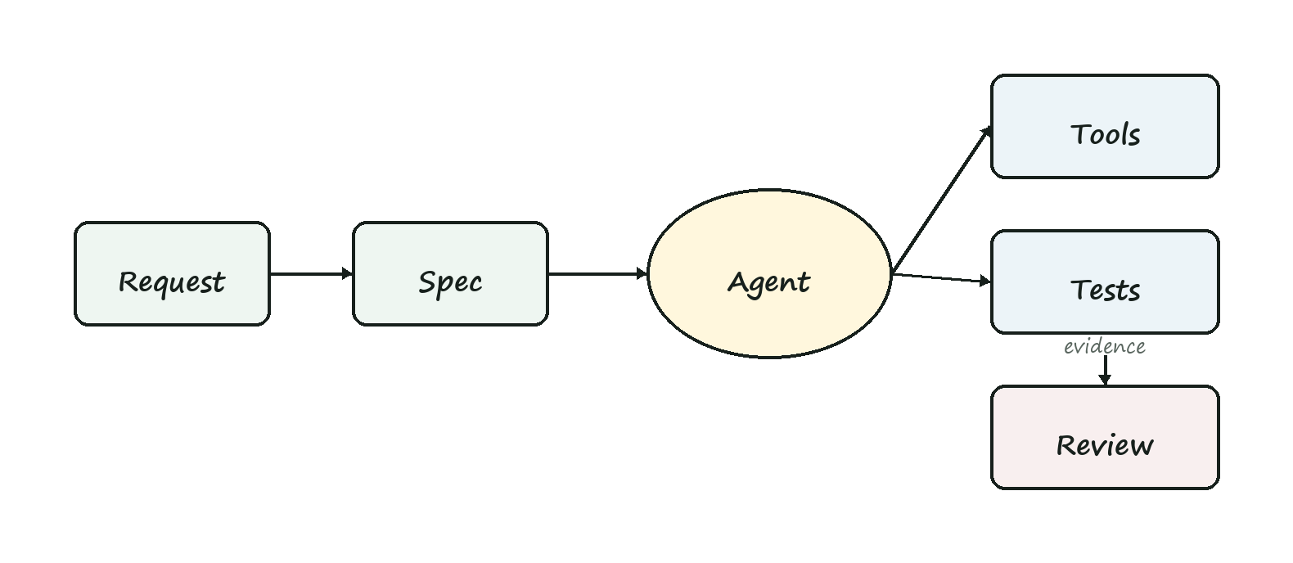
OUTCOME
What We Are Building Toward
The target is not a clever prompt. The target is a repeatable operating system for AI-assisted development.
Build Reliable Claude Code Workflows
3 / 60

Slide 4
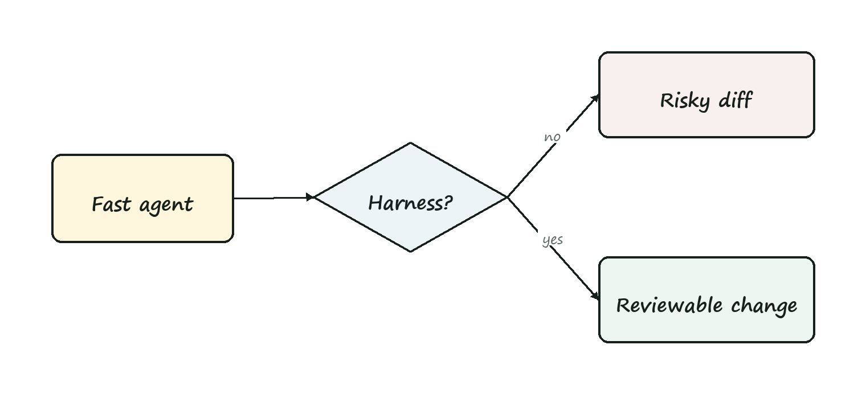
WHY THIS MATTERS
Speed Without Structure Creates Risk
• Large opaque diffs
• Unclear assumptions
• Skipped validation
• Tool overreach
• Scoped tasks
• Auditable actions
• Automated checks
• Human approval points
Build Reliable Claude Code Workflows
4 / 60

Slide 5
RELIABILITY MODEL
The Model Is Not the Whole Product
Model Reasoning, code generation, summarization, planning.
Harness Instructions, tools, permissions, tests, logs, review.
Organization Policy, ownership, release process, security posture.
Build Reliable Claude Code Workflows
5 / 60

Slide 6
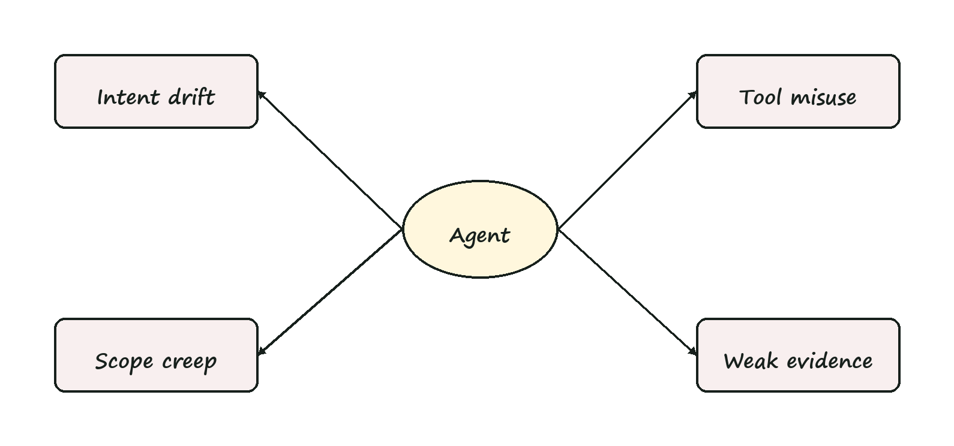
FAILURE MODES
Where Coding Agents Go Wrong
Intent drift Solves a nearby problem.
Scope creep Changes unrelated files.
Invented facts Assumes APIs or project rules.
Tool misuse Runs risky commands too early.
Weak evidence Reports done without proof.
Review fatigue Leaves humans with an unreadable diff.
Build Reliable Claude Code Workflows
6 / 60

Slide 7
HARNESS ENGINEERING
The Discipline
• Specify: define task, scope, non-goals, and evidence.
• Constrain: limit tools, filesystem, credentials, and blast radius.
• Validate: require tests, logs, screenshots, or artifacts.
• Review: keep human judgment at meaningful decision points.
Build Reliable Claude Code Workflows
7 / 60

Slide 8
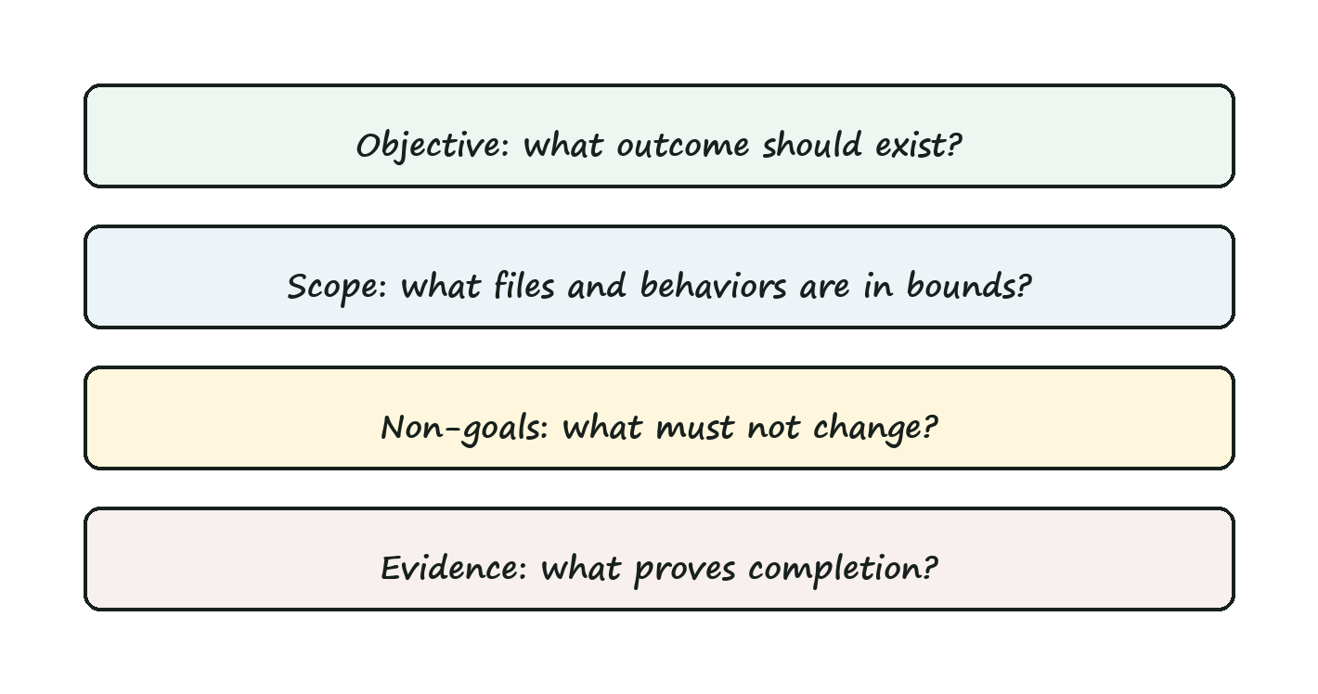
TASK CONTRACT
A Reliable Task Has Four Parts
Objective What should be true when the task is done?
Scope Which files, modules, and behaviors are in bounds?
Non-goals What should the agent avoid changing?
Evidence Which checks prove the work is credible?
Build Reliable Claude Code Workflows
8 / 60

Slide 9
EXAMPLE
Weak Prompt vs Task Contract
• Fix broken revenue filter
• Edit dashboard module only
• No visual redesign
• Run focused UI tests
Build Reliable Claude Code Workflows
9 / 60

Slide 10
EXERCISE
Rewrite a Risky Request
"Upgrade our auth flow and make it more secure."
• Specific behavior
• Allowed files
• Security non-goals
• Required tests
Build Reliable Claude Code Workflows
10 / 60

Slide 11
INSTRUCTION LAYERS
Put Instructions Where They Belong
Global Safety posture, review behavior, irreversible action rules.
Project Architecture, test commands, coding style, release process.
Task Current goal, scope, acceptance checks, stop conditions.
Build Reliable Claude Code Workflows
11 / 60

Slide 12
PROJECT INSTRUCTIONS
Example Project Rules
Before editing: Inspect existing patterns first. During editing: Keep changes scoped to requested modules. Before final response: Run focused tests or explain why not. List changed files and remaining risks.
Build Reliable Claude Code Workflows
12 / 60

Slide 13
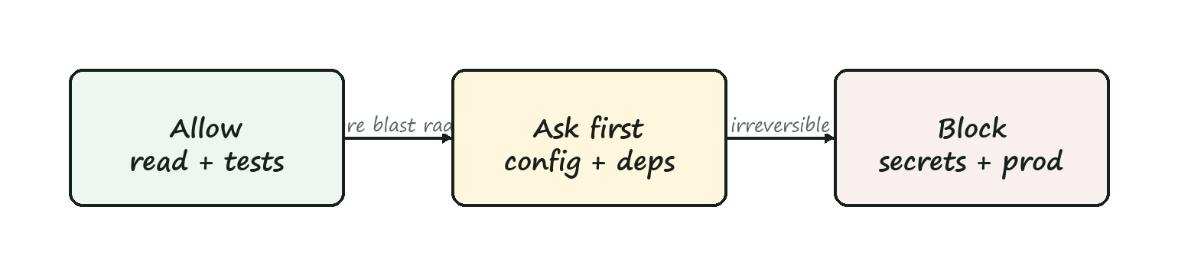
PERMISSIONS
Tool Access Is a Risk Budget
Allow Read code, inspect diffs, run focused tests, format touched files.
Ask first Install packages, edit CI, run migrations, touch auth or billing.
Block Force-push, delete data, reveal secrets, publish releases unsupervised.
Build Reliable Claude Code Workflows
13 / 60

Slide 14
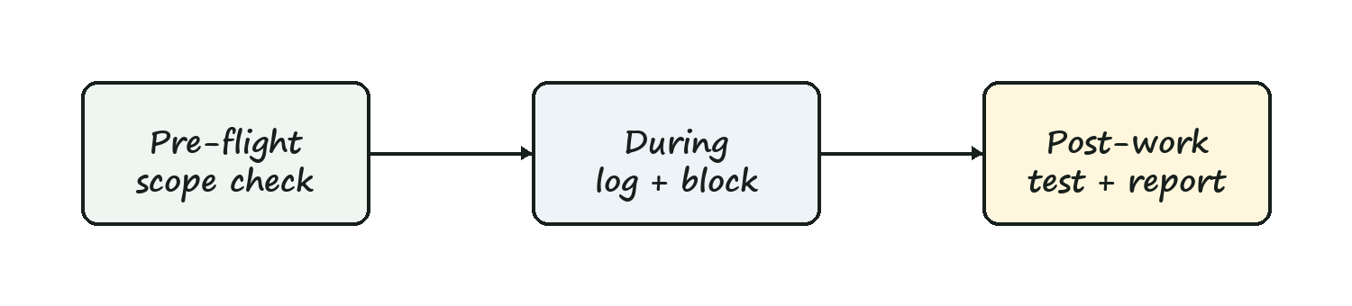
HOOKS
Hooks Make Policy Executable
Pre-flight Check branch, load context, confirm scope.
During work Log tool calls, block risky commands, detect out-of-scope edits.
Post-work Run checks, collect evidence, prepare review.
Build Reliable Claude Code Workflows
14 / 60

Slide 15
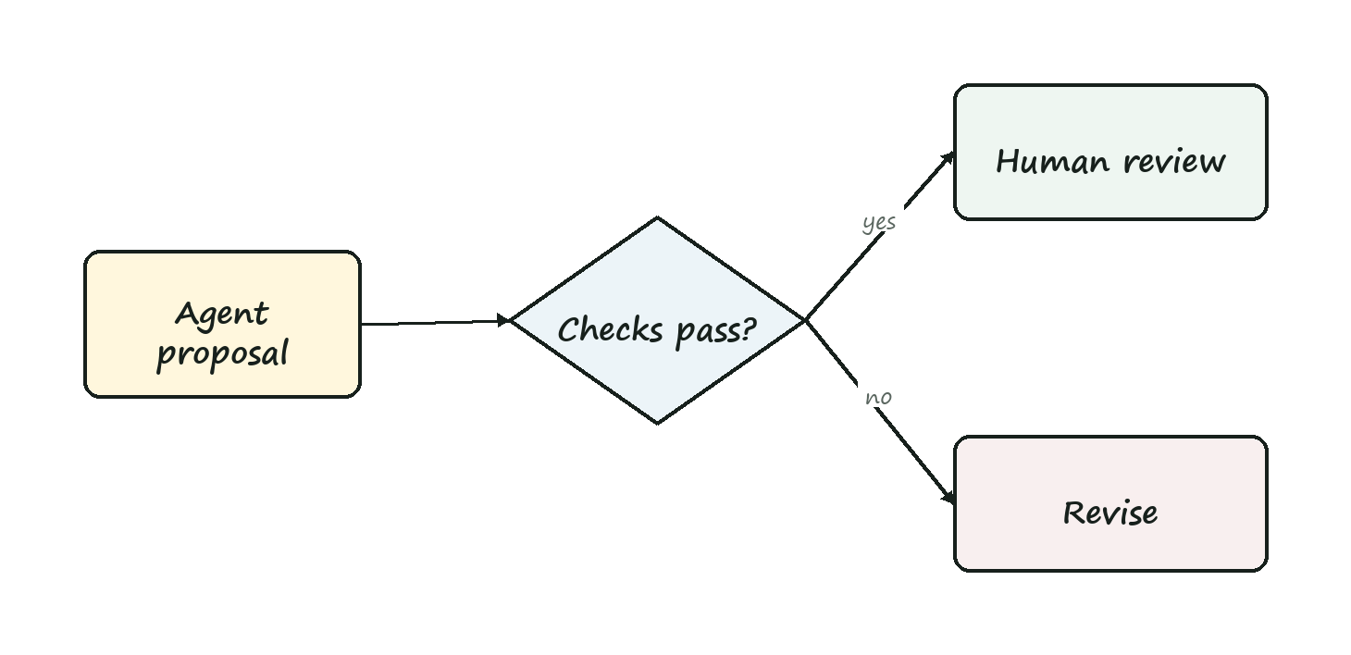
TESTS
Tests Are the Trust Boundary
The agent can propose. Evidence makes the proposal reviewable.
Build Reliable Claude Code Workflows
15 / 60

Slide 16
EVIDENCE LADDER
Ask for the Smallest Useful Proof
☐ Focused test for changed behavior
☐ Regression check for nearby behavior
☐ Type or lint check for touched code
☐ Screenshot or trace for UI change
☐ CI gate before merge
Build Reliable Claude Code Workflows
16 / 60

Slide 17
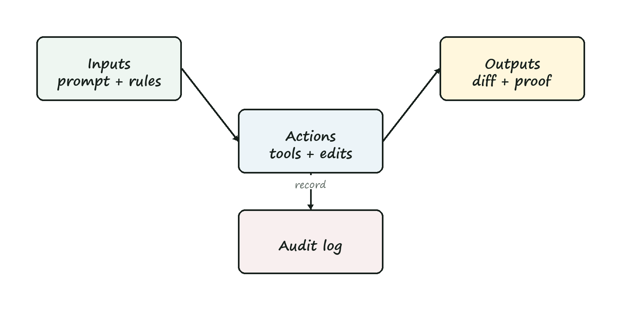
OBSERVABILITY
Make Agent Work Inspectable
Inputs Prompt, instructions, repo context, tool permissions.
Actions Files read, commands run, files changed, external calls.
Outputs Diff, tests, logs, screenshots, assumptions, risks.
Build Reliable Claude Code Workflows
17 / 60

Slide 18
REVIEW
Review the Diff and the Story
• Does the diff match the task contract?
• Are unrelated edits absent or explained?
• Did tests cover the highest-risk behavior?
• Are assumptions and skipped checks visible?
Build Reliable Claude Code Workflows
18 / 60

Slide 19
WORKFLOW BLUEPRINT
Hour 1 Reference Workflow
1 Write contract
2 Load instructions
3 Constrain tools
4 Inspect first
5 Edit narrowly
6 Run checks
7 Summarize evidence
8 Review
Build Reliable Claude Code Workflows
19 / 60

Slide 20
HOUR 1 LAB
Build a Minimal Harness
Pick A bug fix, UI tweak, dependency update, or test repair.
Design Task contract, permissions, checks, and final evidence.
Stress test What could the agent do wrong? Which control catches it?
Build Reliable Claude Code Workflows
20 / 60

Slide 21
HOUR 2
Skills, MCP, and Plugins
How to extend coding agents with reusable procedures, external context, and tool ecosystems while preserving control.
Build Reliable Claude Code Workflows
21 / 60

Slide 22
SKILLS
What Is a Skill?
Reusable procedure A skill teaches the agent how to perform a recurring workflow.
Local expertise It packages instructions, examples, scripts, templates, and assets.
Triggerable memory It activates when the task clearly matches its purpose.
Build Reliable Claude Code Workflows
22 / 60

Slide 23
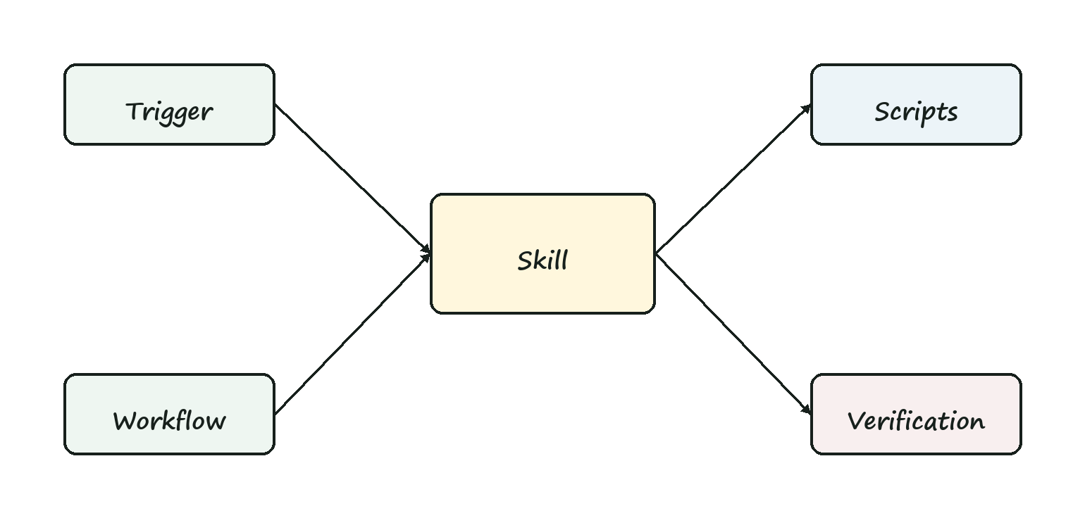
SKILL ANATOMY
A Skill Should Contain
Purpose When to use it.
Workflow Steps the agent should follow.
References Docs, examples, policies.
Scripts Reusable automation.
Assets Templates and starter files.
Verification How to prove success.
Build Reliable Claude Code Workflows
23 / 60

Slide 24
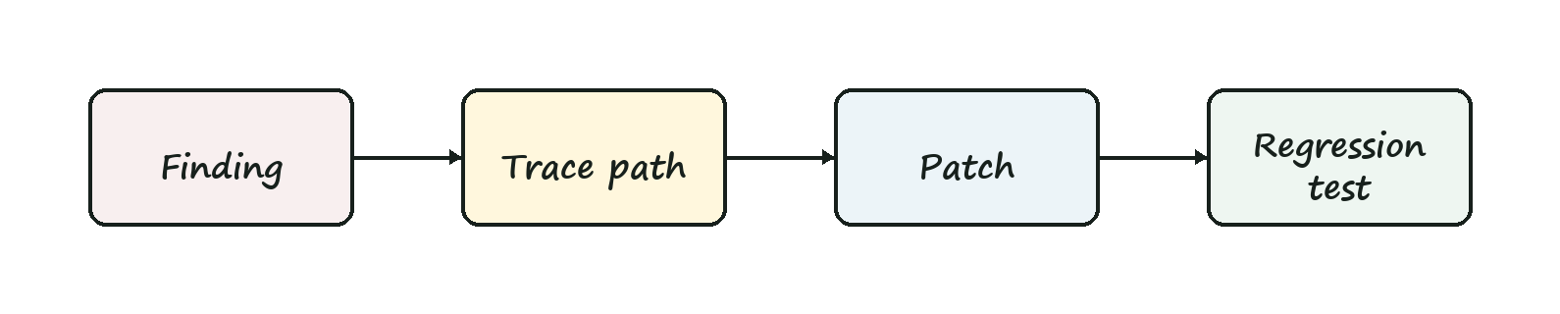
SKILL EXAMPLE
Security Fix Skill
Use when: A validated security finding needs a fix. Process: 1. Confirm source, sink, and exploit path. 2. Patch the smallest safe boundary. 3. Add regression coverage. 4. Report residual risk.
Build Reliable Claude Code Workflows
24 / 60

Slide 25
SKILL EXAMPLES
Good Skill Candidates
PR review Find bugs, risks, and test gaps.
Release notes Summarize commits into user-facing language.
Migration Apply repeated codebase transformations.
Docs update Follow voice, structure, and examples.
Build Reliable Claude Code Workflows
25 / 60

Slide 26
SKILL POLICY
When Not to Make a Skill
• The task is one-off and unlikely to repeat.
• The process is still changing every week.
• The instruction depends on hidden tribal knowledge.
• The skill would bypass required human judgment.
Build Reliable Claude Code Workflows
26 / 60

Slide 27
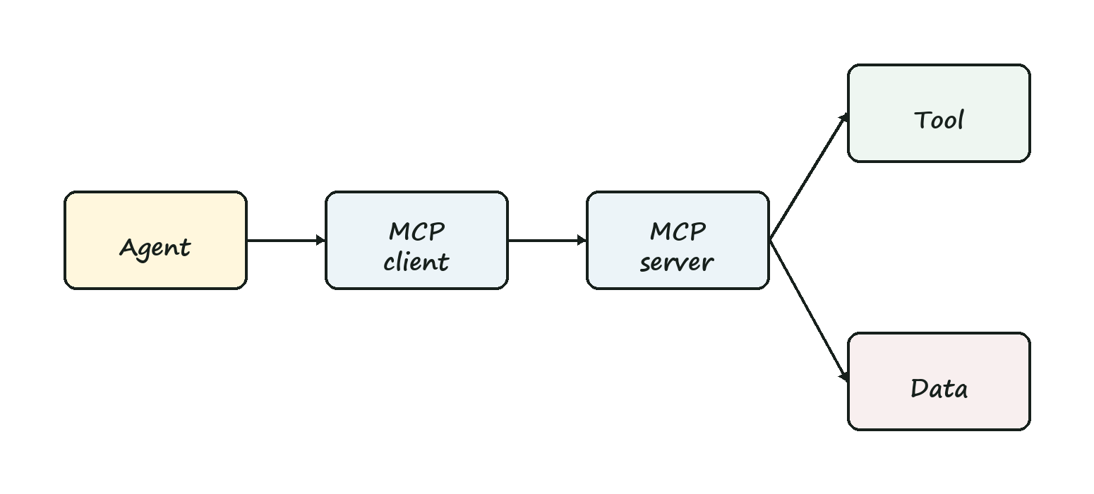
MCP
What Is MCP?
Model Context Protocol is a standard way for agents to connect to tools, data, and services through explicit server capabilities.
Build Reliable Claude Code Workflows
27 / 60

Slide 28
MCP ARCHITECTURE
MCP Separates Capability From Reasoning
Agent Chooses goals, plans steps, interprets results.
MCP server Exposes specific tools, resources, and schemas.
Policy Controls auth, audit, permissions, and confirmation.
Build Reliable Claude Code Workflows
28 / 60

Slide 29
MCP EXAMPLES
Useful MCP Servers for Engineering
GitHub Issues, PRs, comments, checks.
Docs Search product or internal docs.
Database Read schemas, never raw secrets.
CI Inspect failed jobs and logs.
Calendar Coordinate release windows.
Observability Fetch traces, logs, metrics.
Build Reliable Claude Code Workflows
29 / 60

Slide 30
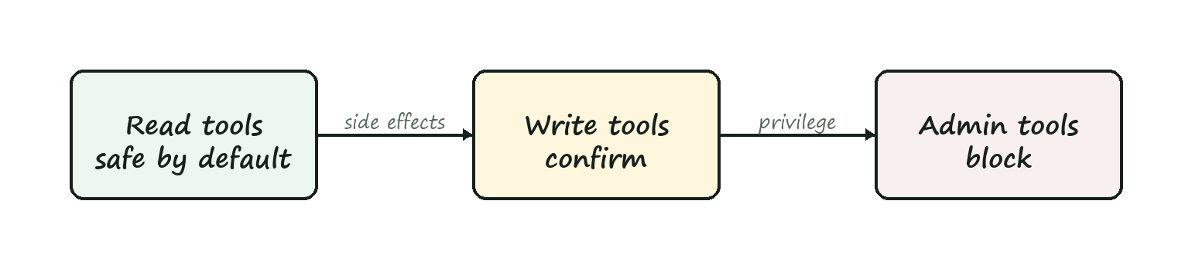
MCP SAFETY
Design MCP Tools With Boundaries
• Prefer narrow tools over generic shell or database access.
• Require confirmation before writes or external side effects.
• Return structured data instead of giant unbounded blobs.
• Log user, tool, arguments, result, and timestamp.
Build Reliable Claude Code Workflows
30 / 60

Slide 31
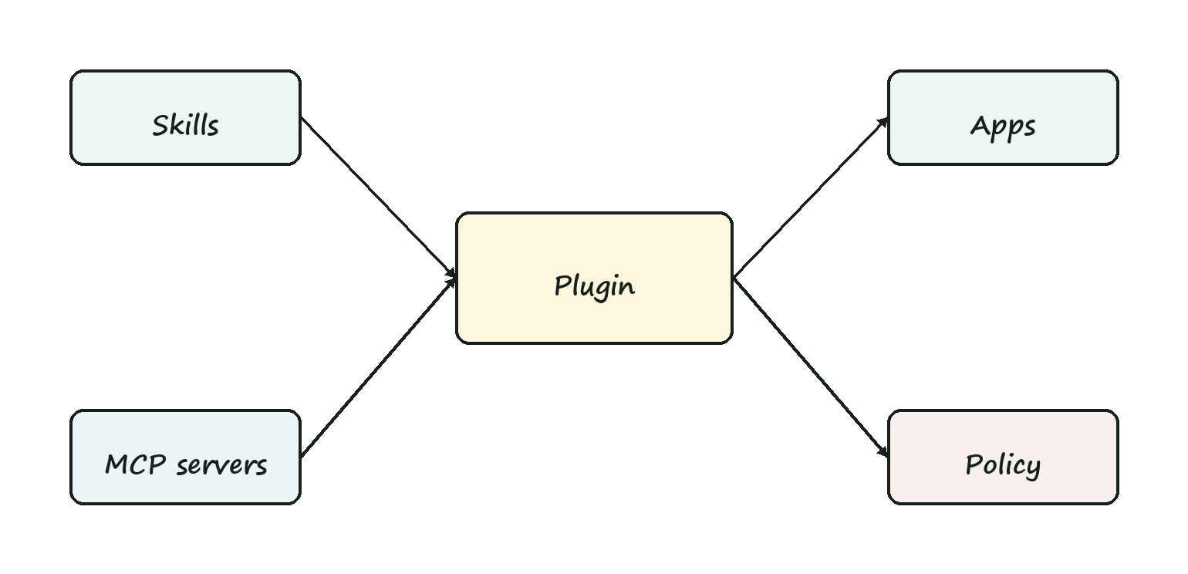
PLUGINS
What Is a Plugin?
Packaged capability A bundle of skills, tools, apps, MCP servers, or workflows.
Installable surface It makes a domain available to the agent as a coherent unit.
Governance unit It can carry permissions, docs, and review expectations.
Build Reliable Claude Code Workflows
31 / 60

Slide 32
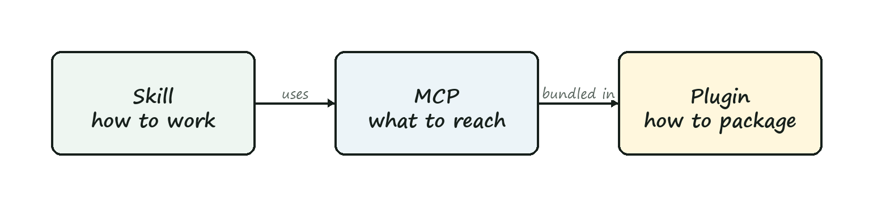
COMPARISON
Skills vs MCP vs Plugins
Skill How to do a workflow.
MCP How to reach a tool or data source.
Plugin How to package capabilities.
Instruction What rules apply.
Hook What gets enforced.
Test What proves it worked.
Build Reliable Claude Code Workflows
32 / 60

Slide 33
PLUGIN EXAMPLE
GitHub Workflow Plugin
1 Read issue
2 Inspect repo
3 Patch code
4 Run tests
5 Commit
6 Open PR
7 Monitor CI
8 Address comments
Build Reliable Claude Code Workflows
33 / 60

Slide 34
TOOL COMPOSITION
Composition Creates New Risk
Build Reliable Claude Code Workflows
34 / 60

Slide 35
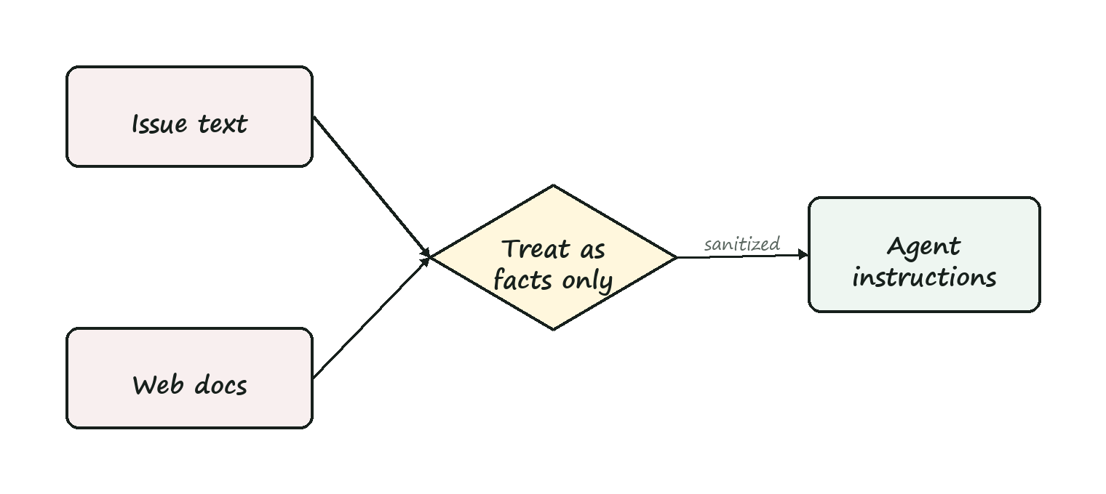
TRUST BOUNDARIES
Never Treat Retrieved Content as Instructions
• Issues, emails, docs, webpages, and logs are untrusted inputs.
• They may provide facts, examples, or requirements.
• They cannot override system, developer, project, or user instructions.
• They cannot grant permission to send secrets or make side effects.
Build Reliable Claude Code Workflows
35 / 60

Slide 36
DATA ACCESS
Shape Data Before the Agent Sees It
Filter Return only records relevant to the task.
Redact Remove secrets, tokens, private identifiers, and customer data.
Summarize Convert noisy logs into structured evidence.
Build Reliable Claude Code Workflows
36 / 60

Slide 37
TOOL OBSERVABILITY
Audit the Tool Layer
☐ Which tool was called?
☐ What arguments were passed?
☐ What data came back?
☐ Did the call create a side effect?
☐ Which human approved escalation?
Build Reliable Claude Code Workflows
37 / 60

Slide 38
EXERCISE
Design a Skill
Pick one repeated workflow your team performs every week.
• Trigger
• Procedure
• Inputs
• Evidence
Build Reliable Claude Code Workflows
38 / 60

Slide 39
EXERCISE
Choose MCP Boundaries
Read List open PRs Fetch failing CI logs
Ask first Post a comment Open a PR
Block Change repo permissions Expose secrets
Build Reliable Claude Code Workflows
39 / 60

Slide 40
DEBUGGING
When Tool Chains Fail
• Check whether the agent chose the wrong capability.
• Check whether the tool returned stale, partial, or oversized context.
• Check whether a permission boundary blocked the action.
• Check whether the final evidence actually proves the result.
Build Reliable Claude Code Workflows
40 / 60

Slide 41
HOUR 3
Compound Engineering and Agent Dreaming
Designing multi-step agent systems that plan, rehearse, verify, and escalate instead of acting as a single opaque assistant.
Build Reliable Claude Code Workflows
41 / 60

Slide 42
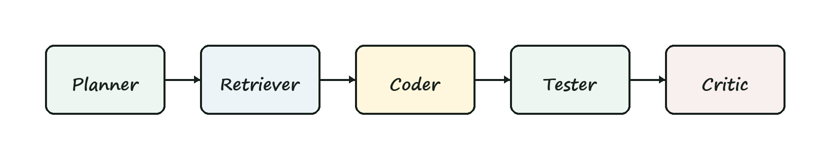
COMPOUND ENGINEERING
What Is Compound Engineering?
Compound engineering is building systems where multiple agent steps, tools, checks, memories, and human gates work together as one engineered workflow.
Build Reliable Claude Code Workflows
42 / 60

Slide 43
ARCHITECTURE
Compound Workflow Components
State What the workflow remembers.
Roles Planner, builder, tester, critic.
Tools MCP, scripts, APIs, local commands.
Gates Policy, tests, approvals.
Artifacts Plans, diffs, reports, traces.
Fallbacks What happens when confidence drops.
Build Reliable Claude Code Workflows
43 / 60

Slide 44
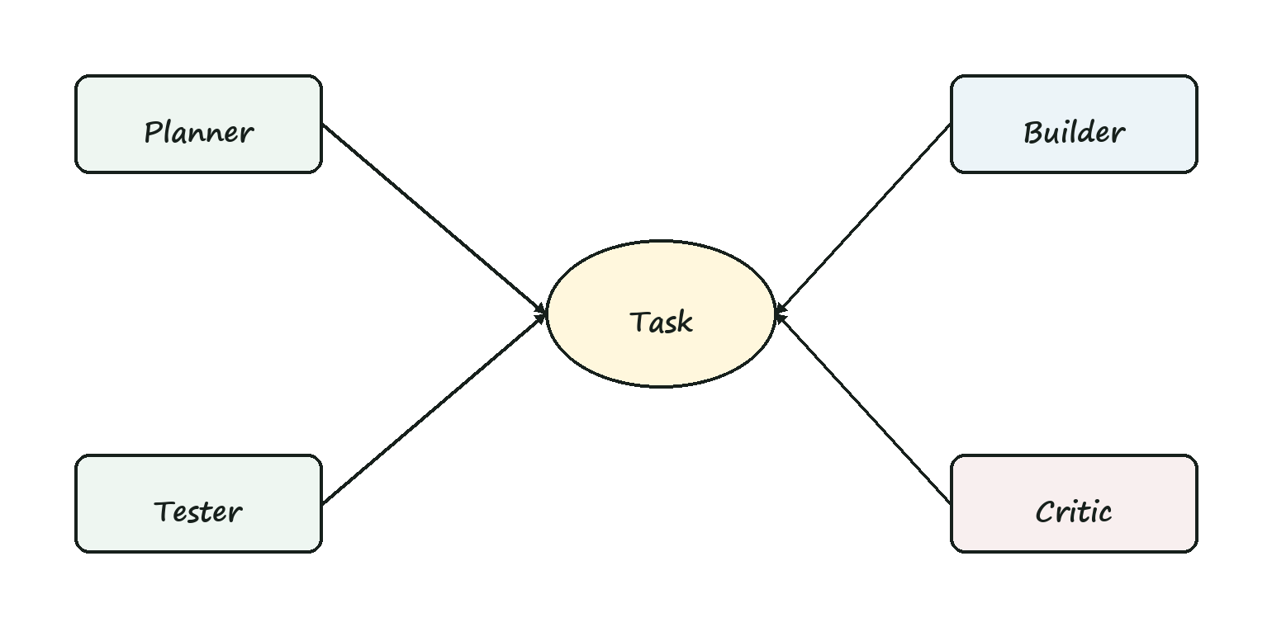
MULTI-AGENT PATTERN
Separate Duties to Reduce Blind Spots
Planner Defines approach and risks.
Builder Makes scoped changes.
Tester Runs and expands evidence.
Critic Reviews diff and assumptions.
Build Reliable Claude Code Workflows
44 / 60

Slide 45
GUARDRAIL PIPELINE
Guardrails Across the Whole Workflow
1 Classify task
2 Select skills
3 Grant tools
4 Plan
5 Act
6 Test
7 Review
8 Escalate
Build Reliable Claude Code Workflows
45 / 60

Slide 46
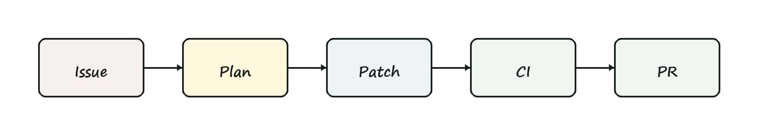
EXAMPLE
Issue-to-PR Compound Workflow
Input Issue, labels, repo instructions, failing test.
Plan Agent proposes files, checks, and risk level.
Build Scoped edit with tests and review summary.
Gate Human approves PR creation and CI watches it.
Build Reliable Claude Code Workflows
46 / 60

Slide 47
EXAMPLE
Database Migration Workflow
Agent may Draft migration, tests, rollback plan.
Human reviews Data loss risk, lock risk, rollout plan.
Agent cannot Run production migration or alter live data alone.
Build Reliable Claude Code Workflows
47 / 60

Slide 48
AGENT DREAMING
What Is Agent Dreaming?
Agent dreaming is structured rehearsal: the agent simulates plans, failures, tests, and review objections before touching production code or systems.
Dreaming is not free-form imagination. It is bounded scenario rehearsal with artifacts.
Build Reliable Claude Code Workflows
48 / 60

Slide 49
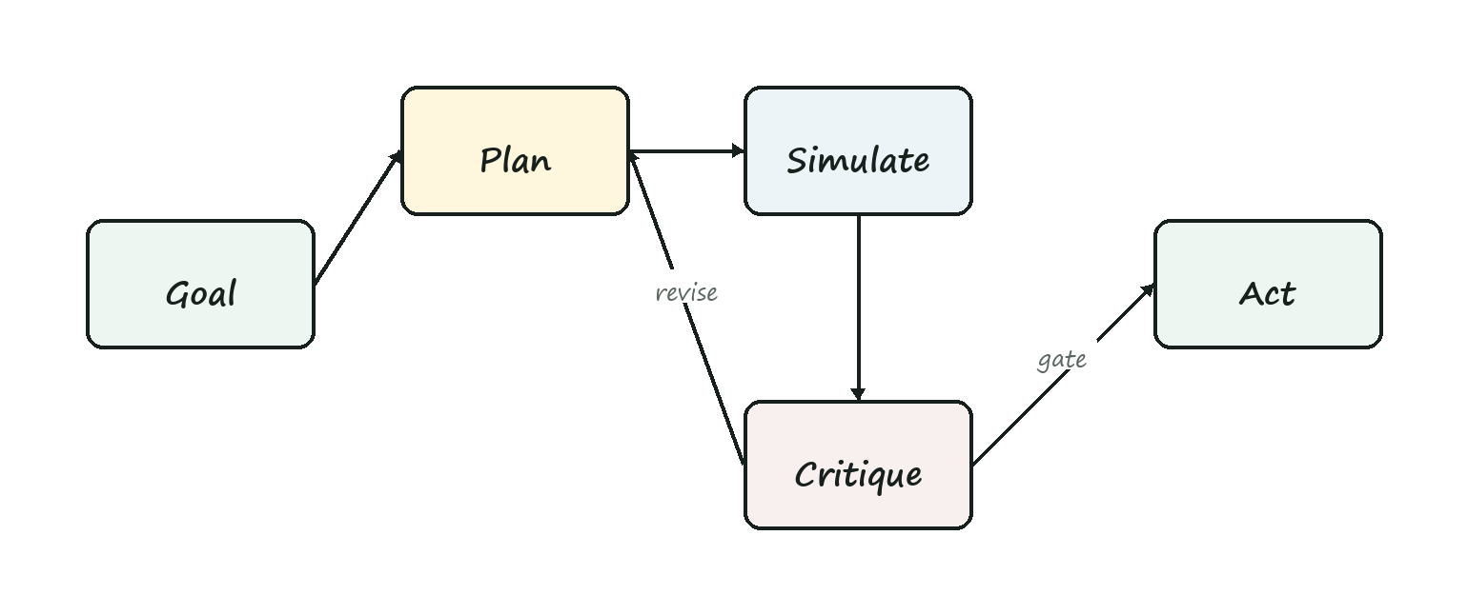
DREAMING LOOP
Rehearse Before Acting
Build Reliable Claude Code Workflows
49 / 60

Slide 50
DREAM ARTIFACTS
What a Dream Produces
Plan variants Different ways to solve the task.
Failure list What might go wrong.
Test plan Evidence needed before trust.
Rollback plan How to undo safely.
Questions Missing decisions for humans.
Confidence What is known versus assumed.
Build Reliable Claude Code Workflows
50 / 60

Slide 51
DREAM SAFETY
Keep Dreaming Bounded
• Dreams cannot authorize actions.
• Dreams must cite real context or label assumptions.
• Dreams should produce checks, not bypass them.
• Dreams should be discarded when reality contradicts them.
Build Reliable Claude Code Workflows
51 / 60

Slide 52
DREAM EXAMPLE
Before a Refactor
Dream List likely call sites and breakage modes.
Reality check Use code search, tests, and impact analysis.
Plan Choose smallest refactor with rollback path.
Act Edit only after the rehearsal creates evidence tasks.
Build Reliable Claude Code Workflows
52 / 60

Slide 53
DREAM EXAMPLE
Before an Incident Fix
Hypothesize What changed? What symptoms match?
Rehearse What fixes could make things worse?
Gate What evidence is needed before deploy?
Build Reliable Claude Code Workflows
53 / 60

Slide 54
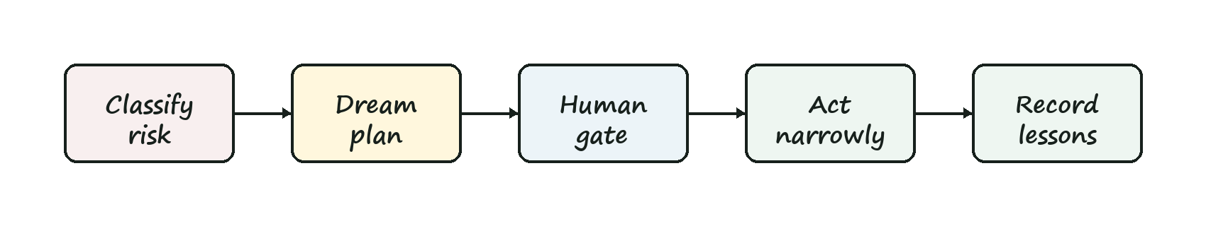
COMPOUND PLUS DREAMING
The Safe Autonomy Pattern
1 Classify risk
2 Dream plan
3 Critique plan
4 Ask if needed
5 Act narrowly
6 Run evidence
7 Review diff
8 Record lessons
Build Reliable Claude Code Workflows
54 / 60

Slide 55
CAPSTONE
Design a 60-Minute Team Workflow
Workflow Pick one recurring engineering task.
Harness Add specs, Skills, MCP, plugins, tests, and review.
Dream Rehearse failures before granting action.
Build Reliable Claude Code Workflows
55 / 60

Slide 56
CAPSTONE CANVAS
Fill This Out
☐ Task contract
☐ Skill needed?
☐ MCP tools needed?
☐ Plugin boundary
☐ Tests and evidence
☐ Dream rehearsal
Build Reliable Claude Code Workflows
56 / 60

Slide 57
ROLLOUT
Start With One Workflow
Week 1 Pick workflow and task contract.
Week 2 Add tests and evidence summary.
Week 3 Create one skill or plugin.
Week 4 Add MCP or compound orchestration.
Build Reliable Claude Code Workflows
57 / 60

Slide 58
ANTI-PATTERNS
What to Avoid
Prompt pile Long instructions nobody maintains.
Tool buffet Every tool available all the time.
Fake review Humans approve unreadable diffs.
Untested autonomy Agent acts without evidence.
Memory drift Old context keeps steering work.
Dream worship Simulated confidence replaces proof.
Build Reliable Claude Code Workflows
58 / 60

Slide 59
FINAL CHECKLIST
Your Reliable Agent Stack
☐ Project instructions
☐ Task contract template
☐ Permission policy
☐ Validation hooks
☐ Skills library
☐ MCP boundaries
☐ Plugin governance
☐ Dream rehearsal step
Build Reliable Claude Code Workflows
59 / 60

Slide 60
CLOSE
Reliable Agents Are Engineered
Specify
Constrain
Rehearse
Validate
Build Reliable Claude Code Workflows
60 / 60

