Slide 1
IB PSYCHOLOGY · BIOLOGICAL LEVEL OF ANALYSIS
The Brain & the Neuron
Lobes, structures, and the building blocks of the nervous system

Slide 2
BIG PICTURE
Three Major Divisions of the Brain
Cerebrum
Cerebellum
Brainstem
The largest region. Two hemispheres, four lobes each. Handles higher-order thinking: reasoning, language, movement, and personality.
Tucked under the back of the cerebrum. Coordinates balance, posture, and smooth, precise movement — often called the “little brain.”
Connects the brain to the spinal cord. Controls automatic, life-sustaining functions like breathing, heart rate, and reflexes.
2

Slide 3
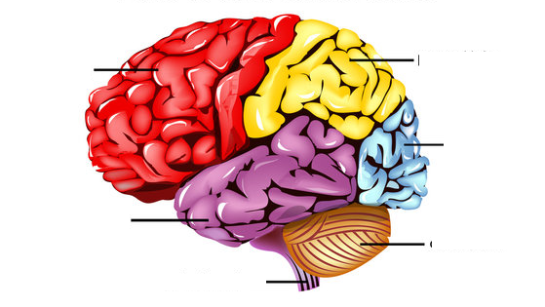
CEREBRAL CORTEX
The Four Lobes, at a Glance
Frontal Lobe
Reasoning, planning, movement, personality
Parietal Lobe
Touch, spatial awareness, sensory integration
Temporal Lobe
Hearing, language comprehension, memory
Occipital Lobe
Visual processing
Cerebellum & Brainstem
Coordination and vital automatic functions
3

Slide 4
CEREBRAL CORTEX
Lobe Functions in Detail
Frontal Lobe
Parietal Lobe
The brain's executive & motor centre
The brain's sensory integration hub
Prefrontal cortex: planning, judgment, and impulse control
Motor cortex: initiates voluntary movement
Broca's area: controls speech production
Somatosensory cortex: processes touch, pressure, temperature, and pain
Spatial awareness: helps judge distance, direction, and body position
Sensory integration: combines input from multiple senses
4

Slide 5
CEREBRAL CORTEX
Lobe Functions in Detail
Temporal Lobe
Occipital Lobe
Hearing, language, and memory
The brain's visual centre
Auditory cortex: processes sound and pitch
Wernicke's area: supports language comprehension
Hippocampus: medial structure vital for forming new memories
Visual cortex: processes what the eyes see
Colour & motion: detects colour, movement, and depth
Damage effects: can impair or eliminate vision
5

Slide 6
BEYOND THE CORTEX
Cerebellum & Brainstem
Cerebellum
Brainstem
Balance & posture: keeps the body upright and stable
Coordination: smooths and times voluntary movement
Procedural learning: builds motor skills and habits through practice
Medulla: regulates heart rate and breathing
Pons: relays signals between brain regions; supports sleep
Midbrain: coordinates reflexes and eye movement
6

Slide 7
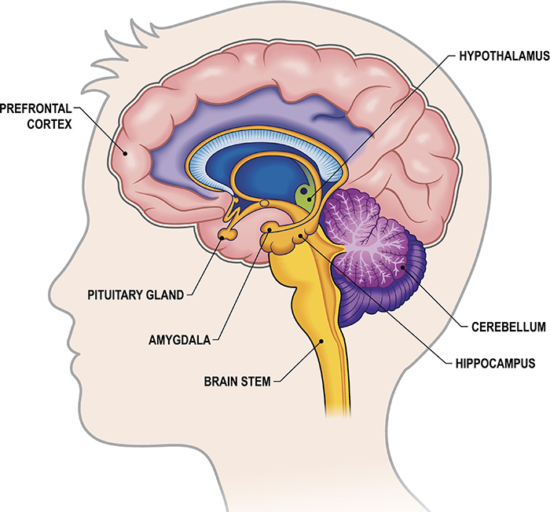
BENEATH THE CORTEX
The Limbic System
A network of structures that governs emotion, memory, and regulation.
Prefrontal Cortex
Regulates emotional responses from the limbic system; supports decision-making
Hypothalamus
Maintains homeostasis — hunger, thirst, temperature, and hormone release
Pituitary Gland
The body's “master gland”; releases hormones directed by the hypothalamus
Amygdala
Processes emotion, especially fear and threat detection
Hippocampus
Forms and consolidates new long-term memories
Brain Stem
Regulates automatic survival functions; links brain to spinal cord
Note: the cerebellum is shown for anatomical context but is not classically considered part of the limbic system.
7

Slide 8
APPLYING THE ANATOMY
Case Study: Social Phobia
How the regions above interact to produce a real psychological disorder.
1
Social Threat Is Detected
2
Attention Shifts to Threat
Fusiform gyrus: ↑ increased processing of faces, especially socially relevant cues
Amygdala: ↑ increased detection of threat, e.g. an angry or disapproving face
BNST: ↑ sustained, anticipatory anxiety — “something bad might happen”
Focus narrows: the person becomes highly focused on faces, reactions, and signs of rejection
Right hemisphere: some studies find greater relative activation, though less consistently than the amygdala finding
3
Internal Processing Is Altered
4
Speech & Language Affected
Posterior cingulate cortex: ↓ deactivation of this default-mode / self-referential region
Interpretation: a shift from internally directed thought toward monitoring the external social environment
Left Broca's area: activity may decrease in some studies or conditions
Interpretation: fits the experience of “going blank” or struggling to formulate a response
8

Slide 9
APPLYING THE ANATOMY
Putting It Together
Social cue
→
Fusiform gyrus
→
Amygdala
→
BNST
→
Attention → threat
→
PCC ↓ / Broca ↓
→
Difficulty speaking
A Simple Way to Remember It
Fusiform
“What face is that?”
Amygdala
“Is it threatening?”
BNST
“What if something bad happens?”
PCC
“Me / my internal world” — reduced during threat-focused processing
Broca
“What do I say?” — may become less active
9

Slide 10
THE NERVOUS SYSTEM'S BUILDING BLOCK
Anatomy of a Neuron
Dendrites
receive signals from other neurons
Soma (cell body)
integrates incoming signals
Nucleus
contains the cell's genetic material
Myelin sheath
fatty coating that speeds transmission
Terminal buttons
release neurotransmitters
10

Slide 11
THE NERVOUS SYSTEM'S BUILDING BLOCK
Neuron Parts, Explained
Dendrites
Soma (Cell Body)
Axon
Branch-like extensions that receive chemical signals from neighbouring neurons and pass them toward the cell body.
Contains the nucleus and cell organelles. Integrates incoming signals and decides whether to fire an impulse.
A long fibre that carries the electrical impulse (action potential) away from the cell body toward other neurons.
Myelin Sheath
Axon Terminals
Synapse
A fatty layer wrapped around the axon in segments. Speeds up signal transmission; gaps are called Nodes of Ranvier.
Branches at the end of the axon, each ending in a terminal button that stores neurotransmitters.
The tiny gap between one neuron's terminal button and the next neuron's dendrite, where neurotransmitters cross.
11

Slide 12
HOW NEURONS TALK TO EACH OTHER
Synaptic Transmission
1
An electrical impulse (action potential) travels down the axon to the terminal button.
2
Neurotransmitters are released from vesicles into the synaptic gap.
3
They cross the gap and bind to receptors on the next neuron's dendrite.
Presynaptic terminal
Synaptic gap
Postsynaptic dendrite
4
The signal continues (excitatory) or is dampened (inhibitory) in the receiving neuron.
12

Slide 13
BEFORE YOU LABEL
Key Terms to Know
Use this word bank to check yourself before the labelling activity.
Brain Regions
Limbic System
Neuron Structures
Frontal lobe
Parietal lobe
Hypothalamus
Pituitary gland
Dendrites
Soma (cell body)
Nucleus
Temporal lobe
Occipital lobe
Amygdala
Hippocampus
Axon
Myelin sheath
Nodes of Ranvier
Cerebellum
Brainstem
Motor cortex
Prefrontal cortex
Homeostasis
Terminal buttons
Synapse
Broca's area
Wernicke's area
Neurotransmitters
Action potential
13

