Slide 1

LoanAgent
Intelligent Multi-Agent Loan Processing System
FentesticFour | UMHackathon 2026

Slide 2

The Problem
The Current State of Loan Processing
Manual & Inefficient: Traditional loan applications are bogged down by manual data entry, document review, and verification, leading to slow processing times and high operational costs.
Error-Prone: Human error in data extraction and compliance checks can lead to significant financial losses and regulatory penalties.
Lack of Transparency: Borrowers often face opaque processes, and lenders struggle with a clear audit trail of decisions.
Regulatory Complexity: Navigating diverse and evolving regional legal frameworks for loan compliance is a constant challenge, increasing risk.

Slide 3

The Solution
Introducing LoanAgent: Revolutionizing Loan Processing with AI
LoanAgent is an AI-powered, multi-agent system designed to automate and optimize the entire loan lifecycle. We transform complex, manual processes into a streamlined, intelligent workflow, ensuring speed, accuracy, and compliance.
Our Solution Delivers:
Automation: From document parsing to decision-making, significantly reducing manual effort.
Accuracy: AI-driven extraction and analysis minimize errors and improve data integrity.
Compliance: Built-in regional legal checks ensure adherence to diverse regulations.
Transparency: A clear audit trail of every decision made by the system.
Efficiency: Faster loan approvals and reduced operational overhead.

Slide 4

How it Works: The 7-Agent Pipeline
1. EXTRACTION
Gemini 2.0 parses text/files into structured data.
2. VALIDATION
Auto-discovery of missing fields and data gaps.
3. FINANCIAL
DSR calculation and automated risk assessment.
4. CREDIT CHECK
Score and property valuation simulation.
5. COMPLIANCE
Verifies local laws (MY/SG/TH/ID) via MCP.
6. CONTRACT
Scans documents for legal "traps" and hidden fees.
7. DECISION
Final multi-factor verdict and safety report.
All agents are managed and coordinated by a central Orchestrator Agent.

Slide 5
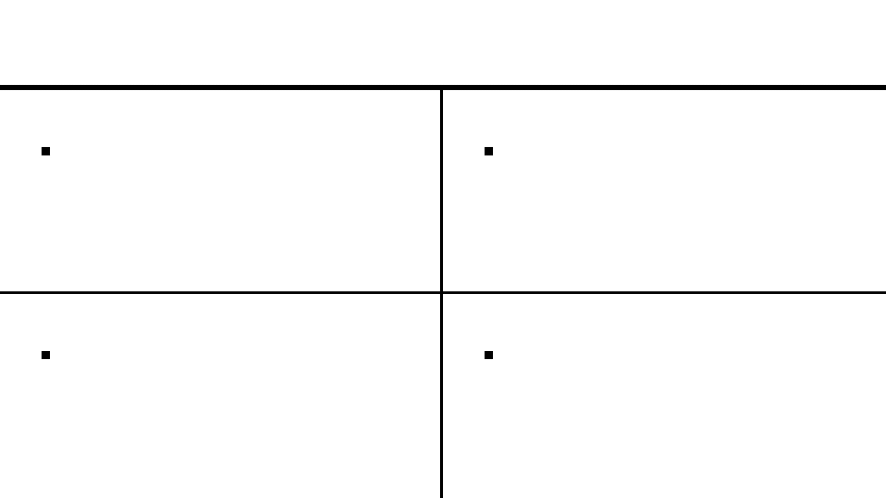
Key Features & Innovations
EFFICIENCY
COMPLIANCE
Automated Workflow Discovery
Regional Legal Compliance
Intelligently processes available data without halting. Identifies missing fields and continues background analysis (e.g., contract safety) to ensure zero-friction progress.
Hyper-local regulatory checks for Malaysia, Singapore, Thailand, and Indonesia. Automatically adjusts DSR caps and minimum income requirements based on user location.
SECURITY
INTELLIGENCE
Predatory Contract Detection
Intelligent Data Synthesis
Proactively scans agreements for legal "traps." Detects hidden fees, predatory late interest, and unfair settlement penalties to protect both lenders and borrowers.
Advanced multimodal extraction of core terms (Principal, Rate, Tenure) directly from uploaded PDFs or images, eliminating manual data entry errors.

Slide 6

Technology Stack
Robust & Scalable Foundations
FastAPI
Gemini 2.0 Flash
High-performance Python framework for building asynchronous APIs with speed and reliability.
Multimodal AI core for sophisticated document analysis, extraction, and natural language reasoning.
Vanilla JS/CSS
Pydantic
Premium glassmorphic Single Page Application (SPA) frontend for a responsive and intuitive user experience.
Strict data validation and schema enforcement to ensure integrity across the multi-agent pipeline.

Slide 7

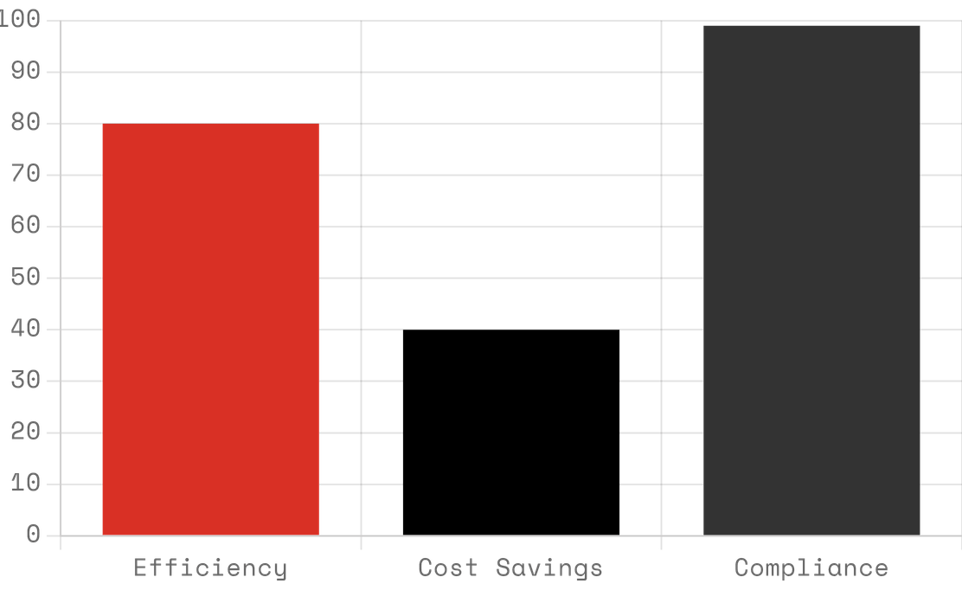
Market Opportunity & Impact
Financial Institutions
Projected System Impact
Reducing operational costs and accelerating approval times for traditional banks.
Fintech Startups
Providing a ready-to-integrate, intelligent backbone for digital lending platforms.
Borrowers
Offering a faster, more transparent, and fairer loan application experience.

