Slide 1


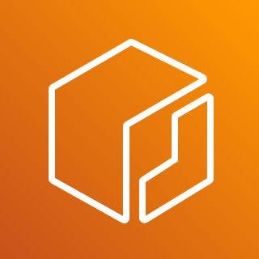







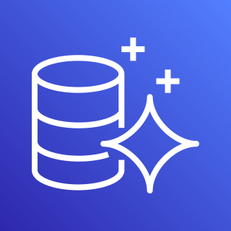

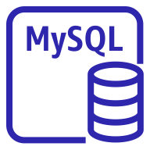

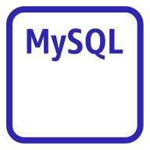

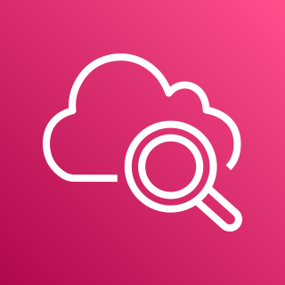
AWS Cloud
Region（Tokyo）
AWS WAF
Amazon ECR
BaseStack/NoteAppVPC
AWS App Runner
Private subnet
Aurora Serverless V2
User
VPC Connector
App Runner Service（Note App)
・・・
Writer instance
Container
Container
Container
Private subnet
Reader instance
Amazon CloudWatch

