Slide 1










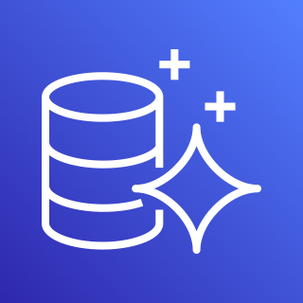

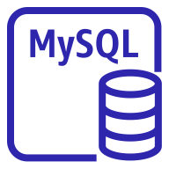




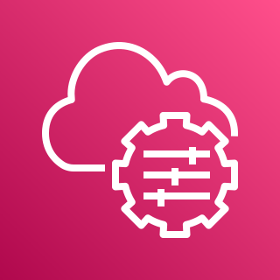


AWS Cloud
Region（Tokyo）
AWS WAF
Amazon ECR
BaseStack/NoteAppVPC
AWS App Runner
Private subnet
Aurora Serverless V2
User
VPC Connector
App Runner Service（Note App)
・・・
Writer instance
Container
Container
Container
Private subnet
User
Reader instance
Systems Manager
Secrets Manager
CloudWatch

