Slide 1


Kenichi Shibata
DevSecOps Lead, esure

Slide 2
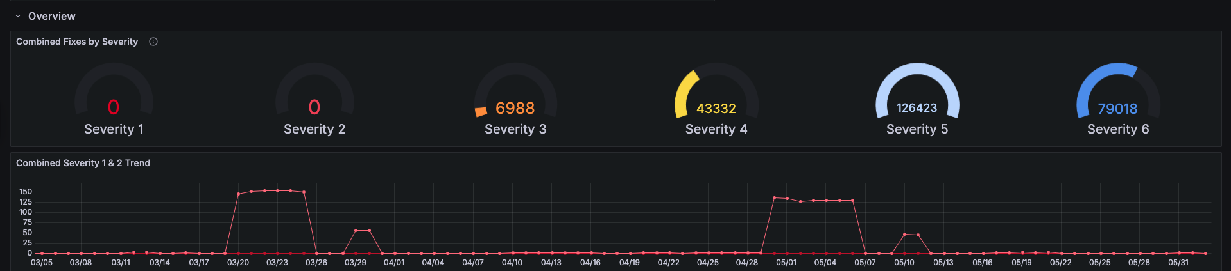
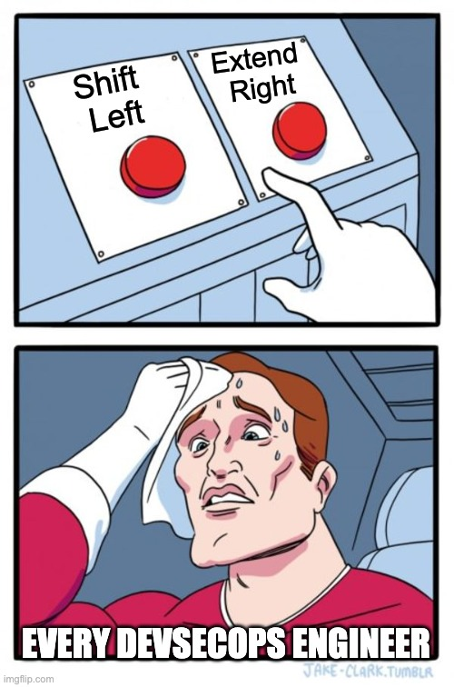

DevSecOps at esure: From alert overload to a pragmatic security roadmap
Strategic Pivot – Phase 1
Prioritized visibility into our live cloud environment first. Chose Wiz Cloud.
Our Initial Pains
Strategic Pivot – Phase 2
SonarCloud: Code quality only, missed basic security (e.g., AWS keys not caught).
Prisma Cloud: "1M+ vulnerabilities," no actionable prioritization = alert paralysis.
Goal: Prevent now-known issues before merge.
Approach: Mandatory GitHub PR Scans with Wiz Code & Semgrep (integrated findings into Wiz).
How should we rebuild our DevSecOps program?
Notes:
Talking notes based on our sync: "Our DevSecOps journey started from a common pain point: our existing tools weren't effective for security. SonarCloud missed basics, and Prisma Cloud buried us in unprioritized alerts.”
"We realized we couldn't 'shift left' meaningfully without first understanding our actual risk. So, our first strategic move was 'extreme right' – deploying Wiz to get a clear, actionable view of our production cloud environment.”
"Once we had better control over our cloud posture, we leaped to the 'extreme left.' Knowing our Jenkins CI was brittle, we wanted to catch issues directly in GitHub Pull Requests before they even hit CI.”
"This involved integrating Wiz Code for IaC, secrets, PII, and SCA, and Semgrep for SAST, making these scans mandatory for developers."

Slide 3




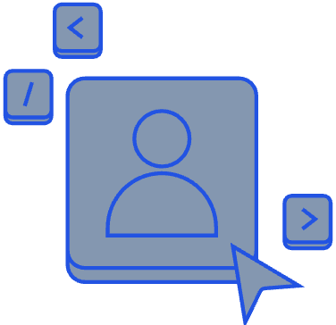









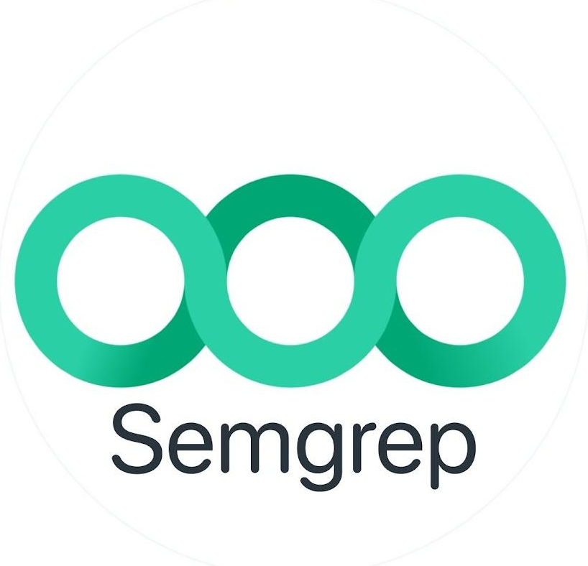
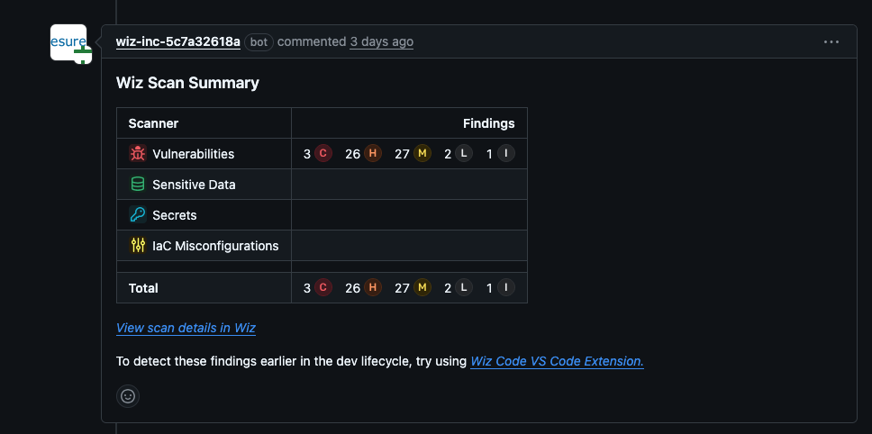

Operationalizing “Start Left”: Rolling Out PR Scans (Part 1: The Technical Setup)
Update logos w/ Kenichi/esure:
Add fortigate + cloudflare
Very old versions of Java, OS, images, versions of MySQL. Lots of tech debt.
Unified Policy Engine
Vulnerabilities
Secrets
Sensitive Data
IaC Configs
Wiz Cloud, Wiz Sensor
Dev
Validation, Remediation in Code
SIEM / SOAR
Push
Build
Dev
IDE or CLI
VCS
GitHub
CI/CD Pipelines
CSP
DevSecOps
Triage, Prioritization, Remediation Guidance
SAST Engine
SAST/CWEs
Notes:
Talking notes based on our sync:
"With the strategy set, we focused on the 'how.' For Wiz Code, we utilized its GitHub integration to automatically scan PRs. Semgrep was similarly set up to trigger on code changes."
"We were deliberate about what we scanned for initially. With Wiz Code, the immediate priorities were preventing new secrets, critical IaC issues, and high-severity vulnerabilities from vulnerable packages. For Semgrep, we focused on common, high-impact SAST findings."
"Our rollout strategy involved [Kenichi to elaborate: e.g., piloting with a few key teams, then expanding / deciding if scans were initially audit-only then blocking]. We learned quickly about the importance of fine-tuning to avoid overwhelming developers while still maintaining a strong security baseline.”
"One of the early considerations was the performance impact of these scans on the PR process – we wanted it to be fast and provide quick feedback."

Slide 4
Operationalizing “Start Left”: Developer Adoption & Feedback (Part 2: The People)
Findings & Feedback Loop
Communication & Training
Dev Reception & Impact
Initial surge of findings: cloud secrets exposed by external devs (contractors).
Clear guidance on interpreting findings and remediation.
Iterative improvements based on developer feedback.
Dedicated enablement sessions (leveraging Notion docs, etc.).
Role of Security Champions in evangelizing and supporting engineering guilds.
Security Champions suggest learning/training topics.
Shift in mindset: From "security as a blocker" to "security as a partner."
Observed changes: Improved code quality pre-merge, maintaining “Zero Critical” posture.
Notes:
Talking notes based on our sync:
"A critical part of this rollout was how we engaged our developers. We ran specific enablement sessions, using our internal documentation [mention Notion example], to explain the new tools, how to interpret their findings, and how to remediate them.”
"Our Security Champions were invaluable here – acting as advocates and first-responders for their teams.”
"Initially, yes, there can be a surge in findings, especially on older codebases. We had to establish a clear process for [Speaker to detail: e.g., focusing on new issues first, systematically addressing backlog, tuning rules to reduce noise, handling false positive reports].”
"The goal was to make the feedback actionable and the process supportive. We've seen a positive shift in how developers view these security checks – increasingly as a helpful part of their workflow, leading to cleaner code and fewer fire-drills later."

Slide 5
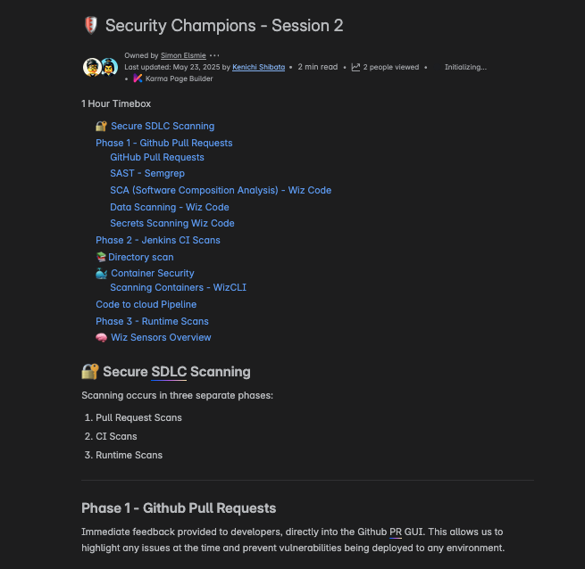
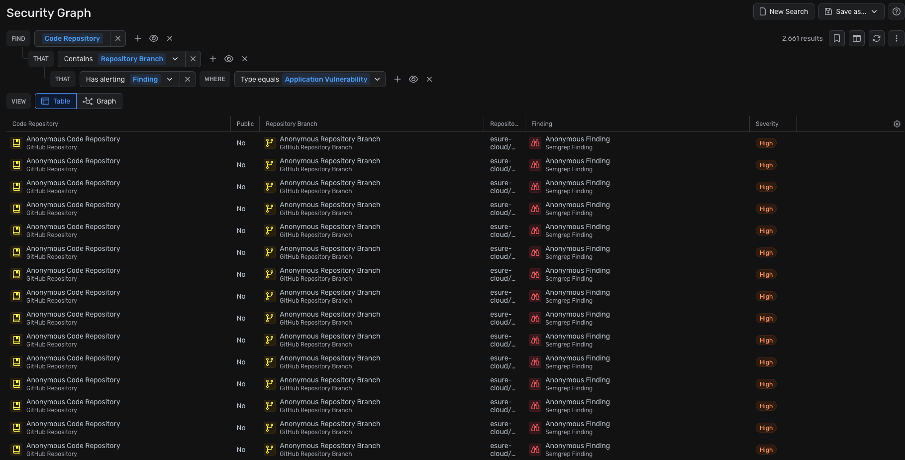
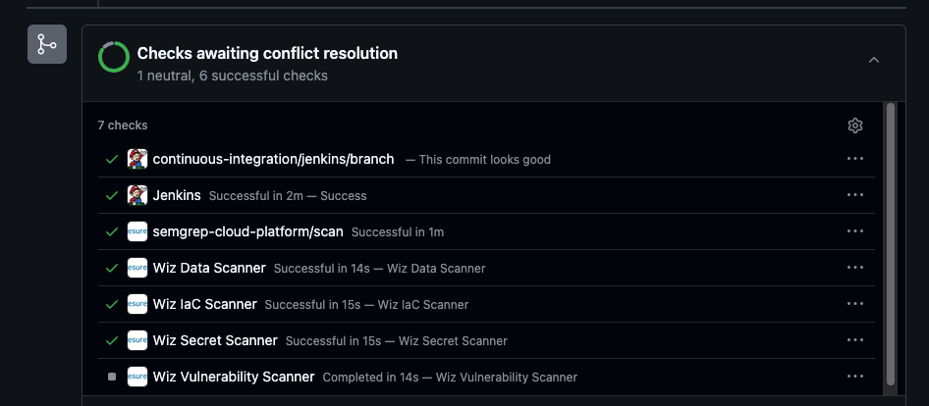
Evolving Pipeline: CI/CD, SAST Integration & Our "Pragmatic" State
The "Middle Ground" (CI/CD)
ASPM & Unified Visibility
Champions & Continuous Enablement
Post-merge: WizCLI for container image scans in Jenkins.
Note: directory scans are planned for deprecation.
Semgrep findings fully ingested into Wiz; a single pane of glass for AppSec + CloudSec.
Ongoing effort beyond 1st rollout–regular sessions with new topics.
Notes:
Talking notes based on our sync:
"A critical part of this rollout was how we engaged our developers. We ran specific enablement sessions, using our internal documentation [mention Notion example], to explain the new tools, how to interpret their findings, and how to remediate them.”
"Our Security Champions were invaluable here – acting as advocates and first-responders for their teams.”
"Initially, yes, there can be a surge in findings, especially on older codebases. We had to establish a clear process for [Speaker to detail: e.g., focusing on new issues first, systematically addressing backlog, tuning rules to reduce noise, handling false positive reports].”
"The goal was to make the feedback actionable and the process supportive. We've seen a positive shift in how developers view these security checks – increasingly as a helpful part of their workflow, leading to cleaner code and fewer fire-drills later."

Slide 6
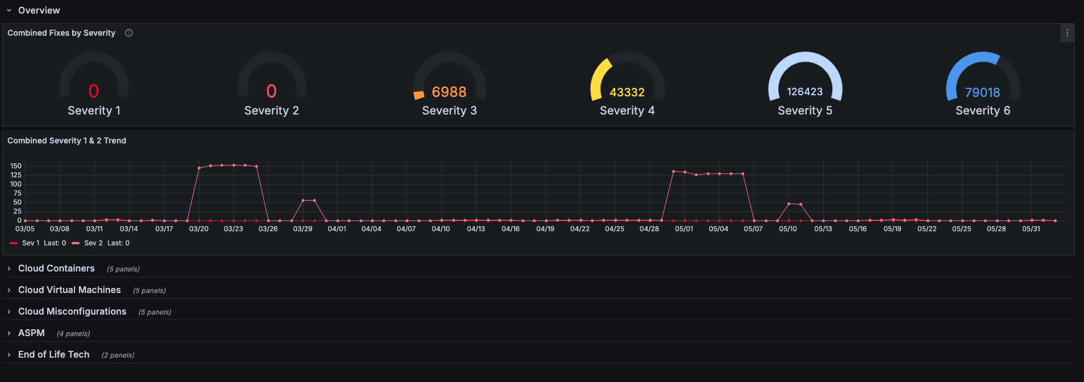
Bonus Operational Dashboard: Yikes (Vulnerability and Misconfig Mgmt Dashboard)
Notes:
Talking notes based on our sync:
"A critical part of this rollout was how we engaged our developers. We ran specific enablement sessions, using our internal documentation [mention Notion example], to explain the new tools, how to interpret their findings, and how to remediate them.”
"Our Security Champions were invaluable here – acting as advocates and first-responders for their teams.”
"Initially, yes, there can be a surge in findings, especially on older codebases. We had to establish a clear process for [Speaker to detail: e.g., focusing on new issues first, systematically addressing backlog, tuning rules to reduce noise, handling false positive reports].”
"The goal was to make the feedback actionable and the process supportive. We've seen a positive shift in how developers view these security checks – increasingly as a helpful part of their workflow, leading to cleaner code and fewer fire-drills later."

Slide 7
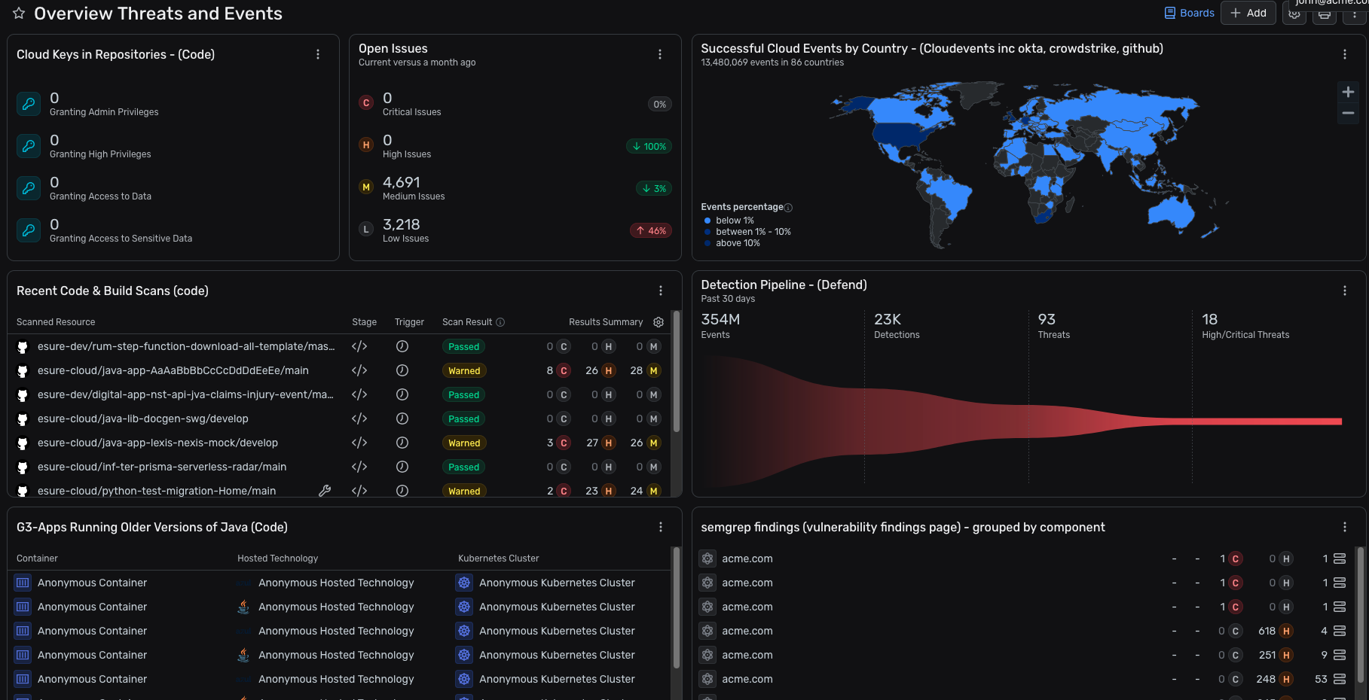
Bonus Operational Dashboard: Wiz Code + Defend + Event/sensor Dashboard
Notes:
Talking notes based on our sync:
"A critical part of this rollout was how we engaged our developers. We ran specific enablement sessions, using our internal documentation [mention Notion example], to explain the new tools, how to interpret their findings, and how to remediate them.”
"Our Security Champions were invaluable here – acting as advocates and first-responders for their teams.”
"Initially, yes, there can be a surge in findings, especially on older codebases. We had to establish a clear process for [Speaker to detail: e.g., focusing on new issues first, systematically addressing backlog, tuning rules to reduce noise, handling false positive reports].”
"The goal was to make the feedback actionable and the process supportive. We've seen a positive shift in how developers view these security checks – increasingly as a helpful part of their workflow, leading to cleaner code and fewer fire-drills later."

Slide 8






Kenichi Shibata
CYBER SECURITY
More details
https://medium.com/beyond-devsecops/building-a-modern-devsecops-pipeline-part-1-building-foundations-348ac81af630

