Slide 1
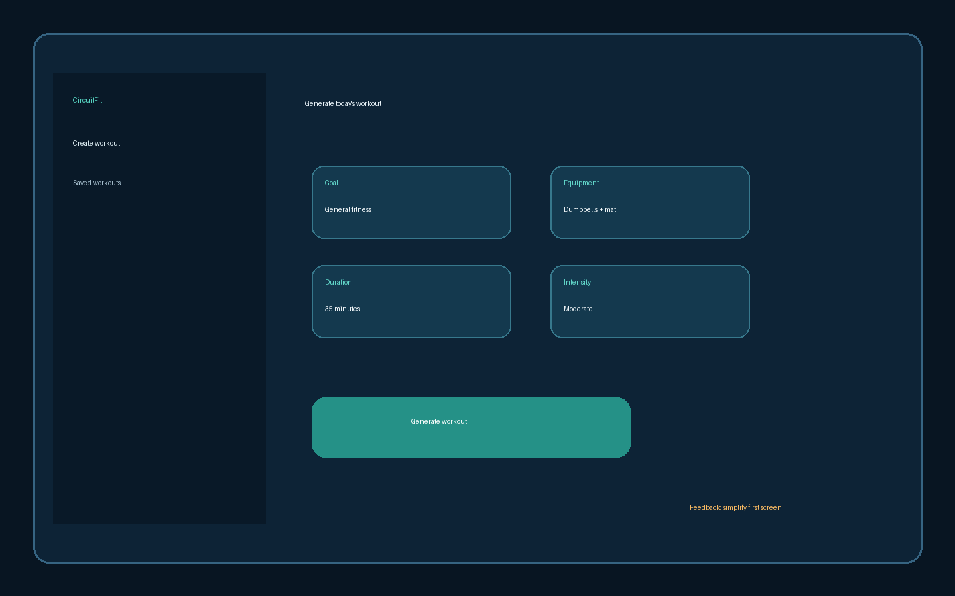
CircuitFit Mobile Browser Review
Review notes
Keep first screen simple
Mobile browser first
No mandatory login in MVP
Marketing wants share card concept
Confirm whether export/import is in scope

Slide 2
Decision Matrix - Draft
Item | Current direction | Status | Comment
Login | No login | Approved | Keep beta low-friction
Persistence | Browser localStorage | Approved | Backend deferred
AI generation | Templates first | Approved | AI later
Leaderboard | Concept only | Needs clarification | Do not implement yet
Wearable HR zones | Deferred | Conflict | Requested in late email

