Slide 1
Amazona A Kitchenary Stop!
Guided By: Prof. Binal Kaka
Initiated And Developed By: Kenith Shah-18DCS107
Upasi Shah-18DCS113

Slide 2
OUTLINE
Problem Statement
Challenges Faced
Software Used
Hardware Used
Project Flowchart
What we mainly implemented
Snapshots of our Project
Limitation and Future scope
Conclusion
References

Slide 3
PROBLEM STATEMENT
A Web Application in which people can SHOP kitchenary things from their home. For E.g.: Buying a cooker Or Buying a Dinner set etc..
Here basically every individual will have their own personal account with their own credentials to place an order.

Slide 4
CHALLENGES FACED
First of all we wanted to develop A web app with some new technologies.
So we decided that we would go with React framework for frontend and Node framework for backend and MongoDB for database and it was very difficult to learn these new technologies in this short period of time.
Implementing the design using HTML-CSS was bit challenging
Catching error in React was quiet difficult.

Slide 5
SOFTWARE USED
VS Code
Robo 3T
Command prompt
Any Browser

Slide 6
HARDWARE USED
Processor i3/i5/i7 8th gen or above
RAM 4GB or above
2560 X 1600 Minimum Screen Resolution

Slide 7
Homepage
Surfing through various products
Add to cart
Log out
Placing Order
Profile of user
Sign in
Placing order
Create Account
Account Exists
No
Yes
Payment
Shipping
Sign in Successfully

Slide 8
What we mainly implemented!?
Creating react app.
Create node and express server.
Fetching server data using react hooks.
Managing state with redux.
Implementing through store, reducers, actions (for fetching data for every screens.
Connecting to mongodb.

Slide 9
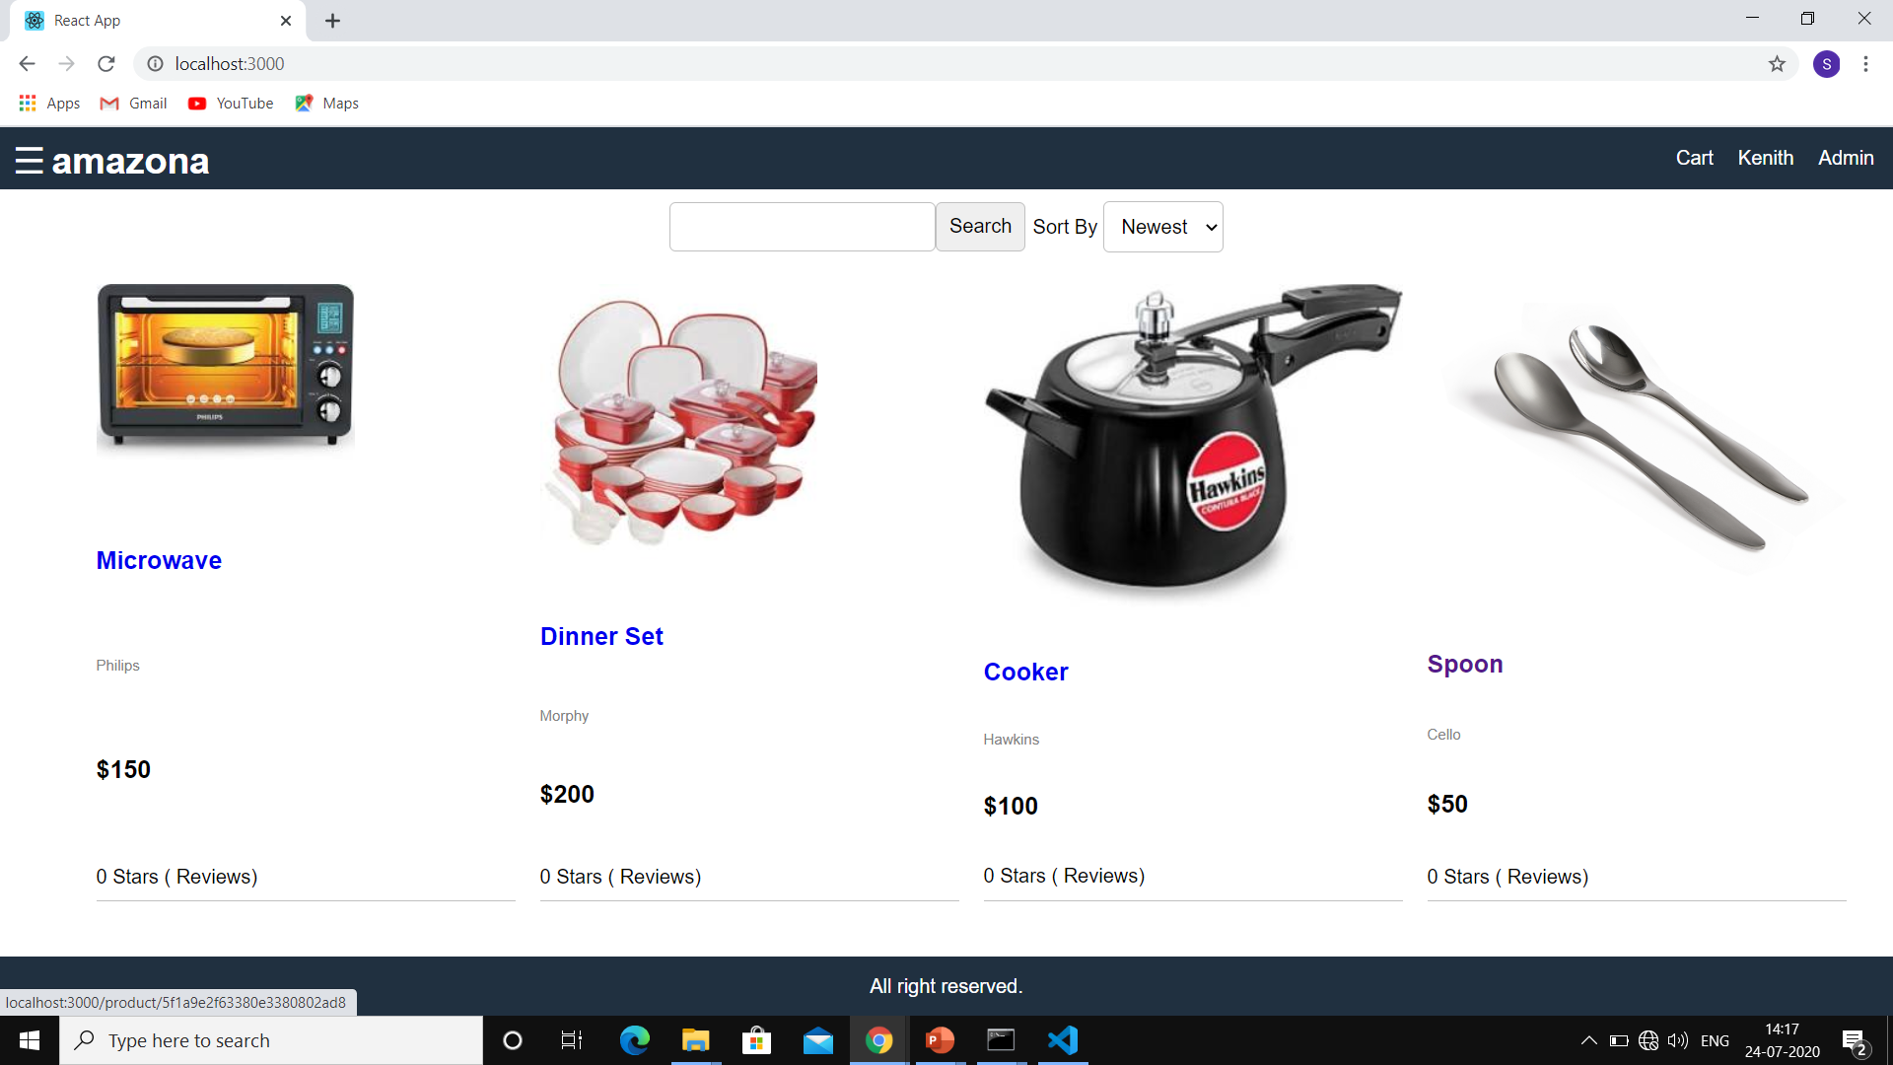
Snapshots Of Our Project…

Slide 10
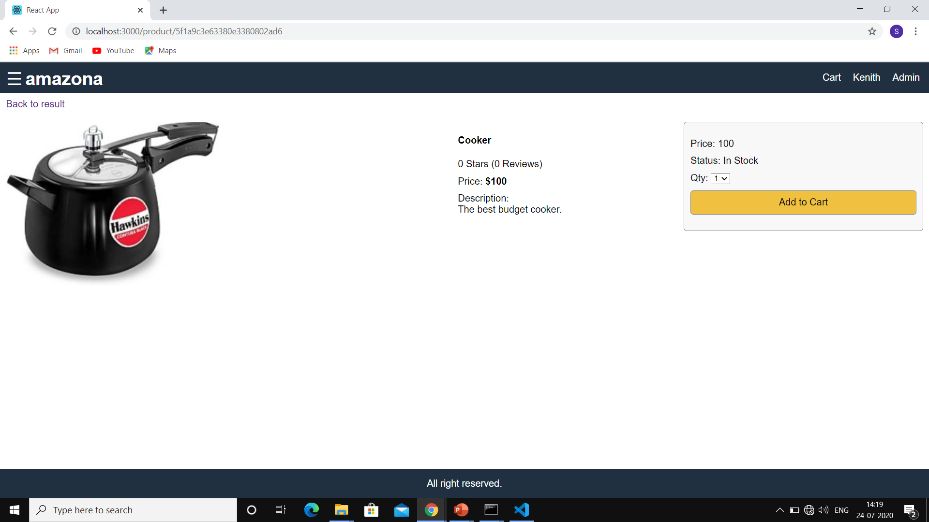

Slide 11
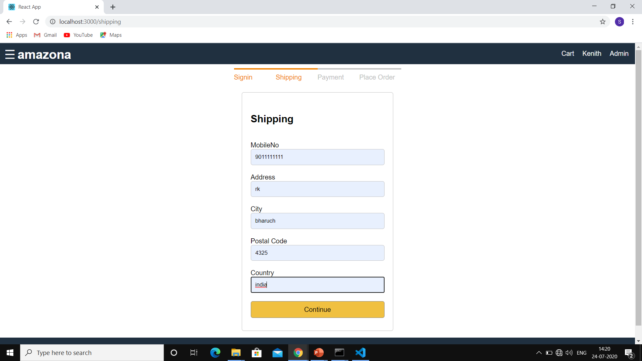

Slide 12
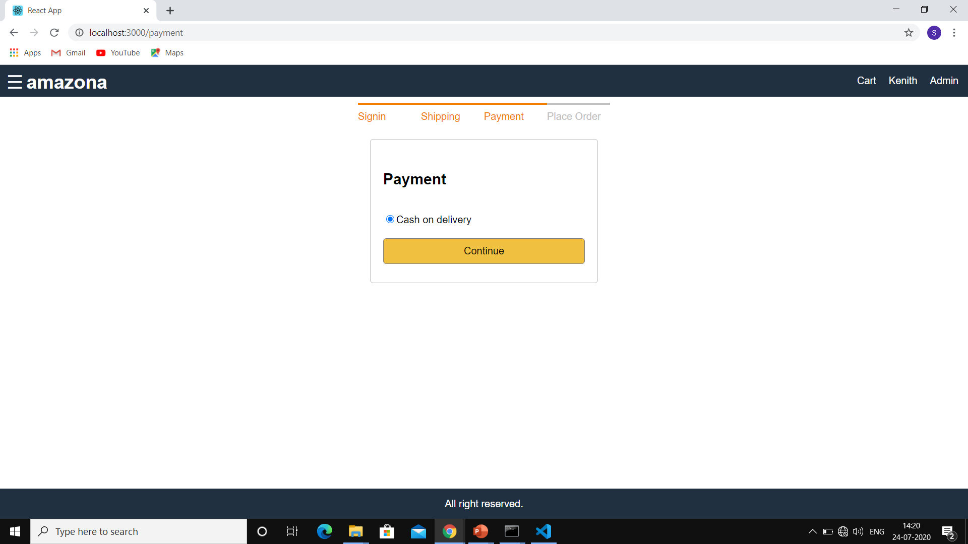

Slide 13
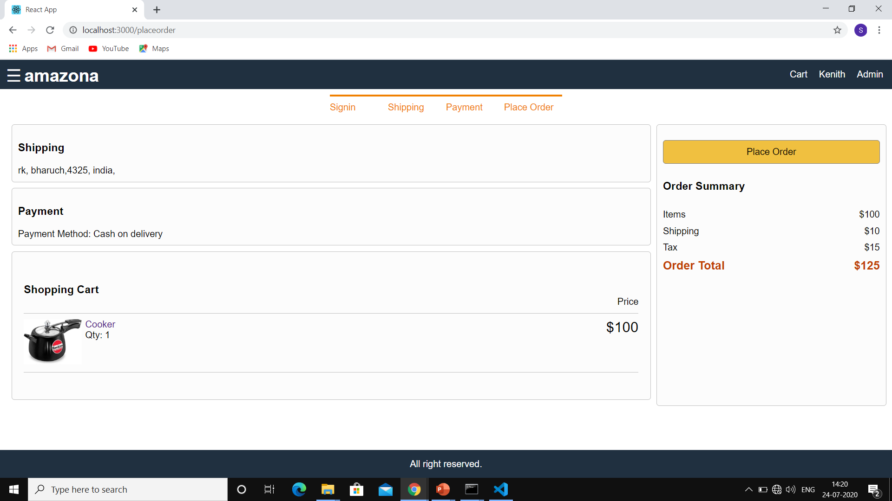

Slide 14
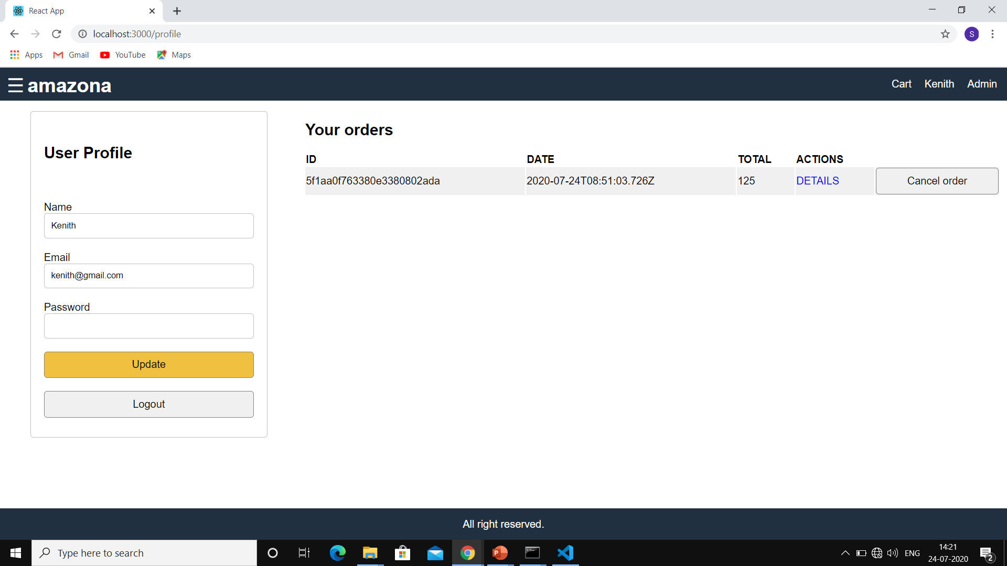

Slide 15
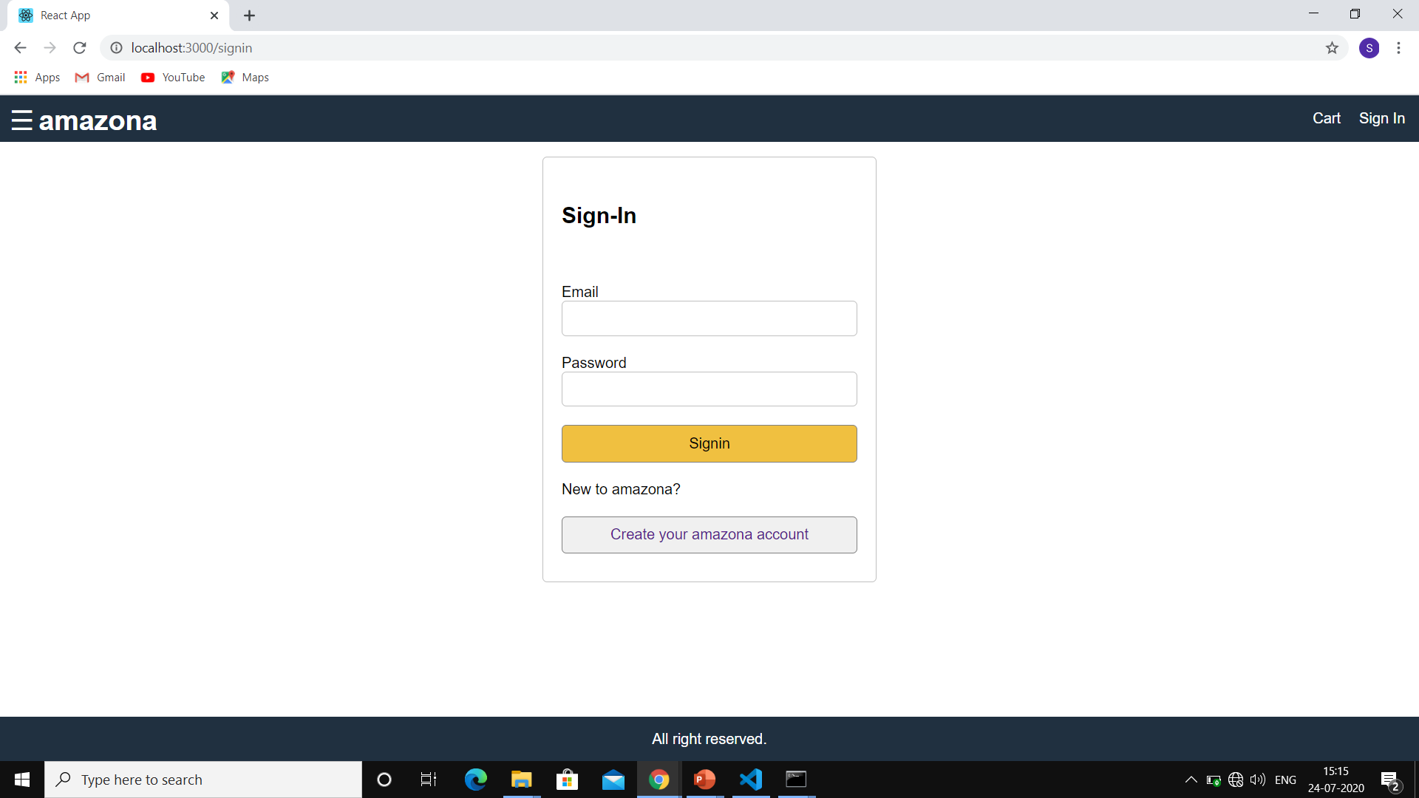
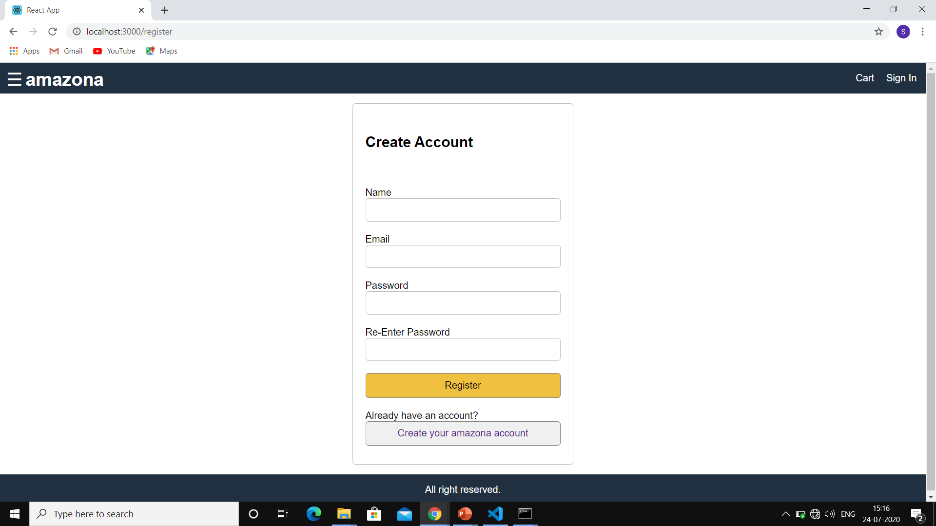

Slide 16
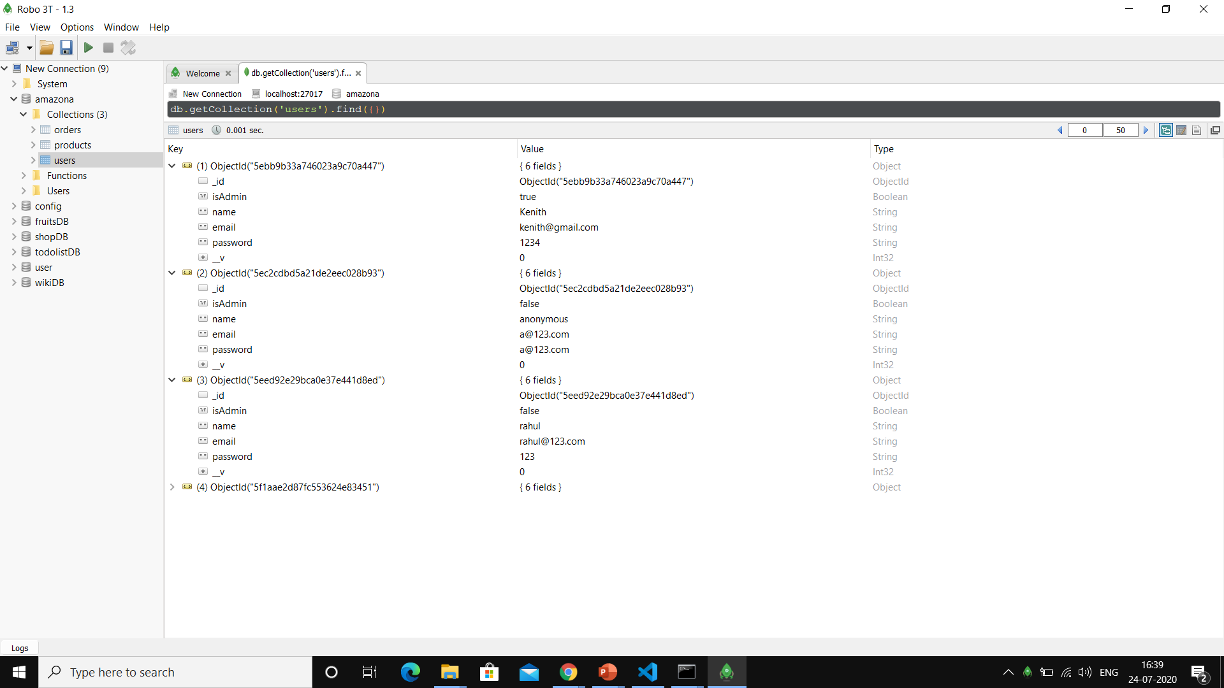

Slide 17
LIMITATIONS
Internet is Compulsary and also Low internet speed can result to a bad experience with this Web Application
No Payment option is available like Google pay or paytm etc..other than cash on delivery.
There are limited products of kitchenary items as we have just developed a model.
Security is less.

Slide 18
FUTURE SCOPE
Keeping the users updated with new and trending items.
Acknowledging the Payment method with more options through which online payment can be possible like G-pay, paytm etc…
Adding all sort of kitchenary Products.
Implying more Security to the users.
Can apply recommendation Algorithm to recommend products based upon user’s interest.

Slide 19
CONCLUSION
This project was a great experience for us.
We learnt new technologies which developed our mind so far.
The purpose of this web application is to make people comfortable with online buying of kitchenary items and which can be a great option…
From this project we also got experience to work in a group and how to coordinate with with each other.

Slide 20
REFERENCES
https://www.youtube.com/watch?v=DLX62G4lc44
https://www.udemy.com/course/the-react-development-bootcamp/12749785#overview
https://stackoverflow.com/

Slide 21
THANK YOU.

