Slide 1
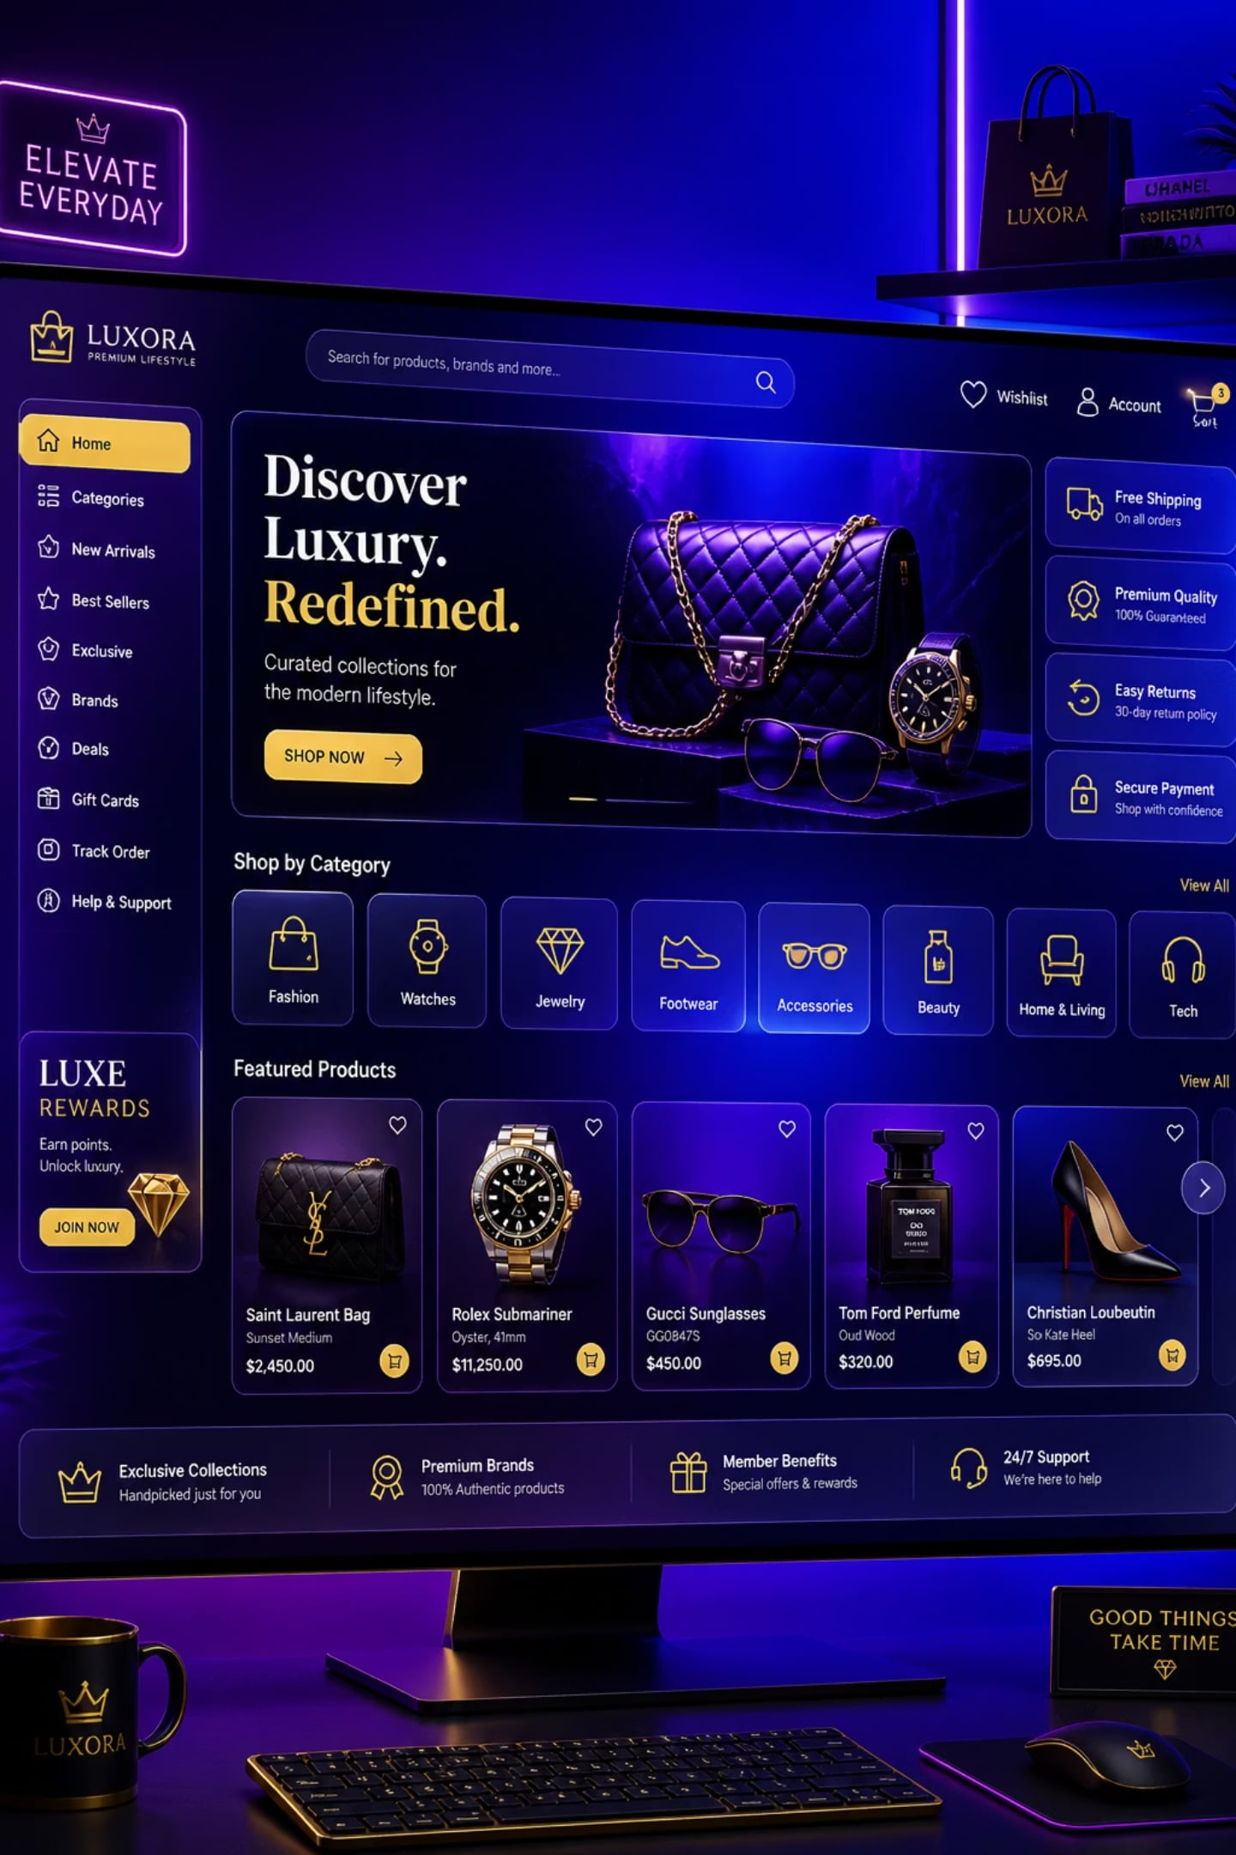
OrderMS — Premium Tech Store
Modern e-commerce web application — responsive design built with HTML5, CSS3 and JavaScript (ES6). Clean, premium UI with glassmorphism panels and an animated gradient background for a refined shopping experience.

Slide 2
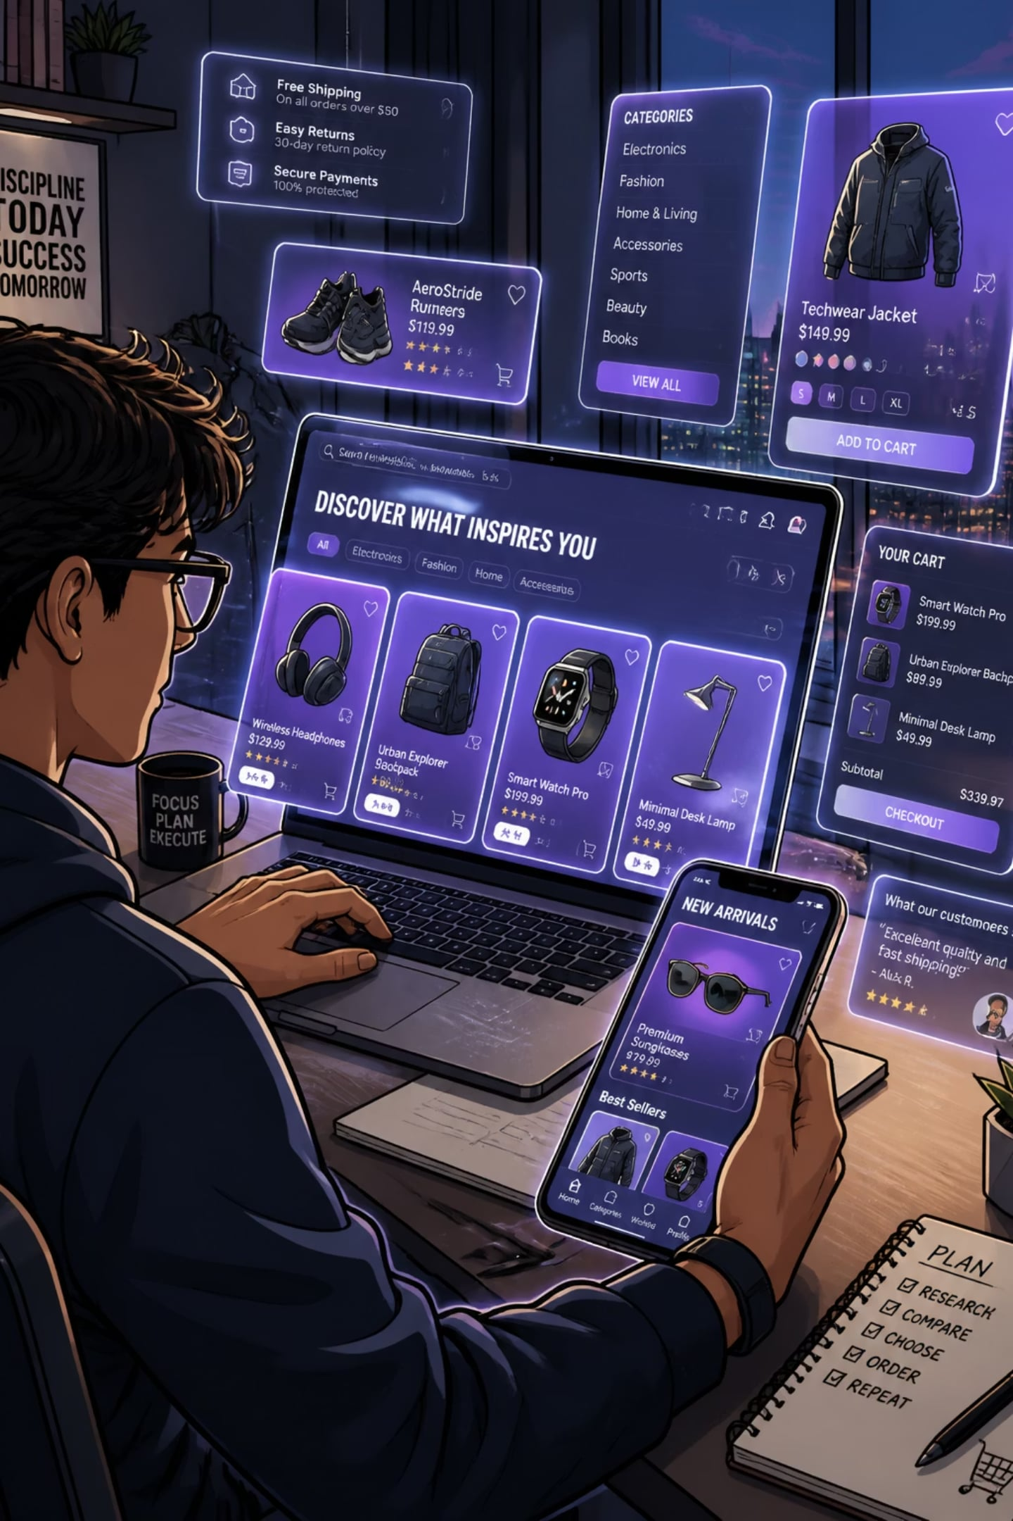
Project Overview
OrderMS is an online store for premium tech products. Customers can browse curated items, search, filter by category, add to cart and complete orders — all across desktop, tablet and mobile.
Core user flows
Design focus
Discover → Select → Buy — optimised for speed and conversion
Glassmorphism UI, premium iconography, readable typography
Performance
Lightweight assets, CSS-driven animations, minimal JS for interaction

Slide 3
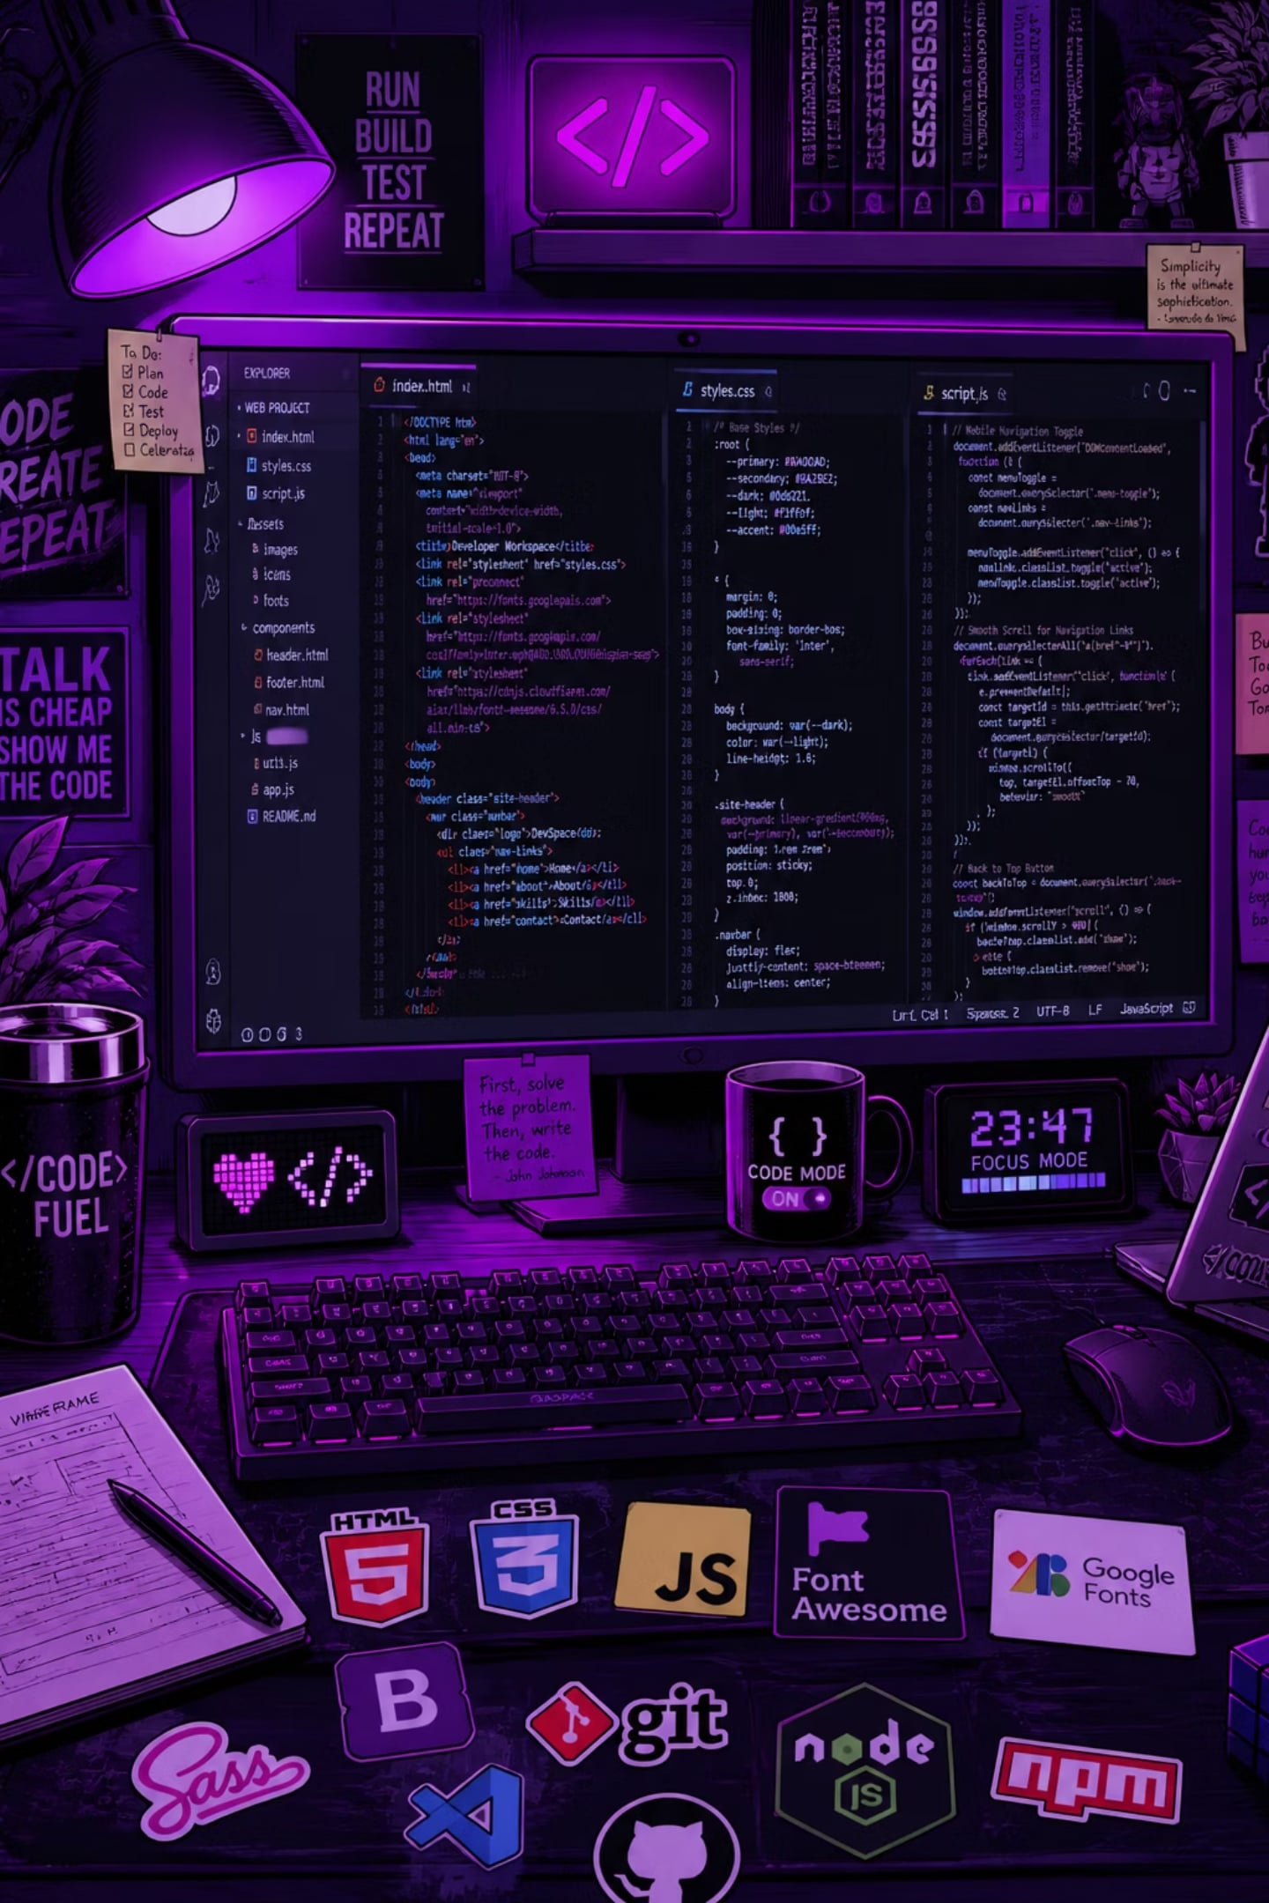
Objectives & Technologies
Objectives
Technologies
Build a responsive, accessible e‑commerce website
Improve the shopping experience with intuitive search & filters
Implement a persistent shopping cart and checkout flow
Create an attractive, interactive premium UI
HTML5 — semantic markup & accessibility
CSS3 — Grid, Flexbox, variables, glassmorphism
JavaScript (ES6) — UI interactions, cart logic
Font Awesome — premium icons
Google Fonts — refined typography

Slide 4

System Architecture & Workflow
User
Browse
Search
Add to Cart
Client-side app handles browsing, filtering and cart state. Checkout triggers backend integration (future) for payment and order persistence. Design encourages quick discovery and low-friction checkout.

Slide 5

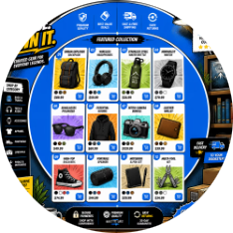




Key Features
Responsive Navigation
Product Catalog
Search & Filters
Shopping Cart & Checkout
Adaptive menu with accessible keyboard interactions and mobile drawer.
Prominent product cards, quick view and SKU-level variation support.
Instant search, category filters, sort and facet-driven results.
Persistent cart, edit quantities inline, clear checkout funnel.
Order History
Authentication
User account tracks past orders and statuses for easy reorders.
Secure sign up / sign in with session management and progressive enhancement.

Slide 6
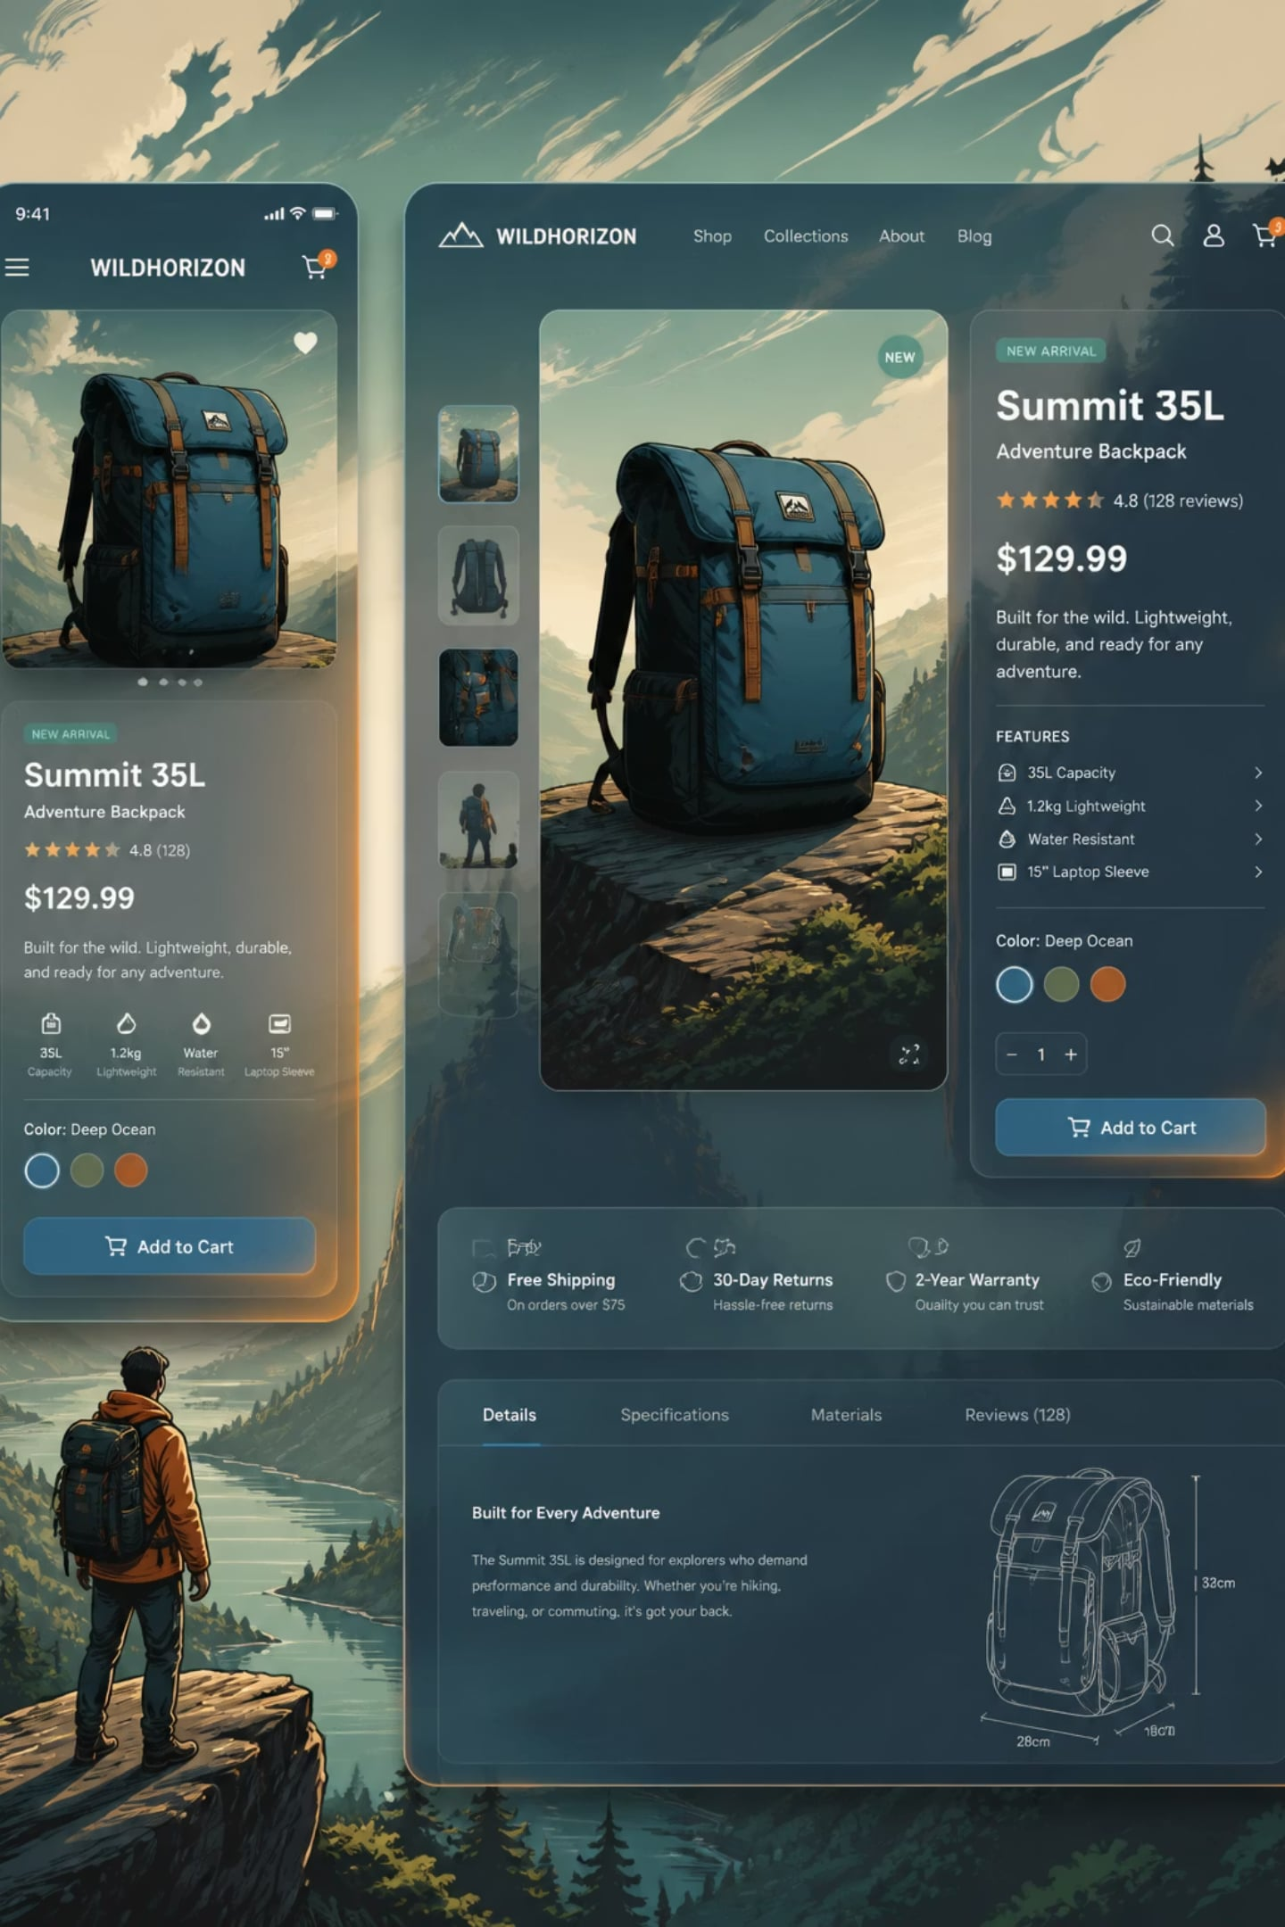


User Interface
Design Highlights
Micro-interactions
Glassmorphism cards with subtle frosted blur and elevated shadows
Animated blue–purple gradient background for brand depth
Modern product cards with clear CTAs and micro-interactions
Mobile-first breakpoints and touch-friendly controls
Hover, focus and add-to-cart animations that reinforce action feedback.
Trust Signals
Clear shipping, returns and data privacy cues on product and checkout pages.

Slide 7

Advantages & Roadmap
Advantages
Future Enhancements
Intuitive, premium UX that increases conversion potential
Fast, responsive front-end built with modern web standards
Modular codebase to accelerate future features
Accessible and mobile-first for broad reach
1
2
Payment Gateway
Database & Backend
Integrate PCI-compliant processors for live transactions.
Persist products, orders and user accounts with an API-driven backend.
3
4
Admin Dashboard
Personalisation
Inventory, orders and analytics for store operators.
Wishlist, reviews and AI-driven recommendations to boost AOV.

Slide 8


Conclusion & Next Steps
OrderMS delivers a polished, responsive foundation for a premium tech storefront — focused on discoverability, conversion and delightful UI. Next steps: integrate payments and persistent backend, build admin tools, and iterate with user testing.
Thank you — Questions & Answers

