Slide 1
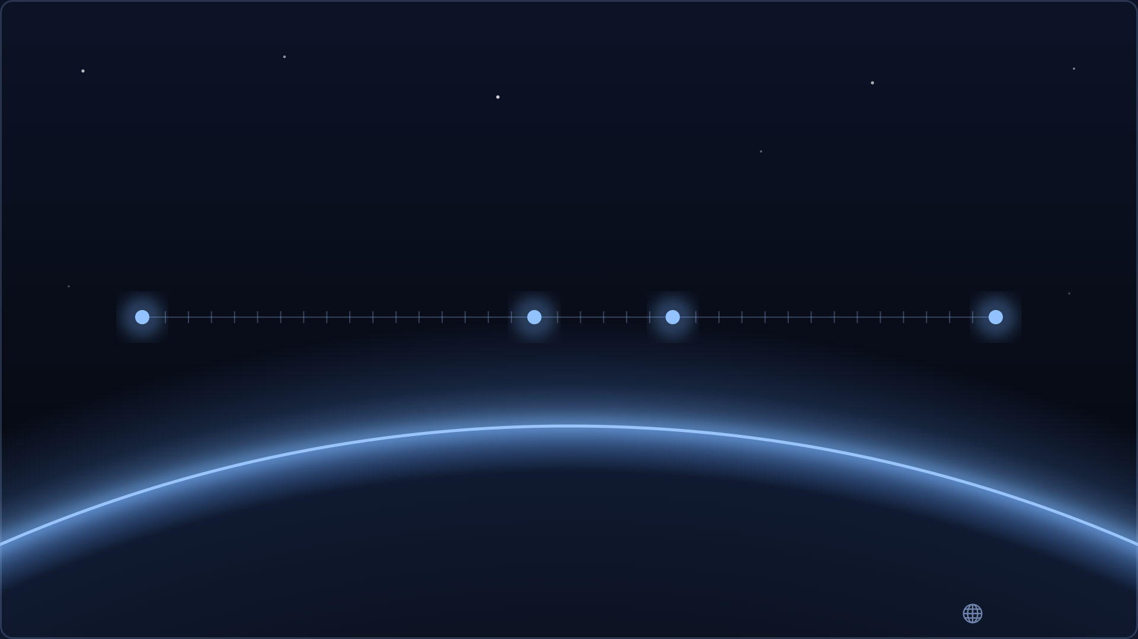
— what you just saw —
One Matrix / One Camera
z −17
z 0
z 6
z +20
the solar system
the globe
Japan
a street corner
2³⁷ = ×137,438,953,472
37 doublings · flat map ⇄ 3D — no seams, no discontinuity
WebGPU sphere · WASM decoders · OPFS cache — nothing outside your browser
© 2026
Ortho Earth

Slide 2
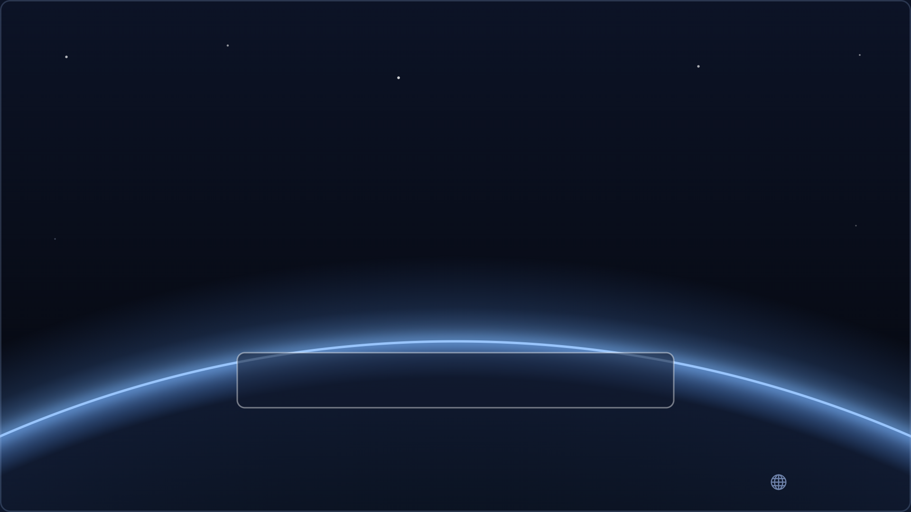
Why Japan first?
The data was already there.
SDK
npm i @ortho-earth/japan
2026.08.24
© 2026
Ortho Earth

Slide 3

Open it on your phone — now
it’s the live map,
not a video
tap ▶ for the
3-minute tour
Tokyo stays cached on
your device — revisit offline
ortho-earth.com/japan/
© 2026
Ortho Earth

