Slide 1
AutoComis
Freeing the humanity of drivers

Slide 2
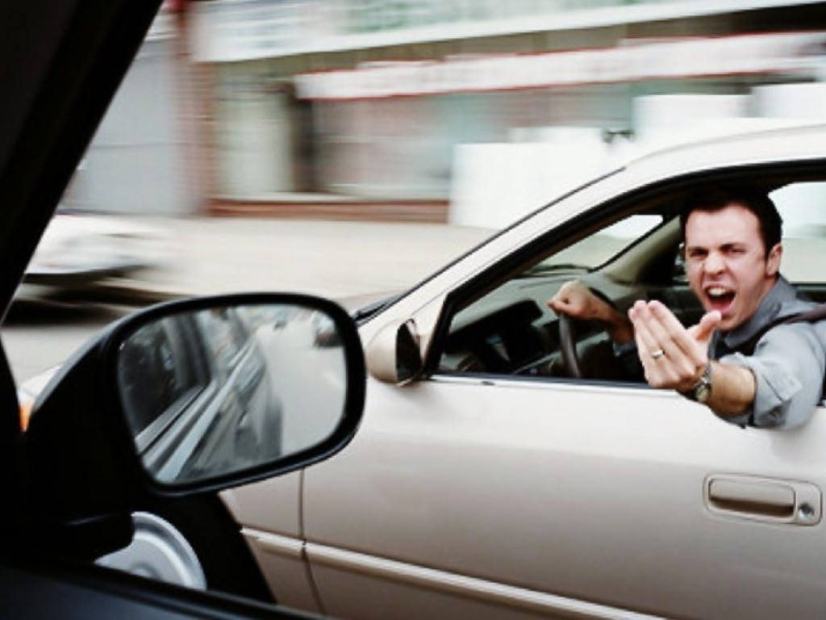
Problem Statement
Drivers can’t express many emotions within their car
Car horns
Vehicle lights
Cannot communicate some pieces of information to other drivers effectively
May contribute to:
Road rage
Negative emotions associated with driving

Slide 3
Pertinence in Society
How does this problem manifest in reality?
Anger-inducing actions
Cutting people off
Switching lanes frequently
Emotions to convey
“Sorry!”
Appreciation
Forgiveness
Anger

Slide 4
Driver Emotion Spectrum
Increasing likelihood of objectifying other drivers and experiencing distress
Appreciation
Remorse
Forgiveness
Anger
Car accident!

Slide 5
Solution
Interface to bridge emotions between drivers:
1. Gather user input when appropriate
2. Display to LED matrices mounted on the most visible parts of the car
Ultimately - we want to make the isolated process of driving as humane as possible. Our goal is to make drivers aware of each other in a less impersonal context.

Slide 6
Ingredients
Front LED Display
Rear LED Display
Thalmic Myo
How do we integrate all these? We utilize the Myo to decode the driver’s body language and display their intentions in a clear manner on the LED displays.

Slide 7
Integrated System
Myo and displays are inactive, while linked on the Android app. The Myo waits for user activation.
The user is placed into a scenario where they wish to convey a message through the display.
The user activates the Myo’s detection state by the ‘thumb-to-pinky’ motion.
The Myo indicates its awake state by a quick double vibration, and is now receptive to other motions.
The user makes their intended motion. The Myo vibrates once to indicate success, and pushes the appropriate info to the Android app.
The Android app pushes the message to the MeU display, which displays an image for a preset amount of time.
The user exits the scenario and deactivates the detection state by performing the ‘thumb-to-pinky’ motion once again.
And repeat!

Slide 8
Preset Motion-to-Message Pairs
Using the Myo’s 5 detectable configurations, we created preset pairings between motions and conveyed messages:
Fist：Corresponds to anger/frustration, displays ‘angry face’
Spread fingers: Corresponds to remorse, displays “Sorry”
Wave in: Displays “Go ahead”
Wave out: Displays an image corresponding to “Me first”
Thumb-to-pinky is reserved for (de)activation of the device

Slide 9
Demo!

Slide 10
Questions?

