Slide 1
MP0 - xv6 Setup
CSIE3310 - Operating System
NTU

Slide 2
TA Information
陳愷謙 Chen Kai-Chien / Brandon
Lab: CSIE 401
Email: ntuos@googlegroups.com
TA Hour: Tue. /Thu. 13:00~15:00

Slide 3
Summary
You have to do…
Launch Docker
Programming your own mp0.c & Makefile
Compile your own C code & run it on QEMU

Slide 4
Docker Installation
If you are Linux / MacOS user…
Follow the step from MP0.pdf
If you are Windows user…
Use WSL2 to run Docker & QEMU

Slide 5
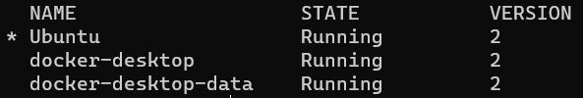
Run Docker on Windows
Install WSL
$ wsl –install
$ wsl –l –v to check your version in WSL2

Slide 6

Run Docker on Windows
Install Docker
Follow the step in MP0.pdf -> Docker Engine for Ubuntu
Run commands below in ~/mp0/ to build xv6
$ sudo apt install make
$ sudo apt install gcc-riscv64-unknown-elf
$ sudo apt install qemu-system-misc
$ make

Slide 7
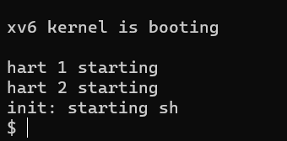
Run QEMU in Docker
Run $ make qemu in ~/xv6/

Slide 8
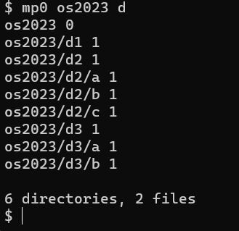
MP0 Homework
Build your own mp0.c and Makefile
mp0.c
Detail in MP0.pdf
Result should like this
Makefile
Let you can run mp0 command after $make qemu

Slide 9
Grading Policy
MP0 will be graded with running $ make grade
This MP is the foundation for others, suggest to try it your self
You can discuss on NTU COOL

Slide 10


