Slide 1
DESIGN AND IMPLEMENTATION OF A WEB-BASED AUCTION SYSTEM
By ODOH KENNETH EMEKA
SUPERVISED BY Mrs. TIINA FERM

Slide 2
TABLE OF CONTENT
Definition of keywords.
Architecture Design of the Auction system.
Database Model
System & Sub-System
Sequence diagram
Third-party Library & Core Technology
ScreenShots

Slide 3
Definition of keywords
Bid
Auction
Collective Intelligence
Igbo
kpoba

Slide 4
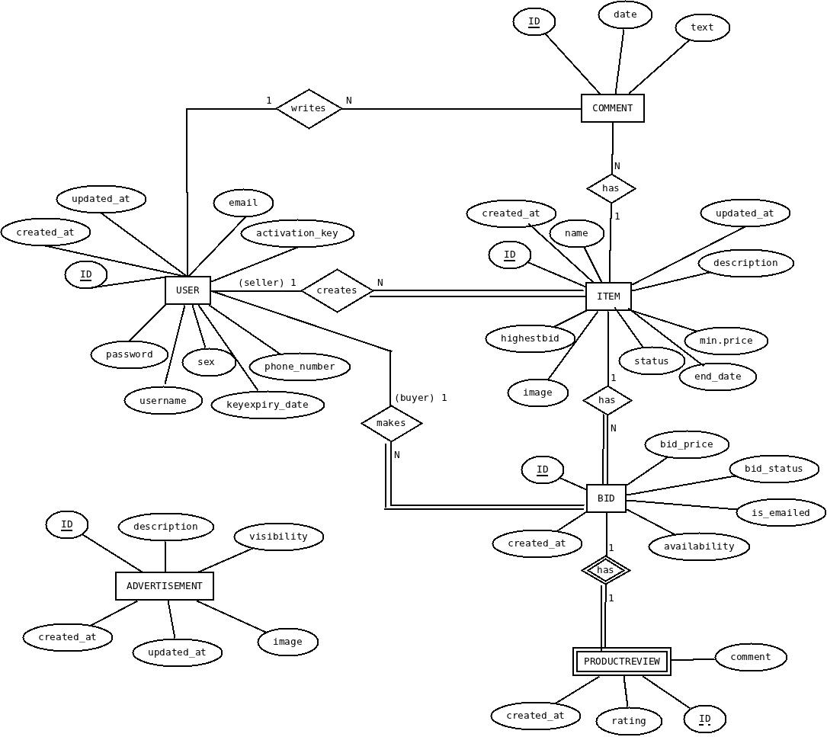
Architecture Design of the Auction system
Database Model
Entity-Relationship Table

Slide 5
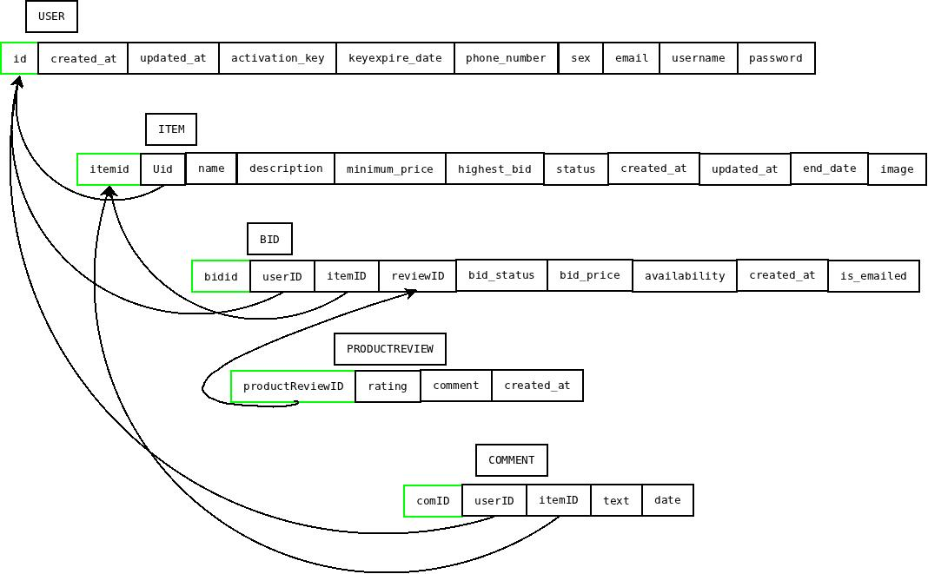
Architecture Design of the Auction system (CONTD.)
Relational Model

Slide 6
Architecture Design of the Auction system (CONTD.)
System & Sub-System
These are the Building blocks.
”You call them modules, I call them engines”
Bidding Engine
Comment Engine
Business Intelligence Engine
Graphic Engine
Advertisement Engine
Recommendation Engine
Reputation Engine

Slide 7
Architecture Design of the Auction system (CONTD.)
Biding Engine
This engine should be designed in a such a way that the bids have the following properties.
They include:
Inclusion
Exclusion
Uniform receipt
Ordering
Authentication
Non-repudiation
The following events occur in this engine.
user can create/update account.
user can create an auction.
user can bid on items according to business rules.
Resolving of auctions.

Slide 8
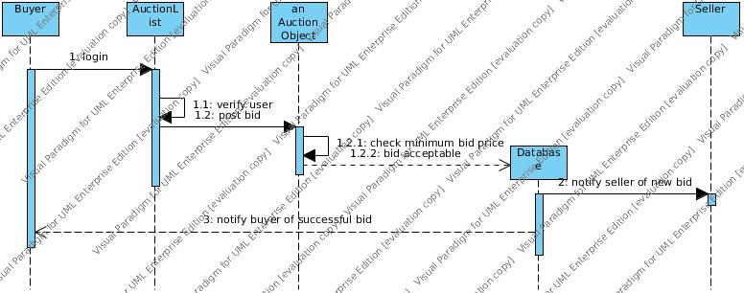
Architecture Design of the Auction system (CONTD.)
Sequence diagram
Sequence diagram describing the bidding process

Slide 9

Architecture Design of the Auction system (CONTD.)
Captcha
"Completely Automated Public Turing test to tell Computers and Humans Apart”
Uses of ” CAPTCHA”
Source: www.google.com

Slide 10










Third-party Library & Core Technology
ghettoq
django-picklefield
django-kombu
Anything_slider
django-simple-captcha
Source: www.google.com

Slide 11
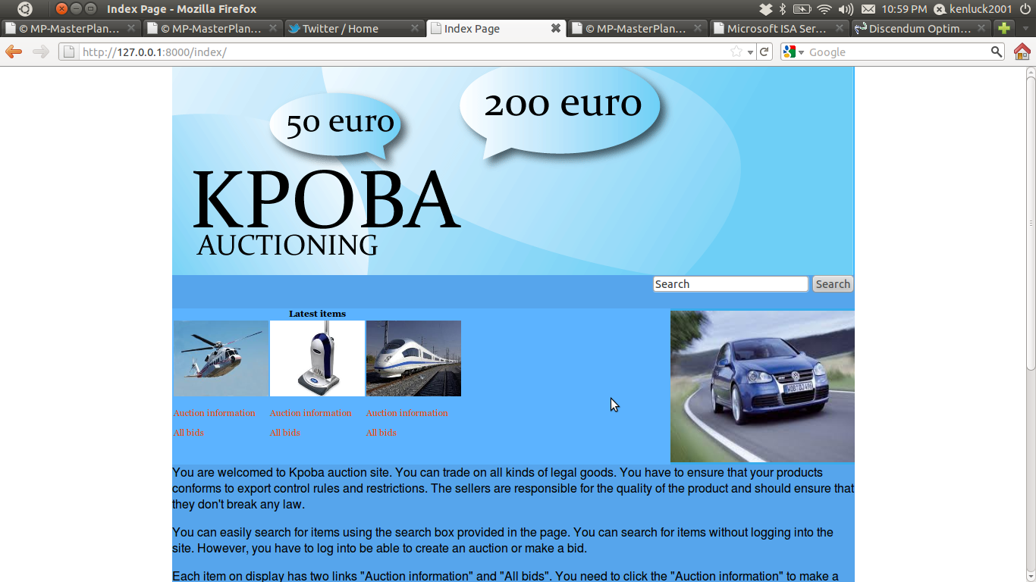
SCREENSHOTS
Index page

Slide 12
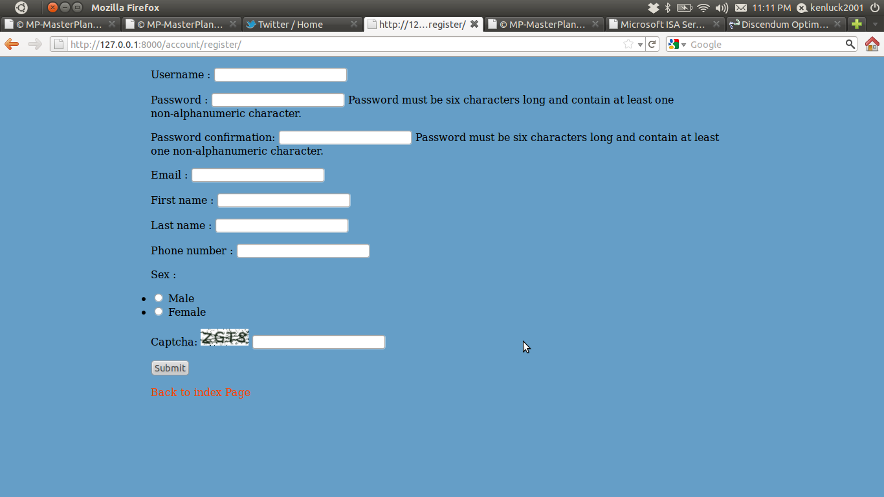
SCREENSHOTS (CONTD.)
User Registration Form

Slide 13
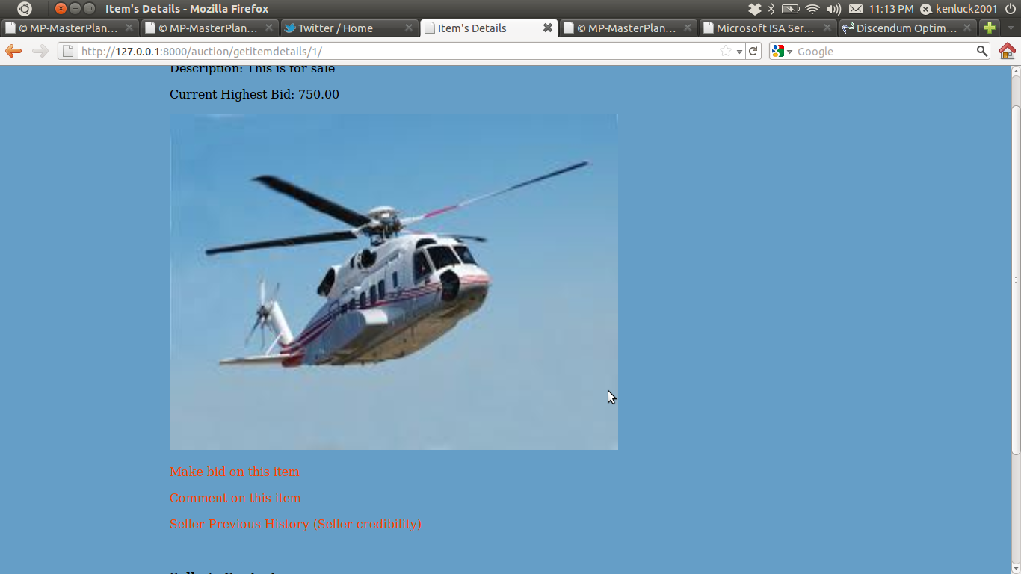
SCREENSHOTS (CONTD.)
Item Description Page

Slide 14
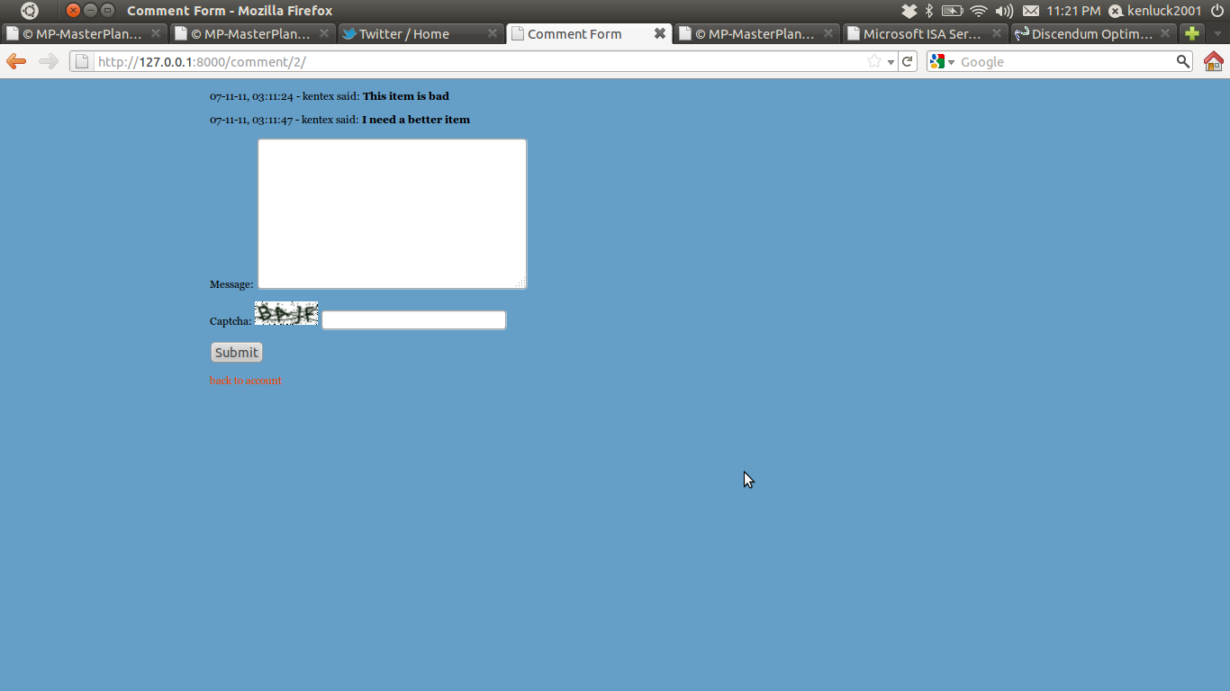
SCREENSHOTS (CONTD.)
Comment Form

Slide 15
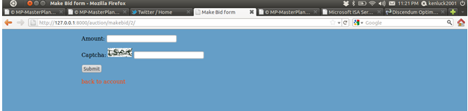
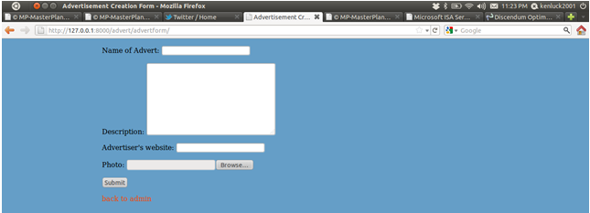
SCREENSHOTS (CONTD.)
Bidding Form
Advertisement Form

Slide 16
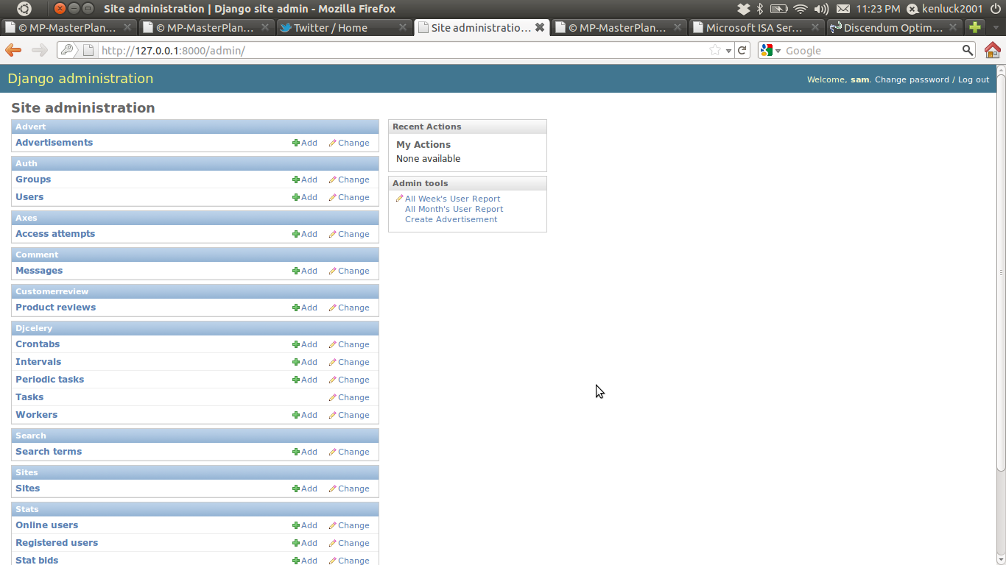
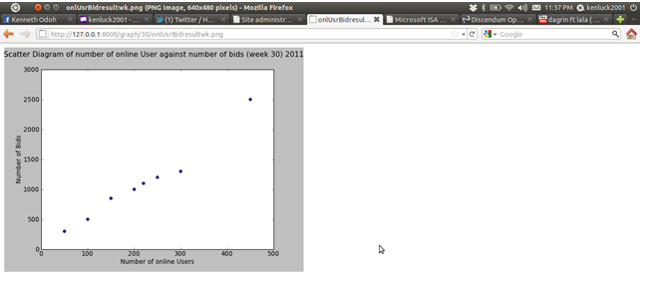
SCREENSHOTS (CONTD.)
Admin Page
Example of a Scatter Diagram Plot

Slide 17

THANKS FOR YOUR ATTENTION
Follow me on @kenluck2001

