Slide 1

Selenium and Powershell
Controlling a browser through code

Slide 2
How to get selenium up and running
NuGet registration into PowerShell Package sources
Download / install of Selenium
Download / Install of Chrome Driver for Selenium
How to do what we need to do
Google is your friend for Selenium
Learn through Demos
Part 1 – install
Part 2 – Get Chrome To Open
Part 2 A – Do “Stuffs”
Part 3 - Making it easier
Building a Class for our usage
Navigation
Find and Type
Find and Click ( by ____ )
Additional Methods for parsing
Agenda

Slide 3
How to get selenium up and running
NuGet registration into PowerShell Package sources
Download / install of Selenium
Download / Install of Chrome Driver for Selenium

Slide 4
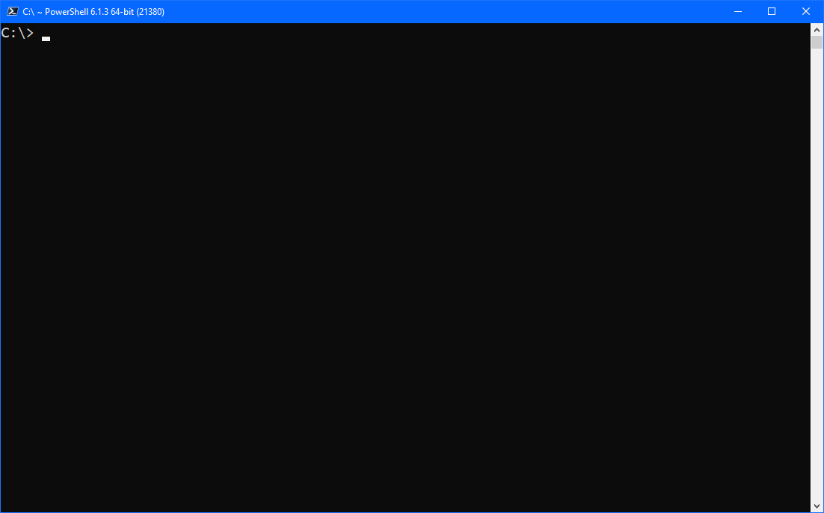
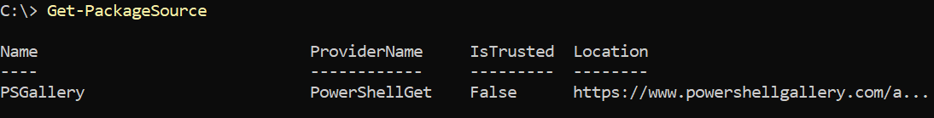
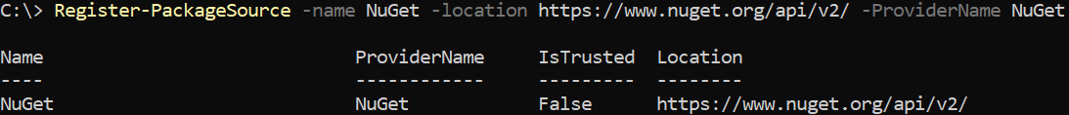
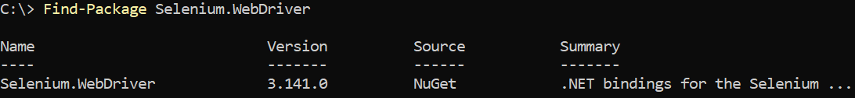
Commands to help us out
Get-PackageSource
Register-PackageSource -Name -Location -ProviderName
Unregister-PackageSource -Source
Find-Package

Slide 5
Installing WebDriver and Chrome Driver
You probably DON’T want to just install the package
there are a TON of requirements – up to you!
Hello-World Demo – Part 1!
installing all the bits, but to a location
Install the Chrome Driver while we’re at it!
It’s the only one that’s got a NuGet package – so why not!

Slide 6
Demo
Learn through Demos
Part 1 – install
Part 2 – Get Chrome To Open
Part 2 A – Do “Stuffs”
Part 3 - Making it easier
Building a Class for our usage
Navigation
Find and Type
Find and Click ( by ____ )
Additional Methods for parsing

