Slide 1
Uncategorized

Slide 2
Metadata-driven views - Spillover from Q4

Slide 3
Detect and remediate external sharing via links

Slide 4
Launch relevant KB by default in the Files view (powered by keyword Search)

Slide 5
Document Room Level Index Display Control

Slide 6
Share Links that open Contract Extractions

Slide 7
Visibility into files being removed from retention

Slide 8
Metadata-driven views - Spillover from Q4
PB Link
Problem
This is the spill-over work from Q4 2024. The feature is divided into 3 phases
- Phase-A - Only show relevant tags. Expected to complete in Q4 2024
- Phase-B – Inline editing of metadata, search in columns (properties with values)This piece is dependent on datagrid 2.0 migration.
- Phase-C – Save/share views.
Phase B and C are expected to spill into Q1.
Seehttps://egnyte.atlassian.net/wiki/spaces/CFS/pages/631964095/13.+Metadata+driven+Viewsfor detailed requirements
Objective -
- Empowers users to leverage Smart tags and other metadata properties for easily customize their viewing experience
- Allow users to create, save, and share views that leverage metadata
- Make metadata easier to consume and hence make our product more sticky
See -https://egnyte.atlassian.net/wiki/spaces/CFS/pages/631964095/13.+Metadata+driven+Views
Link to requirements

Slide 9
Detect and remediate external sharing via links
PB Link
Currently, we only detect external sharing for Egnyte folders where a standard user is added via folder permissions, not via sharing links. This is a potential blindspot for our customers and adding the ability to detect when sensitive content is shared with external users, regardless of method, would reduce the risk of potential data exposure.
Link to confluence page for requirements:https://egnyte.atlassian.net/wiki/spaces/DEL/pages/1019412591/Detect+and+remediate+external+sharing+via+links
Customers:NASDAQ, West Bend Insurance
Link to requirements
DEL-41989

Slide 10
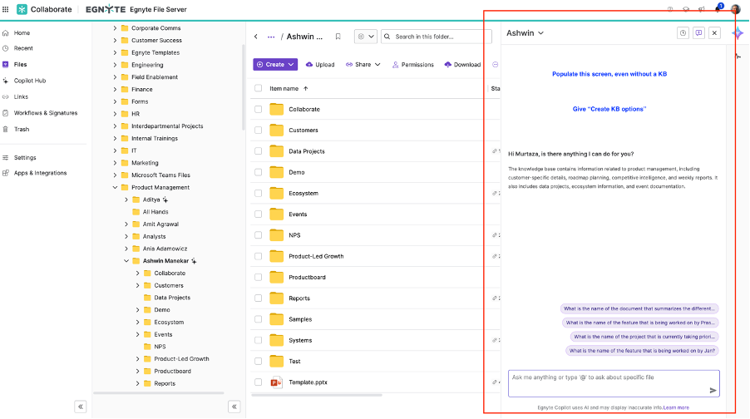
Launch relevant KB by default in the Files view (powered by keyword Search)
PB Link
Problem
We need to create a KB before an end user can start interacting
User Story:
As a user KB interaction screen pops-up without the need for KB creation, initially
Description
We auto-open the Copilot tab as a user lands in the folder tree. If no KB exists we power the KB via Keyword Search. We push the user to create a KB for better answers. We can show this notification once the user has engaged with the kb and asked 3 questions.
After say a user (having the rights asks a 2 questions), we pop up an option - create KB, and let the user go through the KB flow.
Directional Ux
Link to requirements

Slide 11
Document Room Level Index Display Control
PB Link
​
- Indexing makes documents searchable, allowing users to quickly locate specific files​
​
- Ability to download only as csv​
- Indexing enabled by default​
- Index are automatically generated (Order can't be changed)
​
- Inclusion of Direct Links in the Index CSV Report​
- Ability to turn the indexing on/off for a specific document room​
- Option to regenerate index for the entire document room​
- Update index for folders and files by dragging and dropping them from the folder listing (for users with access level of Editor and above)​
- Ability to download as PDF​
Confluence:
https://egnyte.atlassian.net/wiki/spaces/CFS/pages/745734149/16.+Document+Room+-+Enhancements+to+the+Content+Indexing+Capability
Link to requirements

Slide 12
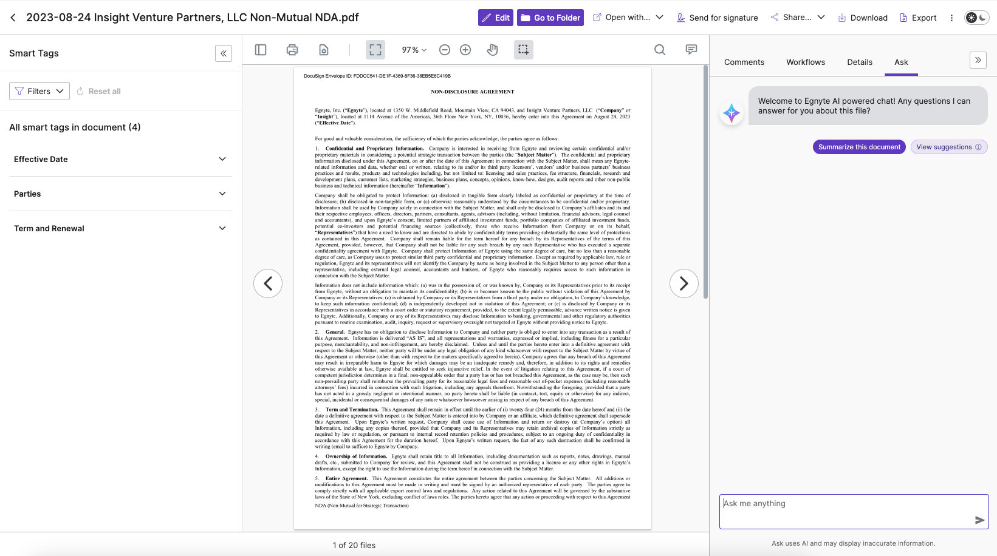
Share Links that open Contract Extractions
PB Link
Problem
Share links to take users to Contracts Extractions Preview
User Story:
As a user, I want to share links from contract analyzer app so that the recipient is able to click on it and view extracted content as well as chat with ASK.
Description
Currently share links take user to the regular document preview which does not show any extracted clauses. This can be an issue because there is no straightforward way to navigate to the contracts analyzer view. User would need to manually open the contracts analyzer app and search for the shared contract to view extractions.
Link to requirements

Slide 13
Visibility into files being removed from retention
PB Link
As a user, I would like to have detailed visibility into the file that are currently under retention but are set to expire this month.
Thinking an export of the "files with retention expired this month" widget like we do with a couple of the other widgets in the CL dashboard. Future versions could make this have a configurable timeframe.
Data in export (similar to what we do for the policy export):
- Location
- Filename
- Created date
- Last accessed date (if enabled)
- Expected trigger date (would all be the current month)
- File size
- Policy
- Do we know this or is the only info we have based on the retention stamp? Might be nice to at least list whether it's policy-based or default retention
Link to requirements
DEL-22394

