Slide 1
Uncategorized

Slide 2
Metadata-driven views - Spillover from Q4
PB Link
Problem
This is the spill-over work from Q4 2024. The feature is divided into 3 phases
- Phase-A - Only show relevant tags. Expected to complete in Q4 2024
- Phase-B – Inline editing of metadata, search in columns (properties with values)This piece is dependent on datagrid 2.0 migration.
- Phase-C – Save/share views.
Phase B and C are expected to spill into Q1.
Seehttps://egnyte.atlassian.net/wiki/spaces/CFS/pages/631964095/13.+Metadata+driven+Viewsfor detailed requirements
Objective -
- Empowers users to leverage Smart tags and other metadata properties for easily customize their viewing experience
- Allow users to create, save, and share views that leverage metadata
- Make metadata easier to consume and hence make our product more sticky
See -https://egnyte.atlassian.net/wiki/spaces/CFS/pages/631964095/13.+Metadata+driven+Views
Link to requirements

Slide 3
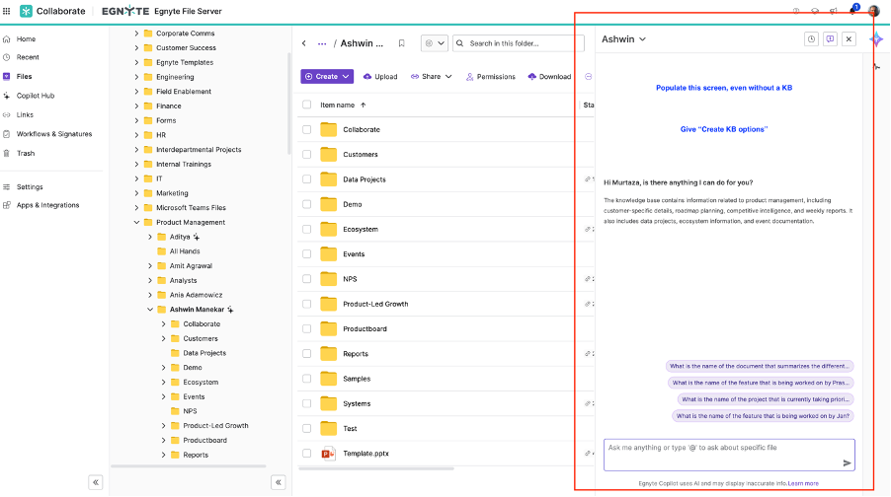
Launch relevant KB by default in the Files view (powered by keyword Search)
PB Link
Problem
We need to create a KB before an end user can start interacting
User Story:
As a user KB interaction screen pops-up without the need for KB creation, initially
Description
We auto-open the Copilot tab as a user lands in the folder tree. If no KB exists we power the KB via Keyword Search. We push the user to create a KB for better answers. We can show this notification once the user has engaged with the kb and asked 3 questions.
After say a user (having the rights asks a 2 questions), we pop up an option - create KB, and let the user go through the KB flow.
Directional Ux
Link to requirements

Slide 4
Document Room Level Index Display Control
PB Link
What?​
- Indexing makes documents searchable, allowing users to quickly locate specific files​
Current Challenges:​
- Ability to download only as csv​
- Indexing enabled by default​
- Index are automatically generated (Order can't be changed)
Key Enhancements:​
- Inclusion of Direct Links in the Index CSV Report​
- Ability to turn the indexing on/off for a specific document room​
- Option to regenerate index for the entire document room​
- Update index for folders and files by dragging and dropping them from the folder listing (for users with access level of Editor and above)​
- Ability to download as PDF​
Confluence:
https://egnyte.atlassian.net/wiki/spaces/CFS/pages/745734149/16.+Document+Room+-+Enhancements+to+the+Content+Indexing+Capability
Link to requirements

Slide 5
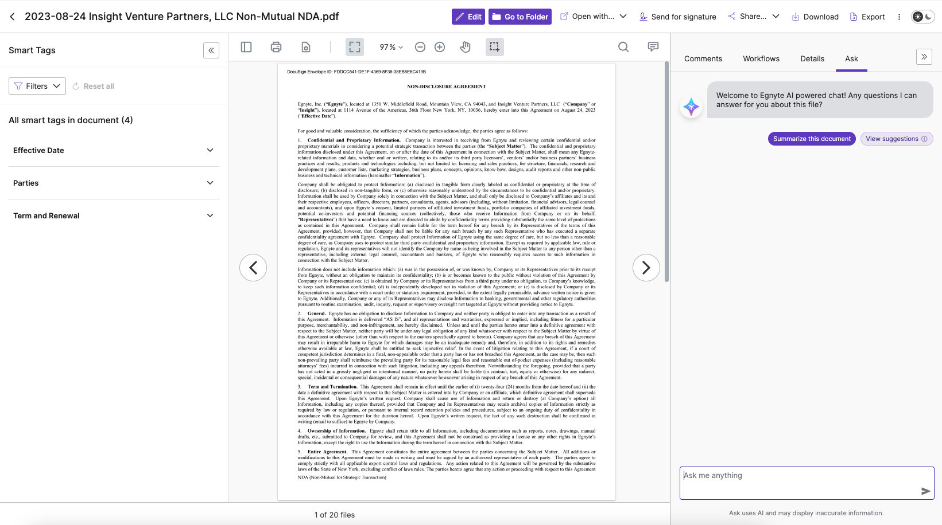
Share Links that open Contract Extractions
PB Link
Problem
Share links to take users to Contracts Extractions Preview
User Story:
As a user, I want to share links from contract analyzer app so that the recipient is able to click on it and view extracted content as well as chat with ASK.
DescriptionCurrently share links take user to the regular document preview which does not show any extracted clauses. This can be an issue because there is no straightforward way to navigate to the contracts analyzer view. User would need to manually open the contracts analyzer app and search for the shared contract to view extractions.
Link to requirements

Slide 6
Visibility into files being removed from retention
PB Link
As a user, I would like to have detailed visibility into the file that are currently under retention but are set to expire this month.
Thinking an export of the "files with retention expired this month" widget like we do with a couple of the other widgets in the CL dashboard. Future versions could make this have a configurable timeframe.
Data in export (similar to what we do for the policy export):
- Location
- Filename
- Created date
- Last accessed date (if enabled)
- Expected trigger date (would all be the current month)
- File size
- Policy
- Do we know this or is the only info we have based on the retention stamp? Might be nice to at least list whether it's policy-based or default retention
Link to requirements
DEL-22394

Slide 7
Document Portal Enhancements

Slide 8
Public API for Document Portal
PB Link
Ability to create workspaces via API, similar to what is already possible for project folders
Link to requirements
CFS-64844

Slide 9
Document classification and metadata extraction
PB Link
Link to requirements
CFS-62728

Slide 10
Enhanced AI copilot

Slide 11
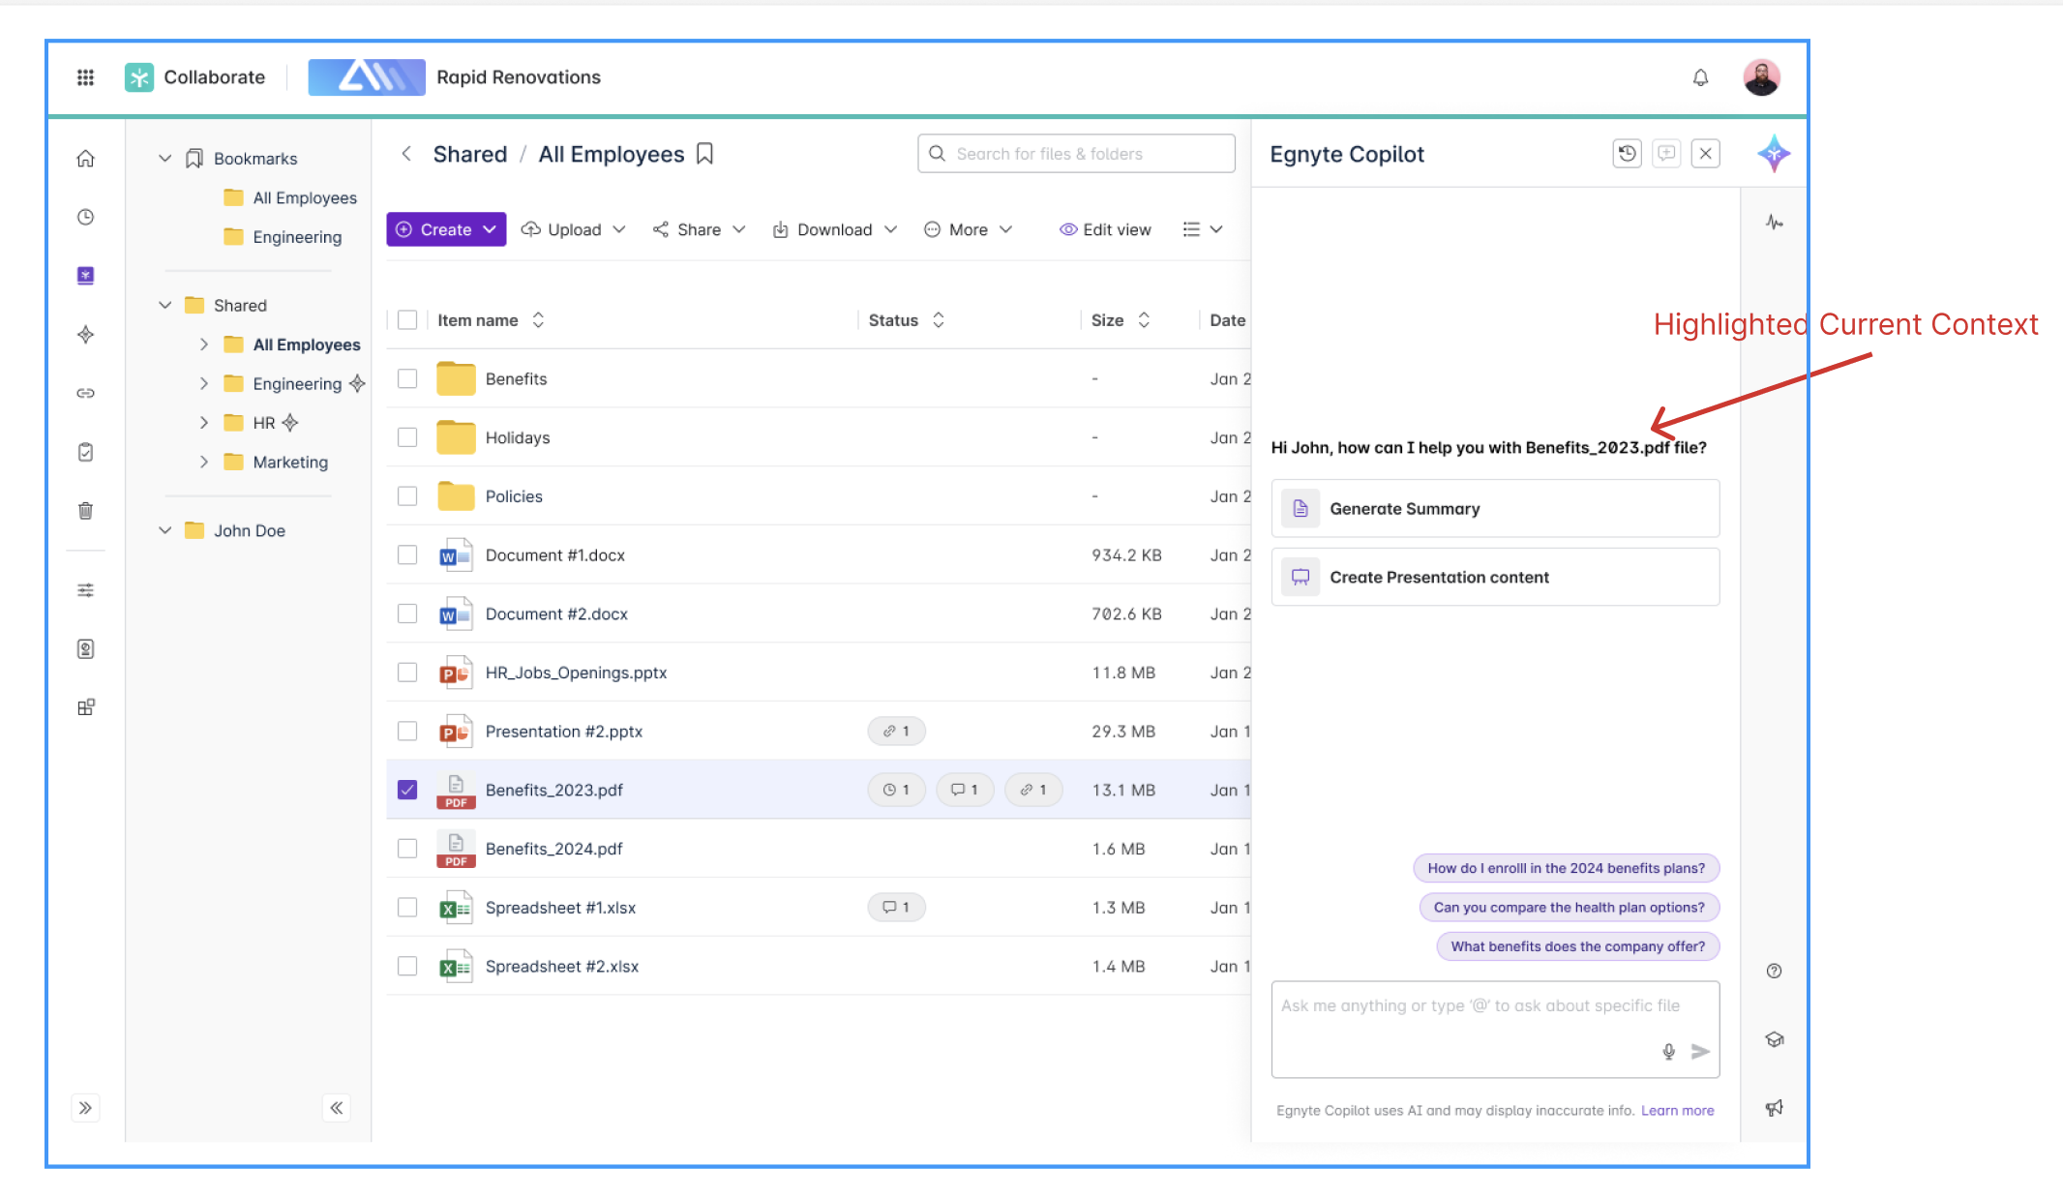
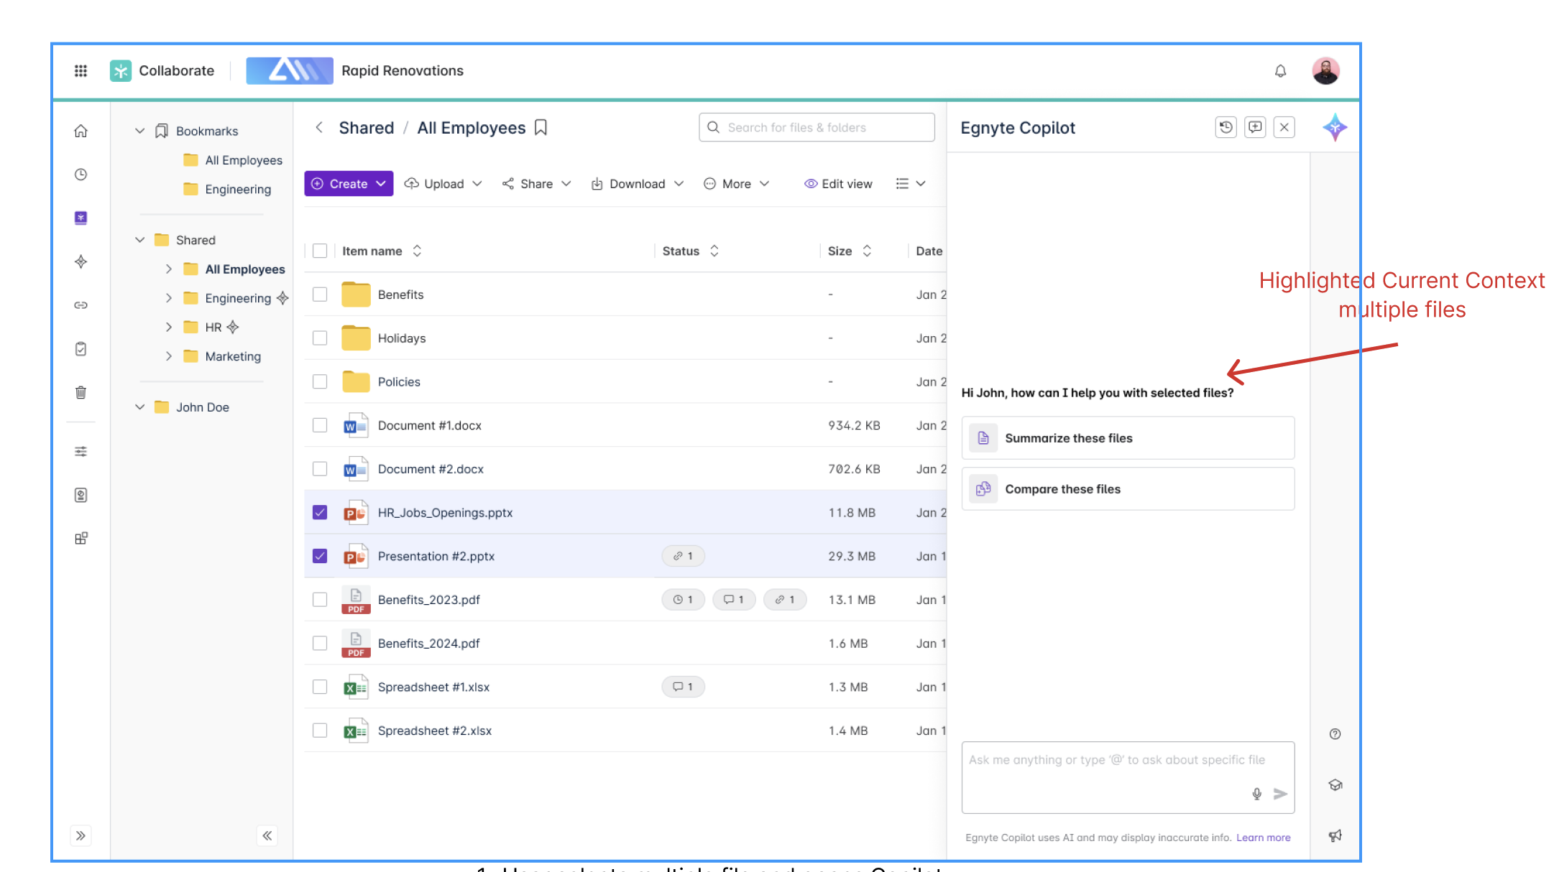
Select multiple files to ask a question
PB Link
User Story:
As a user, i should be able to select multiple files and ask questions on it.
Description
We allow the user to select files and launch Copilot.
Post selection Copilot can be launched from File Menu as well as Side Panel.
In the interface the appropriate message is shown and the Prompts and questions are based on the selection.
- Multiple files can be selected
- Files + Folder selection is also allowed
Directional Mock:
Figma link -
Embedded content
Link to requirements
CFS-65266

Slide 12
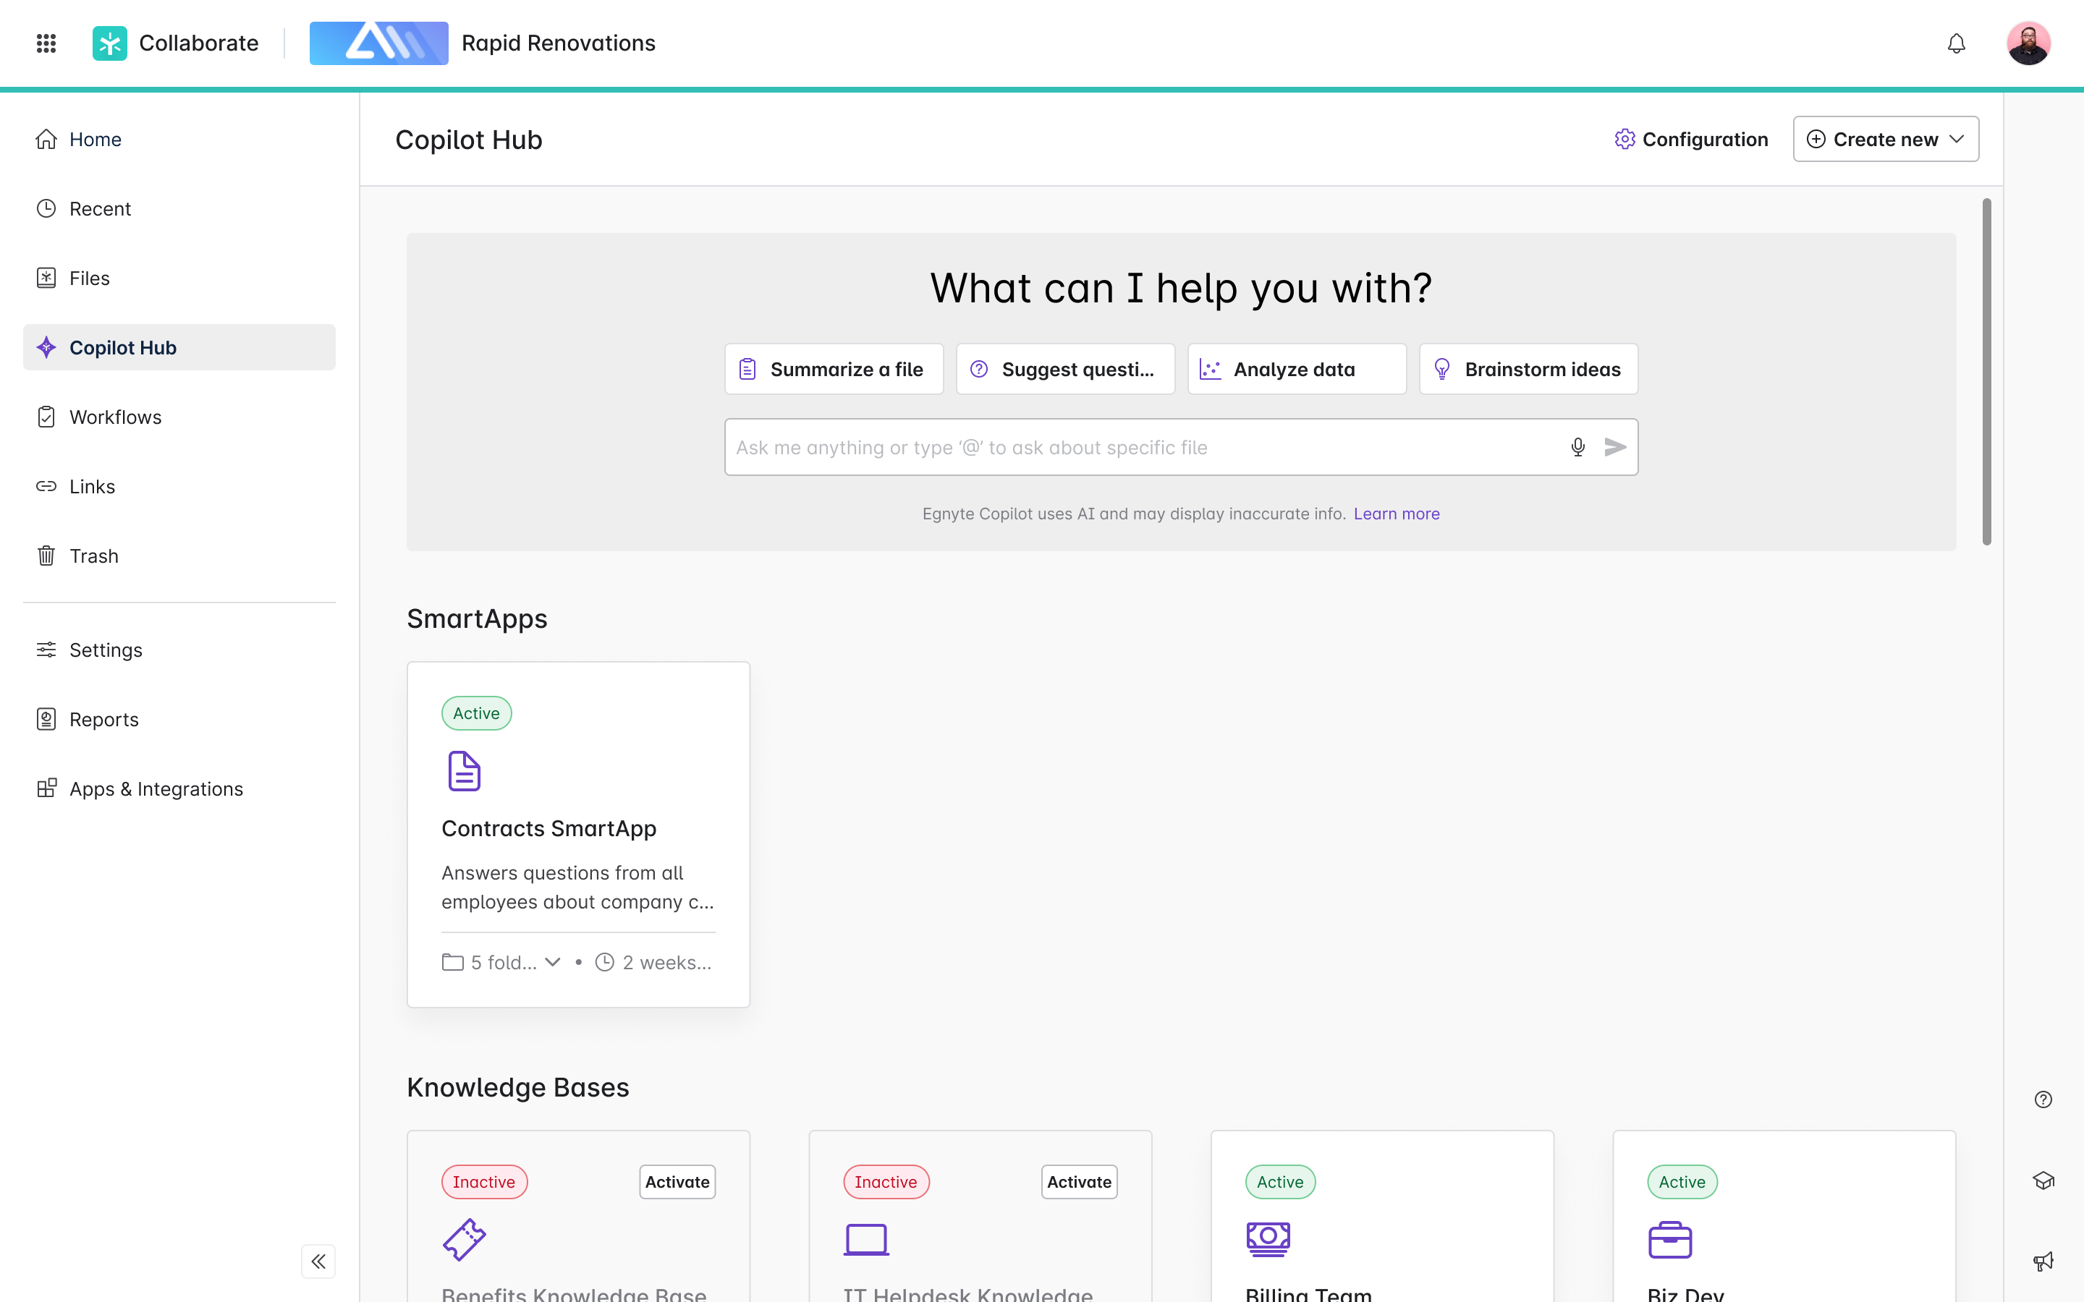
Platform Copilot - UI Changes on Copilot Hub
PB Link
Requirements link -https://egnyte.atlassian.net/wiki/spaces/CFS/pages/818118709/Egnyte+Copilot+WIP
Link to requirements
CFS-65265

Slide 13
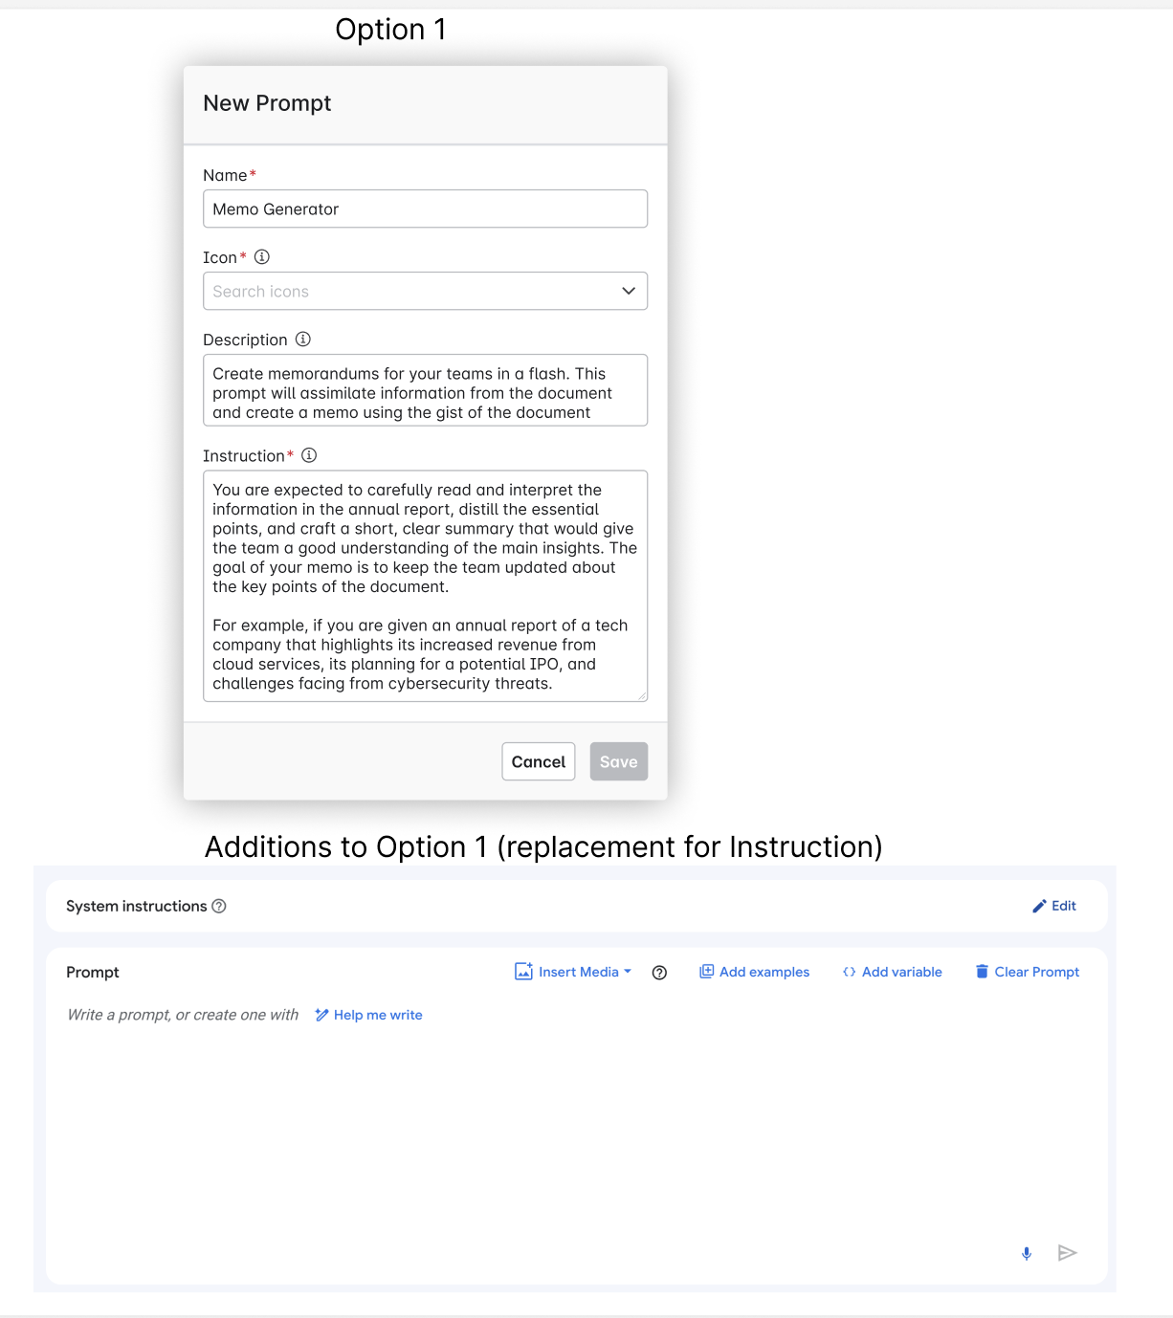
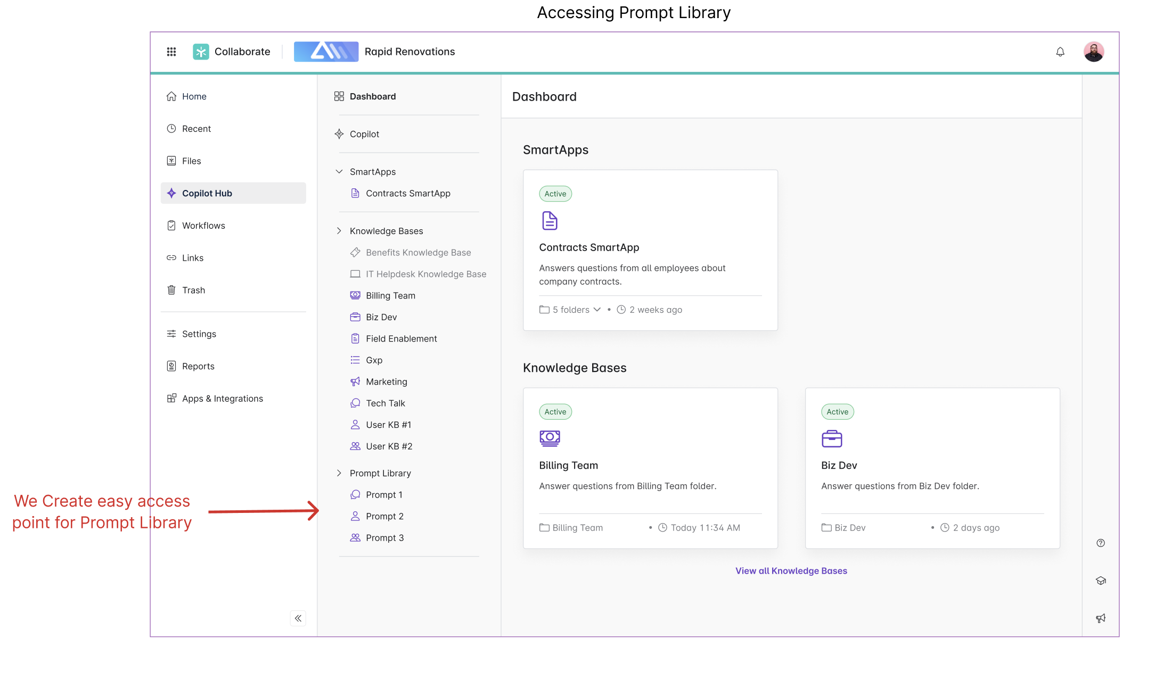
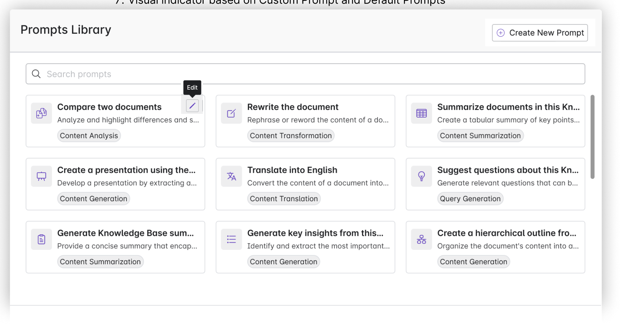
Prompt management – Creation, edit, share
PB Link
Behind - Feature flag (not available by default)
Problem
Today, users cannot edit, modify, create prompts for Ask or KB
User Story:
As a user I want to create, edit, delete prompts. Manage prompts on my domain end to end.
Description
Directional Ux:
List of Prompts:
Creation of Prompts:
Accessing Prompt Library:
Figma Link:
Embedded content
Link to requirements
CFS-65267

Slide 14
Agent Creation (only instruction only Prompt)
PB Link
We rebrand KBs to Agents, within Agent creation Modal flow - Knowledge (selecting a folder) becomes option. We additionally expose the system instruction in the creation flow.
------------------------------------------------------------------------------------------------------------------
Similar to Prompts we allow users to create agents.
Agents are personification of Instructions. Some additional info can also be fed to this (not defined yet).
Invoking agents:
Using "/" character we can invoke agents. Contract expert, Schedule epxert, etc. in the conversational interface.
https://egnyte.atlassian.net/wiki/spaces/CFS/pages/1227161693/Agents+Introduction+in+Copilot+Hub
Link to requirements
CFS-65268

Slide 15
AEC AI Applications

Slide 16
Classify all files under AEC project folders
PB Link
Problem
AEC customers have asked to classify all the files that get uploaded into their project folders.
Classification opens up use cases such as easy retrieval and discovery of content based on document type. Customers have thousands of archived projects that contain requirements, proposals, detailed drawings, estimates etc. When they are starting a new project, it is extremely valuable to be able to find data from similar past projects (e.g. find all old proposals for projects in earthquake zones, etc). Classifying all files and extracting relevant entities from them will allow for easy search through their old projects.
User Story:
As an AEC project manager, I want to classify all the files uploaded inot my project, so that I can easily search, filter, and create views based on file types (RFI, proposal, etc.)
Description
- Classify every file that is uploaded into a project folder
- Use AEC specific document classes (see this page for a list -https://egnyte.atlassian.net/wiki/spaces/AEC/pages/1112866940/AEC+Doc+Types+-+Extraction+Prompts
Link to requirements

Slide 17
Codebooks KB for AEC
PB Link
AEC industry requires to follow regulations and standards that govern the design, construction and maintenance of structures like buildings, bridges or stadiums. These regulations are based on international standards such as International Building Code (IBC), International Residential Code (IRC), International Plumbing Code (IPC) and more.
Requirements:https://egnyte.atlassian.net/wiki/spaces/AEC/pages/1076199541/KB+for+Building+Codes
Link to requirements
CFS-64858

Slide 18
Smart Specifications - In Product Version
PB Link
Placeholder ticket for the work to integrate the Smart Spec service into the Egnyte platform.
Requirements - https://egnyte.atlassian.net/wiki/spaces/AEC/pages/446464310/Smart+Specification+Requirements
Figma -https://www.figma.com/design/pSP6gVOM1NB1dORHzVw1k5/AEC-Trial-Onboarding?node-id=7-17521&node-type=frame&t=2GCW5Ubc2U9ardCl-0
FEATURE FLAG:features.server.SmartSpecFeatureEnabled
Link to requirements
CFS-60040

Slide 19
Contract Analyzer Q1
PB Link
Link to requirements
CFS-65119

Slide 20
test initiative

Slide 21
Detect and remediate external sharing via links
PB Link
Currently, we only detect external sharing for Egnyte folders where a standard user is added via folder permissions, not via sharing links. This is a potential blindspot for our customers and adding the ability to detect when sensitive content is shared with external users, regardless of method, would reduce the risk of potential data exposure.
Link to confluence page for requirements:https://egnyte.atlassian.net/wiki/spaces/DEL/pages/1019412591/Detect+and+remediate+external+sharing+via+links
Customers:NASDAQ, West Bend Insurance
Link to requirements
DEL-41989

Slide 22
Augment AEC Add-on Value

Slide 23
[LA] AEC Project Folder Homepage - Milestone 2
PB Link
Item that were decided to be pushed out of MVP scope
https://egnyte.atlassian.net/wiki/spaces/AEC/pages/258670885/Q3+2023+Requirements
Link to requirements
CFS-50519

Slide 24
BIM Preview Enhancements
PB Link
Problem:Project owners, field technicians, or estimators are periodically required to review BIM design files and provide feedback to the VDC team. They do not have AutoCAD or necessary applications to view these files. Our existing BIM preview capabilities address this problem. However, the reviewers lack the advanced capabilities needed to provide relevant feedback.
User Story:As a reviewer of the BIM design models, I want advanced capabilities (zoom in/out, isolate families, isometric views) to properly view a 3D BIM model and provide relevant feedback to the VDC team.
Description:This enhancement improves the usability of the BIM previewer by providing richer capabilities required for annotation.
Link to requirements
SRV-2516

Slide 25
Native ACC Integration
PB Link
Build a direct integration between Egnyte and Autodesk Construction Cloud (ACC) allowing users to sync files 1-way from ACC to Egnyte
Requirements -https://egnyte.atlassian.net/wiki/spaces/AEC/pages/746651753/ACC+Integration
Figma - https://www.figma.com/design/LlzP9CPnCoI44cAH0oKlPU/Egnyte-to-ACC-bi-directional-connection-%5BUX-3132%5D?node-id=201-376&node-type=canvas&t=3IHBOcnMUsa8sDuO-0
Link to requirements
DEL-40646

Slide 26
Procore Power Users -> widget
PB Link
PINT side : ~ 1 month based on current knowledge
Story: Procore WidgetAs a user with the Procore integration enabled,I want to configure and manage my Procore project sync from the dashboard, so that I have full visibility into my files syncing to and from Procore
Acceptance Criteria:
Resources:
- https://egnyte.atlassian.net/wiki/spaces/AEC/pages/1262190598/Procore+Widget+Requirements+-+Project+Dashboard
- https://www.figma.com/design/ZBxPaDgTrrYniqCXSU4D4L/AEC-~~-Procore-dashboard-widget-~~-Q1-2025?node-id=1-4&p=f&t=17kEzoN1x59VZ6ve-0
Expectation for Q1-2025:
Link to requirements
PINT-12934

Slide 27
[AEC] Project Center
PB Link
The idea behind the project list is to gather all projects available on the domain in one place to allow efficient management in large organizations.
Background
Many SaaS products including Project management systems, ERPs, and Egnyte all have their own concepts of “projects”. This is because the concept of a project is familiar to AEC end users. Projects are how they these end users not only organize their data, but their employees, their financials, and more. By supporting a familiar type of data structure, these SaaS products enable IT admins and end users to organize and view their data in a way that they are accustomed to.
In Egnyte specifically, project folders provide value to end users in a few different ways:
- Project folders provide a clear distinction between project and non-project data. This is critical for a number of reasons including properly managing the content lifecycle of this data.
- Project folders include specific metadata that isn’t available on “normal” folders - Metadata that is searchable such as “Client”, or “Address”, makes it easier for end users to locate the information that they need.
- Additional capabilities - Egnyte includes many features built on top of project folders including Smart upload, the project dashboard, and more. These features are all built to support specific workflows within a project, but without marking a folder as a project folder in Egnyte, these features are inaccessible.
With all of this being said, adoption of project folders in Egnyte is growing, just not as quickly as we had hoped. One area in which Egnyte is lacking is a need for better visibility into project folders. Customers need to be able to quickly and easily get an overview of their projects to understand things like “which projects are in progress” and “which projects are in California?”. A dedicated page/section where users can find all information related to their projects will satisfy this need.
User Stories
Story 0: Project Center Availability
As a user,
I want the Project Center feature to be available,
so that users accessing these files in my domain can use this feature
Acceptance Criteria:
Story 1: Project List
As a user,
I want to view a list of all project folders in my domain,
so that I can get an overview of the projects to which I have access.
Acceptance Criteria:
Story 2: Search/Sort/Filter Project List
As a user,
I want to search, sort and filter my project list using project metadata,
so that I can find the projects that I want to view.
Acceptance Criteria:
Story 3: Create a New Project
As a user,
I want to create a new project from the Project List or Map View pages,
so that I can organize my data in ways that are familiar to my team.
Acceptance Criteria:
Story 4: Project Recommendations
As a user,
I want to be notified of folders that should be marked as a project from the Project Center dashboard,
so that I can easily convert non-project folders to project folders.
Acceptance Criteria:
Story 5: Project Metrics [Post MVP]
As a user,
I want actionable metrics across my project folders from the Project Center page,
so that I can more effectively manage these folders within my domain.
Acceptance Criteria:
Story 6: Map View [Post MVP]
As a user,
I want to view all of my projects from a map view,
so that I can quickly locate projects within a given region.
Acceptance Criteria:
User interaction and design
Figma Designs -
https://www.figma.com/design/I3FsHFo8dWq344C1qDiCeq/AEC-%2F-Projects-home-page-MVP--?node-id=1-4&t=N5PMSJhejOwyq4No-0
Link to requirements
CFS-52807

Slide 28
Build Pax8 Distributor Program

Slide 29
Distribution model - automatic deployments
PB Link
Background
Aiming to integrate with Pax8 we've worked on a preparing a new type of partner to manage.
The plan is to integrate with a distributor Pax8 through SFDC. SFDC will be the recipient of requests sent from Pax8 via webhooks and will be a dispatch system to provide deployment requests and data to downstream systems.
Reseller and Billing apps need to be prepared to respond to such requests and act accordingly.
Goal
- manage requests provided by SFDC for the distributor related partners
Requirements
Based on a transaction request from SFDC prepare automated deployment for:
- change of plan pool (power users, storage)
- change of SU (standard users)
- allocation of resources to domain
- enabling, disabling features and add-ons for child domains
Proposed solution
Resources
- Requests from Pax8 can be of different types:docs:https://devx.pax8.com/docs/provision-request-typesNetNew- Request to start new subscription for a given productUpdate- Request to update existing subscriptionDeprovision- Request to stop services for an existing trial or subscriptionTrialCreate- Request to start a new trial subscription for the given product.TrialConvert- Request to convert an existing trial subscription into a paid subscriptionChangeProduct- Request to upgrade or downgrade current subscription from one product to anotherPartnerEnrollment- Optional request that allows the creation of a partner-level account
- Egnyte needs to recognise the types of request and act accordinglysome can be managed automaticallysome can be mapped to manual processes
- Proposed flow:Pax8 Marketplace and Egnyte Integration.vsdx
Link to requirements
APPS-12970

Slide 30
Trial add-ons for MSPs active domains via Plan details page
PB Link
Background
Currently, any requests to enable an add-on or a feature for the trial period for an active child domain of a partner are managed through contact with PAM, getting DEED acceptance and deploying changes by the Finance team. This makes the process lengthy and troublesome.
A new feature has been added to support this process for theactive direct customers- the ability to trial new features/add-ons and evaluate their value without financial commitment.
This epic focuses on providing the same feature for the MSP partners by allowing them to see and manage Plan details page for their child domains. This will allow MSP partners to quickly enable the active end customers to explore add-ons/features risk-free, ultimately encouraging them to upgrade or purchase additional features once they see the value which supports the upsell motion.
Benefits:
- Increase awareness of available features to enhance product engagement.
- Create stickiness with the product by encouraging customers to explore and adopt new features.
- Increase new logos and upsell opportunities.
Goals
- Allow MSP Reseller users going through MTA to the child domains to see and manage the Plan details page.
- Enable MSPs to manage active child domains for trial add-ons/ features
- Align the experience for direct and indirect customers:enable customers to trial add-ons for 14 days without being charged.
- Allow MSP to purchase the add-ons during or after the trial period for their customers.Keep the purchase possibility in the Usage details of MSP Reseller Dashboard tooKeep the two places in sync - if purchase is made in MSP RD then it should be reflected in the Plan details page
Requirements
https://egnyte.atlassian.net/wiki/spaces/IA/pages/1097007127/Trial+Add-on+for+MSP+active+customers
Link to requirements
APPS-13070

Slide 31
Distribution model - new type of resellers
PB Link
Background
Aiming to integrate with Pax8 we're working on a new type of partner to manage. Such partner will be managed financially by an external operator but Egnyte still needs to provide features in the Billing App, Reseller dashboard and MSP Reseller Dashboard to support such a new type of partner.
Goal
- prepare to manage a new type of reseller in Reseller App and Billing App
Assumptions
Requirements
Once the MSP is registered and is to be managed by an external Distributor solution needs to:
- distinguish partners managed in a distribution model and by a specific integrator e.g. Pax8
- distinguish plans which can be used for such partners and will be offered through the Distributor
- allow Egnyte internal staff users to manage such MSPs in the Settingssupport migration to a Distributor e.g. between plans
- allow to find such partners easily in Reseller and in Billing App
- simplify onboarding and approval processadd planset specific for this type of partnersdo not require payment type or giving CC to be fully active
- do not include such partners in financial processes e.g. payments jobthey will be billed by the Distributor
- adjust existing MSP Reseller dashboard for such partnersuse MTA to access the child domainsview the list of their customersmanage own employees usersgo to their NFR domain
- allow to migrate MSP partners to be managed by a Distributor
Link to requirements
APPS-12865

