Slide 1
Uncategorized

Slide 2
Migrate Data from Box to Egnyte - GA
Migrate data from Box to Egnyte using our Content Lifecycle product.
Define what GA means for this product. Must be available to some or all customers to self-serve.
View in Productboard
No Jira Link
Missing requirements

Slide 3
Migrate Data from Dropbox to Egnyte - GA
Migrate data from Dropbox to Egnyte using our Content Lifecycle product. Define what GA means for this product. Must be available to some or all customers to self-serve.
View in Productboard
No Jira Link
Missing requirements

Slide 4
Big File Handling
Prospect says that the 5gb file limit on our Procore integration is a blocker. We want to look into seeing if this is possible and how much work would it be. They are transferring files that are 10 GB already out of Procore. We would need to split files and upload in chunk's as per Procore's API.
Ticket:https://jira.egnyte-it.com/browse/PINT-14789
View in Productboard
No Jira Link
Missing requirements

Slide 5
Ransomware Unification - Replace Ransomware signature source with reputable threat intel source
Confluence page:https://egnyte.atlassian.net/wiki/spaces/DEL/pages/1425834012/Ransomware+Unification+-+Replace+Ransomware+signature+source+with+reputable+threat+intel+source
View in Productboard
DEL-44545
Missing requirements

Slide 6
Advanced policy configuration
Problem Statement
Larger customers have more complex data structures and need to be able to create more granular content lifecycle policies to manage their data
User Story
As a user, I would like to be able to define more complex policy criteria in order to create more targeted policies. Basically, create a rule-based, wizard-driven type policy creation workflow.
•
Feature Description
Within the CL policy building wizard, allow users to create a hierarchical list of criteria that creates a configuration that allows for much more targeted file matches
• Provide (limited) set of customizable criteria that can be added to a policy
• Provide and/or/not (Exceptions) options for all of the criteria
• Should still support existing Files/Folders/Projects options
View in Productboard
DEL-27433
Link to requirements

Slide 7
Migrate Date from Egnyte to Egnyte (D2D) - GA
Migrate data from one Egnyte domain to another (D2D) using our Content Lifecycle product. Define what GA means for this product. Must be available to some or all customers to self-serve.
View in Productboard
No Jira Link
Missing requirements

Slide 8
Remove or reduce size od Egnyte banner
https://jira.egnyte-it.com/browse/PINT-13022
As a Egnyte user I have ability to disable the "powered by Egnyte" banner in the Outlook add-in when creating share links
View in Productboard
PINT-13022
Missing requirements

Slide 9
[Outlook] Send multiple files in one email
https://jira.egnyte-it.com/browse/PINT-13023
As Egnyte use I can select multiple files at a time for sharing with Outlook integration
View in Productboard
PINT-13023
Missing requirements

Slide 10
set preference to always send attachements with Egnyte
The description is empty.
View in Productboard
No Jira Link
Missing requirements

Slide 11
APIs for Initiating and Managing Cloud Migrations
Need to offer APIs to initiate and manage migrations
View in Productboard
DEL-41756
Missing requirements

Slide 12
Cloud Migration Sources
The description is empty.
View in Productboard
No Jira Link
Missing requirements

Slide 13
GA for Cloud Migration
The description is empty.
View in Productboard
No Jira Link
Missing requirements

Slide 14
E2E Connector - Bidirectional Sync
The description is empty.
View in Productboard
No Jira Link
Missing requirements

Slide 15
SS on Azure Gov public cloud (FedRAMP certified)
There is requirement from customers especiallyNetCov( an high profile MSP ) to support SS on Azure Gov public cloud due to high compute and performance requirement from their applications.
View in Productboard
No Jira Link
Missing requirements

Slide 16
Domain without a Trial
Background and Strategic Fit:
Setting an account without the need to go through a trial can be used for multiple reasons:
• Creating a domain for a customer that signed a contract and did not go through a trial. Sales had direct discussions with a prospects including demos, so when a contract is signed there is no need for a "trial", they are ready to start working
• If on invoice - mark as invoice
• If on CC - ask for CC details
• Send the user a "special email invite" (e.g. congratulations for choosing Egnyte...)
• Use special design (Lisa Raid)
• Send the user a link to collect the credentials of the first user (Who is this sent to, the business person or the technical person)
• Leverage the mechanism from https://jira.egnyte-it.com/browse/APPS-8320
• Skip the admin survey or any lead creation in SFDC
• Ask the user for the domain name, create it and mark it as "paid", make that first user the first admin of the domain
• Validate domain is not used
• Validate user email
Goals:
• Simple for user
• No need to create a trial first
• Elevated experience ("White glove" feel to it)
Proposed Solution:The proposed flow is here [https://lucid.app/lucidchart/0c321564-165e-4fe4-be8b-b4c47f7bc3ef/edit?invitationId=inv_945897cc-e8cc-4620-9d03-403060f6442d&page=0_0#|#]]
• Get indication from SFDC that the account is paid
• Get from SFDC the parameters of the user we will be sending this to
• Use elements from https://jira.egnyte-it.com/browse/APPS-8320 in order to create the domain
View in Productboard
APPS-10412
Missing requirements

Slide 17
SC Indication - link to SC view for non-admins
In order to facilitate users moving from CFS to S&G to remediate sensitive content, we should provide them a link that will take them to the SC view with the associated location.
Will require some entitlement changes in S&G
https://egnyte.atlassian.net/wiki/spaces/PM/pages/658374842/SC+Visibility+Phase+2+-+user+actions+workflows
View in Productboard
DEL-38580
Missing requirements

Slide 18
Analysis and Modification of Recommendation Engine Test Results
The description is empty.
View in Productboard
GR-603
Missing requirements

Slide 19
Upload request instance modification from template
Problem Statement
The upload request template cannot be modified at all while creating an upload request instance. The customers would like to remove specific document(s) or mark them optional while creating a request instance.
User Story
As an Egnyte Domain user, I would like to modify the documents from a template while creating an upload request so that I can modify the existing template to request specific documents based on specific criteria.
Feature Description
• While creating an upload request instance, allow users to mark a document as optional or remove the document from a template.
• Provide a setting in the template to control the modification action while creating an upload request instance.
View in Productboard
CFS-67186
Missing requirements

Slide 20
Add item count to SC and Issues pages
Problem Statement
The system has limits on how many objects are displayed on S&G feature pages to prevent long load times (or even completely prevent it from loading). However, because of this limit, it's difficult for user to understand the scope of how many object there actually are.
User Story
As a user, I want a clear understanding of how many issues and sensitive content items I have. This includes filters in place, limits based on the browser resources and total items that the system has identified
Feature Description
Display the counts of the items displayed on the lists
• Issues view - Count of rendered items in the list is displayed
• SC view - Count of rendered items in the list is displayed
Public Summary
View in Productboard
DEL-39631
Link to requirements

Slide 21
Sales Initiated Trial
Background and Strategic Fit:
Offer a chance to start a Platform Enterprise trial to a potential customer. The customer is interested in Egnyte and we want to avoid starting them on a regular trial. We do not want them waiting for several days due to manual setup and removal of limitations of this plan.
• Send the user a "special email invite" (e.g. Thank you for being a great Egnyte customer...),
• Send the user a link to "Setup your account"
• Should use the same flow as Egnyte For Life only difference is that the PVI that they're landing on has a single plan
Goals:
• Allows Sales to send an invitation to a PROSPECT and have them land on a Platform Enterprise Trial without limitations
• Create a domain without needing to do so onhttps://www.egnyte.com/
View in Productboard
APPS-12538
Missing requirements

Slide 22
Egnyte Copilot in MS Office apps research
Problem Statement
Egnyte Copilot is positioned as an alternative to MS Copilot, A significant limitation of MS Copilot is that it does not allow integration with Egnyte-stored content or any other third-party storage providers—it is restricted to SharePoint storage only.
To truly differentiate Egnyte Copilot and enhance its value, we must expand its integration across Microsoft 365 apps (Word, PowerPoint, Excel, Outlook, and potentially others), enabling AI-driven assistance regardless of where the files are stored.
Use Case
Introducing Egnyte Copilot plugins for Microsoft 365 apps will enable users to:
• Access Egnyte AI-powered assistance within Word, PowerPoint, Excel, MS Teams, and Outlook.
• Use Egnyte AI features seamlessly within the Microsoft ecosystem without requiring MS Copilot.
Current Solution & Gap
• Users must pay for MS Copilot to access AI-powered features in Microsoft 365 apps.
• MS Copilot does not support third-party storage providers, including Egnyte.
Proposed Solution
DevelopEgnyte Copilot pluginsfor Microsoft 365 apps, powered by Egnyte AI, to provide essential AI-driven assistance:
• Word
• PowerPoint
• Excel
• MS Teams
• Outlook
Importance & Business Impact
• Competitive Advantage – Differentiates Egnyte Copilot from MS Copilot by supporting third-party apps integration. Users must pay for and use MS Copilot
• Customer Demand – Enables users to use AI-driven assistance with Egnyte files inside Microsoft 365 apps.
• Revenue & Adoption Growth – Increases Egnyte adoption within organizations using Microsoft 365 without MS Copilot.
Relevant Links or Details
🚀Upcoming CFS API (Q2)– Enables deeper integration of Egnyte AI with Microsoft apps.
Next Steps
1.Q2: Utilize CFS API– Develop integration points for Egnyte AI within Microsoft 365 apps.
2.Q3: Develop & Pilot Plugins– Test AI-powered Egnyte Copilot features in select Microsoft applications.
3.Q4: Full Rollout– Launch Egnyte Copilot functionality across Microsoft 365 apps.
View in Productboard
No Jira Link
Missing requirements

Slide 23
MS Teams - Custom configuration
Requirements & Features
1. Disable New Folder Creation in MS Teams Integration
• Prevent users from creating new folders within Egnyte via MS Teams.
• Restriction should apply across all MS Teams channels and chats where the integration is enabled.
• Admins should have the option to toggle this restriction via settings.
• JIRA ReferenceCOM-268(RB Request)https://jira.egnyte-it.com/browse/SER-3461(pfluger request)
2. Remove Recents & All Files in Messaging Extension
• Remove the Recents and All Files views in the MS Teams messaging extension\.
• This will prevent users from sharing unwanted or sensitive files by limiting file selection\.• Admins should be able to control file visibility settings via integration settings\.
3. Custom Tab Addition Without Admin Setup Completion
• Currently, users can add a custom Egnyte tab even if the admin has not completed the setup\.• Implement a restriction preventing tab addition until the admin setup is fully completed\.
4. Enable MS Teams Add-in for Selected Teams/Channels Only
• Allow admins to enable Egnyte integration selectively for specific MS Teams teams or channels instead of applying it across the entire organization\.
• Admins should be able to define allowed Teams\/Channels from the Egnyte Admin Panel\.
Business Justification & Impact
✔Security & Compliance– Prevents unauthorized folder creation and limits the risk ofaccidental file sharing.
✔User Experience– Aligns with customer requests to improve usability and control within MS Teams.
✔IT/Admin Control– Gives admins greater flexibility in managing Egnyte’s integration with Microsoft Teams.
View in Productboard
No Jira Link
Missing requirements

Slide 24
DocuSign Upload Enhancement
The current integration with DocuSign utilizes API version 2.0, which restricts file uploads to a maximum size of 25 MB. This limitation is causing issues for customers attempting to share larger files. To address this problem, we need to upgrade to DocuSign API version 2.1, which supports file uploads up to 32 MB via APIs and up to 52 MB via chunked uploads. Additionally, we will implement a user interface enhancement to notify users when they attempt to upload files that exceed the allowed size limits. This upgrade will improve file sharing capabilities and user experience.
Acceptance Criteria:
1. Upgrade to DocuSign API version 2.1 and ensure compatibility with the current integration.
2. Implement support for handling files up to 52 MB using chunked uploads.
3. Develop and deploy a pop-up notification feature to alert users when attempting to upload files larger than the allowed limits.
4. Perform thorough testing to validate the new functionality and pop-up notifications.
5. Update documentation to reflect the changes and new file upload limits.
Links:https://developers.docusign.com/docs/esign-rest-api/esign101/rules-and-limits/#:~:text=Docusign%20has%20the%20following%20limitations,of%20up%20to%2052%20MB
https://developers.docusign.com/docs/esign-rest-api/reference/envelopes/chunkeduploads/
Ticket:https://jira.egnyte-it.com/browse/PINT-15240
View in Productboard
No Jira Link
Missing requirements

Slide 25
Google Import Functionality Enhancement
Problem Statement
Users who will import files from Google Drive (G Drive) to Egnyte currently lack the ability to select and import entire folders. Instead, they may be restricted to importing individual files, which can be time-consuming, especially for users who need to transfer large sets of organized files and subfolders. This limitation presents several issues:
• Inefficiency: Without the ability to import folders directly, users must manually select files one by one. This process is cumbersome, particularly when dealing with large data sets.
• Loss of Folder Structure: When users import individual files, the original folder structure from G Drive isn’t maintained, making it challenging to organize content in Egnyte as it was originally structured.
• Time-Consuming Workflow: Reconstructing folders and re-uploading files separately adds time to workflows and increases the chance of errors, such as missing files or misplacement.
• Reduced Usability: This lack of folder import functionality impacts the user experience, as they must go through multiple steps to transfer data, creating frustration and potential reluctance to use the import feature.
Solution: Provide Folder Selection Functionality for Importing Folders to Egnyte from G Drive
To address this problem, the solution is to implement a folder selection capability within the G Drive to Egnyte import feature. This enhancement will allow users to select an entire folder (or multiple folders) from G Drive, preserving the structure and significantly streamlining the import process. Here are the solution details:
1. Folder Selection Interface
2. Preservation of Folder Structure
3. Seamless Integration with Egnyte
4. Benefits of the Solution
View in Productboard
No Jira Link
Missing requirements

Slide 26
ServiceNow Incident Sync
Enhancing the ServiceNow functionality to provide bidirectional sync of ticket status and display the ticket in the third pane within the Secure & Govern (S&G) Issues module involves several detailed steps and considerations. Here’s a breakdown:
1.Bidirectional Sync of Ticket Status
• Sync Status Updates from ServiceNow to Secure & Govern: Automatically update the status of tickets in Secure & Govern whenever the status changes in ServiceNow. For example, if a ticket is marked as “Resolved” or “In Progress” in ServiceNow, this update should reflect in the S&G Issues module without manual intervention.
• Sync Status Updates from Secure & Govern to ServiceNow: Allow updates made to the ticket status in Secure & Govern (if any) to sync back to ServiceNow. This ensures that both platforms maintain a consistent view of the ticket’s current state.
• Reduce Communication Gaps: The sync helps eliminate communication gaps, ensuring that teams using Secure & Govern can see the latest ticket status without needing to switch platforms.
• Automated Polling or Webhooks: Implement mechanisms like periodic polling or webhooks to detect and trigger updates between the systems to maintain real-time or near-real-time synchronization.
2.Display ServiceNow Ticket in the Third Pane within Secure & Govern Issues Module
• Clickable Ticket Link: Make the ticket ID or title clickable to open the full ServiceNow ticket in a new window or tab. This provides quick access to the full ticket details if more in-depth review or actions are needed.
• Live Status Updates in Pane: Ensure that the ticket status in the third pane updates in real-time (via the bidirectional sync) so that users have an up-to-date view of the issue’s progress.
• Enhanced Usability: This integration reduces the need for users to switch between Secure & Govern and ServiceNow, improving efficiency for security and operations teams. The third-pane display also helps users get a consolidated view of their issues and related incidents in a single interface.
3.Benefits of the Enhancement
• Streamlined Incident Management: By integrating status updates and a visual display of ServiceNow tickets in Secure & Govern, incident management becomes more streamlined, as users can track and respond to incidents directly.
• Improved Transparency and Communication: Both the security and IT teams gain access to the latest status, improving transparency and collaboration. Secure & Govern users can see real-time ticket information without accessing ServiceNow directly.
• Efficient Workflow: Eliminates redundant steps of switching between platforms, saving time and reducing errors.
View in Productboard
No Jira Link
Missing requirements

Slide 27
Windows Server Next ( 2025 )
The description is empty.
View in Productboard
No Jira Link
Missing requirements

Slide 28
Windows 11 24H2 Support as Client
The description is empty.
View in Productboard
No Jira Link
Missing requirements

Slide 29
PVI - Milestone 14.1 - Accuracy of Deployment
Background and Strategic Fit:
Currently, there are thousands of PVIs created over time due to various customizations. A plan created with a different price, a different user/storage, or feature set requires a new manual PVI close. Also there is no formal association between a cloned PVI and its source PVI for audit purposes. PVIs have a static structure as well. This means that once a PVI is created it does not reference new features or services developed in the future. We are set to re-imagine this and create a new architecture that will allow MI to be more flexible.
Goals:
• Start identifying items that can be automated or updated to improve the speed of features being released.
View in Productboard
APPS-11863
Missing requirements

Slide 30
[UX] MSP RD Designs part 3 - multiple pages
Problem Statement
MSP Reseller Dashboard is used by MSP partners manage the child domains, access to them for their employees and also allows to self-serve purchase transactions. Currently the interface is not aligned with Egnyte look and feel and some parts of it are not design properly for the comfort and easiness of our partners.
User Story
As an Egnyte staff user I want to manage a Pax8 MSP so that Egnyte can sell products through a Distributor.
Feature Description
• Prepare designs to organise the application according to the best UX practices and adding the look and feel currently used in other Egnyte applications.
• For Q2 work on designs for several tabs:
View in Productboard
APPS-11774
Link to requirements

Slide 31
Convert Google OCR PoC to a production grade integration
Confluence documentation ~~>HERE
The current integration of Google OCR within the S&G extraction pipeline is a limited PoC. It needs additional development to convert it to a production ready service. Those tasks are captured in this Epic.
TODO: Tickets for Scheduling & Polling of the batch requests, once the vision is clear (mby some updated diagrams?)
View in Productboard
DEL-42652
Missing requirements

Slide 32
Splunk App Tech-debt
This is a blanket epic to address some of the Tech-debt, Security and Observability tasks.
Reference:https://egnyte.atlassian.net/wiki/spaces/PINT/pages/1101791255/4Q2024+Splunk+plugins+knowledge+transfer+leftovers+and+priorities
View in Productboard
No Jira Link
Missing requirements

Slide 33
Ability to specify URLs in Sources
The description is empty.
View in Productboard
No Jira Link
Missing requirements

Slide 34
Include original/destination path in stub file
Problem Statement
There have been escalations created due to customers moving stub files so the stub file no longer matches the source/destination.
User Story
Support has requested that the original source and destination paths be included in the stub file text to avoid confusion/escalations when this happens
Feature Description
Beneath the standard text but before custom text in the stub file, the new information should be included:
• Original file location (domain and path)
• Original archive destination (domain and path)
Public Summary
Egnyte provides access to all files in a customer's domain, including the system-generated stub files that are left by processes like content lifecycle policies. In some cases, these stub files are moved which can cause confusion when a user look at the text. To avoid that confusion, we want to include the original file source location as well as the original archive destination in the stub text.
View in Productboard
DEL-44393
Link to requirements

Slide 35
Setting Webhook limit at the domain level using FF
Issue:Currently, the webhook limit is set at the data center (DC) level, meaning any increase in the limit applies to all customers. This is not ideal from a scalability and load management perspective. As a result, individual customers requesting a higher webhook limit cannot be accommodated without impacting others. The current webhook limit is 10 for all customers.
Solution:To address this, we need to introduce a domain-level feature flag that allows for a higher webhook creation limit based on customer demand and specific use cases. This will enable us to grant exceptions to select customers without affecting the overall system performance.https://jira.egnyte-it.com/browse/PINT-14850
View in Productboard
No Jira Link
Missing requirements

Slide 36
ServiceNow Integration GA
The description is empty.
View in Productboard
No Jira Link
Missing requirements

Slide 37
Presto Portal For Customer
The description is empty.
View in Productboard
No Jira Link
Missing requirements

Slide 38
Procore Power Users -> widget
Story: Procore WidgetAs a user with the Procore integration enabled,I want to configure and manage my Procore project sync from the dashboard, so that I have full visibility into my files syncing to and from Procore
Acceptance Criteria:
1. UX design is required and that is available already
2. A new Procore widget should be created on the Dashboard.
3. Once configured, the widget should include the Procore Project being synced, the Egnyte folder selected for syncing, the last successful sync, and the service account used.
4. The widget should be visible on the project dashboard only for users that have enabled the integration.
5. Admins or PUs with permissions to configure the Procore Project sync should be able to initiate the configuration directly from the Project Dashboard widget.
6. Admins or PUs with permissions to configure the Procore Project sync should be able to stop and remove the connection directly from the Project Dashboard widget.
7. Users without permissions to configure the Procore Project sync, but with the ability to view the project folder should be able to view the status of the Procore connection from the widget
Resources:
• https://egnyte.atlassian.net/wiki/spaces/AEC/pages/1262190598/Procore+Widget+Requirements+-+Project+Dashboard
• https://www.figma.com/design/ZBxPaDgTrrYniqCXSU4D4L/AEC-~~-Procore-dashboard-widget-~~-Q1-2025?node-id=1-4&p=f&t=17kEzoN1x59VZ6ve-0
Expectation for Q2-2025:
1. Development is expected to be completed by Q1 and GA by Q2.
View in Productboard
No Jira Link
Missing requirements

Slide 39
New Homepage (iOS)
We are creating a new homepage for our mobile app to enhance user productivity and streamline access to key features. This homepage will integrate various widgets and quick access links, offering users a more personalized and efficient experience. By allowing customization and ensuring seamless synchronization between the web UI and mobile app, users will have a consistent and intuitive interface across all platforms.
Homepage requirements:
1. Widget Display and Interaction -As a user, I want to view widgets like Egnyte Copilot, Bookmarks, Recent Files, and Project Folders, on the homepage so that I can quickly access relevant content and actions.
2. Quick Access Links -As a user, I want to have quick access links on the homepage for actions I often perform like File Upload, and mobile-specific features like Smart Upload updates, so that I can perform tasks efficiently from the homepage.
3. Widget Customization -As a user, I want to be able to customize my homepage by showing or hiding specific widgets so that my homepage displays only the information and tools I need.
4. Sync Settings Across Mobile Devices -As a user, I want my widget settings (show/hide preferences) to be synced across all my mobile devices so that my homepage layout remains consistent regardless of the device I use.
View in Productboard
No Jira Link
Missing requirements

Slide 40
Track sensitive content indicator labeling
Problem Statement
The sensitive content indicator is of high interest to senior leadership, so we're going to need to track what customers have the SCII labeling policy enabled.
User Story
As an feature owner, I need to be able to report on the usage of all released features
Feature Description
The sensitive content indicator is of high interest to senior leadership, so we're going to need to track what customers have the SCII labeling policy enabled.Information needed:
• Tenant ID
• Tenant name (nice to have)
• Policy state (enabled/disabled)
• Associated CC policies (policy ID)
• Associated sources (source ID)
• Number of files labeled
• Update schedule TBD (maybe every 24 hours)
If it's built for generic doc labeling info:
• Mark individual patterns (yes/no)
• Write persistent labels (yes/no)
• Policy name
• Description
Ideas:
• Make information available in admin panel
• Make information available in BQ
Public Summary
This is an internal-only feature. As we continue to expand the scope of document labeling, we need a better mechanism to track the usage of the feature. This work will allow for more robust reporting on how customers are using document labeling.
View in Productboard
DEL-44434
Link to requirements

Slide 41
Google Photos Import
https://jira.egnyte-it.com/browse/PINT-16612:taken from Hackathon.
View in Productboard
No Jira Link
Missing requirements

Slide 42
Google V4 Improvements and Tech debt
Google v4 improvements to achieve full fidelity.
View in Productboard
No Jira Link
Missing requirements

Slide 43
[S&G] Unusual Access - Reduce false positives associated with Windows system activity
Link to original S&G feature -https://egnyte.productboard.com/feature-board/8521480-cfs-s-g-joint-projects/features/18143025/detail
View in Productboard
No Jira Link
Missing requirements

Slide 44
Model DB Refactoring for Scale
The description is empty.
View in Productboard
GR-597
Missing requirements

Slide 45
Value Scorecard
The description is empty.
View in Productboard
GR-457
Missing requirements

Slide 46
Fundamental Value Resources
We need assets that explain the fundamental value of Egnyte. Not "HOW" to do something, but "WHY."Why something is important, why you should care, why you should change your way of working, why other users find value in something.
After sharing the Value Scorecard, for example, what is the prescription we give the customer if they have areas in need of improvement?
1. Sharing
2. Co-editing
3. Offline/Connected Folders
4. Using Smart Cache for Large Files
5. Using Slack or Teams
6. Content Classification Policies
7. Content Lifecycle Policies
8. Data Security Issues
9. Search
10. Creating Folders
11. Metatagging
12. Bookmarks
View in Productboard
GR-594
Missing requirements

Slide 47
Other Plans for Prospects: Plan Exploration & Trial Management
The current Plan Details page, written with outdated technology, requires a rewrite to align with Egnyte standards. Transitioning to a Common UI framework is critical, enabling integration with CFS navigation and improving the overall user experience. Additionally, recent industry trends have shifted towards a preference for self-service and personalized interactions, emphasizing the need for prospects to access pricing details, research product specifications, and initiate free trials without direct sales involvement. This shift, supported by findings from over 2,000 technology buyers, highlights the necessity for transparent pricing and direct access to free trials to meet customer expectations and remain competitive, particularly in light of practices adopted by companies like Microsoft and Google.
The Trial Add-Ons feature was the first phase of this initiative, allowing customers to explore additional features during their trials. The next phase of this project is the introduction of the Other Plans Page, which will provide a more comprehensive experience for prospects. This page will give users a centralized location to explore, trial, and upgrade plans, further enhancing the self-service experience and aligning with the evolving market demands.
Presentation to e-staff on 2/27/24https://egnyte.egnyte.com/dl/CFwIo6sFGk
Goals:
• Provide aunified experiencefor prospects toexplore, trial, and upgrade planswithin and across PVIs.
• Expand {}self-service functionality{}, allowing users to start trials and upgrade plans independently while enabling sales to guide the process when needed.
• <span data-color="var(~~-ds-text, #172b4d)">Improve </span>{}plan discoverability and flexibility{}<span data-color="var(~~-ds-text, #172b4d)">, making it easier for customers to evaluate and select the plan that best suits their needs.</span>
• Reduce {}friction in the trial-to-paid process{}, ensuring a seamless path from exploration to conversion.
View in Productboard
APPS-13504
Missing requirements

Slide 48
CLM Redesign
As a part of the Redesign Initiative, we are have to align the design components to be similar to CFS.
Refactor existing Content Life Cycle view using new Shared components.
View in Productboard
No Jira Link
Missing requirements

Slide 49
Provide Sensitive content on 'Unpermitted locations' via OLAP
Data populated on the S&G dashboard consists of Sensitive content locations across all locations - not just "Unpermitted Locations". We require the ability to look at SC across only Unpermitted locations.
View in Productboard
DEL-38410
Missing requirements

Slide 50
[S&G] Content Safeguards - Add Purview-labels as a supported option
Problem Statement
Egnyte integrates with Microsoft Purview to imports labels and apply them persistently on files stored in Egnyte. Purview labels are often used to indicate the sensitive nature of a document (Confidential, Secret, Internal, Public, etc.). S&G Content Safeguards do not currently support this notion.
User StoryAs a Security Administrator, I want to protect sensitive content identified through Purview-labels from being shared with improper permissions.
Feature Description
This feature includes:
• Add support for Purview-labels in Content Safeguards
View in Productboard
DEL-44557
Missing requirements

Slide 51
Purview labeling - Support for priority field
Problem Statement
Microsoft Purview labels can be configured with a priority. This ensures that when multiple sensitivity labels or content classification policies are applicable, the label with the highest priority takes precedence. This priority order is typically configured by administrators in the Microsoft Purview
User Story
As a Security Administrator, I want to apply the Purview label with the highest priority on a document so that I can label sensitive content correctly.
Feature Description
1. Import the priority order along with the label definition
2. Sort the labels in UI based on the priority order, highest label will be on the top.
3. As Egnyte S&G Document Labels allows to import the label definitions from more than one source, it is advisable to divide and sort the label based on the source and display the same in Document labels UI
4. In the event of applying multiple labels, S&G should consider the higher Priority order label and apply only one label (send the highest level of priority label information to Metadata Stamping Service. MIP SDK cannot stamp more than one label definition at a time, trying to apply more than one label will replace the old label with latest)
View in Productboard
DEL-43515
Missing requirements

Slide 52
Disable new folder creation in MS Teams Integration
Product Requirement: MS Teams Integration – Folder Creation Control
Use Case
In the MS Teams integration with Egnyte, when users add a new Egnyte tab, they are prompted to either select an existing folder or create a new one. Choosing to create a new folder automatically generates a folder and an Egnyte group within /Shared/Microsoft Teams Files.
Problem Statement
1. Slow Folder Creation – Creating a new folder takes a significant amount of time, causing delays\.
2. Duplicate Folder Issues – Newly created folders often result in duplicate entries within \/Shared\/Microsoft Teams Files, specifically landing in a duplicate folder \(e\.g\., *Red Bull \(1\)*\)\. This leads to confusion and clutter as more duplicate locations accumulate over time\.
3. Access management - content is uploaded to the folder where access is not controlled
Proposed Solution
Introduce an Admin-controlled setting todisable the option to create new foldersduring setup. When enabled, users will only be able to select from existing folders where they already have access.
Value Proposition
• Improves User Experience – Reduces folder creation delays\.
• Eliminates Duplicates – Prevents multiple duplicate folder locations, ensuring a cleaner structure\.
• Enhances Control – Allows Admins to enforce folder management policies and maintain a more organized file system\.
• Reduces Confusion – Ensures users work within existing authorized folders, avoiding misplaced files\.
https://jira.egnyte-it.com/browse/COM-268
https://jira.egnyte-it.com/browse/SER-3461
View in Productboard
No Jira Link
Missing requirements

Slide 53
Other Plans Page for Customers: Trials
placeholder
View in Productboard
APPS-13646
Missing requirements

Slide 54
Automated Deployment Spillover
Automated Deployment Spillover
View in Productboard
APPS-13663
Missing requirements

Slide 55
Complete revamp of Egnyte developer portal
For the below we have already started the discovery of right tool for documentation, currently we are talking with APIdog, Theneo, Document360 (https://egnyte.atlassian.net/wiki/spaces/PINT/pages/1429864598/AI-Powered+Tools+for+Generating+API+Documentation) :
TheEgnyte Developer Portalwill undergo a complete revamp to enhance usability, improve API documentation, and provide a more seamless experience for developers. The new portal will feature an intuitive interface, updated guides, and better support for integrations with Egnyte services. This update aims to streamline API adoption, making it easier for developers to explore, test, and implement Egnyte’s capabilities in their applications.
Additionally,AI-powered searchis will be looked upon in the portal to improve content discoverability. This advanced search functionality will leverage AI to provide more relevant results, intelligently surfacing documentation, code snippets, and troubleshooting guides based on user queries. The goal is to reduce friction in finding information and improve developer productivity by offering precise and contextual search results.
These enhancements will provide a more user-friendly and efficient platform for developers, driving better engagement and faster integration with Egnyte’s ecosystem.
View in Productboard
No Jira Link
Missing requirements

Slide 56
Distribution model - review and select solution for automatic deployments
Problem Statement
Egnyte is starting cooperation with Pax8 who owns a marketplace for MSPs offering multiple products from a variety of vendors. To support this integration, internal systems need to be adjusted but we need to allocate time to select the best solution.
User Story
As Egnyte system I want to review and select the best solution for communication between applications so that automatic deployments can be supported.
Feature Description
• Review possible options
• Select the solution
• Coordinate with TechOPS and external teams to establish a contract
• Prepare technical document so that it is known what needs to be done
View in Productboard
APPS-13575
Link to requirements

Slide 57
MSP RD - First child domain user edge cases
Problem Statement
Previously, a feature to create the 1st administrator of a domain as a service account automatically has been prepared. It covers the main use cases:
1. starting a trial
2. creating a service account
The feature changes the way of starting child domains for the partner and allowed to access the domains free of charge for the Administrator user.
This is to continue the effort for identified edge cases.
User Story
As an Egnyte staff user I want to manage a Pax8 MSP so that Egnyte can sell products through a Distributor.
Feature Description
• deactivating the reseller user who created the trial domain and assigning a different user
• convertins a direct domain to MSP domain
• converting an MSP domain to direct domain
• clean up for the feature once it is rolled out in full
View in Productboard
APPS-13482
Link to requirements

Slide 58
[Data Mover] Data Collection APIs (Spillover)
The description is empty.
View in Productboard
No Jira Link
Link to requirements

Slide 59
Procore Sync Notifications
The description is empty.
View in Productboard
No Jira Link
Missing requirements

Slide 60
Trial Add-on Adoption Initiative
Multiple Pendo tasks to support the Add-On Trial capability being developed by the MI team and released in Q1 25. It will be released ONLY to direct domains and VAR domains. It will exclude MSPs and child domains.
1. In the UI, we want to introduce multiple "New" badges and a Pendo Guide that lead a user to the Trial Add-Ons.
• New next to Settings, drives user to Subscription: Trial Add-Ons
• Pendo Guide introducing the new feature.
2. Run a Pendo campaign to Admins to promote the new ability to try add-ons for 14 days.
3. Create individual Pendo guides (contextually, if possible) to advise users on a domain that they have access to try a feature for 14 days. If contextual campaign isn't possible, we will trigger a generic "first log in" campaign.
Link to 12/17 Presentation:https://egnyte.egnyte.com/dl/QOkxJeRFY1
Link to Confluence Page:https://egnyte.atlassian.net/wiki/spaces/IA/pages/1223262209/Services+Add-Ons+Eligible+for+Trials
View in Productboard
GR-537
Missing requirements

Slide 61
FSI 5/21/25 Virtual Summit Promotion
Pendo campaign to drive FSI customers to the evnt.
View in Productboard
No Jira Link
Missing requirements

Slide 62
New S&G UI Awareness Campaign
Pendo campaigns for multiple recently-released S&G items. Listed in order of priority:
1. CLM insights on CFS UI aka Folder Insights hidden under the “more” drop-down on CFS UI.
2. Sensitive Content Visual Indicator on CFS UI (Hemant is already working on this)
3. Custom Reports (OLAP reports) on S&G report ctr.
4. Promote Usage of Reporting Center.
5. Auto-remediation with large number of open public links
Saved Filters on Issues and Sensitive Content
See details below..
GR-563
https://jira.egnyte-it.com/browse/GR-560
https://jira.egnyte-it.com/browse/PENDO-603
https://jira.egnyte-it.com/browse/PENDO-592
https://jira.egnyte-it.com/browse/PENDO-617
https://jira.egnyte-it.com/browse/PENDO-618
View in Productboard
GR-588
Missing requirements

Slide 63
Convert to PDF step
The description is empty.
View in Productboard
CFS-66426
Missing requirements

Slide 64
Feature Entitlements Q2 2025 Grouping
Feature Entitlements Q2 2025 Grouping
View in Productboard
APPS-13455
Missing requirements

Slide 65
Reverting Storage Per User for MSP Platform Enterprise & Platform Enterprise Lite Plans
Background and Strategic Fit:
We have recently made changes to the amount storage per user is given to new MSPs. However, through initial research we found that this configuration was given to older MSPs at a lower price point. The objective of this epic is to correct this so that we can give Sales a way to incentivize Platform Enterprise Lite and Platform Enterprise customers to upgrade.
MSPs who have signed up <span data-color="#de350b">before</span> October 31st should have the following storage per user per plan:
• 200GB/per user for AFS
• 100GB/per user for Platform Enterprise
• 100GB/per user for Platform Enterprise Lite
• 100GB/per user for CFS
MSPs who have signed up <span data-color="#de350b">after</span> October 31st should have the following storage per user per plan:
• 200GB/per user for AFS
• 200GB/per user for Platform Enterprise
• 200GB/per user for Platform Enterprise Lite
• 100GB/per user for CFS
Goals:
• Figure out how many MSP domains across Platform Enterprise & Platform Enterprise plans, who signed up prior to October 31st, have 200GB enabled; starting with the following PVIs:
• 892441
• 889731
• 889731
• 888371
• 877181
• 854851
• Create a script to update the storage per user on these domains from 200GB to 100GB
View in Productboard
APPS-13022
Missing requirements

Slide 66
Server-side MixPanel events
Mixpanel events from backend
View in Productboard
APPS-13645
Missing requirements

Slide 67
Augment AEC Add-on Value

Slide 68
[AEC] Project Center
SPILLOVER FROM Q1 - blocker for AEC expansion
The idea behind the project list is to gather all projects available on the domain in one place to allow efficient management in large organizations.
Background
Many SaaS products including Project management systems, ERPs, and Egnyte all have their own concepts of “projects”. This is because the concept of a project is familiar to AEC end users. Projects are how they these end users not only organize their data, but their employees, their financials, and more. By supporting a familiar type of data structure, these SaaS products enable IT admins and end users to organize and view their data in a way that they are accustomed to.
In Egnyte specifically, project folders provide value to end users in a few different ways:
• Project folders provide a clear distinction between project and non-project data. This is critical for a number of reasons including properly managing the content lifecycle of this data.
• Project folders include specific metadata that isn’t available on “normal” folders - Metadata that is searchable such as “Client”, or “Address”, makes it easier for end users to locate the information that they need.
• Additional capabilities - Egnyte includes many features built on top of project folders including Smart upload, the project dashboard, and more. These features are all built to support specific workflows within a project, but without marking a folder as a project folder in Egnyte, these features are inaccessible.
With all of this being said, adoption of project folders in Egnyte is growing, just not as quickly as we had hoped. One area in which Egnyte is lacking is a need for better visibility into project folders. Customers need to be able to quickly and easily get an overview of their projects to understand things like “which projects are in progress” and “which projects are in California?”. A dedicated page/section where users can find all information related to their projects will satisfy this need.
User Stories
Story 0: Project Center Availability
As a user,
I want the Project Center feature to be available,
so that users accessing these files in my domain can use this feature
Acceptance Criteria:
1. A new feature flag will need to be created to toggle this feature’s availability from billing
2. This feature will be available in any plans that have project folders (Ent-Lite+, LS plans, and the project control add-on)
Story 1: Project List
As a user,
I want to view a list of all project folders in my domain,
so that I can get an overview of the projects to which I have access.
Acceptance Criteria:
1. Any project folder that a user has access to view in Egnyte Collaborate will be displayed from this list
2. All project metadata will be displayed on this page
3. A user will need to be able to export this project list to CSV/Excel
4. The default view of the project list will be in alphanumeric order by project name
5. Selecting a project from this view will take the user to the folder location in their folder hierarchy
6. A folder owner should be able to edit project settings from this page
Story 2: Search/Sort/Filter Project List
As a user,
I want to search, sort and filter my project list using project metadata,
so that I can find the projects that I want to view.
Acceptance Criteria:
1. A user will need to be able to search the project metadata directly from the Project Center page.
2. From the project list page, a user will need to be able to sort each project metadata column in ascending and descending order.
3. From the project list page, a user will need to be able to filter each project metadata column
Story 3: Create a New Project
As a user,
I want to create a new project from the Project List or Map View pages,
so that I can organize my data in ways that are familiar to my team.
Acceptance Criteria:
1. A user will need to be able to create a new, empty project folder
2. A user will need to be able to create a new project folder from a template
3. When creating from the project list or map view, the user will need to choose a save location where the project folder will live in Egnyte Collaborate.
Story 4: Project Recommendations
As a user,
I want to be notified of folders that should be marked as a project from the Project Center dashboard,
so that I can easily convert non-project folders to project folders.
Acceptance Criteria:
1. A [recommended projects] button will be available from the Project Center dashboard.
2. The recommended projects button should show a numerical value representing the number of folders that are suggested to be marked as a project.
3. Selecting this button will open a modal where users can selectively choose folders and whether or not they want to mark the folders as a project, or not a project.
Story 5: Project Metrics [Post MVP]
As a user,
I want actionable metrics across my project folders from the Project Center page,
so that I can more effectively manage these folders within my domain.
Acceptance Criteria:
1. Metrics will be personalized to the user. In other words, if there are 50 projects in my domain but I only have access to 35 of them, the metrics that I see should only represent those 35 projects.
2. Widgets should be created on the project list page including:
3. The widgets should display trends for each metric being tracked via upwards and downward arrows, and percentages. See PM mockups below.
4. Selecting a project from one of these widgets will direct the user to that project folder in the Egnyte folder hierarchy.
Story 6: Map View [Post MVP]
As a user,
I want to view all of my projects from a map view,
so that I can quickly locate projects within a given region.
Acceptance Criteria:
1. A toggle to switch between list and map view is required.
2. A location pin will be displayed on the map for any project folder that has an address
3. Some project folders will not have an address populated and hence, we will not be able to show these in map view.
4. Users will need to be able to zoom in/out and pan on the map view
5. Users will be able to make the map view full screen
6. The default view when landing on the Map View should zoom out far enough so that each project pin is visible, but no farther than that.
7. Users will need be able to search for a location and be taken to that location on the map view
8. Selecting a project pin should open a thumbnail of the project folder that displays the project name, project ID, project status, project logo, and address.
9. When selecting “View Project” the landing page (either files or dashboard) that has been selected by the user from the project folder itself should be respected.
10. Hovering over a project location pin should display a tooltip with the complete project address.
User interaction and design
Figma Designs -
https://www.figma.com/design/I3FsHFo8dWq344C1qDiCeq/AEC-%2F-Projects-home-page-MVP--?node-id=1-4&t=N5PMSJhejOwyq4No-0
View in Productboard
CFS-52807
Link to requirements

Slide 69
[AEC] AEC Image Classification - Phase 2
Note: This is phase-2 of the feature. Phase 1 was completed in 2024. Phase-1 completed the auto identification of items, so the feature is usable by end users. However, there are additional UX and filtering enhancements that were postponed and are grouped as phase-2.
Problem:
Construction progress photos are vital to documenting the progress of a construction job site. They allow users to review the state of a project at a given point in time which is commonly required for offsite personnel to receive progress updates, for users to review constructibility issues, or even to dispute legal issues later on down the road.
However the value of these images is often greatly diminished because there are many challenges with capturing, organizing, and finding the photos that are needed. Egnyte helps support the capture/upload of job site images with the Smart Upload feature today. This feature helps users to get images off a mobile device and into the appropriate project folder in the cloud. Once the photos are dumped into a common folder however, users can have difficulty sorting through them and finding a specific image that they need.
Solution:
After a user creates a project folder, any images that are uploadedwithin that project folder are automatically classified and taggedwith the built-in classes trained on AEC specific images. Thisallows users to search and filter their construction progress photos bythe contents within the image.
View in Productboard
No Jira Link
Link to requirements

Slide 70
[AEC] Titleblock Extraction
• Create additional intelligence and automation for Egnyte’s AEC offering
• Replace need for other 3rd party applications that perform the same functions
• Drive adoption of the AEC package
• Make it easier for end users to interact with Construction Drawings in Egnyte
Background and strategic fit
Construction drawings contain lots of valuable information that is either manually extracted or automatically extracted via a 3rd party application. This information is commonly saved as metadata on each file, and used as search parameters so that end users can quickly find the drawing file that they need. By extracting this information natively in Egnyte and saving it as metadata on each file, users will interact with drawing files more frequently in Egnyte and drive adoption of Egnyte at their AEC firms.
Assumptions
• Feature is only available on project folders
• Project level attributes such as AOR (Architect of Record), EOR (Engineer of Record), Project Address, Project Name, etc should be set at the project folder level
• Only PDF files are supported
• Available from the WebUI only
View in Productboard
No Jira Link
Missing requirements

Slide 71
[AEC] Native ACC Integration 1-way
Build a direct integration between Egnyte and Autodesk Construction Cloud (ACC) allowing users to sync files 2-way from ACC to Egnyte
Requirements -https://egnyte.atlassian.net/wiki/spaces/AEC/pages/746651753/ACC+Integration
Figma -https://www.figma.com/design/LlzP9CPnCoI44cAH0oKlPU/Egnyte-to-ACC-bi-directional-connection-%5BUX-3132%5D?node-id=201-376&node-type=canvas&t=3IHBOcnMUsa8sDuO-0
View in Productboard
DEL-40646
Link to requirements

Slide 72
[AEC] BIM Preview Enhancements
Problem:Project owners, field technicians, or estimators are periodically required to review BIM design files and provide feedback to the VDC team. They do not have AutoCAD or necessary applications to view these files. Our existing BIM preview capabilities address this problem. However, the reviewers lack the advanced capabilities needed to provide relevant feedback.
User Story:As a reviewer of the BIM design models, I want advanced capabilities (zoom in/out, isolate families, isometric views) to properly view a 3D BIM model and provide relevant feedback to the VDC team.
Description:This enhancement improves the usability of the BIM previewer by providing richer capabilities required for annotation.
View in Productboard
SRV-2516
Link to requirements

Slide 73
[AEC] Team Management Enhancements
Requested by NORR, Austin, Taaleri. Blocking further rollout of Team Management to other AEC domains.
Goals
• Empower project managers to serve as admins of their project folder and remove the IT bottleneck
• Project dashboard should serve as the master aggregator of project information
• Proactively expose risks as they pertain to a project
Background and strategic fit
In early 2023 Egnyte launched the first iteration of the project dashboard. At the time, the project dashboard was thought of as a means to bring key project information to the forefront so that end users could quickly make better informed decisions. We did this by creating several widgets on the dashboard including “Recent Files”, “Bookmarked Items”, and “Saved Searches”. After gathering customer feedback on the dashboard for several quarters, there are two primary initiatives we are hoping to address in the next phase:
1. Empower project managers to serve as “admins” of their project folder and remove the IT bottleneck
2. Serve as the master aggregator of project information
The following requirements have selectively been chosen to address both of these use cases.
Assumptions
• Folder owners or users with the “can manage projects” role should be considered as Project Managers
• Project dashboard is personalized to the user accessing it
Manage Project Team - available for full permission users
As an Admin or Power User with at least full access to the project,
I want to see the option to manage users and groups with access to my project folder from the Project Team tab,
so that I can easily control who has access to my project
Acceptance Criteria:
1. Team management option should be visible to users with full permissions without the condition of “can manage all groups” role.
1. Users shouldn’t be able to create groups if they do not have can manage all groups role.
Story 2: Opening team management in the context of the folder
As an Admin or Power User with at least full access to the project,
I want to open team management view in the folders view when I open from subfolder
Acceptance Criteria:
1. Opening team management from subfolder should result in opening by folders view with the particular folder marked.
Story 3: Group management
As an Admin or Power User with at least full access to the project,
I want to be able to manage groups of the groups that I am owner of (or every group if I have ca manage all groups.
Acceptance Criteria:
1. Opening group members view will have an additional option of addind/removing group members.
View in Productboard
No Jira Link
Missing requirements

Slide 74
LS Mid Market Capabilities

Slide 75
Drafts Creation & Management
Problem Statement
1 - 2 sentences describing the problem we are trying to solve
User Story
Format: As a [user role], I want [goal], so that [benefit]. 1-2 sentences
Feature Description
• High-level requirements
• No need for detailed acceptance criteria
• Three bullets max
View in Productboard
LS-4151
Missing requirements

Slide 76
Optional Effective End Date
The description is empty.
View in Productboard
No Jira Link
Missing requirements

Slide 77
Support for CAPAs, Deviations, and Event Data
The description is empty.
View in Productboard
No Jira Link
Missing requirements

Slide 78
Permissions Management

Slide 79
Data Owner - Scheduled Permission Reviews
Admins and Data Owners need the ability to schedule periodic (monthly, quarterly, yearly) permission reviews. The following requirements need to be completed
Scheduled Permission Review Requirements:
• Provide the ability to schedule permission reviews from the Permissions Management view in S&G
• When the "Schedule" button is selected, new Permission Review scheduling modal should appear
• Permission Review Scheduling Modal Requirements
• Allow the user to enter the permission review start date, end date and review duration period* For review duration period, we should provide a dropdown with the following options:* Weekly (7 days)* Monthly (30 days)* Quarterly (90 days)* Annual (1 year)* We should also support a customizable number of days
• Provide a folder picker so the user can select the folder(s) they want reviewed* User can only schedule reviews in folders they can "See" based on the folders they are granted within the "Permissions" role entitlements (see below)* Only folders where a Data Owner is assigned should be selectable. If not Data Owner is assigned, the folder should be greyed-out* User can select a single folder or a parent folder and all subfolders
• If a folder doesn't have a Data Owner assigned (folder is greyed-out), we should allow the user to add a Data Owner.* If "Add Data Owner" is selected the existing add Data Owner should appear and allow the user to assign a Data Owner* When the Add Data Owner modal opens, it should be defaulted to the source and folder the user chose to add the Data Owner* Once the Data Owner is added and saved, the user should be sent back to the "Permission Review Scheduling Modal" to schedule the periodic review for the selected folder* If the user decides not to add the Data Owner, he user should be sent back to the "Permission Review Scheduling Modal"
• Allow user to save the periodic review
• MixPanel Requirements
• TBD
• Audit Requirements
• TBD
Role Entitlement Requirements:
• Add a new Permissions role entitlement named "Schedule Periodic permission reviews ".
• Schedule Periodic permission reviews (checkbox)
• By default, the box should be checked (entitled) for the Admin role only. All other roles should have this box unchecked (not entitled)
• If the "Schedule Periodic permission reviews " the "View and Manage Permission Reviews" role entitlement should automatically be entitled to the role.* Any user granted this entitlement should only be able to see/view and manage permission reviews they have "Requested" or been "Assigned to"
• Any user granted this entitlement should be able to schedule permission reviews from within the permission review management view (not from from the permission browser)* They should only see content sources they have access to
• A user can only schedule reviews in folders they can "See" based on the folders they are granted within the "Permissions" role entitlements (see below)
Folder Restrictions based on Permission view Entitlements:
!image-2023-05-05-15-31-49-655.png!
Initial UX Mockups:
!image-2023-05-05-16-05-39-950.png!
https://balsamiq.cloud/so1iw4d/pl1wjlw/r2278
Final UX Design:
• TBD
View in Productboard
DEL-22618
Missing requirements

Slide 80
Mark 'Unused Permissions' on Permissions View
User currently has the provision to access the list of unused permissions from the reporting center.
We want to extend the functionality to highlight folders with unused permission directly in the S&G platform inside the permission view.
More details in the ticket attached.
View in Productboard
DEL-43511
Missing requirements

Slide 81
Elevate Desktop App Capabilities

Slide 82
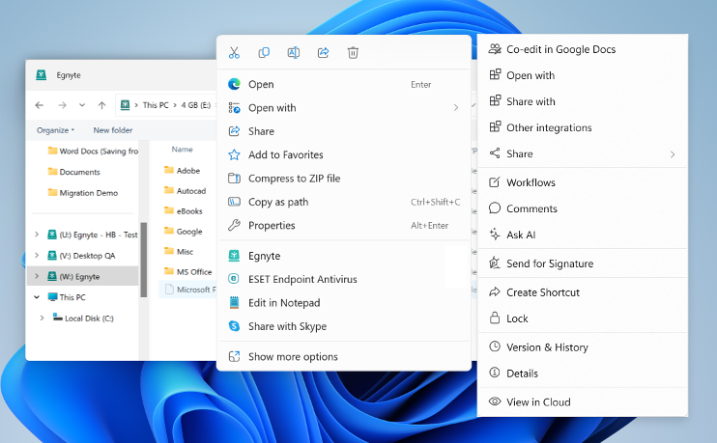
Windows 11 Context Menu Support
Problem Statement
Windows 11 moved the regular File Explorer context menu behind a "Show more options" menu and introduced a new context menu. Users cannot find the Egnyte context menu and this reduces engagement with richer functionality.
User Story
As a user I want the Egnyte context menu to be available on the top-level File Explorer context menu so that I interact with my Egnyte files directly from the desktop.
Feature Description
• Egnyte option will be exposed on the top-level File Explorer context menu
• Clicking the Egnyte option will open the Egnyte Actions "menu", providing access to a wide variety of file-level actions (link sharing, Ask AI, eSig, PDF editing, etc.)
View in Productboard
EGD-21555
Link to requirements

Slide 83
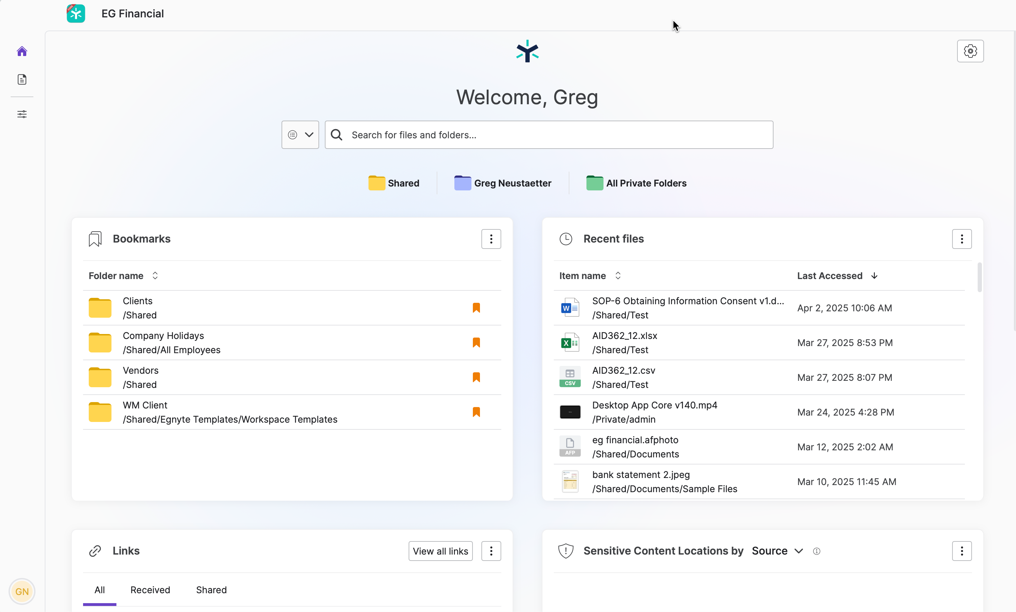
Application UI - Windows
Problem Statement
The majority of Egnyte users are Desktop Users but many new collaborative features are only available on the Web UI today. This can result in poor adoption and user experience challenges for end users.
User Story
As a desktop user, I want to access richer Egnyte functionality on the desktop, so that I don't need to open the Web UI to access them.
Feature Description
• First-class application for the Desktop App (as compared to current widget approach)
• Embed Web UI home page and search capability
View in Productboard
EGD-20540
Missing requirements

Slide 84
SCDA Win - Beta-2 Readiness
What is the problem?
Users in AEC and media work on massive and complex files. They face a challenge of working on these files directly from the cloud
How do we solve it?
We have introduced the Adaptive Streaming and Block Caching technology in Desktop App. The Beta-2 project goal is to enable up to 100 AEC domains with block cache and get feedback on the following applications:
1. AutoCAD
2. Civil 3D
3. Navis
4. Bluebeam
5. Acrobat
View in Productboard
No Jira Link
Missing requirements

Slide 85
SCDA Mac - Beta-0 Readiness
What is the problem?
Users in media work on massive and complex files. They face a challenge of working on these files directly from the cloud
How do we solve it?
We have introduced the Adaptive Streaming and Block Caching technology in Desktop App. The Beta-0 project goal is to enable up to 5 media domains with block cache and get feedback on the following applications:
1. Adobe Premiere Pro
2. Illustrator
3. Photoshop
4. InDesign
View in Productboard
No Jira Link
Missing requirements

Slide 86
Top Customer Requests

Slide 87
Content Safeguards - Group-based Link Sharing Controls - Phase 2
Currently, when applying a Content Safeguard policy, the policy will apply to all roles/groups and all users. Several customers are looking for more flexible CS policies where some roles/groups have different link sharing ability than other groups. We currently support exception policies for link expiry only. We need to expand our coverage to support the same as restriction policies
Example Use Case(s):
• Role/Group A can create password-only links on folder A, but Role/Group B is only allowed to create preview-only links on folder A
• Role/Group A & B can create password-only links for files with expiry date, but Role/Group C is only allowed to create password-only links for files without expiry links
Requirements
• Restriction Policy Requirements
• Exception Policy Requirements
• Policies can only be controlled for an entire domain or groups within a single domain
UX Design (Needs to be Updated):
https://www.figma.com/file/Xyhi03eWgv6tnwzq4RwcQA/CS--Role-based-Link-Sharing-Controls(UX-1899)?node-id=2%3A5079&t=wNGi4ZnNg81Ymlcp-0
Use the same UX design for CS Exception policies as we have for CS Restriction policies:
https://www.figma.com/file/x8gotwY1pLOoZERmnOiKI0/CS-~~-Role-based-Link-Sharing-Controls-~~-Q2-2023?node-id=1-5217&t=R6pDhEjG65kCZK9r-0#396444732
View in Productboard
DEL-31667
Missing requirements

Slide 88
Provide ability to pause archival/deletion policies
Problem Statement
IPG has a workflow where they create an archival policy, it moves files to a 'warm archive' location in the main domain and then Storage Sync moves the files in the 'warm archive' to a external location. However, they only have the archival policy active for a few weeks every quarter.
User Story
Their current process is to delete the policies and then complete recreate them. That is a lot of work and they have requested the ability to either pause or recreate/duplicate policies so they can easily 're-enable' the policies on their current schedule.
Feature Description
Based on discussion during refinement on 2/19, the concept of 'pausing' a policy seems to be the most straight forward.
• Frontend - provide pause/restart option for published policies
• Backend - use existing functionality to basically put the policy back into draft mode and unstamp the files that match the policy
View in Productboard
DEL-44353
Link to requirements

Slide 89
[Customer Ask] Inherit folder options to sub-folders (IPG, T&P + 7)
Problem
Today, when the folder options are changed, they do not get inherited consistently to the sub-folder tree.
• The setting that controls folder update notification gets inherited to sub-folders until it finds the folder with a manually updated option.
• The setting that controls the sharing gets inherited to sub-folders until it finds the folder with a manually updated option.
• The setting that controls who can delete/move the folder does not get inherited at all.
• Copy/move folder retains the folder options as per the source location.
User Story:
As an authorised user, I want to have folder options propagated throughout the folder tree so that I can have the same options selected on all the sub-folder trees.
DescriptionWe need to do the following
• We need to have inheritance applicable for the setting that controls who can delete/move the folder.
• When the user makes any change to the folder options - sharing control and/or move/delete control and/or folder update notification control - the system should evaluate if there are any manual overrides within the folder tree and if any provide the user with an option to choose whether to disregard manually overridden values.
• When the user copies/moves a folder, the folder options should get inherited from destination folder where the folder is copied/moved.
This has been already commited to Rajesh inhttps://egnyte.slack.com/archives/C08BHUJLGAU
View in Productboard
CFS-64734
Link to requirements

Slide 90
[Customer Ask] Group improvements (S&L, Norr)
Bucket for group-related enhancements. Requested by NORR (dealbreaker), Austin, Orangewood Foundation, CVC Capital Partners) :
Group improvements encompass:
• Allowing Group owners to see their groups in the list even when group listing is disabled
• Create a role PUs Group Ownership, without allowing them to create groups on their own
• Possibility to add a group description
• Enhanced group exporting and importing
View in Productboard
CFS-67268
Missing requirements

Slide 91
[Customer Ask] Scheduled report enhancements (Sequoia)
Bucket for scheduled report enhancements. Requested by Sequoia Capital, listed in top product gaps by Equity Services, Mississippi Dept of Revenue) :
Scheduled report improvements encompass:
• Auto-archival of scheduled reports
• Custom location of scheduled reports
• Saved and Scheduled queries for power users
•
View in Productboard
No Jira Link
Missing requirements

Slide 92
Purview labeling - Support for hierarchical labels
Problem Statement
Microsoft Purview labels can be configured with a hierarchy. Egnyte does not currently support importing hierarchical Purview-labels. This impacts customers who have already configured hierarchical labels. This hierarchy is typically configured by administrators in the Microsoft Purview
User Story
As a Security Administrator, I want to apply a Purview label from a hierarchy on a document so that I can label sensitive content correctly.
Feature Description
1. Import hierarchical labels from Purview
View in Productboard
DEL-44656
Missing requirements

Slide 93
Skip signed PDFs from persistent document labeling
Background:
Egnyte provides persistent document labeling and protection capabilities for sensitive documents. However, applying a persistent document label to a PDF that has already been signed involves certain considerations due to the nature of digital signatures and document protection mechanisms - in some signature types, for example with Adobe Digital ID signatures, it invalidates signatures that are already present on the PDF leading to customer frustration (because Egnyte invalidates signatures on an already signed PDF).
With Adobe Digital ID signatures, this signature invalidation issue is observed with Egnyte Document Labels but not with Purview labels (perhaps because the MIP SDK is able to recognize PDFs that already have an Adobe Digital ID signature).
Proposed solution:
The proposed solution shall be generic enough that:
• It can skip PDFs with any type of signature on it from being stamped with a persistent document label (our initial research shows that signed PDFs likely have an internal metadata property isSigned = TRUE; however, we will need to verify the existence of this property)
• This behavior is consistent across both persistent Egnyte Document Labels and persistent Purview Labels
Requirements:
• Add a UI tooltip in Document Labels to explain the limitations.
• Introduce a checkbox option to allow customers to choose whether to stamp signed PDFs with a persistent label, with the default setting kept at unchecked. Leaving it unchecked, will not update file metadata as well.
• Configure S&G label stamping to automatically skip signed PDFs from requesting for persistent labeling.
• Capture the reason for skipping the file in audit logs
Slack background 3/14/25:We have this long running PDF signature issue at S&L. After some exhaustive tests, my conclusion is that: # The S&L PDF signature issue occurs when an Egnyte Document Label is persistently applied on a PDF that is signed by the Adobe Digital ID method. For this particular combination, writing the persistent Egnyte Document Label to the PDF seems to invalidate Digital IDs on the file leading to the specific error shared with us.
1. @cbeydlerhelped run these tests independently and concurred with the above finding.
2. Note: Purview-labels don't exhibit this issue...perhaps because the MIP SDK is aware of Adobe's Digital ID signing method.
View in Productboard
DEL-43523
Missing requirements

Slide 94
Backup to S3 and Wasabi
What is the problem?
MSP and channel partners want to create a 2nd copy of Egnyte data on S3 or Wasabi storage. This is in order to meet their compliance needs.
How do we solve it?
Make External Replication available to MSP's and partners. Have a simplified UI workflow to enable replication
View in Productboard
No Jira Link
Missing requirements

Slide 95
Shore the Core

Slide 96
Unusual Access - Reduce false positives associated with Windows system activity
Currently, Microsoft doesn't provide enough information to determine whether a user or system action is causing the anomalous file access/download activity for Windows Explorer. This causes a lot of false-positive detections as well as many ESCs. We need to figure out how to better analyze and detect file activity for Windows Explorer to prevent this from occurring.
Requirements:
• Analyze file actions for Windows Explorer to help separate system actions (e.g. search indexing) from actual user access/download actions
• Can the amount of time accessed be used?
• Provide the ability to filter out the system events an only capture user generated events
• Only user generated events should be used for Unusual Access detections
No UX Design Required
View in Productboard
DEL-31632
Missing requirements

Slide 97
Inactive Container - Content Lifecycle support
Problem Statement
Expand the capabilities of Inactive Container based on customer feedback, including full lifecycle management (deletion from /Inactive) Users will be able to:
• Manage the full content lifecycle of files, both retaining files in Inactive and deleting them from Inactive
User Story
As a user, I want to be able to manage the full lifecycle of my data. With the introduction of the Inactive area, that means I need to be able to move data from primary storage to inactive and then manage the data within Inactive as well
Feature Description
Provide default and policy-based retention for files in Inactive
Provide on-demand and policy-based deletion for files in Inactive
Public Summary
As customers begin to expand their usage of Inactive Containers, they have identified the need to more fully manage the data within the Inactive area in a manner similar to how they manage it in the Shared and Private areas. To work toward providing parity in the different storage areas, we will provide the ability for customer to define both default and policy-based retention on the files within Inactive as well as utilize on-demand and policy-based deletion on Inactive files.
View in Productboard
DEL-34289
Link to requirements

Slide 98
Issues - New Issue Categories
https://egnyte.atlassian.net/wiki/spaces/DEL/pages/1065386630/Issues+-+Risk+vs+Data+Access+Hygiene
View in Productboard
DEL-42493
Missing requirements

Slide 99
S&G Folder Insights in CFS - Phase 2
Problem StatementAfter providing visibility into the basic Content Lifecycle analytics we want to expand what S&G information we show users in CFS
User Story
As a user, I want to be able to access information about my files without needing to navigate to Secure & Govern
Feature Description:
• Create S&G Insight badge component placed in a Status column of the files list on the folder level
• Badge should show the number of S&G Insights for given folder
Public Summary
The folder insights feature has proven to be a valuable feature to Egnyte customers, with over 30% of eligible domains utilizing the feature in the first 2 months after release, without any type of promotion at all. We want to further increase the value of this feature by both expanding the information it presents and also displaying notifications to users when certain data thresholds are crossed
View in Productboard
DEL-41981
Missing requirements

Slide 100
Delegate Issue to Data Owner
Overview
Customers that heavily use Data Owners want the ability to a delegate an Issue to a Data Owner from the Issues view or automatically via Auto-Remediation rules.
Customers:IPG, Sequoia
Requirements
See linked Epic in Jira
View in Productboard
DEL-44433
Missing requirements

Slide 101
Enable Power Users Folder Full access to Folders they Create
In order for a power user to have S&G visibility, the power user must have Folder Full access to the individual folders to see issues and sensitive content in their S&G instance.
This feature would delegate Folder Full access to power users for any sub-folder(s) that they create where they have Folder Editor permissions in the parent folder. This would mitigate having the Egnyte Admin user needing to do it on-demand at-request by the Power User and this also empowers the Power User from a CFS perspective to be able to have folder full access to the folders and content that they are creating and populating and as such the ability to delete any unintentionally created files in the folder that they currently only have Folder Editor privileges to.
This feature would result in the following capabilities:
1. Configuration to enable Folder Full access to Folder Editors for folder editor-created folders
In Settings, Configuration - User Types & Roles - under Power User - the following configuration should be enabled -
Configuration (bolded valuesaredefault):
Option A: DelegatedFolder Full rolewhen creating a new folder – Enabled(True,False**)**
Option B: Delegated role when creating a new folder – Picklist: (Folder Full, Folder Owner, None)
2. When the Value is True or Folder Full (depending on Option A or B) for this feature in Settings/Configuration/User Types&Roles/Power User - then any new folder created by a Folder Editor will result in the permission promotion/escalation of the newly created folder for the folder editor who created the folder to Folder Full.
3. This value will be default set to True or Folder Full (depending on Option A or B) for all domains upon release, as there should be minimal impact to existing workflows since the feature upon release will only impact newly created folders and not existing folders.
View in Productboard
CFS-63434
Missing requirements

Slide 102
Purview labeling - Reclassify files stamped with an encryption label
Problem Statement
Microsoft Purview labels that also apply encryption have a unique challenge in that after S&G stamps a file with a Purview encryption label that file becomes encrypted can can no longer be reclassified even when the file's content changes.
User Story
As a Security Administrator, I want to continuously scan and classify a file based on its contents even when the file has a Purview encrypted label.
Feature Description
Egnyte should scan the files in CFS which are stamped with MSIP encryption / enforcement labels.
1) Identify MSIP Enforcement / Encryption label applied files in CFS
2) Remove Stamp / Decrypt the enforcement of the Labels
3) Execute Content Classification policies on the files from #2
4) Apply Sensitivity labels based on the content classification policies.
View in Productboard
DEL-42147
Missing requirements

Slide 103
CMMC Compliance

Slide 104
*.egnytegov.com domains support for SS devices
Currently SS devices does not take *.egnytegov.com as domains as its hardcoded to *.egnyte.com domains only.
There is strong business need to support fedRAMP supported domains as more customers are opting for it and SS is the only device which is currently supported on public cloud from hybrid appliances.
View in Productboard
TRB-8299
Missing requirements

Slide 105
Trust Center for CMMC Level 1
Problem Statement
CMMC Level 1 is a key compliance mandate for DoD contractors and sub-contractors. Proving CMMC Level 1 compliance ensures that DoD contractors and sub-contractors can participate in DoD RFPs. Compliance Managers are required to collect evidence (or artifacts) for all CMMC Level 1 controls. This is a time and resource intensive effort often leading to human errors, guess work, and rework. Compliance Managers greatly benefit if they had a mechanism to collect such evidence automatically and on a recurring schedule (to prove continuous compliance).
User Story
As a Compliance Manager, I want to collect evidence for CMMC Level 1 controls, so that I can be CMMC audit-ready.
Feature Description
This feature includes:
• Content pack for CMMC Level 1 (Control Number, Control Family, and Control Text)
• Mapping CMMC Level 1 controls to Egnyte capabilities
• Collecting evidence for CMMC Level 1 controls
• Integration into Trust Center landing page
View in Productboard
DEL-43244
Missing requirements

Slide 106
Trust Center for CMMC Level 2
Problem Statement
CMMC Level 2 is a key compliance mandate for DoD contractors and sub-contractors. Proving CMMC Level 2 compliance ensures that DoD contractors and sub-contractors can participate in DoD RFPs. Compliance Managers are required to collect evidence (or artifacts) for all CMMC Level 2 controls. This is a time and resource intensive effort often leading to human errors, guess work, and rework. Compliance Managers greatly benefit if they had a mechanism to collect such evidence automatically and on a recurring schedule (to prove continuous compliance).
User Story
As a Compliance Manager, I want to collect evidence for CMMC Level 2 controls, so that I can be CMMC audit-ready.
Feature Description
This feature includes:
• Content pack for CMMC Level 2 (Control Number, Control Family, and Control Text)
• Mapping CMMC Level 2 controls to Egnyte capabilities
• Collecting evidence for CMMC Level 2 controls
• Integration into Trust Center landing page
View in Productboard
DEL-44555
Missing requirements

Slide 107
egnytegov Support for Smart Cache
What is the problem?
CMMC customers want to deploy Smart Cache in an egnytegov.com domain
How do we solve it?
We need to ensure Smart Cache can register with a *.egnytegov.com domain and is on par in terms of functionality and performance with a Smart Cache on egnyte.com domain
View in Productboard
No Jira Link
Missing requirements

Slide 108
Introduce Gen 4 Plans

Slide 109
Gen 4 Launch - Trial Registration Pages
Placeholder to aggregate tickets related to updates to trial registration pages for Gen 4 plans.
See tickets for additional information.
View in Productboard
APPS-12215
Missing requirements

Slide 110
NGP Upsell from G3 and Prior
The description is empty.
View in Productboard
GR-562
Missing requirements

Slide 111
[PLG] NGP Trial Onboarding Integrations Enablement (Milestone 2.5)
See [https://egnyte.atlassian.net/wiki/x/BgBEV]
• As part of the Onboarding experience, we want to automatically enable all relevant Integrations in the Egnyte App Store, based on the industry specified.
• We also want to add a question to the Admin Survey to determine what type of productivity tools they use. We will automatically enable the appropriate integration (Google, MS)
• And finally we want to enable both Slack and Teams integrations.
• Starting with the 5 industries called out in the App Store, we want to include these integrations if users select any of the following:
PINT team has completed an API for the App Store that will be used for this initiative.[https://egnyte.atlassian.net/wiki/spaces/PINT/pages/1166082078/App+Store+Configuration+API+for+Egnyte+Platform]
PINT-15980
View in Productboard
GR-591
Missing requirements

Slide 112
[PLG] NGP Trial Onboarding Refinements (Milestone 3)
Encompasses everything in Milestone 3
Also includes further expansion of AI and S&G Onboarding Tasks.
Please see the Jira Epic.
View in Productboard
CFS-66581
Missing requirements

Slide 113
[Usability] NGP UI Refresh (Phase 1)
This project involves introducing UI+visual design changes to the platform (all apps) towards distinguishing Next Gen 4 Plans from the previous ones. These changes are deemed necessary to coincide with the release of NGP4, hence the high priority.
Details can be found attached to this Epic -https://jira.egnyte-it.com/browse/UX-3393
Phase 1 includes:
• Comprehensive styling, content, and UI updates to the top/header bar (CFS)
• Updates to the main (left) navigation styling (CFS)
• Introducing brand-new styling to menu buttons (CFS)
• Comprehensive overhaul of the right-drawer menu bar, including brand-new colored icons (CFS)
View in Productboard
CFS-65726
Link to requirements

Slide 114
[Usability] NGP UI Refresh (Phase 2)
This project involves introducing UI+visual design changes to the platform (all apps) towards distinguishing Next Gen 4 Plans from the previous ones. These changes are deemed necessary to coincide with the release of NGP4, hence the high priority.
Details can be found attached to this Epic -https://jira.egnyte-it.com/browse/UX-3393
Phase 2 includes:
• Comprehensive styling, content, and UI updates to the top/header bar (S&G)
• Updates to the main (left) navigation styling (S&G)
• Introducing brand-new styling to menu buttons (S&G)
• Introducing the right-drawer side panel to the UI in S&G. This is also needed for delivering contextual AI + Recommendation Engine capabilities in S&G.
View in Productboard
CFS-67266
Link to requirements

Slide 115
NGP UI Refresh S&G
The description is empty.
View in Productboard
DEL-44118
Missing requirements

Slide 116
Document Portal Enhancements

Slide 117
Optional documents
Problem Statement
There is no way to mark the document optional within the template. To complete the request, an uploader must add all the documents from the template.
User Story
As an Egnyte Domain Administrator or a power user with an assigned role, I would like to mark a specific document optional within the template So that the uploaders can complete the upload request even if that document is skipped
Feature Description
• Allow users to mark a document as optional as part of the template.
• The optional document can be skipped by an uploader and all the actions should be recorded in the audit report.
View in Productboard
CFS-67185
Missing requirements

Slide 118
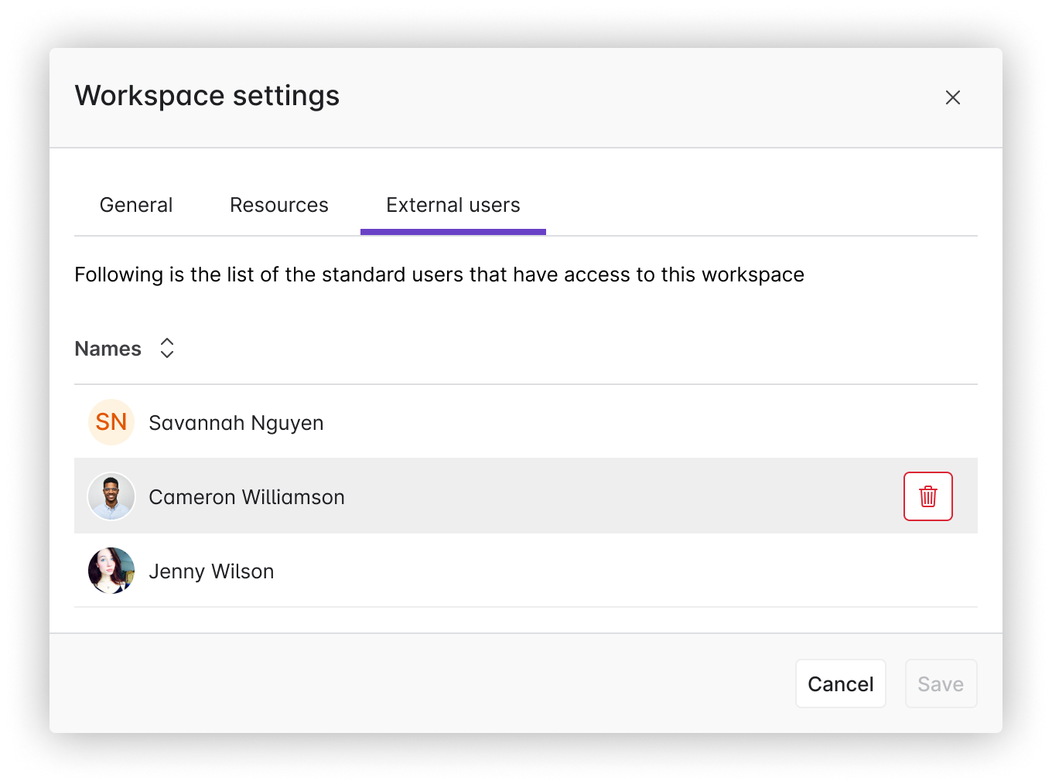
External User Management
Problem Statement
Once a Standard User is added to a workspace there is no way to remove them and they are no longer able to access Collaborate
User Story
As a user, I want to be able to remove Standard Users from a workspace, so that they can access Collaborate
Feature Description
• Provide external user management screen in Workspace Settings that shows external users and allows you to remove them
• If a Standard User is removed from a workspace they should be able to access Collaborate (unless they are associated with other Workspaces)
View in Productboard
No Jira Link
Link to requirements

Slide 119
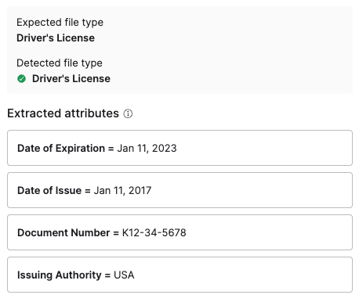
Upload request metadata extraction
Problem Statement
External users add document via upload requests, often as photos of documents, and then our customers need to review those documents and often pull out key fields and enter them into other systems. This can be challenging and time consuming.
User Story
As a user reviewing documents from an upload request, I want the system to extract key fields from documents so that I can pull that information out of Egnyte easily.
Feature Description
• Automatically extract key fields from documents submitted via an upload request
• Keep data encrypted at rest as it may be sensitive
View in Productboard
No Jira Link
Missing requirements

Slide 120
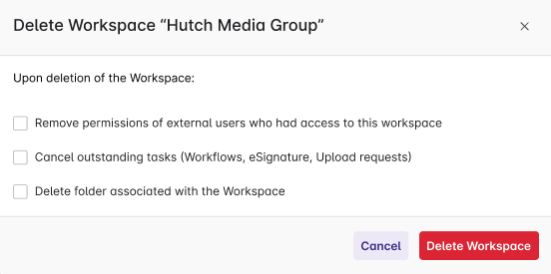
Deleting a Workspace
Problem Statement
Customers create workspaces and then realize that either they chose the wrong folder or don't want the folder to be treated as a workspace. Today there is only a way to deactivate the workspace, but not remove it.
User Story
As a user I want to delete a workspace so that the folder is treated as a normal folder in Collaborate
Feature Description
• Add new action to workspace settings to delete the workspace
• Provide options to delete the folder and to remove external access
View in Productboard
CFS-63196
Link to requirements

Slide 121
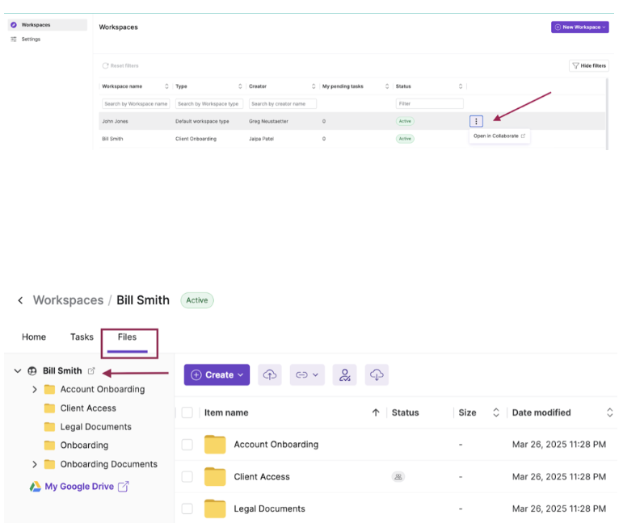
Open Workspace folder in Collaborate
Problem Statement
Users cannot easily find or navigate to collaborate folder associated with a Workspace.
User Story
As as internal user I want to quickly navigate to Collaborate folder from a Workspace I am working on so that I can interact within Collaborate easily.
Feature Description
Users will be given an option to navigate to Collaborate folder from a Workspace.
View in Productboard
CFS-66567
Missing requirements

Slide 122
Build Pax8 Distributor Program

Slide 123
Distribution model - new type of resellers
Problem Statement
Egnyte is starting cooperation with Pax8 who owns a marketplace for MSPs offering multiple products from a variety of vendors. To support this integration, internal and customer facing applications need to be adjusted.
User Story
As an Egnyte staff user I want to manage a Pax8 MSP so that Egnyte can sell products through a Distributor.
Feature Description
• Distinguish MSP partners as managed by Pax8 Distributor
• Allow Egnyte internal staff users to manage such MSPs in the Reseller dashboard
• Simplify onboarding and approval process (plan category, Pax8 planset, no CC required)
• Exclude such partners from financial processes (payments, invoicing)
• Adjust existing MSP Reseller dashboard for such partners allowing them only to:
View in Productboard
APPS-12865
Link to requirements

Slide 124
Productivity Agents

Slide 125
AI Prompt workflow step
Execute a customer-provided Gen AI prompt against the document in the workflow and use the results to either populate metadata, workflow comments, or doc comments.
View in Productboard
CFS-66199
Missing requirements

Slide 126
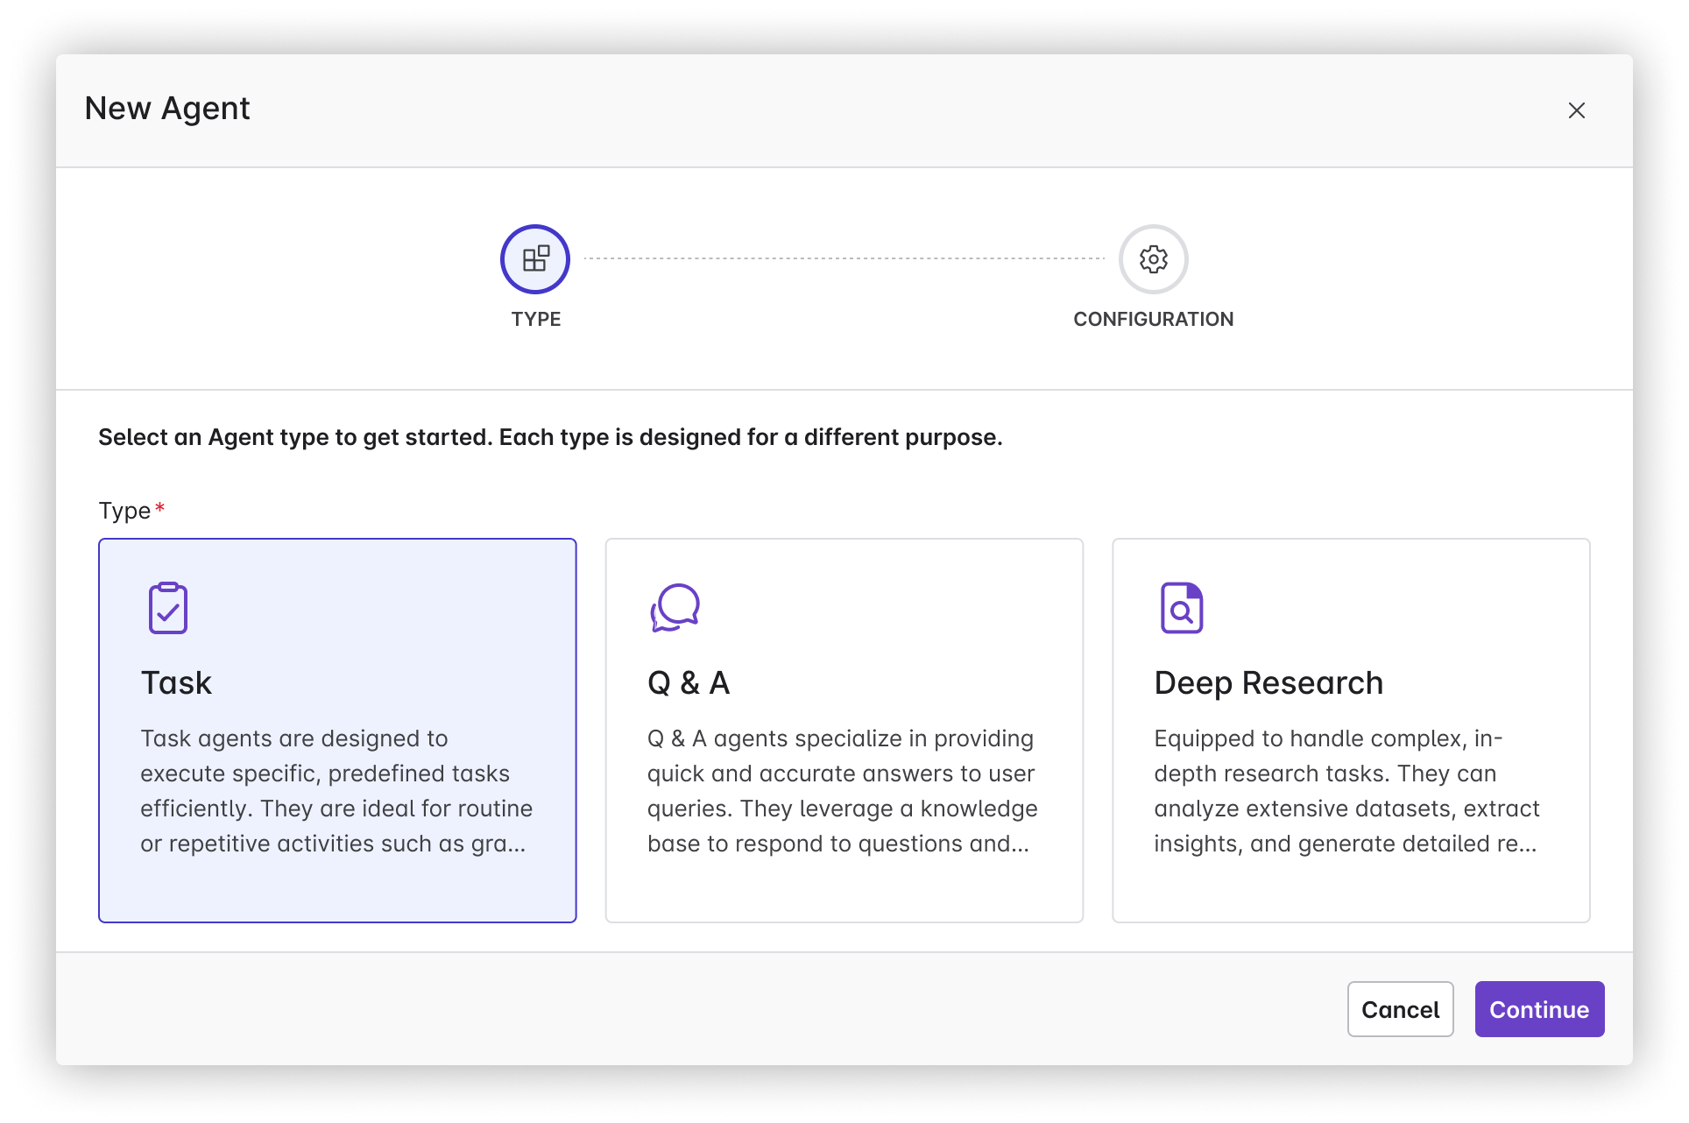
[Agent] Deep Research Agent (Bryce)
Problem Statement
Businesses and researchers often struggle with the time-consuming task of conducting in-depth analysis and research, such as finding historical data or identifying trends from previous projects. This lack of efficiency can delay decision-making processes, harming productivity.
User Story
As a business analyst, I want a Deep Research Agent that can quickly identify similar proposals and investments by analyzing historical data, so that I can accelerate the research process and make more informed decisions based on past trends.
Value Statement
Introducing the Deep Research Agent provides:
• Time Savings: Automates the labor-intensive process of sifting through historical data, drastically reducing the time spent on research from months to mere days or hours.
• Increased Productivity: Allows employees to focus on higher-value tasks by automating repetitive research activities.
• Cost Efficiency: Reduces the need for extensive manual labor, resulting in lower operational costs associated with research and analysis.
• Data Utilization: Maximizes the value derived from existing historical data, ensuring that past learnings are effectively utilized in future projects.
Confluence doc:
https://egnyte.atlassian.net/wiki/x/AQBaV
Use-cases to address: Find Similar Investments, Find Similar Proposals
View in Productboard
CFS-67394
Missing requirements

Slide 127
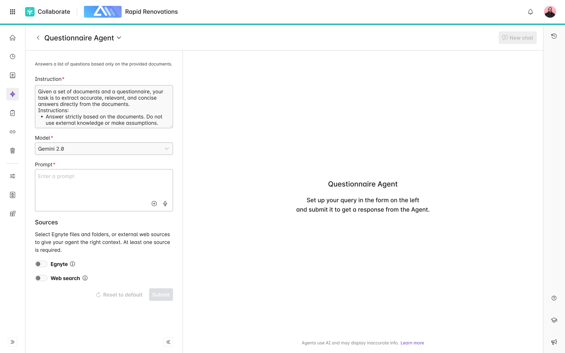
[Agent] Questionnaire Agent (Bryce)
Problem Statement
Users frequently receive lists of questions from clients regarding products, services, and compliances, which require significant time and effort to answer. Often, these questions have already been answered in previous requests or can be found in existing documents. The repetitive nature of this task hinders productivity and wastes valuable time.
User Story
As a user, I want to submit a list of questions (text, excel, pdf, doc) to a Questionnaire Agent and point it to a collection of documents in Egnyte (files or folders) that contain the answers. I expect the Q&A response (text or a document) to be ready for my review, with unanswered questions highlighted for easy review and completion. I should be able to submit the response on Egnyte and further edit it as needed.
Value Statement
• Time Efficiency: Automates the process of finding answers to repetitive questions, significantly reducing the time spent on each information request.
• Enhanced Productivity: Allows users to focus on higher-value tasks by freeing them from the repetitive chore of answering similar questions.
• Improved Accuracy: Ensures consistent and accurate answers by pulling information from established and vetted documents.
• Easy Review and Editing: Identifies unanswered questions for quick review, and allows for easy submission and editing in Egnyte, ensuring thorough and tailored responses.
• Resource Optimization: Maximizes utilization of existing documentation, reducing the need to recreate responses and minimizing redundancy.
Seeding the Questionnaire Agent template will make it easier for users to adopt, ensuring they can start experiencing these benefits immediately upon implementation.
Confluence page:
https://egnyte.atlassian.net/wiki/spaces/CFS/pages/1471152191/Questionnaire+Agent?force_transition=e7e56be6-04a5-4088-bb89-a71bc2d9bb13
More context in slack channels: #ddq-agent
View in Productboard
CFS-67393
Missing requirements

Slide 128
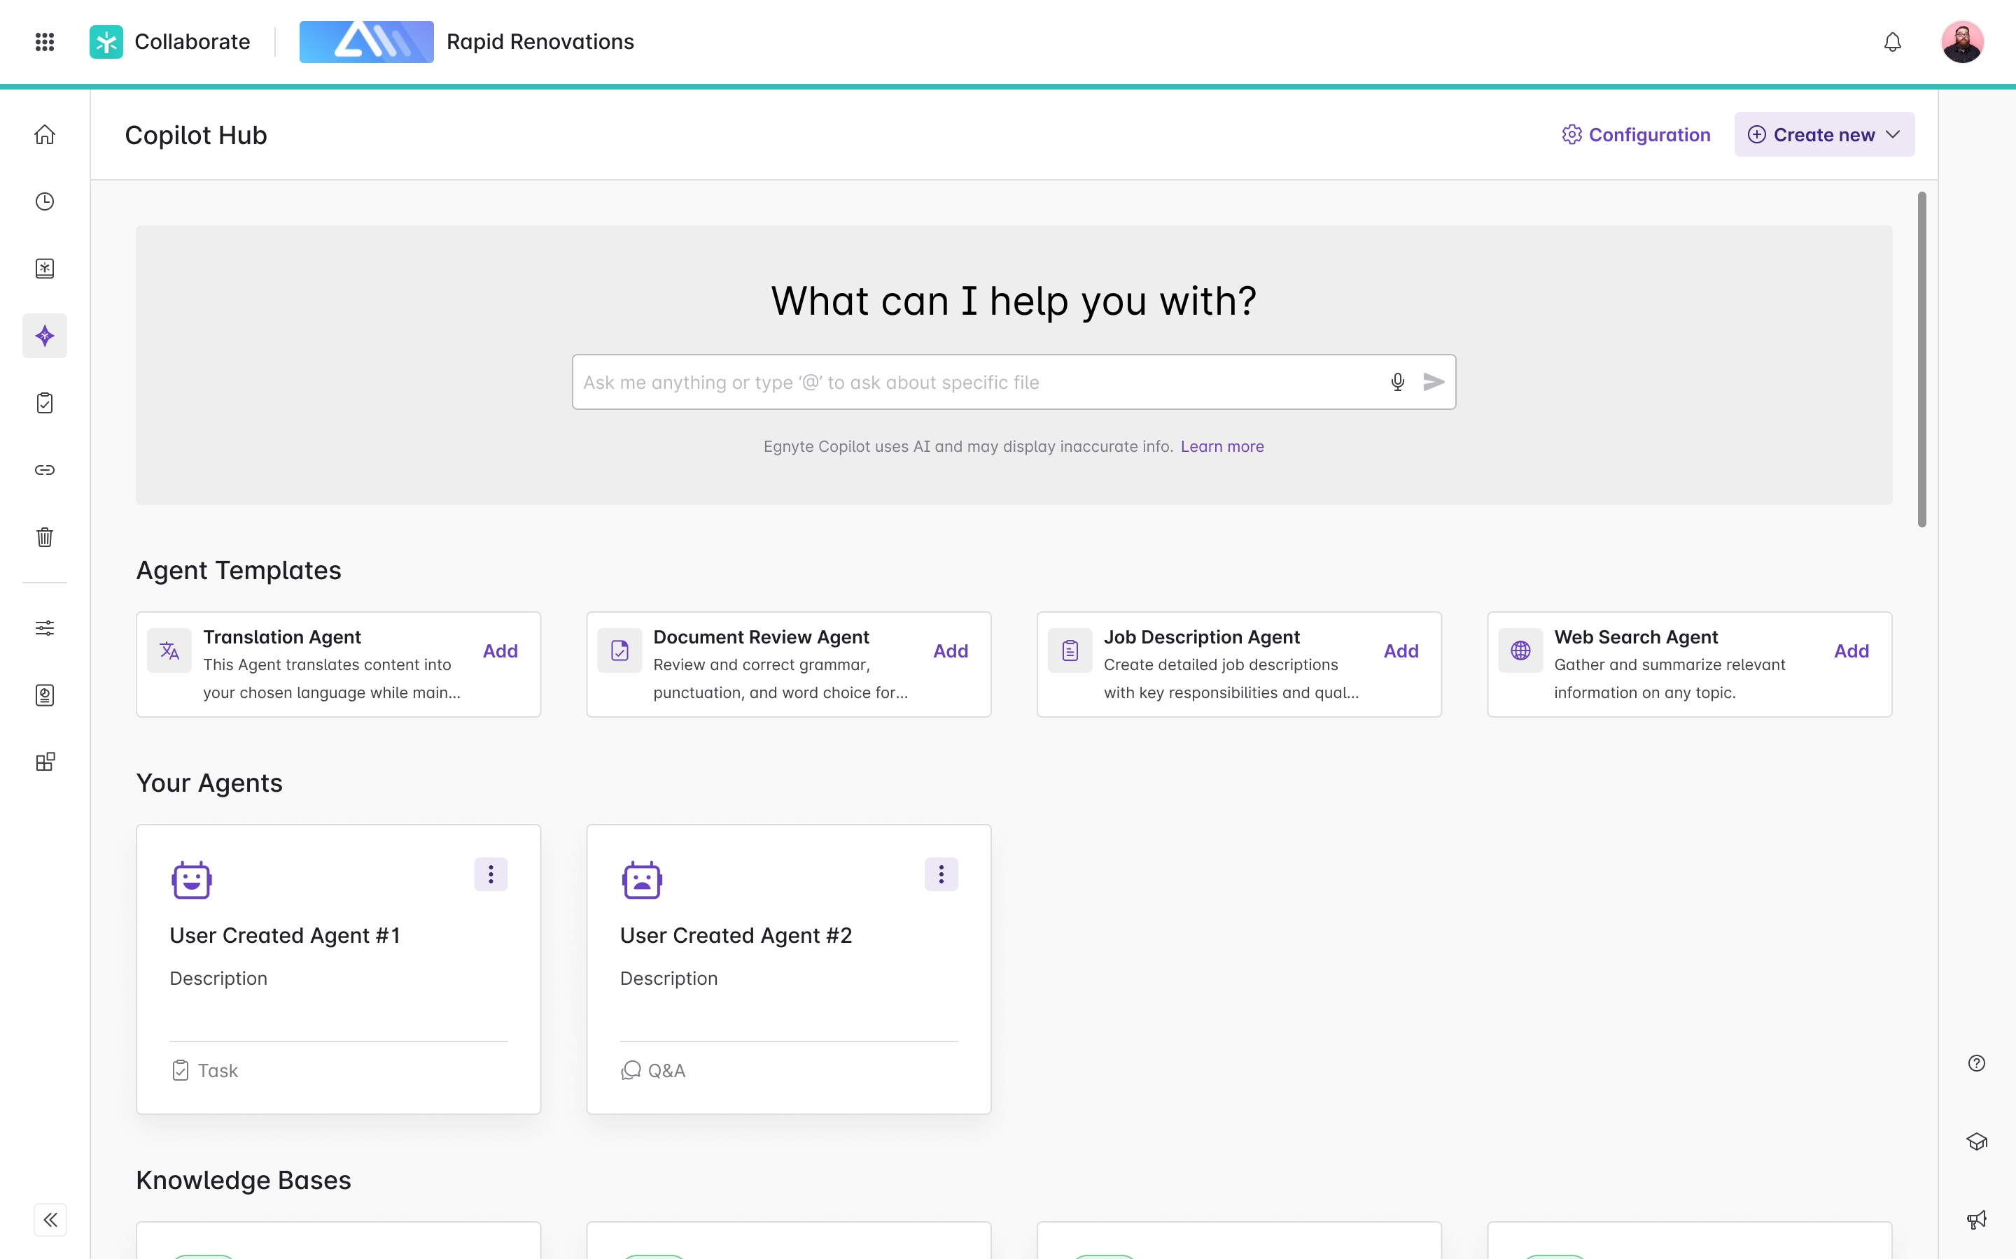
[Agent] Agent Templates in Copilot hub
Problem Statement
New users often face challenges when adopting AI agents due to lack of familiarity and difficulty in configuring them to meet specific needs. This initial barrier can slow down the adoption process, reducing the potential benefits of task automation.
User Story
As a new user of the AI Agents platform, I want pre-configured agent templates available at the start, so that I can quickly set up and begin using these tools without needing extensive customization, thereby experiencing the benefits of automation sooner.
Value Added
• Faster Onboarding: New users can quickly get started with minimal setup time, which reduces the learning curve and speeds up adoption.
• Ease of Use: Pre-configured templates simplify the initial experience, making it less intimidating for users who are not tech-savvy.
• Immediate ROI: Users can achieve immediate productivity gains from automation, showcasing the value of AI agents promptly.
• Flexibility: While templates provide a good starting point, they can be customized later as users become more comfortable with the platform.
• Increased User Satisfaction: Easy access to ready-made solutions enhances user experience and satisfaction, encouraging continued use and exploration of more advanced functionalities.
Agent Template examples:
• Translation Agent:
• Document Review Agent:
• Job Description Creation Agent:
• Web Search Agent:
Original:
https://egnyte.atlassian.net/wiki/spaces/CFS/pages/1227161693/Agents+Introduction+in+Copilot+Hub
Figma:
https://www.figma.com/design/k96o3kXukaVrAUtsaPhN4H/Egnyte-Platform-Copilot---2025?node-id=24179-230269&t=Rc2JPK6PsbVBlXNe-0
Design:
https://egnyte.atlassian.net/wiki/spaces/CFS/pages/1304788999/Agents+Integration
Feature flags:
*server.SmartAppAgentsPowerUserAccessEnabled*
*server.SmartAppAgentsEnabled*
View in Productboard
CFS-65268
Link to requirements

Slide 129
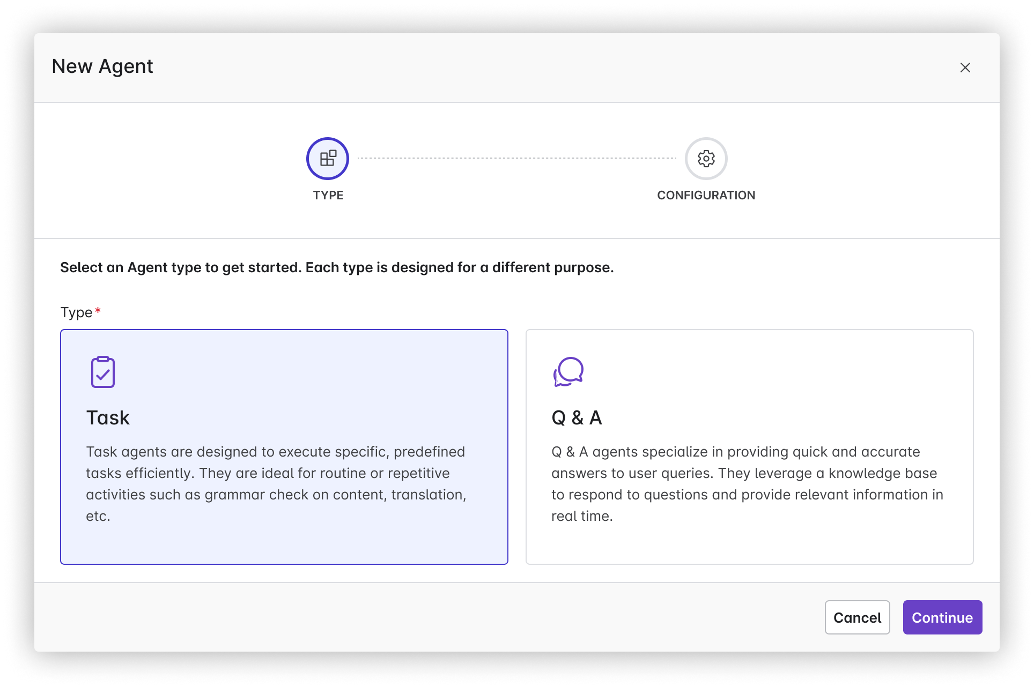
[Agent] Custom Agents in Copilot hub
Problem Statement:
Many businesses are burdened by time-consuming and repetitive tasks that reduce overall productivity and employee engagement. This inefficiency prevents employees from focusing on higher-value work that could contribute more significantly to the company's growth and success.
User story:
As a business owner, I want AI agents to automate repetitive and time-consuming tasks so that my employees can focus on strategic and creative efforts that drive the business forward.
Value Statement:
• 24/7 operational capability, ensuring tasks are completed even outside regular business hours.
• Increased productivity as employees can refocus their time on more valuable activities.
Confluence Pagehttps://egnyte.atlassian.net/wiki/spaces/CFS/pages/1227161693/Agents+Introduction+in+Egnyte+Platform+WIP#Create-your-own-Agent
Figma Link
Embedded content
View in Productboard
No Jira Link
Missing requirements

Slide 130
AI: Security Agent - Suggestions based on internal data
AI security agent would enable agents to suggest actions to users pre-emptively based on several historic insights obtained across Issues, SC, Permissions>
Role of the agent to be specific:The idea is to provide suggestions on specific S&G actions based on internal data analysis, like:
• Creation of Polices -> Content Safeguard Policies, Content Life Cycle Polices, Classification Policies
• Specific Remediation Actions -> Bulk Remediate, Auto Remediation Actions
• Report Creation -> Creation of User / Audit Reports
• Other S&G Actions - TBD
perform the action via calling respective tools / API's.
View in Productboard
DLAB-5054
Missing requirements

Slide 131
Specialized Agents - AEC

Slide 132
Smart Specifications - In Product Version
Problem:
Construction specifications are extremely long, detailed and complex PDF's accessed by different user-roles such as Project Managers, Estimators, VDC and more. Users find it challenging to locate and extract relevant information from the Specs.
User Stories:
1. As a Project Manager / Estimator / VDC team member, I want to open the Smart Spec preview when selecting my specification files, so that I can quickly find the section I’m looking for
2. As a PM / Estimator / VDC, I want to ask a natural language query about my specification, so that I can quickly find the information I am looking for.
Description:
Egnyte's AEC doc-classification will automatically identify and tag Specs within a project. When a user clicks on the tagged specification in WebUI, the Smart Specs will automatically load in the preview pane. The user will see all the sections within the Spec on the left panel. When they click on a specific section in the left panel, the center panel will open that specific section. On the right panel, they can ask natural language queries on the spec.
Requirements:https://egnyte.atlassian.net/wiki/spaces/AEC/pages/446464310/Smart+Specification+Requirements
Figma
https://www.figma.com/design/pSP6gVOM1NB1dORHzVw1k5/AEC-Trial-Onboarding?node-id=7-17521&node-type=frame&t=2GCW5Ubc2U9ardCl-0
JIRA:https://jira.egnyte-it.com/browse/CFS-60040
FEATURE FLAG:features.server.SmartSpecFeatureEnabled
View in Productboard
CFS-60040
Link to requirements

Slide 133
[Agent] Codebooks Agent for AEC
Problem:
Users in the AEC industry require to follow regulations and standards during the design / construction / maintenance of structures and these are stipulated as building codes. These building codes are extremely long, detailed and complex, can vary by local jurisdictions and can change from year to year. Due to these factors, users often face the challenge of finding the right code information pertaining to a project, and using that information to validate project specifications, submittals and other project docs.
Use-Cases:
1. As a project engineer / field engineer, I want to easily get answers to regulatory questions, such as
2. As a project coordinator, I want to easily validate a spec against regulations/codes
Description:
We will create a specialized agent, the code books agent, which the admin can configure to read one or more code books at a specific location on their Egnyte domain. Once configured, users can ask questions against the code book agent from the WebUI or desktop
Requirements:https://egnyte.atlassian.net/wiki/spaces/AEC/pages/1076199541/KB+for+Building+Codes
JIRA:
https://jira.egnyte-it.com/browse/CFS-64858
View in Productboard
CFS-64858
Link to requirements

Slide 134
Co-Editing Enhancements

Slide 135
[Usability] WebUI Context Menu Redesign
1. The entire menu must be aligned with the way sidebars work
2. The available options must be aligned with options available on the top bar and mini preview
View in Productboard
No Jira Link
Link to requirements

Slide 136
[Usability] Disable File Actions During Co-Edit Session
1. Disabling Rename, Move and Delete action with a proper tooltip when Co-editing session is in progress.
View in Productboard
No Jira Link
Link to requirements

Slide 137
Product-Led Growth

Slide 138
Recommendation Engine Test Campaigns
Continue testing the Recommender against Pendo in a series of campaigns.
View in Productboard
GR-578
Missing requirements

