Slide 1
Uncategorized

Slide 2
Migrate Data from Box to Egnyte - GA
Migrate data from Box to Egnyte using our Content Lifecycle product.
Define what GA means for this product. Must be available to some or all customers to self-serve.
View in Productboard
No Jira Link
Missing requirements

Slide 3
Migrate Data from Dropbox to Egnyte - GA
Migrate data from Dropbox to Egnyte using our Content Lifecycle product. Define what GA means for this product. Must be available to some or all customers to self-serve.
View in Productboard
No Jira Link
Missing requirements

Slide 4
Big File Handling
Prospect says that the 5gb file limit on our Procore integration is a blocker. We want to look into seeing if this is possible and how much work would it be. They are transferring files that are 10 GB already out of Procore. We would need to split files and upload in chunk's as per Procore's API.
Ticket:https://jira.egnyte-it.com/browse/PINT-14789
View in Productboard
No Jira Link
Missing requirements

Slide 5
Ransomware Unification - Replace Ransomware signature source with reputable threat intel source
Confluence page:https://egnyte.atlassian.net/wiki/spaces/DEL/pages/1425834012/Ransomware+Unification+-+Replace+Ransomware+signature+source+with+reputable+threat+intel+source
View in Productboard
DEL-44545
Missing requirements

Slide 6
Migrate Date from Egnyte to Egnyte (D2D) - GA
Migrate data from one Egnyte domain to another (D2D) using our Content Lifecycle product. Define what GA means for this product. Must be available to some or all customers to self-serve.
View in Productboard
No Jira Link
Missing requirements

Slide 7
Remove or reduce size od Egnyte banner
https://jira.egnyte-it.com/browse/PINT-13022
As a Egnyte user I have ability to disable the "powered by Egnyte" banner in the Outlook add-in when creating share links
View in Productboard
PINT-13022
Missing requirements

Slide 8
[Outlook] Send multiple files in one email
https://jira.egnyte-it.com/browse/PINT-13023
As Egnyte use I can select multiple files at a time for sharing with Outlook integration
View in Productboard
PINT-13023
Missing requirements

Slide 9
set preference to always send attachements with Egnyte
The description is empty.
View in Productboard
No Jira Link
Missing requirements

Slide 10
APIs for Initiating and Managing Cloud Migrations
Need to offer APIs to initiate and manage migrations
View in Productboard
DEL-41756
Missing requirements

Slide 11
Cloud Migration Sources
The description is empty.
View in Productboard
No Jira Link
Missing requirements

Slide 12
GA for Cloud Migration
The description is empty.
View in Productboard
No Jira Link
Missing requirements

Slide 13
E2E Connector - Bidirectional Sync
The description is empty.
View in Productboard
No Jira Link
Missing requirements

Slide 14
SS on Azure Gov public cloud (FedRAMP certified)
There is requirement from customers especiallyNetCov( an high profile MSP ) to support SS on Azure Gov public cloud due to high compute and performance requirement from their applications.
View in Productboard
No Jira Link
Missing requirements

Slide 15
Domain without a Trial
Background and Strategic Fit:
Setting an account without the need to go through a trial can be used for multiple reasons:
• Creating a domain for a customer that signed a contract and did not go through a trial. Sales had direct discussions with a prospects including demos, so when a contract is signed there is no need for a "trial", they are ready to start working
• If on invoice - mark as invoice
• If on CC - ask for CC details
• Send the user a "special email invite" (e.g. congratulations for choosing Egnyte...)
• Use special design (Lisa Raid)
• Send the user a link to collect the credentials of the first user (Who is this sent to, the business person or the technical person)
• Leverage the mechanism from https://jira.egnyte-it.com/browse/APPS-8320
• Skip the admin survey or any lead creation in SFDC
• Ask the user for the domain name, create it and mark it as "paid", make that first user the first admin of the domain
• Validate domain is not used
• Validate user email
Goals:
• Simple for user
• No need to create a trial first
• Elevated experience ("White glove" feel to it)
Proposed Solution:The proposed flow is here [https://lucid.app/lucidchart/0c321564-165e-4fe4-be8b-b4c47f7bc3ef/edit?invitationId=inv_945897cc-e8cc-4620-9d03-403060f6442d&page=0_0#|#]]
• Get indication from SFDC that the account is paid
• Get from SFDC the parameters of the user we will be sending this to
• Use elements from https://jira.egnyte-it.com/browse/APPS-8320 in order to create the domain
View in Productboard
APPS-10412
Missing requirements

Slide 16
SC Indication - link to SC view for non-admins
In order to facilitate users moving from CFS to S&G to remediate sensitive content, we should provide them a link that will take them to the SC view with the associated location.
Will require some entitlement changes in S&G
https://egnyte.atlassian.net/wiki/spaces/PM/pages/658374842/SC+Visibility+Phase+2+-+user+actions+workflows
View in Productboard
DEL-38580
Missing requirements

Slide 17
Analysis and Modification of Recommendation Engine Test Results
The description is empty.
View in Productboard
GR-603
Missing requirements

Slide 18
Augment AEC Add-on Value

Slide 19
[AEC] Project Center
Problem
Many SaaS products including Project management systems, ERPs, and Egnyte all have their own concepts of “projects”. This is because the concept of a project is familiar to AEC end users. Projects are how they these end users not only organize their data, but their employees, their financials, and more.
Description
By supporting a familiar type of data structure, these SaaS products enable IT admins and end users to organize and view their data in a way that they are accustomed to.
In Egnyte specifically, project folders provide value to end users in a few different ways:
• Project folders provide a clear distinction between project and non-project data. This is critical for a number of reasons including properly managing the content lifecycle of this data.
• Project folders include specific metadata that isn’t available on “normal” folders - Metadata that is searchable such as “Client”, or “Address”, makes it easier for end users to locate the information that they need.
• Additional capabilities - Egnyte includes many features built on top of project folders including Smart upload, the project dashboard, and more. These features are all built to support specific workflows within a project, but without marking a folder as a project folder in Egnyte, these features are inaccessible.
View in Productboard
CFS-52807
Link to requirements

Slide 20
LS Mid Market Capabilities

Slide 21
Drafts Creation & Management
Problem Statement
1 - 2 sentences describing the problem we are trying to solve
User Story
Format: As a [user role], I want [goal], so that [benefit]. 1-2 sentences
Feature Description
• High-level requirements
• No need for detailed acceptance criteria
• Three bullets max
View in Productboard
LS-4151
Missing requirements

Slide 22
Permissions Management

Slide 23
Data Owner - Scheduled Permission Reviews
Admins and Data Owners need the ability to schedule periodic (monthly, quarterly, yearly) permission reviews. The following requirements need to be completed
Scheduled Permission Review Requirements:
• Approach 2 - Scheduled Reviews from Permissions Tab and SC Tab
View in Productboard
DEL-22618
Link to requirements

Slide 24
Elevate Desktop App Capabilities

Slide 25
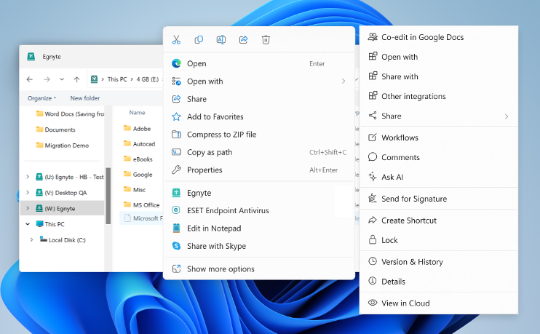
Windows 11 Context Menu Support
Problem Statement
Windows 11 moved the regular File Explorer context menu behind a "Show more options" menu and introduced a new context menu. Users cannot find the Egnyte context menu and this reduces engagement with richer functionality.
User Story
As a user I want the Egnyte context menu to be available on the top-level File Explorer context menu so that I interact with my Egnyte files directly from the desktop.
Feature Description
• Egnyte option will be exposed on the top-level File Explorer context menu
• Clicking the Egnyte option will open the Egnyte Actions "menu", providing access to a wide variety of file-level actions (link sharing, Ask AI, eSig, PDF editing, etc.)
View in Productboard
EGD-21555
Link to requirements

Slide 26
Top Customer Requests

Slide 27
Content Safeguards - Group-based Link Sharing Controls - Phase 2
Currently, when applying a Content Safeguard policy, the policy will apply to all roles/groups and all users. Several customers are looking for more flexible CS policies where some roles/groups have different link sharing ability than other groups. We currently support exception policies for link expiry only. We need to expand our coverage to support the same as restriction policies
Example Use Case(s):
• Role/Group A can create password-only links on folder A, but Role/Group B is only allowed to create preview-only links on folder A
• Role/Group A & B can create password-only links for files with expiry date, but Role/Group C is only allowed to create password-only links for files without expiry links
Requirements
• Restriction Policy Requirements
• Exception Policy Requirements
• Policies can only be controlled for an entire domain or groups within a single domain
UX Design (Needs to be Updated):
https://www.figma.com/file/Xyhi03eWgv6tnwzq4RwcQA/CS--Role-based-Link-Sharing-Controls(UX-1899)?node-id=2%3A5079&t=wNGi4ZnNg81Ymlcp-0
Use the same UX design for CS Exception policies as we have for CS Restriction policies:
https://www.figma.com/file/x8gotwY1pLOoZERmnOiKI0/CS-~~-Role-based-Link-Sharing-Controls-~~-Q2-2023?node-id=1-5217&t=R6pDhEjG65kCZK9r-0#396444732
View in Productboard
DEL-31667
Missing requirements

Slide 28
Provide ability to pause archival/deletion policies
Problem Statement
IPG has a workflow where they create an archival policy, it moves files to a 'warm archive' location in the main domain and then Storage Sync moves the files in the 'warm archive' to a external location. However, they only have the archival policy active for a few weeks every quarter.
User Story
Their current process is to delete the policies and then complete recreate them. That is a lot of work and they have requested the ability to either pause or recreate/duplicate policies so they can easily 're-enable' the policies on their current schedule.
Feature Description
• Frontend - provide pause/restart option for published policies
• Backend - use existing functionality to basically put the policy back into draft mode and unstamp the files that match the policy
View in Productboard
DEL-44353
Link to requirements

Slide 29
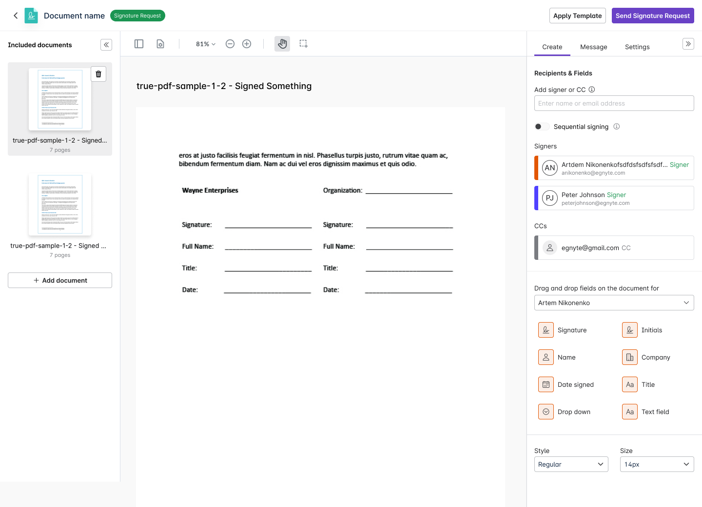
Multi Document Envelope
Problem Statement
With the current eSignature workflow, a user can send only one document per signature request. If a user has to send multiple documents, they have to send as many signature requests or merge the documents using PDF editing capabilities, which is inefficient.
User Story
As a signature requestor, I want to send across multiple documents for signature in a single request so that I can efficiently monitor them and take necessary actions (send reminders, re-assign, etc.) if necessary.
Feature Description
• Multi-document envelopes are a feature that allows users to send multiple documents for signature within a single signature request. This means that instead of sending individual documents separately, you can package several related documents together, and the recipient can sign them all at once.
• The option to select multiple files in the Egnyte file explorer, to trigger multi document request
• In the request creation UI, the user has the option to add more documents.
Requirements
https://egnyte.atlassian.net/wiki/spaces/CFS/pages/984940567/Multi+document+envelope
View in Productboard
CFS-65375
Missing requirements

Slide 30
Bulk send eSignature requests
Problem Statement
In the current setup of templates, if a user has to send across 100 requests based on a template, they have to click on 'Use Template' and assign the role to a person, click on 'Send Signature Request,' and repeat this process 100 times for each request, which is cumbersome. Users need a process that doesn't waste their time and sends across requests in a minimum timeframe and with efficiency.
User Story
As a requestor of Signature Request,
I want to send multiple requests with a single click
as sending multiple requests on same document is cumbersome
Feature Description
• Use a template to send signature requests to a large number of recipients.
• The user needs to upload a CSV file that will contain emails in a column that is headed by that role. Each row will be considered as a separate request. The system will read the file and start sending signature requests.
Requirements
https://egnyte.atlassian.net/wiki/spaces/CFS/pages/1428062312/Bulk+sending+eSignature+request
Figma
TBD
View in Productboard
CFS-67745
Missing requirements

Slide 31
Shore the Core

Slide 32
Unusual Access - Reduce false positives associated with Windows system activity
Currently, Microsoft doesn't provide enough information to determine whether a user or system action is causing the anomalous file access/download activity for Windows Explorer. This causes a lot of false-positive detections as well as many ESCs. We need to figure out how to better analyze and detect file activity for Windows Explorer to prevent this from occurring.
Requirements:
• Analyze file actions for Windows Explorer to help separate system actions (e.g. search indexing) from actual user access/download actions
• Can the amount of time accessed be used?
• Provide the ability to filter out the system events an only capture user generated events
• Only user generated events should be used for Unusual Access detections
No UX Design Required
View in Productboard
DEL-31632
Missing requirements

Slide 33
CMMC Compliance

Slide 34
*.egnytegov.com domains support for SS devices
Currently SS devices does not take *.egnytegov.com as domains as its hardcoded to *.egnyte.com domains only.
There is strong business need to support fedRAMP supported domains as more customers are opting for it and SS is the only device which is currently supported on public cloud from hybrid appliances.
View in Productboard
TRB-8299
Missing requirements

Slide 35
Introduce Gen 4 Plans

Slide 36
Gen 4 Launch - Trial Registration Pages
Placeholder to aggregate tickets related to updates to trial registration pages for Gen 4 plans.
See tickets for additional information.
View in Productboard
APPS-12215
Missing requirements

