Slide 1
Uncategorized

Slide 2
All Workflows Report
A new tab in "Tasks & Workflows" where administrators can view the details of all workflows in the account, similar to what individual users can see for the workflows they've created.
View in Productboard
No Jira Link
Missing requirements

Slide 3
[Customer Ask] Specific allowed/denied email domains for external link sharing (T&P, Nasdaq, human8 +2)
Problem
When sharing editable links with other firms or other known organisations, often companies would like to whitelist certain domains so sharing can be freely supported with those types of accounts. With personal account email domains- These can be blocked off so sharing is not open to them for coediting. It becomes a Business 2 Business sharing only.
User Story:
As a domain admin, I would like to configure allowed/denied email domains for external sharing so that I can have more control over the links shared from my domain.
As a power user, I would like to share links only with email recipients with allowed email domains so that links are shared only with the intended email recipients
DescriptionAllow certain domain types for Coediting making it a better experience for collaboration
Enable the admins to define the email domains to be allowed/blocked for external link sharing at the domain level (default) and specific folder level (overridden defaults) and based on which the restrictions to be added at the time of sharing the external recipient email links. We can also allow to apply the setting only for specific types of links - public links/co-editable links/upload links/etc (nice to have).
Having this configuration at domain levelis must have.
Figma Designs:
Embedded content
View in Productboard
CFS-67573
Link to requirements

Slide 4
Malware - Scan folder download links
The description is empty.
View in Productboard
No Jira Link
Missing requirements

Slide 5
Report Scheduling for S&G Report on CFS
The following feature will provide the users the provision to schedule S&G specific reports from the existing collaboration reporting feature.
View in Productboard
DEL-43442
Missing requirements

Slide 6
Egnyte Cloud Agent - Delta Snapshots
Delta snapshots provides a quicker way to scan the source by looking only the metadata of the file system based on changes made from the previous scan.
View in Productboard
EMT-12070
Missing requirements

Slide 7
Enable Event Access for Unusual Access on WFS via ECA
Event up-streaming to S&G - Sending events to S&G to detect unusual activities by user based on WFS events.
View in Productboard
EMT-12066
Missing requirements

Slide 8
Outlook Email Archiving/Indexing
https://egnyte.atlassian.net/wiki/spaces/AEC/pages/445317176/Outlook+Email+Archiving+Indexing
View in Productboard
No Jira Link
Missing requirements

Slide 9
Configure Syncs in Bulk
The description is empty.
View in Productboard
No Jira Link
Missing requirements

Slide 10
Ingest structured data
The description is empty.
View in Productboard
No Jira Link
Missing requirements

Slide 11
HTTP3 Egnyte.IO adoption
HTTP3Egnyte.IOadoption in CMM/MA
View in Productboard
EMT-13744
Missing requirements

Slide 12
Top Customer Requests

Slide 13
Alert when Procore Sync Status Changes
What is the problem?
AEC project admins do not get alerted when sync between Procore --> Egnyte breaks. This leads to confusion for end-users when they don't see up to date files
How do we solve it?
Send email / MS Teams alerts when Procore Sync fails
View in Productboard
DEL-43525
Missing requirements

Slide 14
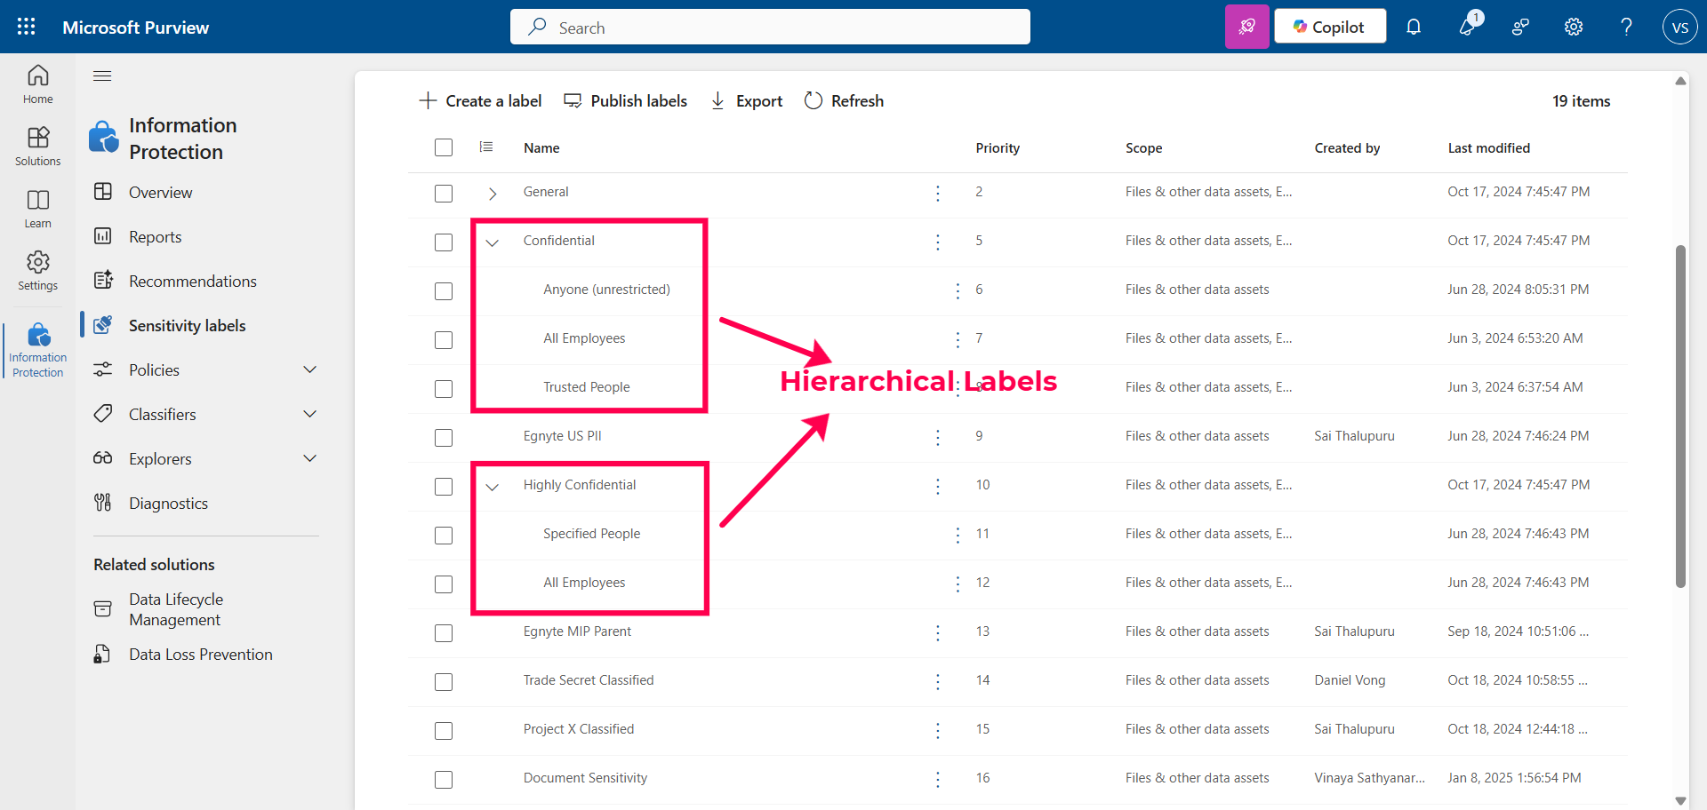
Purview labeling - Support for hierarchical labels
Problem Statement
Microsoft Purview labels can be configured with a hierarchy. Egnyte does not currently support importing hierarchical Purview-labels. This impacts customers who have already configured hierarchical labels. This hierarchy is typically configured by administrators in the Microsoft Purview
User Story
As a Security Administrator, I want to apply a Purview label from a hierarchy on a document so that I can label sensitive content correctly.
Feature Description
• Import hierarchical labels from Purview - both parent and child labels shall be imported and made available for mapping in Egnyte
View in Productboard
DEL-44656
Link to requirements

Slide 15
Augment AEC Add-on Value

Slide 16
[AEC] Deltek Vantagepoint Connector
What is the problem?
When a project is created in Deltek vantagepoint, I would like a project folder to automatically be created in Egnyte.
View in Productboard
No Jira Link
Missing requirements

Slide 17
[AEC] Customizable Project Dashboard
• Idea is to make 3 enhancements identified though discussions with customers
Background
This work builds on theProject Centerfeature. As identified in that PRD, Projects are how these end users not only organize their data, but their employees, their financials, and more. The Project Dashboard is the reflection of that data organization - the visualization of that data in the form of widgets.
The purpose of this Epic is to give our users the ability to visualize their data as they want, and ideally interact with it (i.e. have a reason to go to the dashboard in the fist place).
The main question for the product team here was “what is a user looking for when they arrive on a project?” To that question we had a few answers:
1. Changes
2. Saved Items / Relevant Files
3. Current state
4. Upcoming (listing, but this is outside of Egnyte’s depth)
User Stories
Story 1: Select Widgets
As a user,
I want to select what widgets I want displayed,
so that I can focus on the information that is more important to me
Acceptance Criteria:
1. This feature will be available in any plans that have project folders (Ent-Lite+, and the project control add-on)
2. Default widgets to exist will be
3. Tooltip to show when you first enter a project on the dashboard to explain how the user can select widgets (and order them)
4. Add an event to mixpanel - select project dashboard widget - to be tracked by user and by event
Story 2: Order Widgets
As a user,
I want to order my widgets,
so that I can focus on the information that is more important to me
Acceptance Criteria:
1. This feature will be available in any plans that have project folders (Ent-Lite+, and the project control add-on)
2. Tooltip to show when you first enter a project on the dashboard to explain how the user can select widgets (and order them)
3. Ability to re-arrange order and size of widgets on dashboard, similar Apple widgets
4. Add an event to mixpanel - order project dashboard widget - to be tracked by user and by event
Story 3: set as default project view
As a user,
I want to order my widgets,
so that I can focus on the information that is more important to me
Acceptance Criteria:
1. Set / pin your default view by project to be either dashboard or files
2. Add an event to mixpanel - set project dashboard view - to be tracked by user and by event
Story 4: Project Settings Accessibility
As a user,
I want to access project settings from the dashboard,
so that I can discover settings more easily and take fewer clicks to make changes to improve my Egnyte usability
Acceptance Criteria:
1. Access Project Settings from Dashboard view (currently only in the “Files” view today). Design to be determined. Talk to design about setting and the general hierarchy of options below dashboard and files (team management etc) and how that works
Story 5: Team Management
As an Egnyter,
I want to click team management from dashboard at all times
so that I can assess this feature more quickly
Acceptance Criteria:
1. Team Management in Dashboard should be visible at all times
2. Add an event to mixpanel - Click Team Management - to be tracked, by user and by event
View in Productboard
CFS-67855
Missing requirements

Slide 18
[AEC] Team Management Enhancements
Problem Statement
Several customers participated in the early access program to test the “Team Management” feature that was rolled out for project folders & document rooms. The intent of this feature is to improve permissions management at the project/doc room level by delegating controls that have typically been saved for IT admins, to the respective project/doc room manager. Below are user stories for each piece of feedback we received in the LA period. These items should be addressed before rolling out the feature GA.
User Story
As an Admin or Power User with at least full access to the project, I want to open team management view in the folders view when I open from subfolder
Feature Description
• Manage Project Team - available for full permission users
• Team management view in the folders view when I open from subfolder
• Opening group members view will have an additional option of addind/removing group members.
View in Productboard
CFS-63233
Link to requirements

Slide 19
[AEC] Project Location Public API for Smart Upload
Only a private API is available for Smart Upload features today. We should make this API public so that users can set their project locations in bulk.
Part of CRUD for Smart Folders.
AC:
• specification of the endpoint
• dto is validated (errors are reported),
• entity (SmartFolder) is saved in database
• API tests
View in Productboard
No Jira Link
Missing requirements

Slide 20
[AEC] Geofencing Enhancement - Polygon
Customers have stated that a circle with a configurable radius does not meet all of their needs when defining the area to be included in geolocation search or smart upload. As a result, users would like to be able to create a polygon rather than a circle which will give them more flexibility to define the area accurately.
View in Productboard
No Jira Link
Missing requirements

Slide 21
Document Portal Enhancements

Slide 22
AI document validation
Automatic validation checks on the uploaded documents based on the defined criteria
View in Productboard
No Jira Link
Missing requirements

Slide 23
Product-Led Growth

Slide 24
[PLG] User Enrichment: Job Roles
Problem Statement
• We need to have more accurate Job Roles assigned to our users in order to deliver tailored experiences and recommendations
User Story
• Format: As a PM, I want to understand who the users are that will most closely match the features I'm trying to promote.
Feature Description
• Capture new users' Job Roles
• Allow existing users to change and update their information on their profiles
• Develop a series of campaigns to capture existing users' job roles through Pendo and the Recommender
See Confluence:
https://egnyte.atlassian.net/wiki/spaces/IN/pages/1275134151/Capturing+Job+Function+for+All+Users
View in Productboard
GR-598
Missing requirements

Slide 25
[PLG] Persona-Based User Onboarding Phase 1
This is a direct outcome from the 2025 Hackathon by the GuideWizards team.
This initiative uses AI to power a personalized user onboarding experience for new users.
https://egnyte.egnyte.com/dl/U71oFOD96p/OnboardYourself_BestUsageOfAI.pptx_
https://egnyte.egnyte.com/dl/U8qZ5XEp73/OnboardYourself_BestUsageOfAI.MP4_
Confluence Page:https://egnyte.atlassian.net/wiki/x/LoBIVQ
View in Productboard
GR-596
Missing requirements

Slide 26
[PLG] Recommender Alpha
1. Revise Location of the Notification
2. Pendo IDs: Need Pendo IDs on all items being used in recommendations so we can track user paths (medium)
3. Web-based interface for initiating Recommendations: As a PM, I need an easy way to upload the User Lists (Recommendations) and Campaign criteria without requiring an OPS ticket. (HIGH)
4. Tracking mechanism for active Recommendations: As a PM, I need to be able to view what is actively being run in the Recommender. Ideally included in the Interface, but can also be in Tableau or Kibana. (HIGH)
5. Activity Monitoring for Recommendations: As a PM, I need to be able to track engagement with the Recommender as well as the user adoption of the recommended feature. Ideally, this should be part of the Interface. (medium)
6. Expand customer exposure to 500-1000 users, with multiple recommendations: As a PM, I need to be able to expose this tool to enough users to gather relevant data and draw intelligent conclusions. (medium)
7. Ability to change the duration of display of the flag: Currently set to “display until clicked,” we need to have the ability to test different variables from a simple Interface or feature flag. (medium)
8. Ability to cancel or terminate a recommendation: As a PM, I need to be able to terminate a recommendation at will from the Interface (medium)
9. Ability to target “all users” on a domain with a recommendation: Needed as an alternative to Pendo to recommend new features, new add-ons, new integrations to existing users. (medium)
10. Capturing feedback in the Model from Recommendations: As a result of users responding to Recommendations, we want that data to be captured as feedback to train the Model. If a user indicates “Not Interested”, what does that mean to the Model?If a user clicks Got it, how do we inform the model not to recommend it again? (HIGH)
11. Enable mechanism for easier data collection/extraction for training models (DB Design Project - will include data about Personas) Currently, the process is quite time intensive (by Vivek).
Note: Need data versioning for the data used to train the model. Also need a data archival strategy. We will end up with a great deal of data. DB schema design for the entire Alpha phase - source data, model versioning, recommendation results, campaigns, metadata, etc.
View in Productboard
GR-601
Missing requirements

Slide 27
[PLG] Increase Feature Adoption
AKA "Add-On Metadata API for Pendo"
This project is to automate User Awareness of Features and Add-ons
Problem Statement
• Pendo has the ability to automatically trigger Adoption campaigns and Awareness "Badges" to users to facilitate discoverability of new features or changes in the UI.
• We need to invest in some minor development work to relay the necessary information from CFS to Pendo in order to make this happen.
• Automation here will allow us to improve the user experience and feature adoption, increasing delight and reducing churn.
• Doing this will remove reliance on Engineering and allow us to execute awareness campaigns automatically via Pendo.
User Story
• As a PM, I want to be able to create evergreen Pendo campaigns that show users how to use new features, or make them aware of newly-added capabilities.
Feature Description
• By adding simple tags to the ENV file that is served to the Web UI, Pendo will be able to determine whether:
Public Summary
• This capability will allow us to create a series of automated Pendo campaigns to help existing and new users understand the features available to them in Egnyte, including add-ons in trial, and any newly-released features.
View in Productboard
GR-577
Missing requirements

Slide 28
Productivity Agents

Slide 29
AI: Security Agent - Suggestions based on internal data
AI security agent would enable agents to suggest actions to users pre-emptively based on several historic insights obtained across Issues, SC, Permissions>
Role of the agent to be specific:The idea is to provide suggestions on specific S&G actions based on internal data analysis, like:
• Creation of Polices -> Content Safeguard Policies, Content Life Cycle Polices, Classification Policies
• Specific Remediation Actions -> Bulk Remediate, Auto Remediation Actions
• Report Creation -> Creation of User / Audit Reports
• Other S&G Actions - TBD
perform the action via calling respective tools / API's.
View in Productboard
DLAB-5054
Link to requirements

Slide 30
Permissions Management

Slide 31
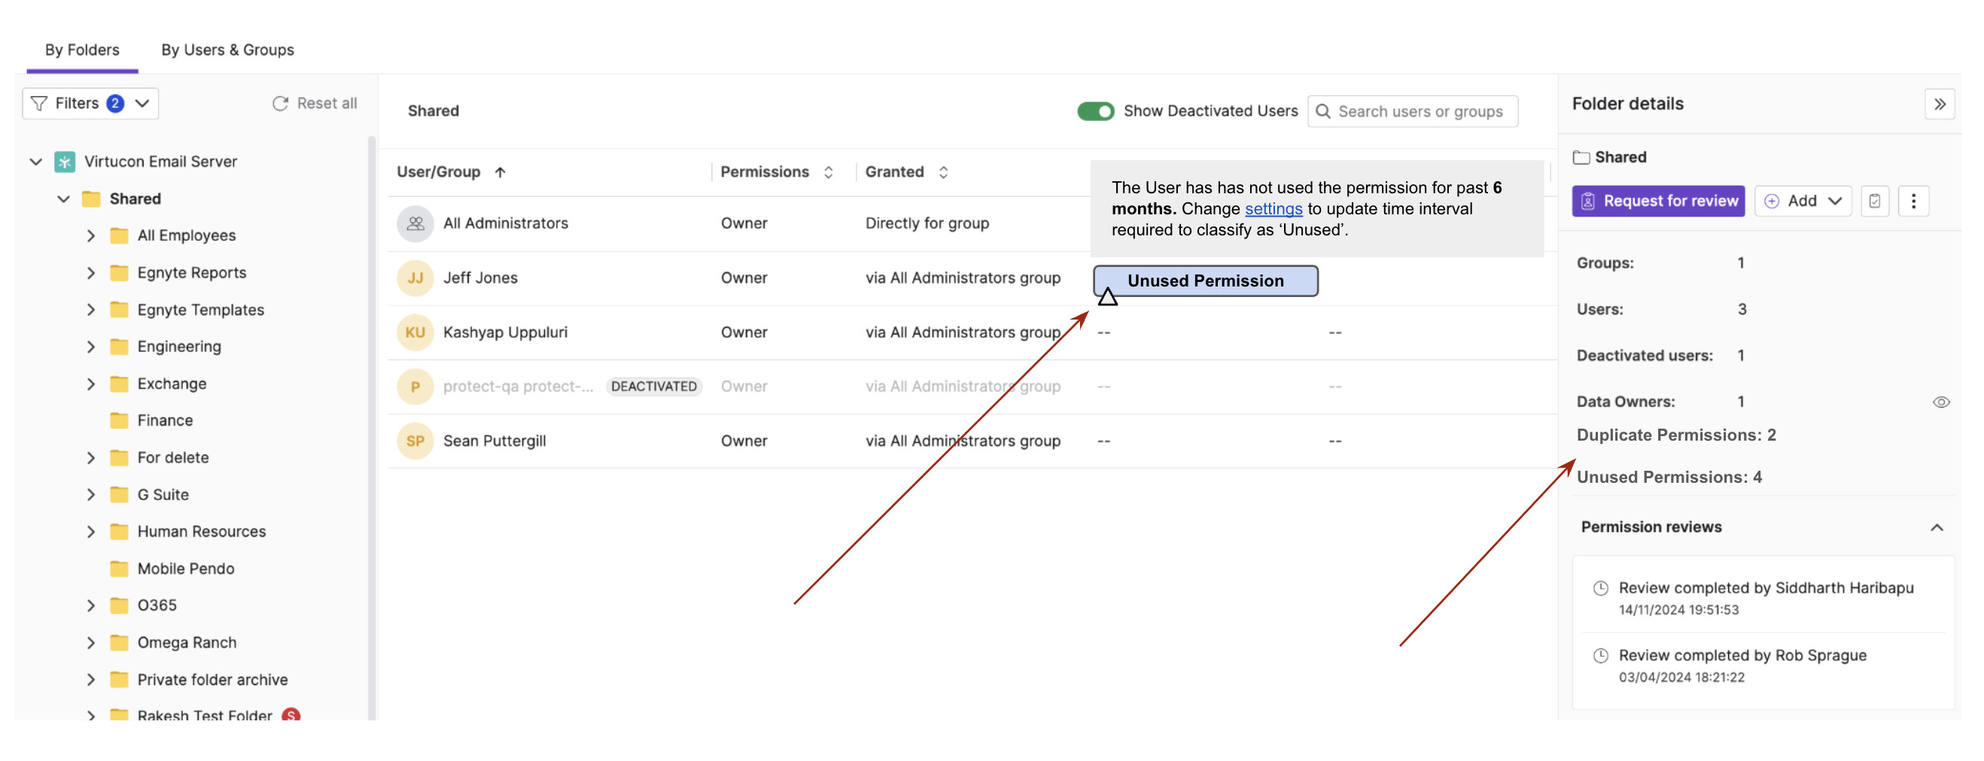
Mark 'Unused Permissions' on Permissions View
Context:
User currently has the provision to access the list of unused permissions from the reporting center.We want to extend the functionalty to highlight folders with unused permission direclty in the S&G platform view.
Requirement:
1. Show that a folder contains a UNUSED PERMISSION as shown below.
2. Primary Question: How do we describe which access is Unused?
3. On hover we can show the 'Reason' and point to chnage settings if required.
4. TBD: Provision for 'Action'
5. As additonal notation to be provided on the right pane indicating the amount of unused permissions on the folder.
View in Productboard
DEL-43511
Missing requirements

Slide 32
Co-Editing Enhancements

Slide 33
[Usability] WebUI Context Menu Redesign
1. The entire menu must be aligned with the way sidebars work
2. The available options must be aligned with options available on the top bar and mini preview
View in Productboard
No Jira Link
Missing requirements

Slide 34
Specialized Agents - AEC

Slide 35
[Agent] RFP/Proposal Agent
In an effort to strengthen our vertical specific AI positioning, Egnyte needs to deliver industry specific agents. One such agent is a Proposal agent which will be adopted by users in the Architecture, Engineering, and Construction industry (AEC). There is at least one known point solution available on the market,Joist AI, that should be taken into consideration when building a competing product. The expectation is that Egnyte’s proposal agent will streamline the RFP response process by:
• Identifying and retrieving past proposals closely aligned with new RFP requirements.
• Generating a draft proposal tailored to the specific RFP inputs
• Validating a draft proposal against the RFP requirements
We need to iterate quickly, and thus will deliver an Alpha version of the Proposal agent first. The intent of this alpha is to get early customer feedback and traction, while continuing to communicate with our AEC customer base about the forthcoming MVP.
Full Requirements -https://egnyte.atlassian.net/wiki/spaces/AEC/pages/1452703784/Proposal+Agent+Alpha?force_transition=ccc75338-410b-4304-8493-476271b71f12
Jira -https://jira.egnyte-it.com/browse/CFS-66991
View in Productboard
No Jira Link
Missing requirements

Slide 36
[Agent] Schedule Agent for AEC
The Project Schedule Agent is an AI-powered tool designed to support users in the Architecture, Engineering, and Construction (AEC) industry by automating schedule analysis tasks. The agent will perform three primary functions:
1. Schedule Comparison:Compare two project schedules and identify changes.
2. Change Summarization:Provide a concise summary of detected changes.
3. Risk Identification:Identify upcoming high-risk safety items in a project schedule based on project milestones, dependencies, and constraints
Full Requirements -https://egnyte.atlassian.net/wiki/spaces/AEC/pages/1489305902/Schedule+Agent+AEC
Jira ticket -https://jira.egnyte-it.com/browse/CFS-67499
View in Productboard
No Jira Link
Missing requirements

Slide 37
[Agent] Project Supervisory Agent for AEC
The Project Supervisory Agent (PSA) will serve as a centralized, intelligent interface for end users within the enterprise content management platform for the architecture, engineering, and construction (AEC) industry. It will act as a single entry point for users to interact with various specialized agents, including:
• Codebooks Agent
• Proposal Agent
• Schedule Agent
• Specification Agent
• Any other AEC agent to come in the future
The PSA will interpret user inputs, determine intent, and dynamically invoke one or more relevant agents based on the context.
Full Requirements -https://egnyte.atlassian.net/wiki/spaces/AEC/pages/1489502556/Project+Supervisory+Agent+AEC
Jira ticket -https://jira.egnyte-it.com/browse/CFS-67500
View in Productboard
No Jira Link
Missing requirements

Slide 38
Enhanced AI copilot

Slide 39
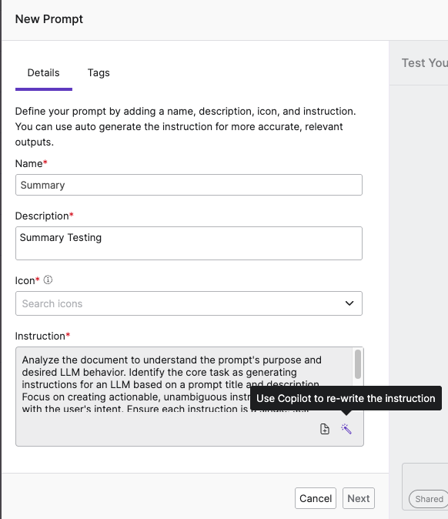
* [Copilot] Improve Prompt (Wand Icon) on Chat Input UI [Copilot, ASK, and KB]
Problem Statement
Users often struggle to craft clear and effective prompts when interacting with Copilot, ASK, and Knowledge Base. This results in suboptimal model outputs—particularly for small or multi-step queries—leading to a poor user experience and negative perception of product performance. This issue becomes especially evident during onboarding sessions and Sales demos, where non-technical users may not articulate inputs in a way that elicits the desired responses from the system.
User Story
As a user, I want the ability to automatically improve or rephrase my input using a built-in feature, so that my query is clearer, more complete, and more likely to return accurate and helpful results from the Egnyte AI products.
Feature Description
We propose introducing a“Refine Prompt”feature, represented by amagic wand iconplaced beside the user input field across Copilot, ASK, and Knowledge Base interfaces.
• When clicked, the feature sends the user’s input to a backend LLM service, which rewrites the prompt to make it more explicit, structured, and contextually rich.
• The rewritten prompt helps improve model understanding and response accuracy.
• This functionality already exists in our “Create Prompt” workflow; the aim is to extend or repurpose that flow into high-usage chat surfaces with minimal lift.
Value
• Increases prompt clarity and quality, especially for new or non-technical users
• Reduces trial-and-error for the end user
• Helps Sales and CS teams showcase the platform more effectively
• Lays the groundwork for future automated prompt rewriting.
UX designs -
Embedded content
View in Productboard
No Jira Link
Link to requirements

Slide 40
Shore the Core

Slide 41
Purview labeling - Read the label from an uploaded file and insert it into file metadata
Problem Statement
Files that have been stamped with a Purview-label outside of Egnyte and then uploaded into Egnyte do not have this label information available with the file metadata in Egnyte. Such files do not show in search results by metadata.
User Story
As a business user I would like to automatically read the Purview-label, if it exists, on an uploaded file and insert this into the file's metadata in Egnyte so that I can search for all files in Egnyte that have the same Purview-label.
Feature Description
• When a file is uploaded to Egnyte, check if the file already has a Purview-label
• If yes, read the Purview-label information and insert it into the file's metadata
View in Productboard
DEL-44970
Link to requirements

