Slide 1
COS40007 · AI for Engineering · Design Project
Smart Government: Forecasting Inflation &
Clustering Malaysian States from Open DOSM Data
Theme 3 — A reproducible AI pipeline + interactive dashboard
Team E's Island
Kenneth Hui Hong CHUA · 102782494
Kelvin Wen Kiong FONG · 102782287
Nigel Zi Jun LING · 102779140
Neng Yi CHIENG · 104386364
Data: Department of Statistics Malaysia (OpenDOSM) · CC BY 4.0 · Random seed = 42

Slide 2
Problem & Motivation
Why apply AI to Malaysian public-sector data?
• National averages hide regional variation. Aggregate CPI inflation hides large differences between states in income level and inflation exposure.
• Policymakers need short-term inflation forecasts to design subsidies, monetary policy, and social-protection schemes.
• Clustering reveals economic peer groups of states — useful for targeted regional policy rather than uniform national instruments.
• Fuel prices are a known driver of CPI inflation in Malaysia; quantifying the pass-through helps the government model subsidy policy.
• Open DOSM data is rich but underused. An AI pipeline + dashboard makes the insight accessible to non-technical stakeholders.
Research question: Can ARIMA reliably forecast national CPI inflation, and do Malaysia's 16 states form interpretable economic clusters from CPI + income features?
COS40007 Design Project · Team E's Island · Smart Government
2 / 18

Slide 3
Project Objectives & Outcomes
Five Objectives
Headline Outcomes
• Forecast national CPI inflation (ARIMA, 24-month horizon).
• Cluster the 16 states by CPI + income features.
• Quantify fuel-price → CPI pass-through.
• Validate every output against DOSM official figures.
• Deliver a reproducible pipeline + Flask dashboard.
2.35
Test MASE (ARIMA)
1.0699
Test RMSE
2
Optimal k (clustering)
0.5764
K-Means silhouette
2.10–2.85%
Forecast range (24 mo)
4 DOSM tables
Datasets processed
COS40007 Design Project · Team E's Island · Smart Government
3 / 18

Slide 4
Data Sources
Rubric 1: Data (10)
All datasets from DOSM / OpenDOSM, CC BY 4.0, fetched programmatically
Dataset | Catalogue | Coverage | Records
CPI Inflation by Division | cpi_2d_inflation | National, Jan 1981–Apr 2026 | 7,770
CPI Index by State & Division | cpi_2d_state | 16 states, 2010–Apr 2026 | 43,904
Retail Fuel Prices | fuelprice | Weekly 2017–2026 → monthly | 111
Household Income by State | hh_income_state | 16 states, 1970–2022 | 303
Why these 4? Longitudinal (forecasting) + cross-sectional (clustering) + driver (fuel)
• Time-series target: monthly national CPI YoY inflation (1 series, 544 obs).
• Cross-sectional features: 5 features × 16 states for clustering.
• Driver variable: monthly average retail fuel price (RON95/97/diesel).
• Validation source: DOSM official 2022 HIES releases for ground truth checking.
COS40007 Design Project · Team E's Island · Smart Government
4 / 18

Slide 5
Preprocessing & Feature Engineering
Rubric 1: Data (10)
src/preprocessing.py · deterministic, fully scripted
Cleaning steps
Engineered features (per state)
• Type coercion: all numerics via errors='coerce', no silent failures.
• Date parsing: to datetime; resample fuel weekly → monthly (MS).
• Missing values: drop rows missing core fields; all 16 states retained.
• Outlier check: ADF stationarity test on CPI series before differencing.
• Reshape: extract 'overall' division from 14-division CPI table → 544 rows.
Feature | Unit
mean_cpi_index | index pts
cpi_growth_rate | %
cpi_volatility (std) | index pts
income_mean_latest | RM
income_median_latest | RM
All 5 features z-score standardised (StandardScaler) before clustering — stops income (thousands of RM) dominating the Euclidean distance over CPI index variables.
COS40007 Design Project · Team E's Island · Smart Government
5 / 18

Slide 6
Time-Series Model — ARIMA
Rubric 2: Training (5)
Why ARIMA? Univariate monthly data, interpretable, gives confidence intervals
• Hyper-parameter selection: BIC grid search over p ∈ [0,4], q ∈ [0,4].
• Stationarity test: ADF on training series → p = 0.0003 (stationary) → d = 0.
• Selected order: ARIMA(4, 0, 4).
• Train / test split: last 24 months held out for evaluation.
• Refit on full series for 24-month out-of-sample forecast.
• Confidence intervals: 95% CI plotted alongside point forecast.
(4,0,4)
ARIMA Order
926.15
AIC
969.14
BIC
520
Train obs
Justification: BIC penalises complexity more than AIC, yielding parsimonious models that generalise better on a moderately long monthly economic series. ARIMA is preferred over deep models here because the series is univariate and the goal is short-horizon forecasting with interpretable uncertainty.
COS40007 Design Project · Team E's Island · Smart Government
6 / 18

Slide 7
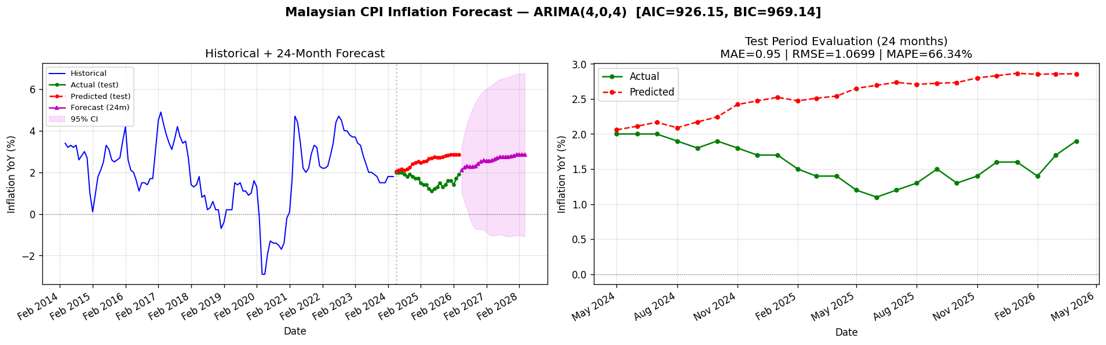
ARIMA Forecast — Results
Rubric 3 + 4: Generalisation + Metrics
Test-set metrics
0.950
MAE
1.070
RMSE
2.35
MASE
0.341
Naive RMSE
Train / test fit and 24-month forecast with 95% CI.
Forecast next 24 mo
Range: 2.10% – 2.85% Mean: 2.58% Direction: moderating from recent peak.
COS40007 Design Project · Team E's Island · Smart Government
7 / 18

Slide 8
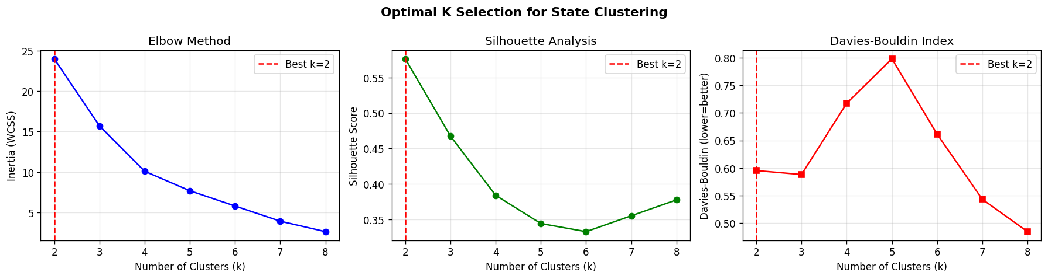
Clustering — Selecting Optimal k
Rubric 2: Training (5)
Three independent criteria, all agree
• Elbow method: clear bend at k = 2.
• Silhouette: peaks at 0.5764 for k = 2.
• Davies-Bouldin: minimised at 0.5953.
• Why two algorithms? independent confirmation.
• K-Means: minimises within-cluster variance.
• Hierarchical (Ward): bottom-up merging.
COS40007 Design Project · Team E's Island · Smart Government
8 / 18

Slide 9
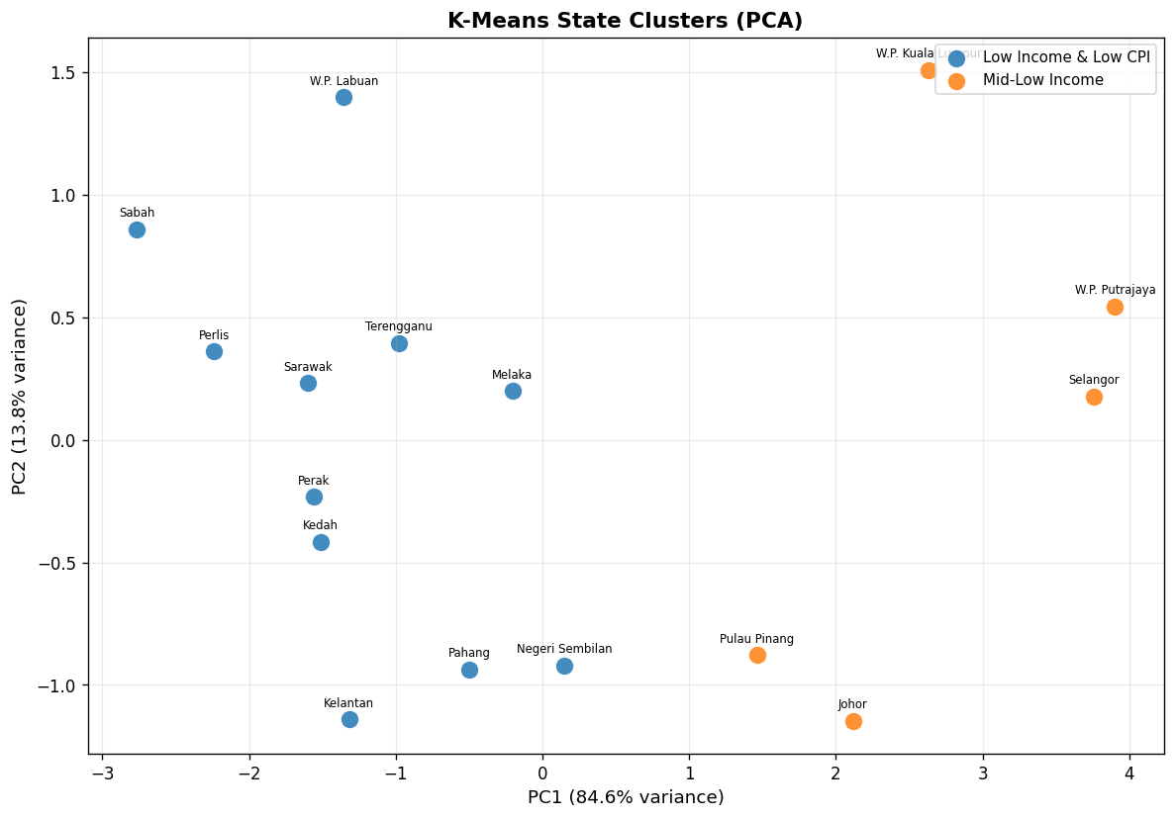
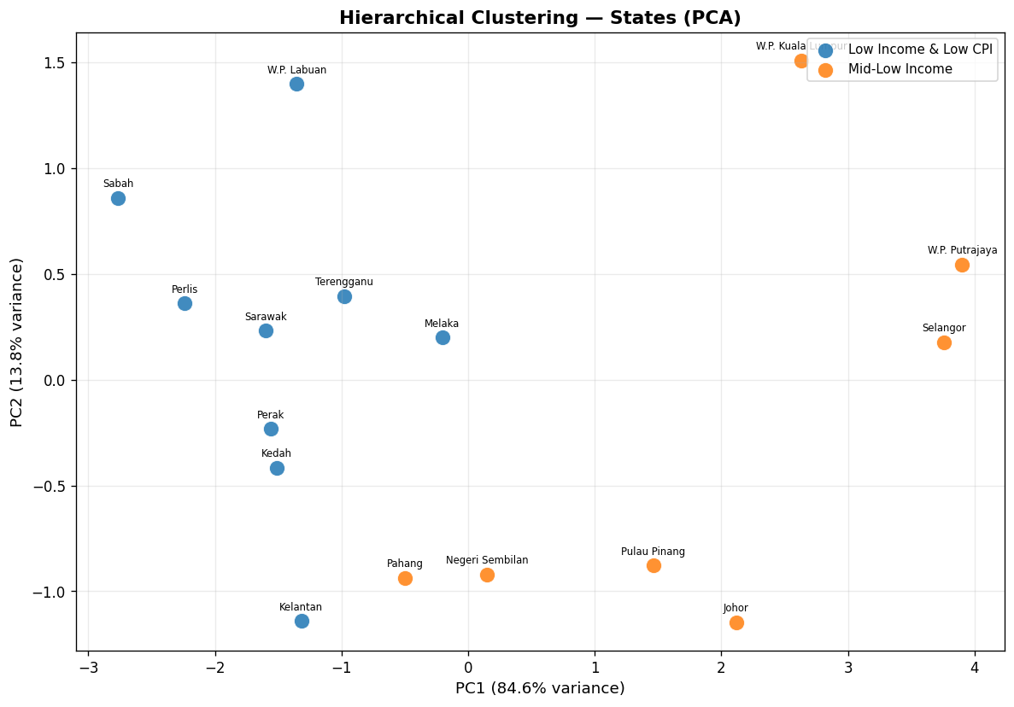
Clustering — State Tiers in PCA Space
Rubric 3: Generalisation
K-Means: states grouped in PC1–PC2 space.
Hierarchical (Ward): near-identical partition.
Both algorithms produce essentially the same partition at k = 2 — evidence that the cluster structure is genuine, not an algorithmic artefact.
COS40007 Design Project · Team E's Island · Smart Government
9 / 18

Slide 10
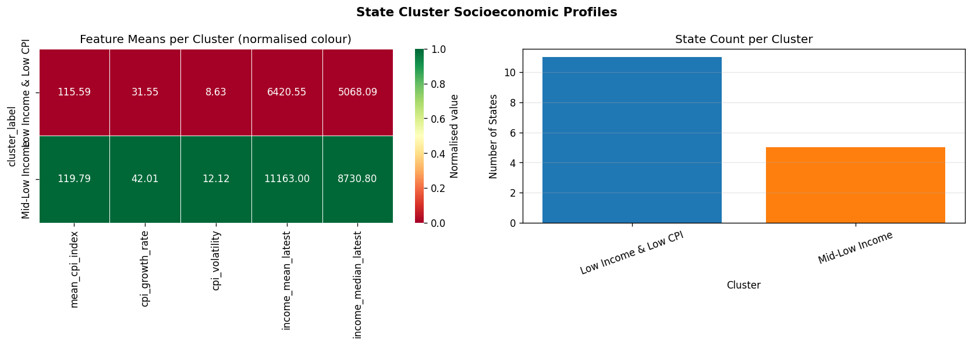
Cluster Profiles — Who's in each tier?
Cluster means
Cluster | States | Income (RM)
Low Income & Low CPI | 11 | 6,420
Mid-Low Income | 5 | 11,163
Key insight: the higher-income tier (Selangor, Putrajaya, KL, Johor, Penang) also shows higher cumulative CPI growth — wealthier states have experienced more inflationary pressure since 2010.
COS40007 Design Project · Team E's Island · Smart Government
10 / 18

Slide 11
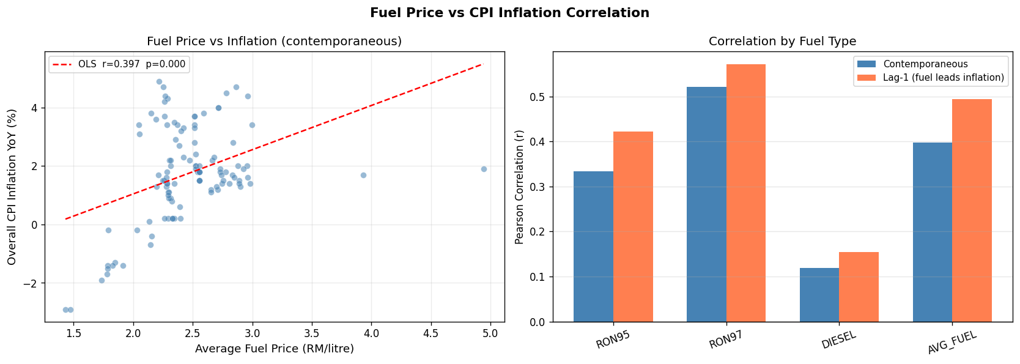
Fuel Price → CPI Pass-through
Rubric 4: Metrics (10)
Cross-domain evaluation
• Contemporaneous: fuel ↑ CPI ↑ in same month.
• Lag-1 correlation: fuel leads CPI by 1 month, slightly weaker.
• Interpretation: rapid but not instantaneous pass-through.
• Why it matters: evidence base for subsidy policy.
OLS fit (left) and Pearson correlations contemporaneous + lag-1 (right).
COS40007 Design Project · Team E's Island · Smart Government
11 / 18

Slide 12
Evaluation Summary — All metrics in one place
Rubric 4: Metrics (10)
Forecasting
Clustering Validity
Metric | Value
ARIMA order | (4,0,4)
MAE | 0.9500
RMSE | 1.0699
sMAPE (%) | 46.06
MASE | 2.35
Naive RMSE | 0.3410
AIC | 926.15
BIC | 969.14
Method | Silhouette ↑ | DB ↓ | CH ↑
K-Means | 0.5764 | 0.5953 | 32.6821
Hierarchical (Ward) | 0.4457 | 0.7683 | 20.1203
Validation against DOSM (sample)
Indicator (2022) | This project | Official
Sabah mean income | RM 6,171 | RM 6,171 (DOSM)
Selangor mean income | RM 12,233 | RM 12,233 (DOSM)
Highest-poverty state | Sabah 19.7% | Sabah 19.7% (DOSM)
COS40007 Design Project · Team E's Island · Smart Government
12 / 18

Slide 13
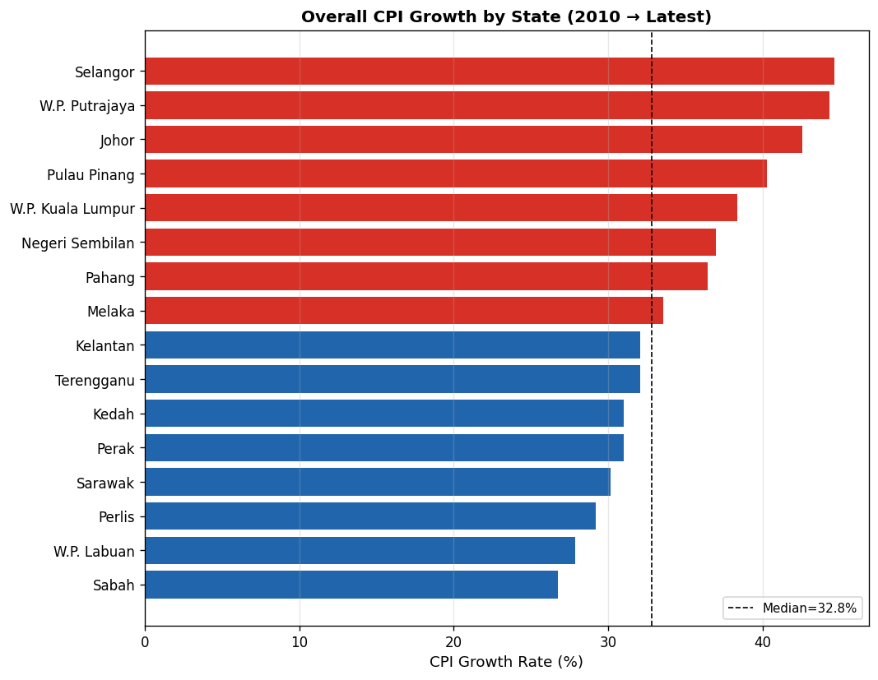
Cross-State CPI Growth (2010 → Latest)
Selangor, Putrajaya and Johor lead CPI growth; East-Malaysia states (Sabah, Sarawak, Labuan) grew most slowly.
COS40007 Design Project · Team E's Island · Smart Government
13 / 18
Red = above median growth, blue = below.

Slide 14
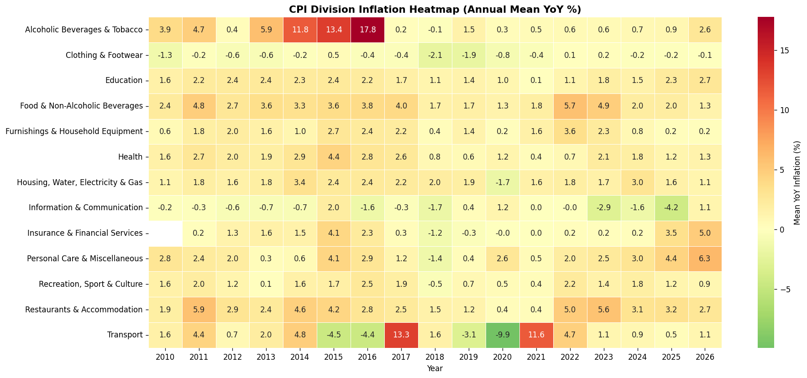
Division Inflation Heatmap
Which CPI categories drove inflation, and when?
COS40007 Design Project · Team E's Island · Smart Government
14 / 18

Slide 15
AI Demonstrator — Flask Dashboard
Rubric 5: System (5)
http://localhost:5050 · 4 tabs · JSON REST API
• Overview tab — national + state CPI and income summary.
• Time-Series tab — live train/test/forecast chart with metrics.
• Clustering tab — PCA scatter, dendrogram, validity scores.
• Fuel Analysis tab — fuel vs CPI correlation explorer.
• JSON API — /api/overview, /api/ts/forecast, /api/cluster/states, /api/fuel/correlation.
• Architecture — pipeline pre-computes → Flask serves cached artefacts → fast UX.
• Reproducible — random_state = 42 across all components, byte-identical re-runs.
Raw DOSM CSVs
src/preprocessing.py
ARIMA + Clustering
outputs/ (JSON, CSV, PNG)
Flask Dashboard localhost:5050
COS40007 Design Project · Team E's Island · Smart Government
15 / 18

Slide 16
Team Contributions
Every member touches the AI part — different model / dataset / pipeline component
Kenneth Hui Hong CHUA
Time-Series Modelling Lead (ARIMA)
CPI dataset · ARIMA module · BIC order selection · ADF stationarity · MAE / RMSE / sMAPE / MASE evaluation.
Kelvin Wen Kiong FONG
Clustering AI Lead
State features · K-Means + Hierarchical (Ward) · silhouette / DB / CH validity · PCA visualisation.
Nigel Zi Jun LING
Evaluation & Analytics
Fuel dataset · fuel→CPI pass-through correlation · division heatmap · DOSM validation.
Neng Yi CHIENG
Time-Series Co-Lead + Pipeline / Demonstrator
Forecast viz + 24-mo out-of-sample · CI extraction · reproducible pipeline · Flask dashboard + JSON API.
COS40007 Design Project · Team E's Island · Smart Government
16 / 18

Slide 17
Limitations & Future Work
Limitations
Future Work
• Long-horizon skill: MASE = 2.35 (>1) — over a 24-month block the stationary model does not beat a naive baseline (reported honestly).
• Fuel adds no forecast gain: fuel correlates with inflation but, as an ARIMAX regressor, did not lower test error in this specification.
• Small cross-section: 16 states limits the number of well-separated clusters.
• Income survey infrequency: income features use the latest available year (≈2022) only.
• Aggregate CPI: national series masks division-level variation already shown.
• Rolling one-step evaluation: the fair test of short-horizon skill, where ARIMA should beat naive.
• LSTM / Prophet: compare non-linear forecasters on the same hold-out.
• Division-level ARIMA: forecast each of the 13 CPI divisions separately.
• District clustering: extend from 16 states to 160 districts when data permits.
• Live dashboard: auto-refresh from OpenDOSM API as new months are released.
COS40007 Design Project · Team E's Island · Smart Government
17 / 18

Slide 18
Conclusions · Thank you · Q&A
• ARIMA gives a national CPI outlook (2.1-2.9% over 24 months; RMSE 1.07), with a candid MASE = 2.35 showing long-horizon point accuracy is limited.
• Two-tier state structure (k = 2) is robust across K-Means and Hierarchical clustering (silhouette 0.576).
• Fuel correlates with CPI but did not improve the forecast (ARIMAX) — association ≠ predictive power.
• Reproducible pipeline + Flask dashboard make the analysis usable by non-technical stakeholders.
• All results reconcile with DOSM official 2022 published figures.
Thank you — Questions?
Repo: github.com/kenn040502/COS40007-Design-Project · Dashboard: localhost:5050
COS40007 Design Project · Team E's Island · Smart Government
18 / 18

