Slide 1
Artist Presentation
Kenna Lewis

Slide 2
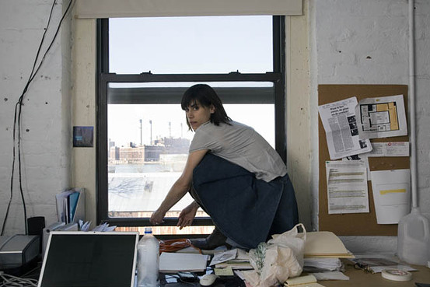
Jill Magid
Responding to the surveillance state, and politics surrounding autonomy, and ownership.
Material process – using existing data collection to aggregate media and present it in a new context.
Notes:
- Why is their work significant within art history?
- What were the social conditions they were responding to?
- Were there any technological developments, new materials or processes they were responding to or utilizing in their practices?
- Compare and contrast the two artists in relation to each other. How were they similar? Different?

Slide 3
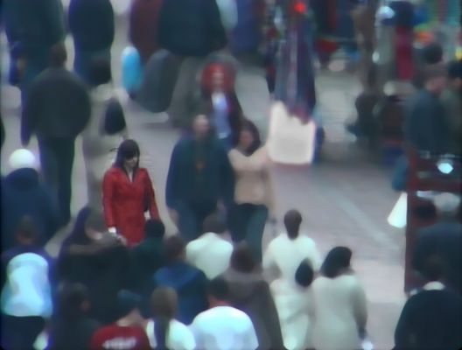
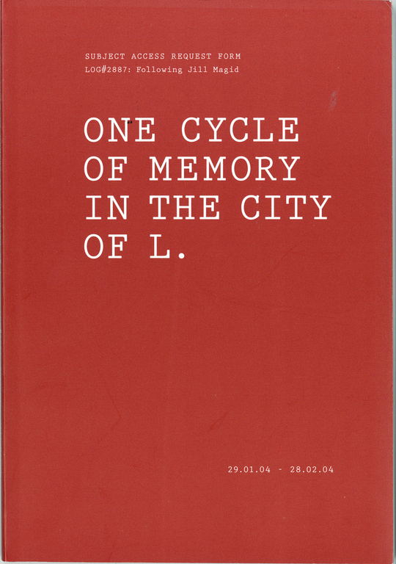
Evidence Locker (2004)
Explores surveillance and intimacy through Liverpool’s extensive CCTV system
Initiated the project by writing daily subject access requests to the Liverpool Police Department’s “Citywatch” program, asking them to track her.
31 days - collected and edited this footage into a series of videos
Created a novella from the forms, One Cycle of Memory in the City of L
^ Evidence Locker. Trust (video still edited by the Forensic Imaging Unit). Digital video. 18 min. 2004
One Cycle of Memory in the City of L, Book, 100 pages. 5.75 x 8. 25”, 2004
Notes:
Jill spent 31 days in Liverpool, and engaged with the city’s “Citywatch” program
Unless requested as evidence, CCTV footage obtained from the system is stored for 31 days before being erased. For access to this footage, Magid had to submit 31 Subject Access Request Forms - the legal document necessary to outline to the police details of how and when an 'incident' occurred. Magid chose to complete these forms as though they were letters to a lover, expressing how she was feeling and what she was thinking.
These letters form the diary One Cycle of Memory in the City of L presented her subject access requests as a novella, critiquing and repurposing a system designed for control into a medium for personal expression and artistic exploration.

Slide 4
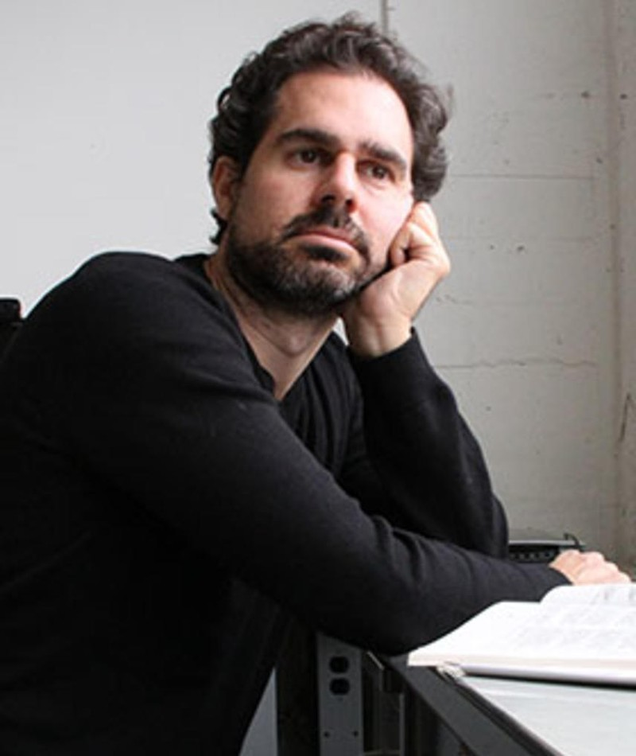
Anthony Discenza
Conceptual artist
Implicates the viewer in the act of conceptualizing by creating a description of an object.
”…looking at forms of description as a way of implicating the visual that then people kind of have to construct for themselves”
Interior construction as a response to the onslaught of prescribed images we’re subjected to daily.
Responding to the art institution’s preoccupation with buying and selling art, as well as our subjective interpretations.
Notes:
”looking at forms of description as a way of implicating the visual that then people kind of have to construct for themselves”

Slide 5
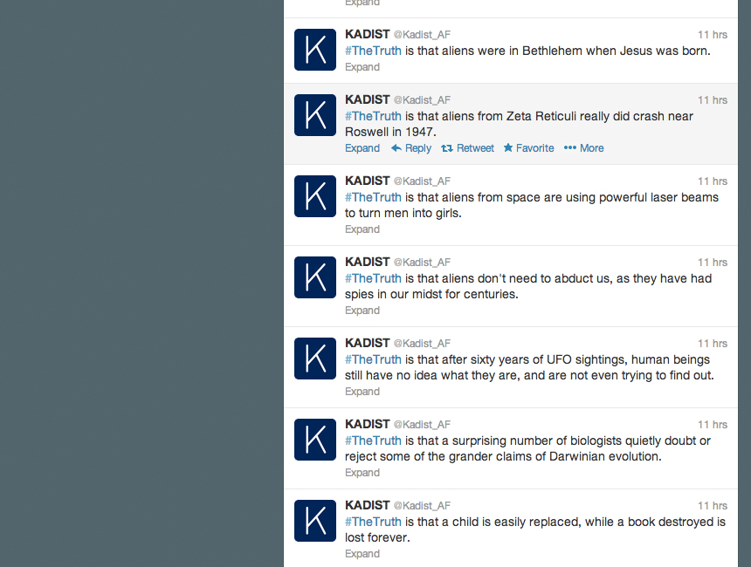
The Truth as We Know It (#thetruth), 2013 - ongoing
Variable media work
1,000 statements collected by searching the internet for occurrences of the phrase, “The truth is that...”
Notes:
The work can be presented in a variety of different ways – social media feed, audio, performance.
The work is revised and updated continually, so it’s also continually evolving.
I find the variability of the work, and the mode of collecting data to create art very interesting.

Slide 6
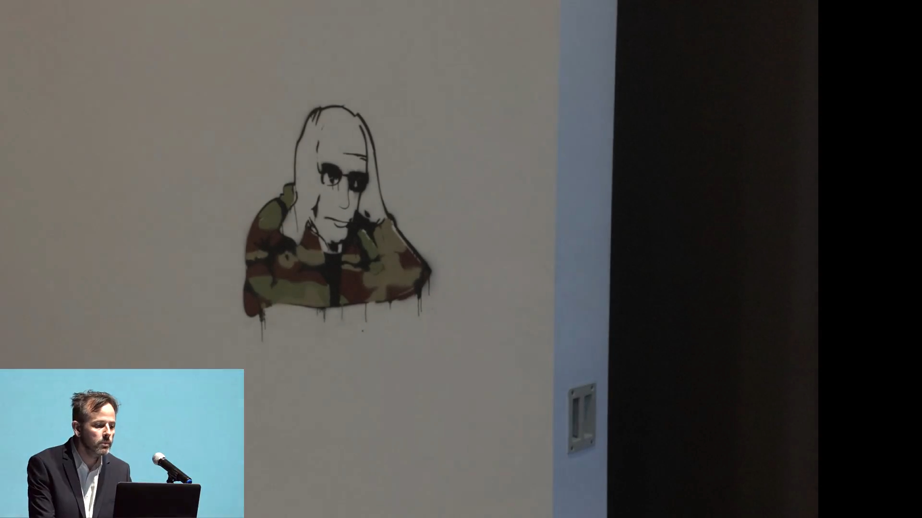
25:25 - ...if the panopticon effect is when you don't know you are being watched or not and so behave as if you are then the inverse panopticon effect is when you know you're being watched but act as if you aren't. This is today's surveillance culture exhibitionism in bad faith. The emergence of stack platforms doesn't promise any solution or even distinctions between friend and enemy...
- Benjamin Bratton on ”The Stack”
Notes:
Benjamin Bratton – anthropologist/researcher/writer talking about the world in terms of the stack, which is the multilayered components and data that make up our digital age.

Slide 7
My Relation to these artists
Creating interventions between myself and power structures (AI, the Cloud)
Collecting information, aggregating it, and altering it to fit my needs.
Variable media – creating conceptual works that can be adapted, tuned, recreated by others, and shared in a multitude of ways.
Connection to the Fluxus movement and the Event score
Social Conditions – I am living during the same time as these contemporary artists, so their ideas are very present to me
Power structures relating to the ownership of data
Extending the work – Utilizing AI and operating from the perspective of a digital native

Slide 8
Bibliography
Art of Surveillance. Directed by PopTech, 2015. YouTube, https://www.youtube.com/watch?v=Eh0Xjo1gPQk.
Discenza, Anthony. “Anthony Discenza: Host.” Leonardo, vol. 40, no. 1, pp. 11–11.
Helfand, Glen. “Anthony Discenza.” Artforum International, vol. 48, no. 7, Mar. 2010, p. 24. Gale In Context: Biography.
Magid, Jill. Evidence Locker | Jill Magid. https://www.jillmagid.com/projects/evidence-locker-2. Accessed 25 June 2024.
---. One Cycle of Memory in the City of L | Jill Magid. https://www.jillmagid.com/books/one-cycle-of-memory-in-the-city-of-l. Accessed 25 June 2024.
Magid, Jill, and Miriam Perier. “« Look !» About Jill Magid’s Work on Surveilance and Security Tools.” Cultures & Conflits, Mar. 2008. DOI.org (Crossref), https://doi.org/10.4000/conflits.2853.
The Stack We Have and The Stack To Come | Benjamin Bratton | 2016 Gray Area Festival. Directed by Gray Area, 2018. YouTube, https://www.youtube.com/watch?v=HRiAF6ILpxw.
Tony Discenza, Interviewed by David Kasprzak. Directed by KADIST, 2012. Vimeo, https://vimeo.com/52046842.
Watlington, Emily. “Meet The Artists Who Double as Investigators, Revealing ‘Public Secrets.’” ARTnews.Com, 1 Mar. 2023, https://www.artnews.com/art-in-america/interviews/artist-investigators-jill-magid-lawrence-abu-hamdan-crystal-z-campbell-1234659223/.

