Slide 1
LEAD-GENERATION SYSTEMS
Peter Gutierrez
I build the machine that turns a stranger into a booked call: the page, the ads that feed it, the CRM behind it, and the follow-up that runs without anyone remembering to send it.
Everything you are about to see, I built in one week.
Notes:
0:00-0:25 — Who you are and what you build. Say it in one sentence before anything appears on screen. Do not open on a login page or a dashboard.

Slide 2
A system, not four deliverables
Each piece is worth something. Wired together they compound.
1
A page that converts
2
Ads that feed it
A clear promise, prices in public, and a form that asks the one question that matters.
A carousel and four ad drafts, one hook angle each, pointed at the page.
3
A CRM behind it
4
Follow-up that runs itself
Every lead in one place, moving from new, to booked, to sold.
Four workflows and branded email, firing on their own within sixty seconds.
Notes:
0:25-0:45 — The map. Say the parts out loud once so the viewer knows the shape of what is coming, then get off this slide. Do not read the cards.

Slide 3
01
The page
A visitor lands, gets a straight promise and real prices, and tells me which of three problems they have.
What I can build for you: a page that earns the click it paid for.
Notes:
Flash card — two seconds, then switch to the live screen. Say the 'what I can build for you' line, not the description. The description is there so you remember the angle.

Slide 4
02
The ads
Nine carousel slides and four ad drafts, built from one creative source and rendered at three ratios.
What I can build for you: creative that survives every placement without a bad crop.
Notes:
Flash card — two seconds, then switch to the live screen. Say the 'what I can build for you' line, not the description. The description is there so you remember the angle. ON SCREEN NEXT: the rendered creative from carousel/out and the four hook angles from ad-drafts.md. Do NOT open Ads Manager — the drafts in there are part-built, and this is the section meant to prove range.

Slide 5
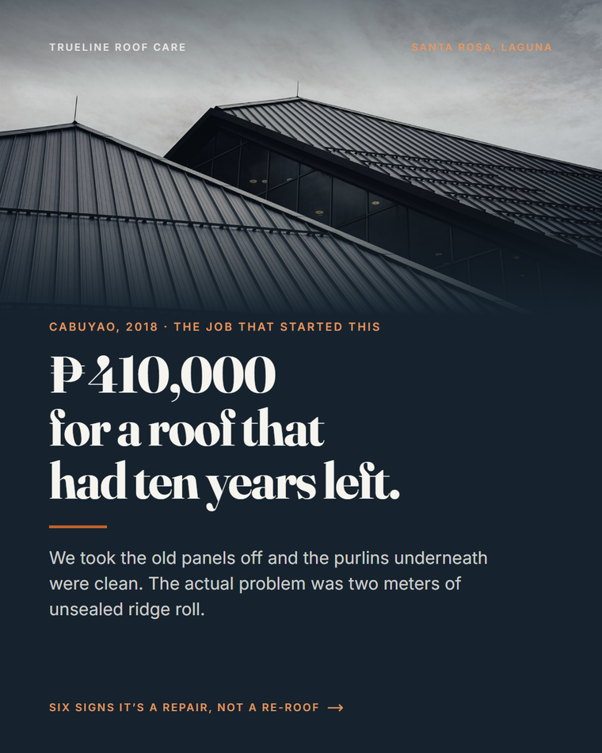

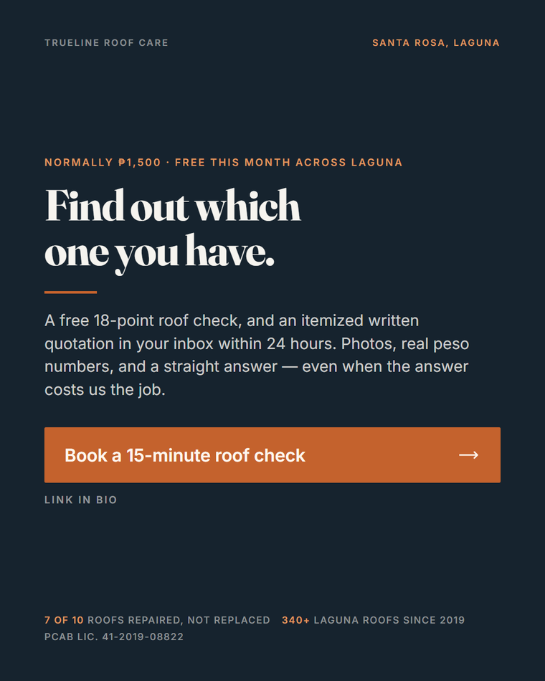
NINE SLIDES, ONE ARGUMENT
Hook, six signs, then the counterweight
01 · the hook
03 · one of six signs
09 · the ask
Every peso figure on these cards is a real range from the price list.
Notes:
Say: nine slides that argue one thing — most roofs get replaced when they needed a repair. The diagrams are hand-drawn, not stock. Do not narrate each card.

Slide 6
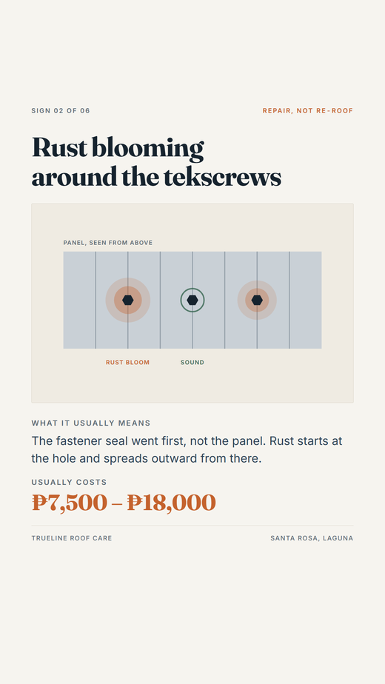


ONE SOURCE, THREE RATIOS
Nothing gets a bad crop
4:5 · feed
1:1 · carousel card
9:16 · Stories and Reels
Same HTML source, three viewport-height media queries. Fix a typo once, re-render three times.
Notes:
The line that lands here: excluding Stories to dodge a bad crop is the wrong instinct — supply the right crop instead.

Slide 7
FOUR ADS, ONE TEST
Written so the result means something
1
six-signs-carousel
The full educational sequence
2
story-7800
Photo · English testimonial
3
taglish-380k
Same creative, Taglish interrupt — isolates copy
4
the-18-peso-part
Diagram instead of photo — isolates creative
Two pairs, one variable each. Four ads that can actually tell you why one won.
Notes:
This is the strategy beat, and it is rarer than being able to make a nice image. Say: two of these share creative so the only variable is the copy, and one swaps the photo for a diagram against the same promise. A test you can learn from, not four guesses.

Slide 8
03
The CRM
Six stages from new lead to won, fifteen real leads on the board, and dead deals that keep their history.
What I can build for you: a pipeline that tells you where money actually stalls.
Notes:
Flash card — two seconds, then switch to the live screen. Say the 'what I can build for you' line, not the description. The description is there so you remember the angle.

Slide 9
04
The follow-up
Four workflows. A reply inside sixty seconds, then a sequence that branches on who the lead actually is.
What I can build for you: the part that runs when nobody is at their desk.
Notes:
Flash card — two seconds, then switch to the live screen. Say the 'what I can build for you' line, not the description. The description is there so you remember the angle.

Slide 10
If you are running the business
I can build this for you.
Your CRM set up, with every lead in one place
Book a call with me
The funnel and the page that fills it
The ads that feed the page
REPLACE WITH YOUR BOOKING LINK
The follow-up that runs on its own
Peter Gutierrez
Notes:
4:10-4:45 — The close. Name the next step out loud; do not let the slide do it alone. Swap the placeholder for a real booking link BEFORE recording.

